Slide 1
Cloud Native Development
Dec 2016

Slide 2

What Is Cloud?
Delivery of on-demand computing resources everything from applications to data centers over the Internet on a pay-for-use basis
Relies on sharing computing resources rather than having local servers or personal devices to handle applications
A cloud refers to a distinct IT environment that is designed for the purpose of remotely provisioning scalable and measured IT resources

Slide 3
Why Cloud?
Shared Resources
Dynamic Scaling
Pay as you Use
High Availability
High Productivity
Environment friendly
Less Deployment Time

Slide 4
Cloud Offerings
IAAS
PAAS
SAAS
Public
Private
Hybrid

Slide 5
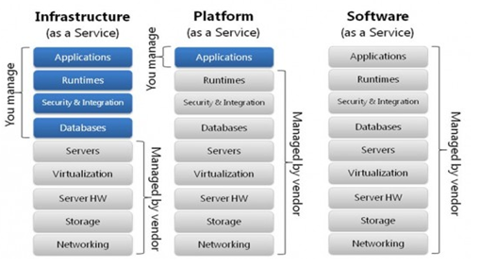

Slide 6

What Is Cloud Native?
Cloud Native is a style of application development that encourages easy adoption of best practices in the areas of continuous delivery and value-driven development.
A cloud-native application is an application that has been designed and implemented to run on a Platform-as-a-Service installation
and to embrace horizontal elastic scaling.
Develop native apps that run on cloud with minimal effort !!!
How?

Slide 7

How ?
12 Factor Apps
Micro-services
API based collaboration
Anti fragility

Slide 8
12 Factor Design Principles
What Is 12 Factor?
The twelve-factor app is a methodology for building Cloud Native apps that has clean contract with underlying operating system, enable continuous deployment with maximum agility, significant scale up capability, and Independent of programming languages and back end services
This is derived by Heroku (a Sales Force PaaS platform) after witnessing thousands of applications development & deployments in cloud.
Read more @http://12factor.net/
Why 12 Factor?
Good code fails if you don’t have a process and platforms. Complexity increases if you have diverse programming environments. Applying certain constraints will help adequately track, use and share the applications easily – that’s why 12 factor app is popular in cloud development.
Its build to exploit the modern cloud platforms principles with agility in mind and so easy for new developers to join with less time, less tooling and low cost

Slide 9
12 factors (Solid principle for Cloud Native Architecture)
Codebase
Dependencies
Build, release, run
Backing Services
Processes
Port binding
Concurrency
Disposability
Dev/prod parity
Logs
Admin processes
Config
One codebase tracked in revision control, many deploys
Explicitly declare and isolate dependencies
Store configuration in the environment
Treat backing services as attached resources
Strictly separate build and run stages
Execute the app as one or more stateless processes
Export services via port binding
Scale out via the process model
Maximize robustness with fast startup and graceful shutdown
Keep development, staging, and production as similar as possible
Treat logs as event streams
Run admin/management tasks as one-off processes

Slide 10
Factor 1 - Codebase
One codebase tracked in SCM, many deploys
An application has a single code base
Multiple codebase = distributed system (not an app)
Tracked in version control like Git, Subversion, etc
Multiple Deployments
i.e. development, testing, staging, production etc

Slide 11
Factor 2 - Dependencies
Dependencies packaged as jars (Java)
Declare dependencies in a manifest
Maven POM etc
No reliance on specific system tools
i.e. Linux tool not available on Windows
Dependencies tracking should contain version numbers of dependencies

Slide 12
Factor 2 - Dependencies
Remember, its about Repeatable Deployments so nothing about the runtime
environment should be assumed.
Explicitly declare dependencies!

Slide 13
Factor 2 - Dependencies
Most contemporary programming languages have some facility for managing application dependencies.
Java – Maven,Gradle
.NET- NuGet
Ruby- Bundler
Go-godeps
Regardless of the tool, these utilities all provide one set of common functionality: they allow developers to declare dependencies and let the tool be responsible for ensuring that those dependencies are satisfied.
A cloud-native application never relies on implicit existence of system-wide packages. For Java, this means that your applications cannot assume that a container will be managing the classpath on the server. For .NET, this means that your application cannot rely on facilities like the Global Assembly Cache. Ruby developers cannot rely on gems existing in a central location. Regardless of language, your code cannot rely on the pre-existence of dependencies on a deployment target.

Slide 14
Factor 3 - Configuration
Store the Config in environment
Where NOT to store it
In the Code
In the Properties file (that’s Code)
In the App Server (e.g. JNDI datasources etc)
In the Build (ONE build, MANYdeploys)
Environment variables recommended
Config mainly includes database credentials, hostnames, passwords etc

Slide 15
Factor 3 - Configuration
Store it in the
Environment
Let’s have a look…

Slide 16
Factor 3 - Configuration
Picking up the environment variable in Spring
...
import org.springframework.context.EnvironmentAware; import org.springframework.core.env.Environment;
@RestController
private String name;
@Override
public void setEnvironment(Environment environment) { this.name = environment.getProperty("hostname");
}
...

Slide 17
Factor 4 – Backing Services
Backing services are services consumed by app as part of normal operations
DB, Message Queues, SMTP servers etc
May be locally managed or third-part managed
Services should be treated as resources
Connected to via URL/configuration
Swappable (change in-memory DB for MySQL)

Slide 18
Factor 5 – Build, Release, Run
Strictly separate build, release and run stages
Build Stage – Converts codebase into build(version)
Includes managed dependencies
Release stage – build + config = release
Ready to run
Run – Runs app in execution environment

Slide 19
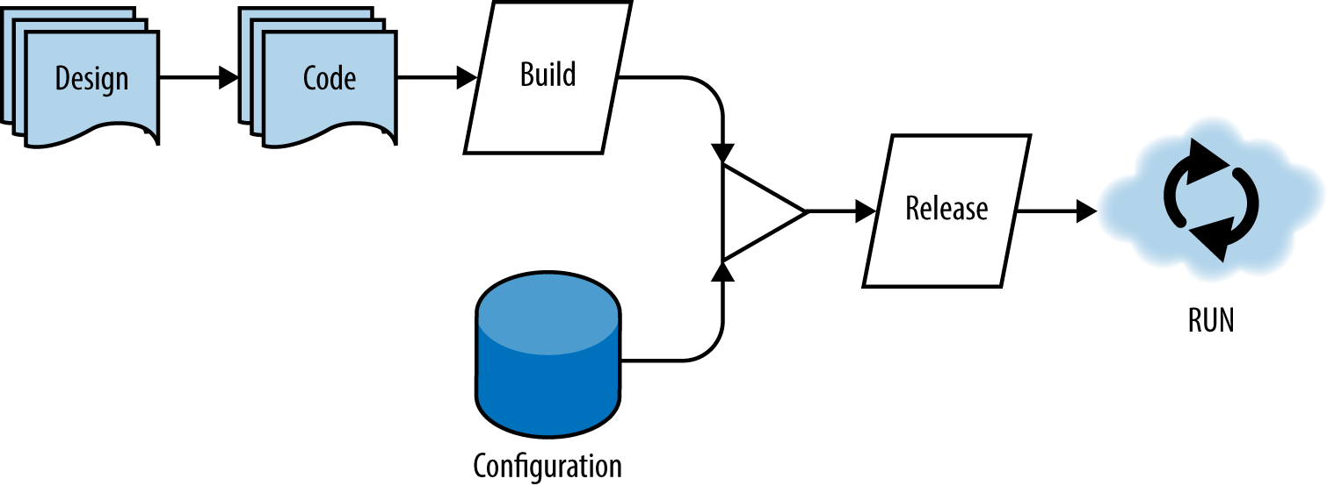
Factor 5 – Build, Release, Run
A single codebase is taken through the build process to produce a compiled artifact. This artifact is then merged with configuration information that is external to the application to produce an immutable release. The immutable release is then delivered to a cloud environment (development, QA, production, etc.) and run.

Slide 20
Factor 6 – Processes
Execute app as one or more stateless processes
Processes
One or more discrete running processes
Stateless – Process should not store internal state (HTTP Sessions)
Shared Nothing – Data needing to be shared should be persisted
Memory/Local tmp storage considered volatile
Processes may intercommunicate via messaging/persistent storage

Slide 21
Factor 7 – Port Binding
Export services via port binding
App should not need a “container”
Java App Server, Apache HTTPD for PHP etc
PAAS now takes that role
App should export HTTP as service
Define as dependency e,g embedded Jetty/Tomcat
Execute at runtime
One app could be another App’s service

Slide 22
Factor 7 – Port Binding
http://192.163.123.45 : 61021 BOOKING SYSTEM
The contract with the execute environment is binding to a port to serve requests
The
foo.com:80
Router
192.163.123.45:61021
192.163.123.45:61021
NAT
NAT
10.254.0.71:61021
10.254.0.76:61001
10.254.0.89:61021
10.254.0.93:61018
… Runner
… Runner

Slide 23
Factor 8 – Concurrency
Processes are first class citizens
Like Unix service daemons
Unlike java threads
Individual processes are free to multithread
BUT a VM can only get so large (vertical scaling)
Must be able to span multiple machines (horizontal scaling)

Slide 24
Factor 8 – Concurrency
file xfer
file xfer
file xfer
Workload diversity
enqueue
etrader
etrader
etrader
etrader
etrader
hello
hello
Scale (running processes)
Scale out by running multiple processes of different types

Slide 25
Factor 9 – Disposability
Maximize robustness with fast startup and graceful shutdown
Processes should be disposable
No loss of state for user, processes are stateless
Processes should be quick to start and stop
Should exit gracefully/finish current requests
Or should be idempotent/ reentrant
Losing process should be a normal event
Platform can adapt to errant process and self heal if required

Slide 26
Factor 10 – Dev/prod parity
Keep dev, staging, prod as similar as possible
Dev/Prod environments often are different
Time gap – (development over weeks/months)
Personnel gap – developers develop, admins deploy
Tool gap – dev use SQLLite/Nginx, prod uses Apache/Oracle
Keep differences minor
Reduce time gap- small changes & continuous deployment

Slide 27
Factor 11 – Logs
Treat log as event streams
Logs are streams of aggregated, time-ordered evnets
Separate log manager handle log management – logging as a service
Apps are not concerned with log management – Just write to sysout
Logs can be managed via tool like Splunk
Log indexing and analysis

Slide 28
Factor 11 – Logs
In application.yml
logging: level:
org.springframework: ${SPRING_LOG_LEVEL:INFO} hello: ${LOG_LEVEL:INFO}
BUT
Use this property file ONLY as an (hierarchical) abstraction!
Store config in the environment!!
Using ENV to config logging in Spring

Slide 29
Factor 12 – Admin Processes
Run admin/mgmt. tasks as one-off processes
Admin Processes/Management tasks run as One-Off Processes
DB Migrations, one time scripts etc
Use same environment, tools, language as application processes e.g.REPL – Read-Eval-Print-Loop (Command-shell for running non-interactive shell scripts)

Slide 30
Factor 12 – Admin Processes
Admin / Management processes run against a release
They “should” run in an identical environment as the release
They use the same codebase and config
Admin code ships with App code to avoid synch issues
Run as a separate process

Slide 31
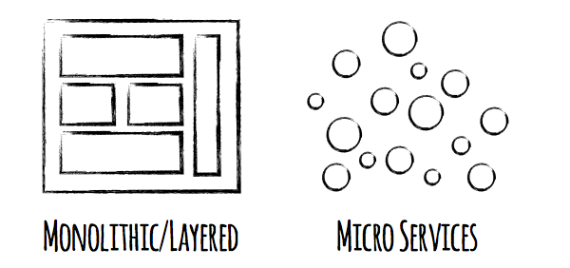
Microservices

Slide 32
Microservices
Microservices are small, autonomous services that work together.
—Sam Newman, Thoughtworks
Loosely coupled service-oriented architecture with bounded contexts.
—Adrian Cockcroft, Battery Ventures
Some services require high availability, but are low volume, and it’s the opposite for other services. A microservice approach allows us to tune for both of these situations, whereas in a monolith it’s all or nothing.
—Beier Cai, Director of Software Development, Hootsuite

Slide 33





Microservices – an ‘atomic’ unit of service that delivers business value
It represents decomposition of monolithic business systems into independently deployable services that do “one thing well”
Decoupling business context allows decoupling change cycles, enabling frequent and rapid changes thus allowing continuous flow of value to business.
Adding people to “late projects” makes the project later. Creating parallel work streams by building more sandboxes by bounded business contexts accelerates development.
Reduced cognitive learning of business domain and existing code; easier for new developers to build relationships within a smaller team; enables more productivity.
Enables adoption of new technology within a single monolith; isolates and minimizes the risk of technology compatibility issues much the same way as it minimizes the risk of runtime failure.
Allows efficient scaling of services thru selective scaling of components that experience heavy load unlike heavy monolithic apps that require scaling up entire architecture.
Notes:
All of this makes microservices useful for cloudnative applications, which are designed to run in cloud environments with lots of commodity hardware resources that can dynamically respond to fluctuations in demand for certain applications
Benefits of Microservices
Quicker App development cycle
Resilient/Flexible – failure in one service does not impact other services
High scalability – scaling microservices on demand
Easy to enhance – less dependency and easy to change and test
Low impact on other services –easy to throw away
Small, easy to understand code base
Ease of deployment
Ability to use a different technology stack

Slide 34
Microservices Architecture Principle
Each Microservice Delivers A Single Complete Business Capability
Autonomy Over Coordination
Small Bounded Contexts Over One Comprehensive Model
Asynchronous Communication Over Synchronous Communication
Best Technology For The Job Over One Technology For All
One Team Is Responsible For Full Life Cycle Of A Micro Service
A single team can deploy and manage a service as well as create new versions and retire obsolete ones
Users of the service have a single point of contact for all questions regarding the use of the service
possibility to choose a different technology for each service
use the best tool for the job
Synchronous dependencies between services is tight coupling, does not scale very well, and the calling service may be impacted by errors in the called service
In Asynchronous communication,the calling service simply publishes it's request and continues with other work
Problems in another service will not break this service
A Bounded Context encapsulates the details of a single domain, such as domain model, data model, application services, etc., and defines the integration points with other bounded contexts/domains
Bounded Context make clear where we can safely use the natural domain terms and where we will need to bridge to other domain
Microservices should have a well defined bounded context that will enable us to work without having to consider, or swap, between contexts.
A business capability should not depend on other services to complete its work.
A more robust solution would be to define a service that handles a process that makes sense to a user
Minimal coordination between capabilities leads to optimal autonomy
Increased autonomy for a microservice gives it freedom to evolve without impacting other services
it will give both organisational and technical advantages.

Slide 35
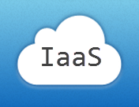
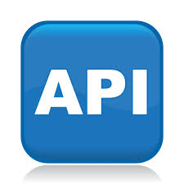

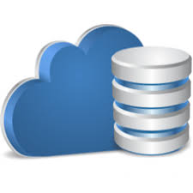
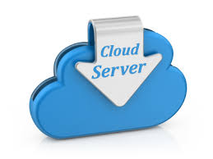
Self Service Agile Infra – Self service Platform that supports Microservices
Automated Application Scaling
Platforms are provisioned using APIs that create virtual server instances, network and storage with various forms of configuration management and automation
Application code is pushed in the form of artifacts, which the platform builds, constructs an Application environment, deploys the Application and starts the necessary processes
Backing services like DB, MQ or Mailserver, etc are also provisioned the same way.
Application Health Management
Dynamic Routing of Requests

Slide 36

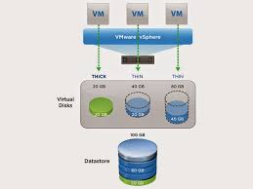

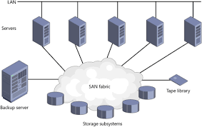

API based Collaboration
JSON serialization
API
Contracts
HTTP
REST-style APIs
Sole mode of interaction is thru published APIs.
Software Development teams could deploy new functionality thru a service without synchronizing with other teams (provided they do not break any API contracts).
No need for submission of tickets to provision, scale, and maintain application infrastructure.
Rather those same requests are submitted to an API that automatically services the requests (thru API contracts).
Contract compliance is verified thru service-to-service interactions.
Only one service is allowed to access the data store at any time.
Such decoupling directly supports cloud native requirement of speed.

Slide 37

Antifragility – ability of a system getting stronger when subject to stress
It is the opposite quality of a system that gets weaker or breaks when subject to stress.
Netflix Simian Army project has been famous for the sub module “Chaos Monkey,” which injects random failures into production components with the goal of identifying and eliminating weaknesses in the architecture.
By explicitly seeking out weaknesses in the application architecture, injecting failures, and forcing their remediation, the architecture naturally converges on a greater degree of safety over time.
The concept of antifragility was introduced in Nassim Taleb’s book Antifragile (Random House). While one may relate antifragility to resilience, or robustness, Taleb clearly states it is the direct opposite of fragility.

Slide 38
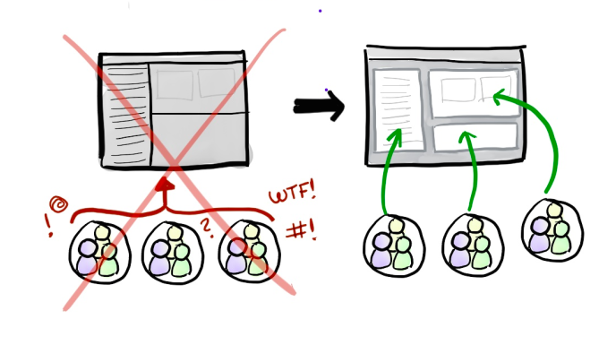
Cloud Native - Summary
Deployments in months
Deployments in days, weeks
It is style and approach in developing applications….
In a more fine-grained, highly distributed fashion
Embodies 12 factors principles of application development
Organized around specific product feature or business capability
As a mesh of small, autonomous services (“microservices”), each independently deployable, running in its own process and communicating with lightweight mechanisms, often an HTTP resource API
That facilitates polyglot and “geo fencing”
That enables….
Faster development and deployment with smaller, multi-disciplinary, nimble teams
Rapid iterative evolution of a business solution or capability; simpler deployments and rollbacks
Individually scalable – only where it is needed
Built-in resiliency, anti-fragility: more confined fault isolation and tolerance
Better availability when designed correctly
More optimized around cloud elasticity and cost model

Slide 39
Migration Approaches
Dealing with Monoliths, Leveraging Spring Cloud and Other methods

Slide 40
Migrate Existing Apps To Cloud
To ensure successful migration of existing applications to cloud computing
Assess your Applications and Workloads
Build the Business Case
Develop the Technical Approach
Adopt a Flexible Integration Model
Address Security and Privacy Requirements
Manage the Migration
There are three common categories for approaching cloud migration:
Lift and Shift –Directly deploy the applications on cloud
Refactor – Deploy application on cloud with minimal modifications/Changes
Rewrite – Rewrite the application with compatible technology to be deployed on cloud

Slide 41

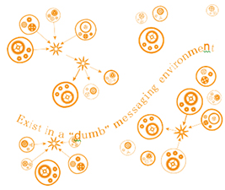
Why modernize monolith apps to be Cloud Native?
Burden of a monolith
Longer to do impact analysis
Harder to modify and debug
Changing, even small ones, requiring full rebuild, comprehensive testing and deploy
Costly
Expensive MIPs and scarce resources
High availability constraints and cost
Months to enhance and deploy
Innovation inhibitor
Difficult to adopt new technology
Weakest link in achieving agility for customer experiences
Little resiliency: any failure in monolith brings it down
Limited, expensive scalability: add more MIPS or horizontally scale the whole monolith
Tightly Coupled
Monolith
Decoupled Mesh of Services
Notes:
Any Language that is supported in the cloud environment can be used to develop microservices
When designing how services will communicate, we need to consider various issues: how services interact, how to specify the API for each service, how to evolve the APIs, and how to handle partial failure. There are two kinds of IPC mechanisms that microservices can use, asynchronous messaging and synchronous request/response

Slide 42


Strangling the Monolith
Gradually creating “a new system around the edges of the old, letting it grow slowly over several years until the old system is strangled.”
We cannot break the monolith; however we can strangle it by following means
Stop any new feature getting into the monolith
Build those new features “The Microservices way” using distributed systems on the Cloud (building new services from scratch is far easier than surgically extracting them from “a big ball of mud.”)
Build interfaces to integrate with the Monolith the DDD way (Domain-Driven Design – integrating two systems in a way that the domain of one does not corrupt the other)
Continue this approach until you have built all required services the Microservices way – the Monolith gets strangled over a period of time.
Some portions of the monolith may remain stable, with no changes happening for years; don’t mind leaving them as they are.
The Monolith
New features
Interfaces
?
Where is the Monolith?

Slide 43
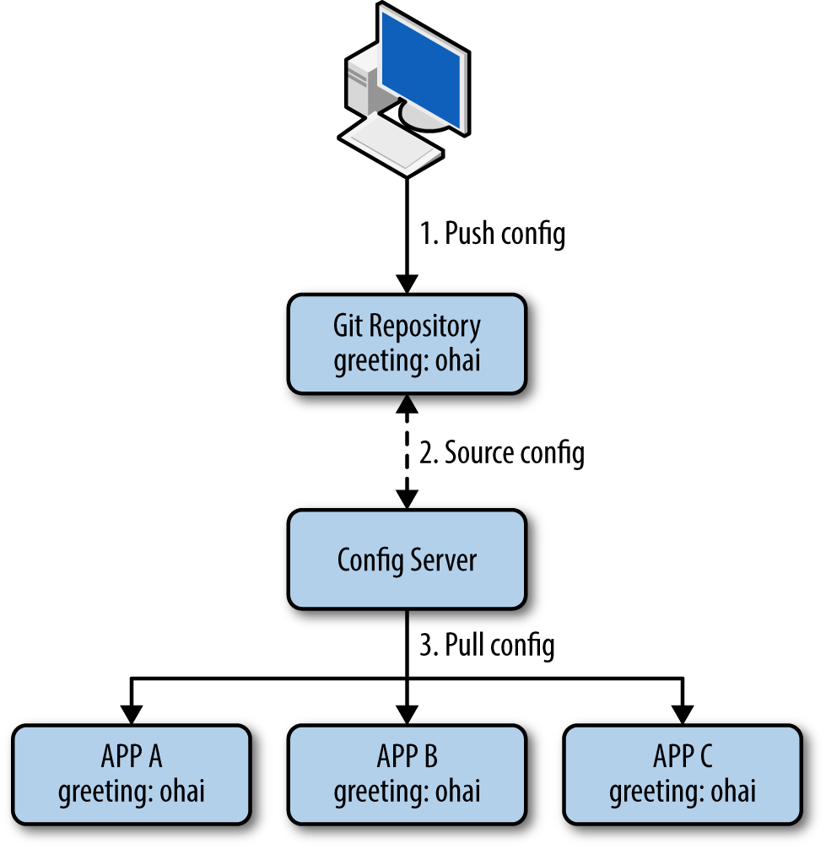
Using Spring Cloud to build common patterns
For some common patterns Spring Cloud provides ready to use tools for developers (e.g. configuration management, service discovery, circuit breakers, intelligent routing, micro-proxy, control bus, one-time tokens, global locks, leadership election, distributed sessions, cluster state).
Coordination of distributed systems leads to boiler plate patterns, and using Spring Cloud developers can quickly stand up services and applications that implement those patterns.
They will work well in any distributed environment, including the developer's own laptop, bare metal data centers, and managed platforms such as Cloud Foundry.
Example :
Configuration
Management
The configuration in the above example was not manually coded, but generated
automatically. We can see that the value for greeting is being distributed to the Spring application by examining its /env endpoint

Slide 44
Example PaaS Cloud Service Providers
Pivotal Cloud Foundry
IBM Bluemix
Heroku
Stackato
Azure
Google App Engine
AppFog
RedHat Openshift
AppHarbor
Amazon AWS

Slide 45
CLOUD FOUNDRY
Cloud Foundry is an open source platform as a service (PaaS) that lets you quickly create and deploy applications on the cloud.
Cloud Foundry is not vendor specific and does not lock you into proprietary software or cloud infrastructure
Cloud Foundry abstracts the underlying infrastructure needed to run a cloud, letting you focus on the business of building cloud applications
The beauty of Cloud Foundry is that it provides choice.
Development Frameworks: | Cloud Foundry supports Java™ code, Spring, Ruby, Node.js, and custom frameworks.
Application Services: | Cloud Foundry offers support for MySQL, MongoDB, PostgreSQL, Redis, RabbitMQ, and custom services.
Clouds: | Developers and organizations can choose to run Cloud Foundry in Public, Private, VMWare and OpenStack-based clouds.

Slide 46
CLOUD FOUNDRY
Cloud Foundry's ability to provide choice comes through buildpacks, a convenient way to package frameworks and runtimes.
Buildpacks can be community based, custom built, or built from scratch.
In other words, if you cannot find a framework or service buildpack that suits your needs, you could modify an existing buildpack or create your own.
By using buildpacks, companies are able to provide enterprise-level services like the Bluemix cloud offering.

Slide 47


Slide 48
References
Migrating to Cloud-Native Application Architectures – Matt Stine (Pivotal)
Beyond_the_12-Factor_App_Pivotal – Kevin Hoffman
http:// www.ibm.com/cloud-computing/bluemix
http:// www.coreos.com
http:// cloud.spring.io
http:// blog.xebia.co
http:// www.netflix.com

