Slide 1
Spring boot application

Slide 2
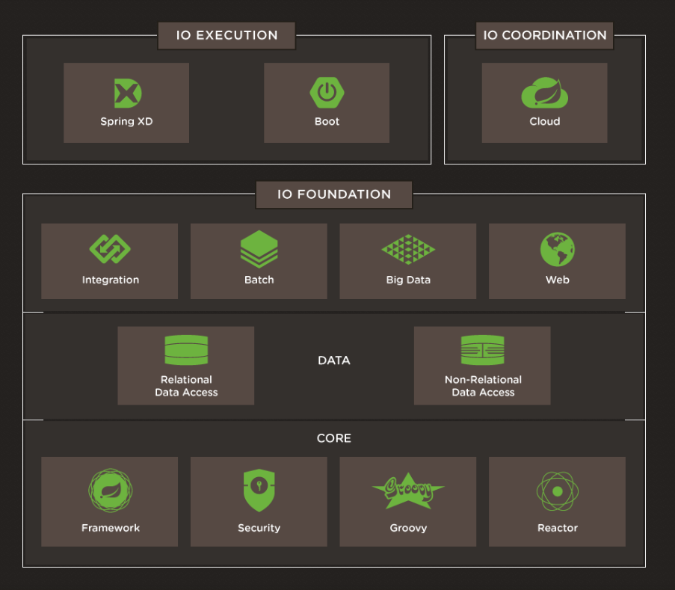
The Spring IO platform

Slide 3
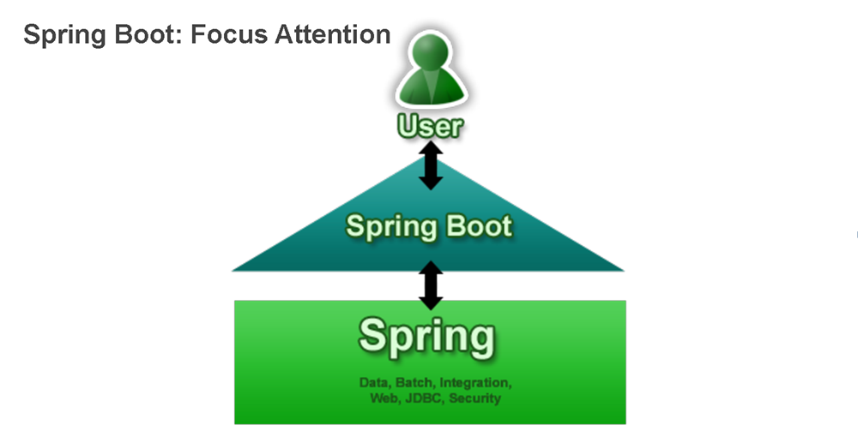

Slide 4
Introduction to spring boot
Single point of focus (as opposed to large collection of spring-* projects)
A tool for getting started very quickly with Spring
Common non-functional requirements for a "real" application
Exposes a lot of useful features by default
Gets out of the way quickly if you want to change defaults
An opportunity for Spring to be opinionated
Spring Boot is NOT
A prototyping tool
Only for embedded container apps
Sub-par Spring experience
For Spring beginners only

Slide 5

Installation
Requirements:
Spring Tool Suite has some nice features for Java projects
Download: https://start.spring.io/spring.zip
Unzip the distro (approx. 10MB), and find bin/ directory
(You can also install Spring Boot CLI with gvm, brew or MacPorts)

Slide 6
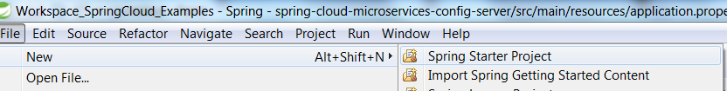
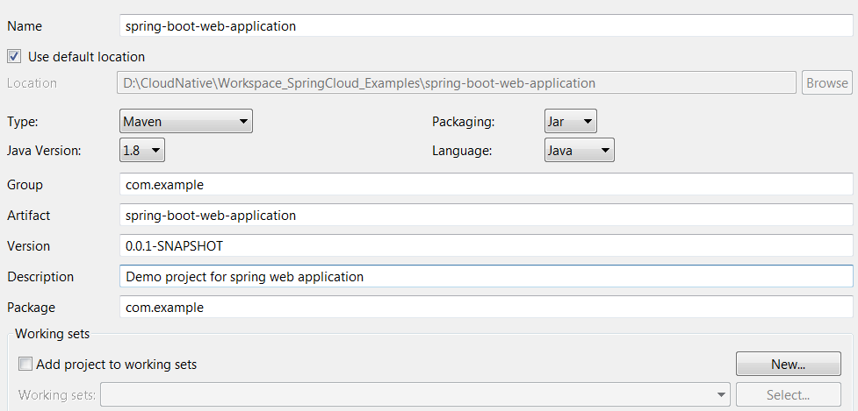
New project creation using STS
1.
Click on File -> New -> Spring Starter Project
2.
Fill below required details as below:
3.
And then click on Next, select the web dependency and click on Finish button

Slide 7
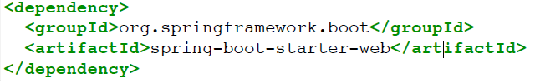
Starter POMs
Standard Maven POMs
Define dependencies that we recommend
Parent optional
Available for web, batch, integration, data, amqp, aop, jdbc, ...
e.g. data-jpa = hibernate + spring-data-jpa + JSR 303

Slide 8
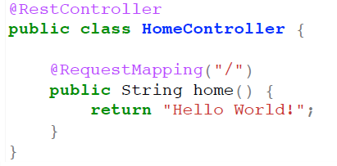
Getting Started in Java
Create simple controller
Build and run this project using below commands:
mvn clean install
mvn spring-boot:run
Open the browser and hit the below url
http://localhost:8080/

Slide 9
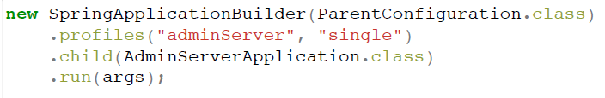
SpringApplication
Gets a running Spring ApplicationContext
Uses EmbeddedWebApplicationContext for web apps
Can be a single line
SpringApplication.run(MyApplication.class, args)
Or customized via SpringApplicationBuilder
SpringApplicationBuilder
Flexible builder style with fluent API for building SpringApplication with more complex requirements.

Slide 10
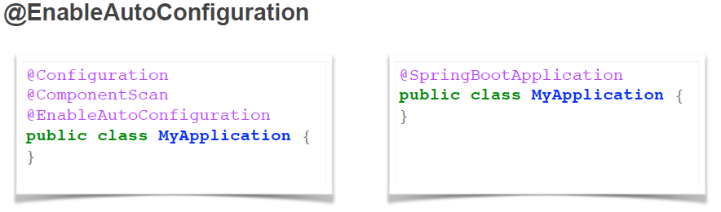
@EnableAutoConfiguration
Attempts to auto-configure your application
Backs off as you define your own beans
Regular @Configuration classes
Usually with @ConditionalOnClass and @ConditionalOnMissingBean

Slide 11
Testing with Spring Test (and MVC)
spring-boot-starter-test provides useful test dependencies
spring-test, Mockito, Hamcrest and JUnit
@SpringApplicationConfiguration
Alternative to the standard spring-test @ContextConfiguration
Does not start the full context by default
@WebIntegrationTest
Requires a web application context
Can add additional properties to the environment

Slide 12
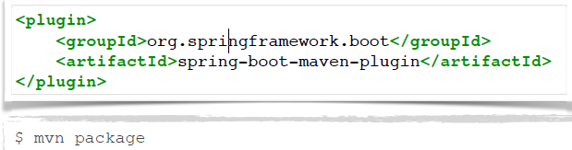
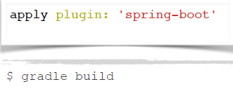
Packaging For Production
Maven plugin (using spring-boot-starter-parent):
Gradle plugin:

Slide 13

Packaging For Production
Easy to understand structure
No unpacking or start scripts required
Typical REST app ~10Mb
Cloud Foundry friendly (works & fast to upload)

Slide 14
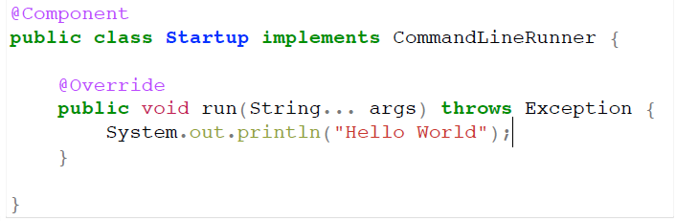
Not a Web Application?
CommandLineRunner is a hook to run application-specific code after the context is created

Slide 15
Environment and Profiles
Every ApplicationContext has an Environment
Spring Environment available since 3.1
Abstraction for key/value pairs from multiple sources
Used to manage @Profile switching
Always available: System properties and OS ENV vars

Slide 16
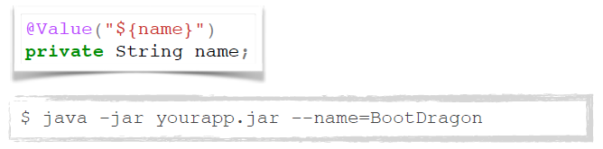
Command Line Arguments
SpringApplication adds command line arguments to the Spring Environment so you can inject them into beans:
You can also configure many aspects of Spring Boot itself:

Slide 17

Externalizing Configuration to Properties
Just put application.properties in one of the following locations:
- A /config sub-directory of the current directory
- The current directory
- A classpath /config package
- The root classpath
Properties can be overridden
- command line arg > file > classpath
- locations higher in the list override lower items

Slide 18
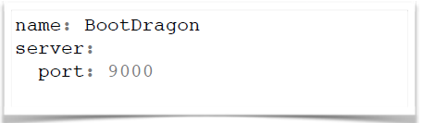
Using YAML
Just include snake-yaml.jar
Just include snake-yaml.jar
Write an application.yml file

Slide 19
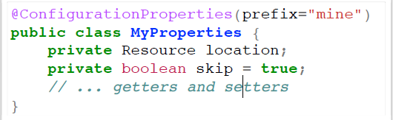

Binding Configuration To Beans
MyProperties.java
application.properties

Slide 20
Data Binding to @ConfigurationProperties
Spring DataBinder does type coercion and conversion where possible
Custom ConversionService additionally discovered by bean name (same as ApplicationContext)
Ditto for validation
configurationPropertiesValidator bean if present
JSR303 if present
ignoreUnkownFields=true (default)
ignoreInvalidFields=false (default)
Uses a RelaxedDataBinder which accepts common variants of property names (e.g. CAPITALIZED, camelCased or with_underscores)

Slide 21
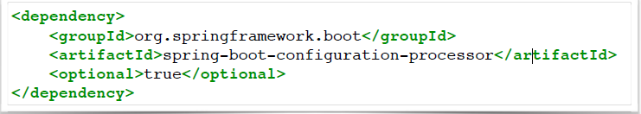
Configuration Meta-data
Annotation processor
Generates a meta-data file while compiling your project
Javadoc on fields are translated to descriptions
Default values are detected (to some extend)
Additional meta-data can be provided for corner cases
META-INF/additional-spring-configuration-metadata.json

Slide 22

Customizing Configuration Location
Set
spring.config.name - default application, can be comma-separated list
spring.config.location - a Resource path
Ends with / to define a directory
Otherwise overrides name

Slide 23
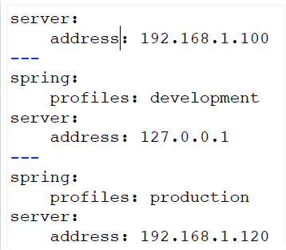
Spring Profiles
Activate external configuration with a Spring profile
file name convention e.g. application-development.properties
or nested documents in YAML:

Slide 24
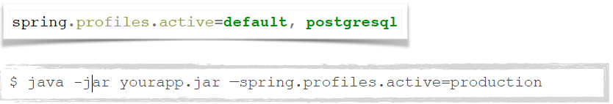

Spring Profiles
Set the default spring profile(s) in external configuration
Add some profile(s) to the active profiles rather than replacing them

Slide 25
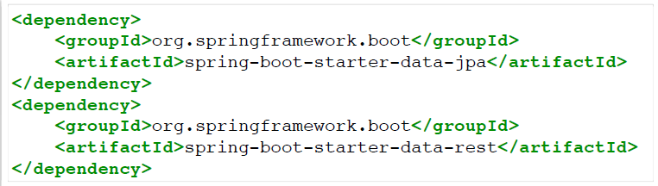
Adding some Autoconfigured Behavior
Extend the demo and see what we can get by just modifying the class path
Create a simple domain object
Expose the repository as a REST endpoint

Slide 26
Logging
Spring Boot provides default configuration files for 4 logging frameworks:
Logback, Log4j, Log4j2 and java.util.Logging
Starters (and Samples) use Logback with colour output
Default log level set to INFO
Debug output can be easily enabled using the --debug option
Log to console by default
logging.file and logging.path to enable file logging
Logging levels can be customised through configuration

Slide 27
Add static resources
Easiest: use classpath:/static/**
Many alternatives:
classpath:/public/**
classpath:/resources/**
classpath:/META-INF/resources/**
Normal servlet context / (root of WAR file, see later)
i.e. src/main/webapp
static/**
public/**
set documentRoot in EmbeddedServletContextFactory

Slide 28
Web template engines
Spring Boot includes auto-configuration support for Thymeleaf, Groovy, FreeMarker, Velocity and Mustache
By default, templates will be picked up automatically from classpath:/templates
Common configuration, e.g. for Thymeleaf
spring.thymeleaf.prefix (location of templates)
spring.thymeleaf.cache (set to false to live reload templates)
Extend and override, just add beans:
thymeleafViewResolver
SpringTemplateEngine

Slide 29
Error handling
/error handles all errors in a sensible way
Registered as global error page in the servlet container
Add a view that resolve to ‘error’ to customize the representation
Default representation
Whitelabel error page for browser if none is found
Standardized JSON format for machine clients
Customize or extend ErrorAttributes
Create dedicated error pages via EmbeddedServletContainerCustomizer

Slide 30
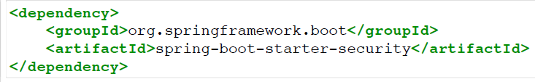
Adding some Autoconfigured Behavior
Secure the web application
Application endpoints secured via security.basic.enabled=true (on by default)
See how you can ask Boot to back off
Configure a custom AuthenticationManager

Slide 31
Currently Available Autoconfigured Behaviour
Embedded servlet container (Tomcat, Jetty or Undertow)
DataSource (Tomcat, Hikari, Commons DBCP)
SQL and NoSQL stores: Spring Data JPA, MongoDB and Redis
Messaging: JMS (HornetQ, ActiveMQ), AMQP (Rabbit)
Thymeleaf, Groovy templates, Freemarker, Mustache and Velocity
Batch processing - Spring Integration
Cloud connectors
Rest repositories
Spring Security

Slide 32
Currently Available Autoconfigured Behaviour
Data grid: Spring Data Gemfire, Solr and Elasticsearch
Websocket
Web services
Mobile & Social (Facebook, Twitter and LinkedIn)
Reactor for events and async processing
Jersey
JTA
Email, CRaSH, AOP (AspectJ)
Actuator features (Security, Audit, Metrics, Trace)

Slide 33
The Actuator
Adds common non-functional features to your application and exposes endpoints to interact with them (REST, JMX)
Secure endpoints: /env, /metrics, /trace, /dump, /shutdown, /beans, /autoconfig, /configprops, /mappings
/info
/health
Audit
If embedded in a web app or web service can use the same port or a
different one (management.port) and/or a different network interface
(management.address) and/or context path
(management.context-path).

Slide 34
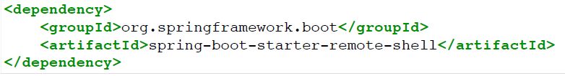
Add a remote SSH server
Add spring-boot-starter-remote-shell to class path
Application exposed to SSH on port 2000 by default

Slide 35
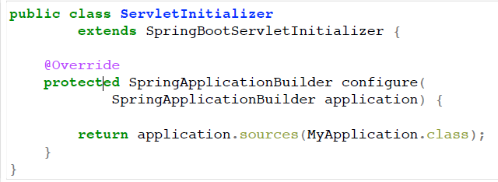
Building a WAR
We like launchable JARs, but you can still use WAR format
if you prefer. Spring Boot Tools take care of repackaging a
WAR to make it executable. If you want a WAR to be
deployable (in a "normal" container), then you need to
use SpringBootServletInitializer instead of or as well as
SpringApplication.

Slide 36
Customizing the Servlet Container
Some common features exposed with external configuration, e.g. server.port (see ServerProperties bean)
Also container-specific properties, i.e. server.tomcat.*
Add bean(s) of type EmbeddedServletContainerCustomizer
all instances get a callback to the container
Add bean of type EmbeddedServletContainerFactory (replacing autoconfigured one)

Slide 37
Customizing @EnableAutoConfiguration
Disable specific feature
@EnableAutoConfiguration(exclude={WebMvcAutoConfiguration.class})
@SpringBootApplication(exclude={WebMvcAutoConfiguration.class})
Write your own…
Create your own @Configuration class
Add the FQN of your configuration class in META-INF/spring.factories
All entries from classpath merged and added to context

Slide 38
Customizing the CLI
Uses standard Java META-INF/services scanning
CompilerAutoConfiguration: add dependencies and imports based on matches in the code
CommandFactory: add additional commands
name and description
usage help
actual execution based on command line arguments

Slide 39
Links:
Documentation: http://projects.spring.io/spring-boot
Source: https://github.com/spring-projects/spring-boot
Blog: http://spring.io/blog

