Slide 1


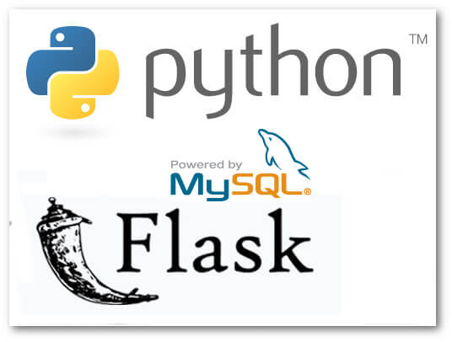

Used Car Sale Price Prediction (Using Python,Pandas,Matplotlib, Seaborn, sklearn, MySQL,SQLAlchemy, Flask, html,css, Java Script)

Slide 2
Our analysis includes 3 main parts:
1 — Data Characteristics and Exploration
2 — Model Selection, Interpretation & Prediction
3 —Summary and Future Scope

Slide 3
Data Characteristics
17477 rows for train and test (80/20)
31 rows for validation
There is no missing data in the dataset. No imputers or drop na or fill na are used
Variables | Type | Meaning
Total cost | continuous | the cost ($) incurred to Drivetime to buy the vehicles
Mileage | continuous | the total miles that the vehicles have travelled at the time of purchase
Vehicle.age | ordinal | The age of the vehicle at the time it was purchased by Drivetime
Vehicle.age.group | categorical | which age group the vehicles belong to: one-three, four+, six+ and seven+
color.set | categorical | the color of the vehicles
makex | categorical | manufacturer brands
state | categorical | where the vehicle is sold
make.model | categorical | the brands and the model of the vehicles
lot.sale.day | Continuous (independent variable) | Number of days the vehicles are in the lot before being sold
overage | Categorical (class label) | “YES" means the lot.sale.days is higher than 90 days. “NO" means the lot.sale.days is lower than 90 days.

Slide 4
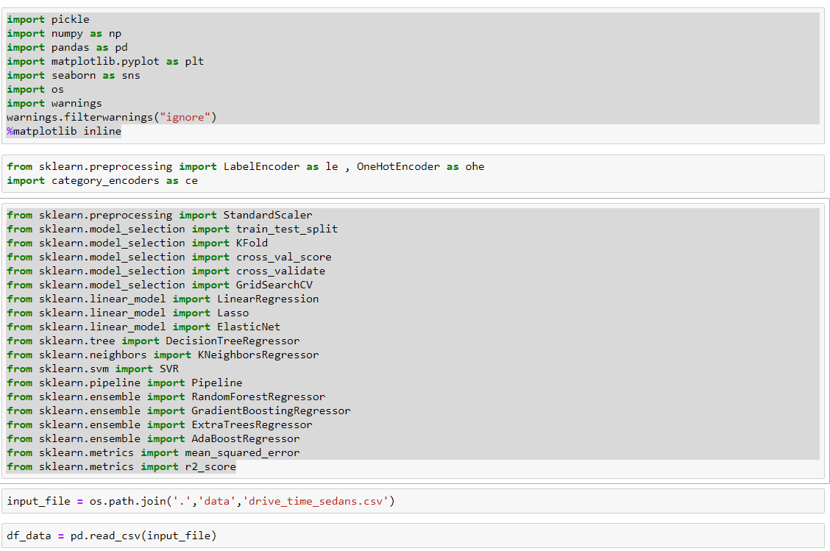

Slide 5
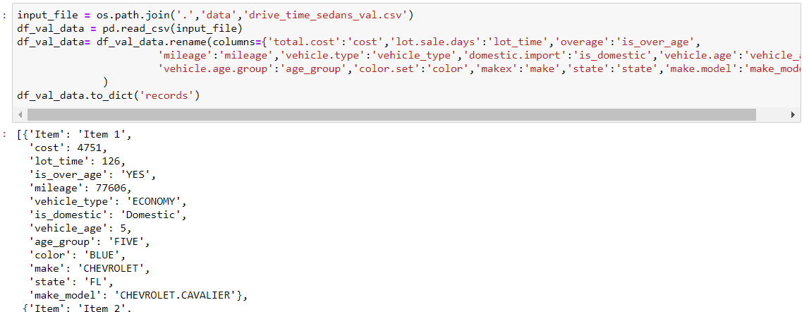
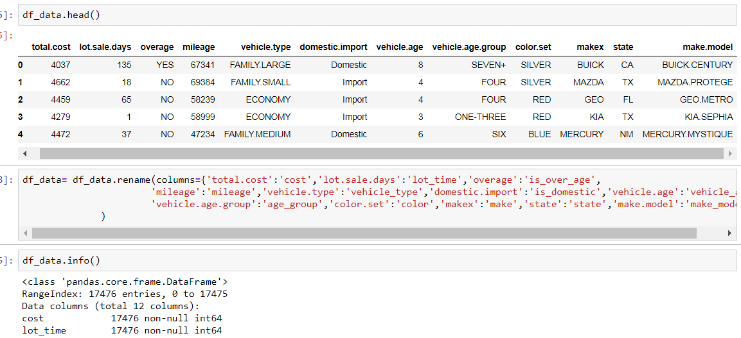
Keeping 31 records val data separate
Data head and rename

Slide 6
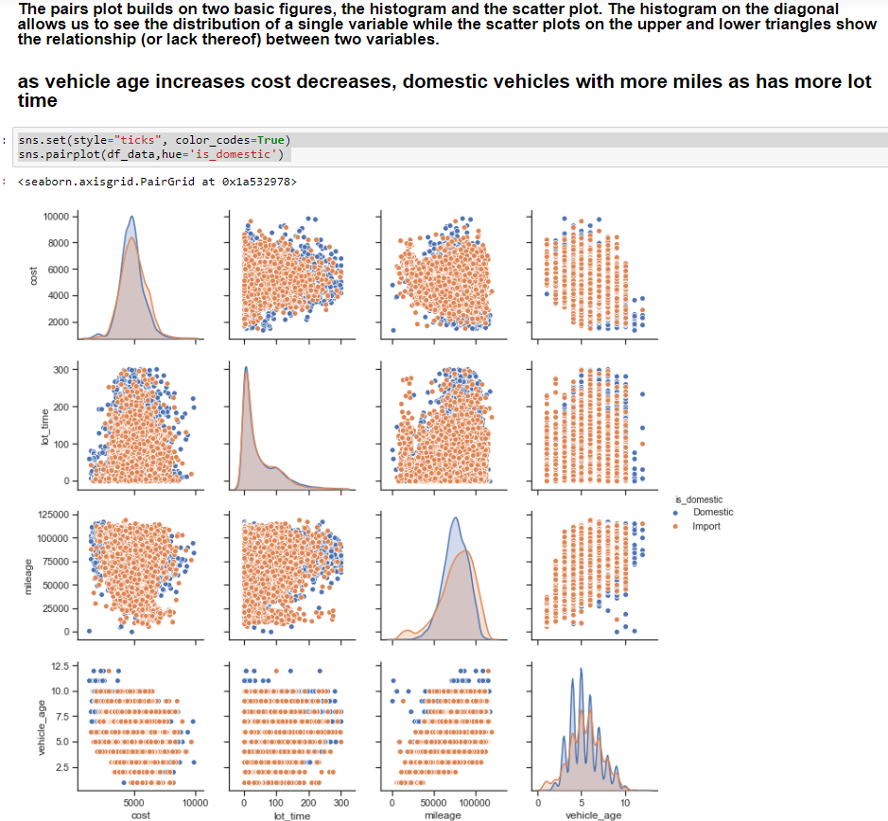
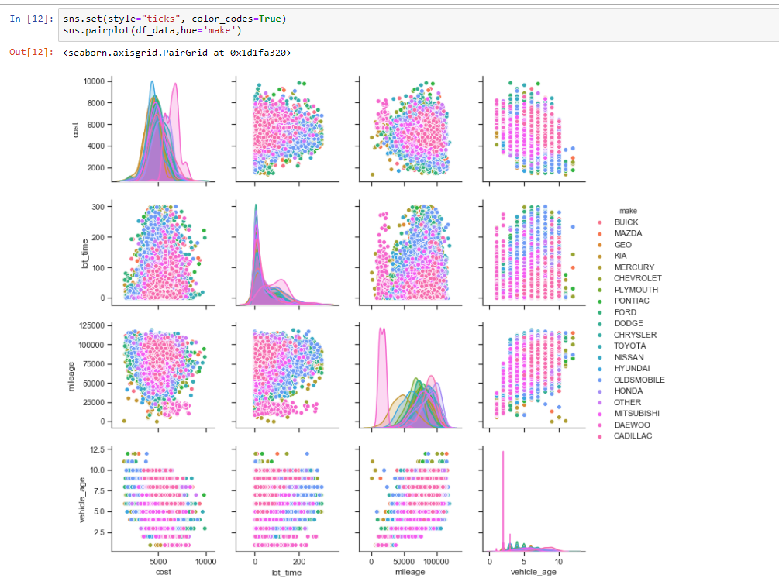
Pairs plots are a powerful tool to quickly explore distributions and relationships in a dataset. Seaborn provides a simple default method for making pair plots that can be customized and extended through the Pair Grid class. In a data analysis project, a major portion of the value often comes not in the flashy machine learning, but in the straightforward visualization of data. A pairs plot is provides us with a comprehensive first look at our data and is a great starting point in data analysis projects.

Slide 7
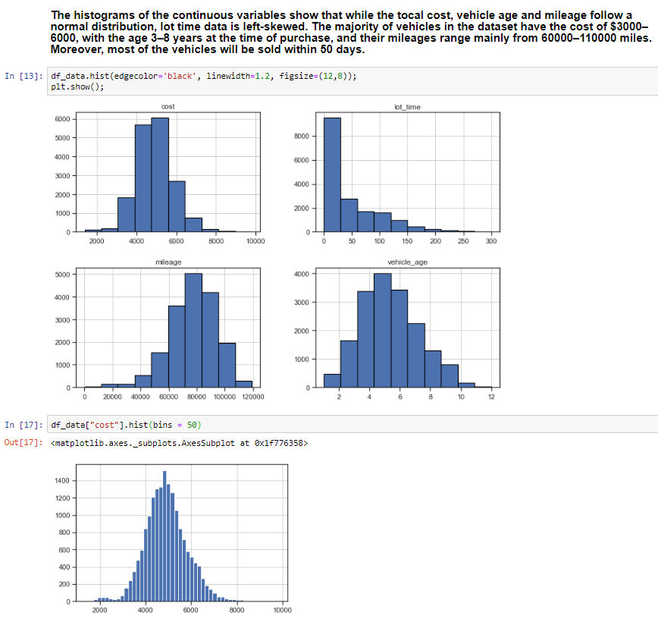
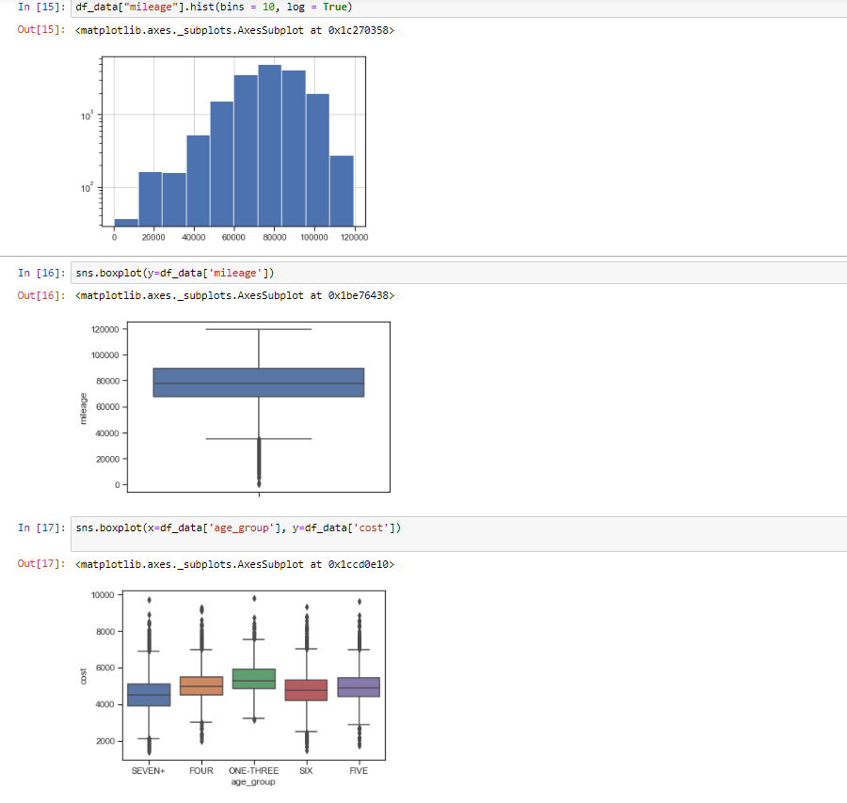

Slide 8
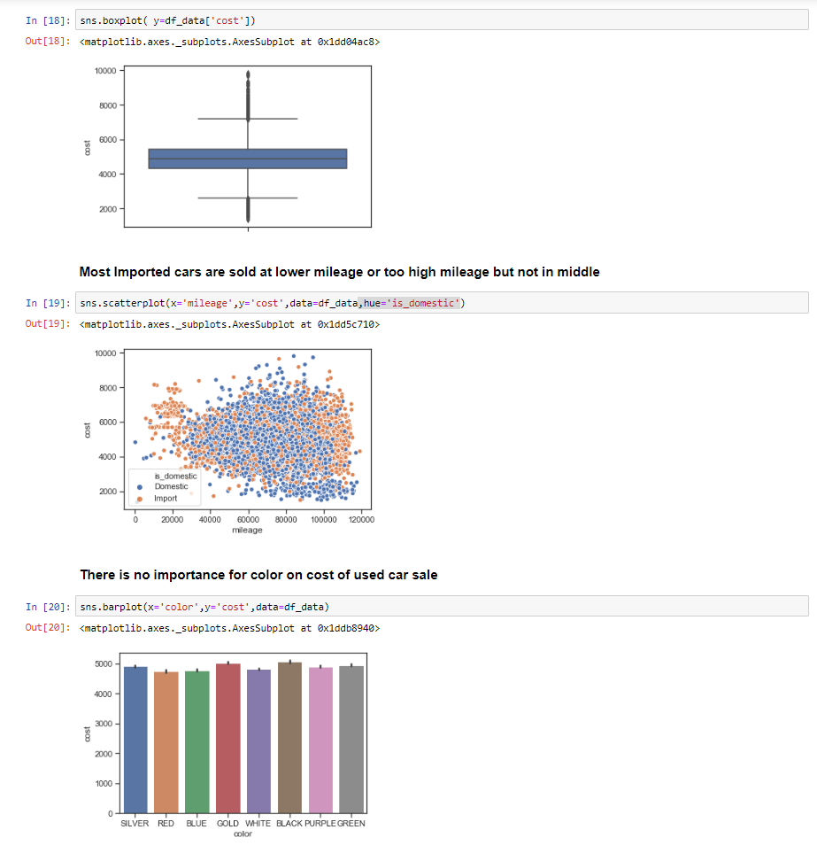
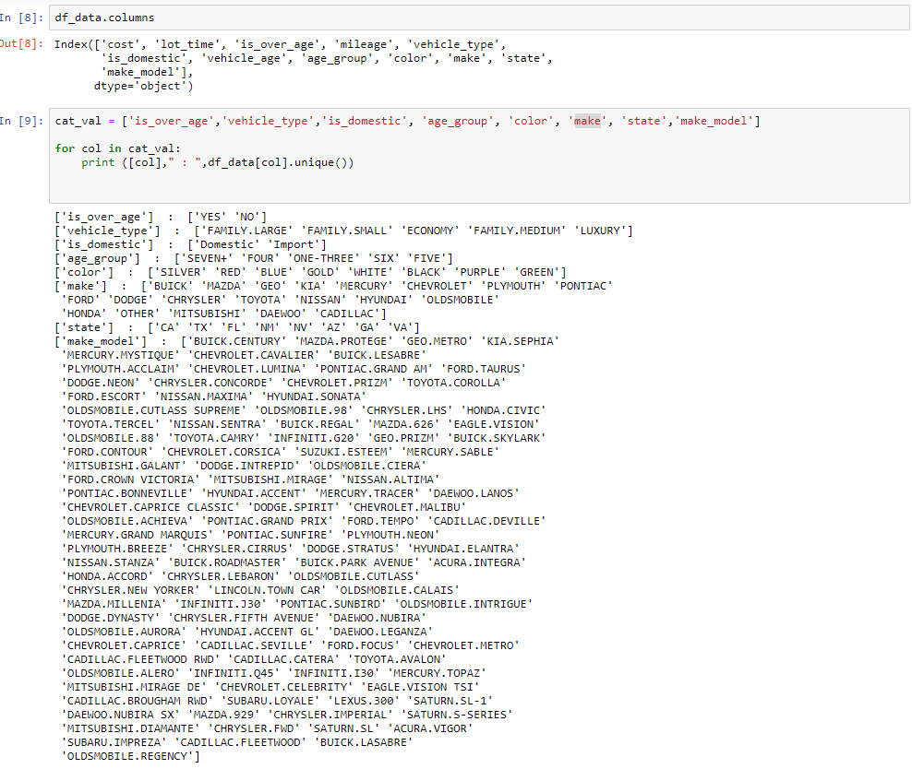
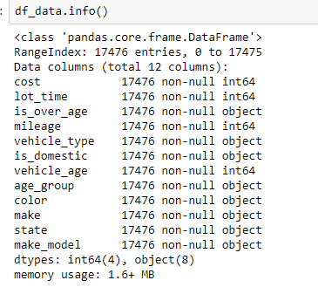

Slide 9
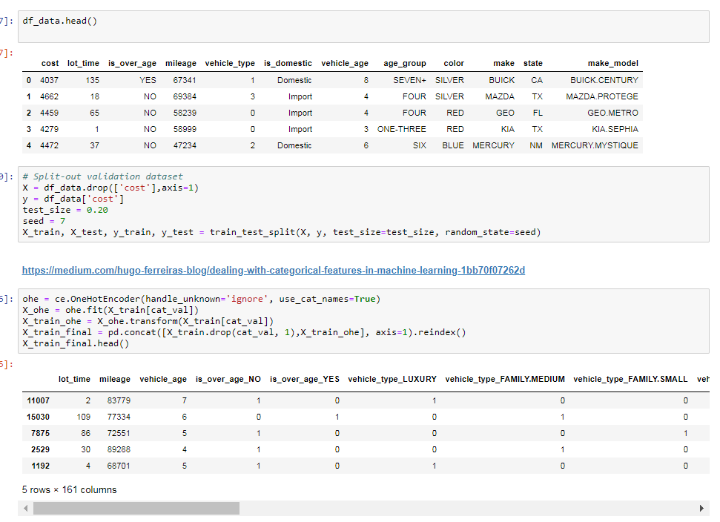
Categorical One Hot Encoding (need to check if we need to drop one of column for one values dummy variable trap concept, not sure if we need that if we are not using pandas get dummies)

Slide 10
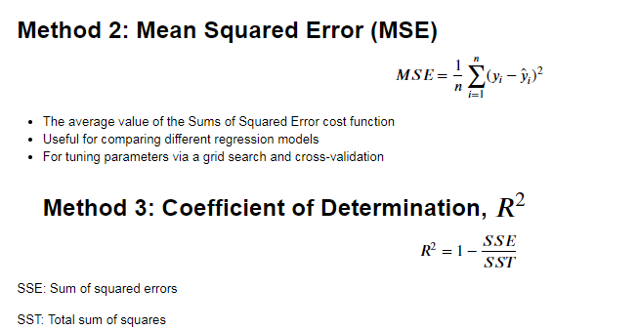
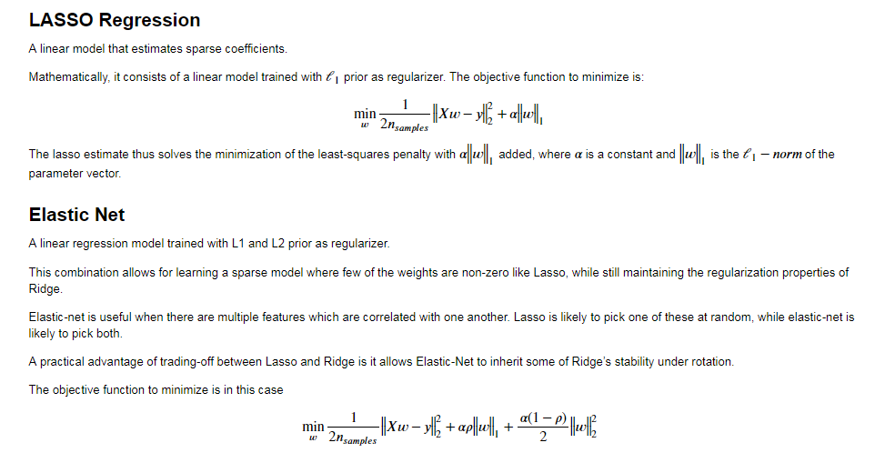
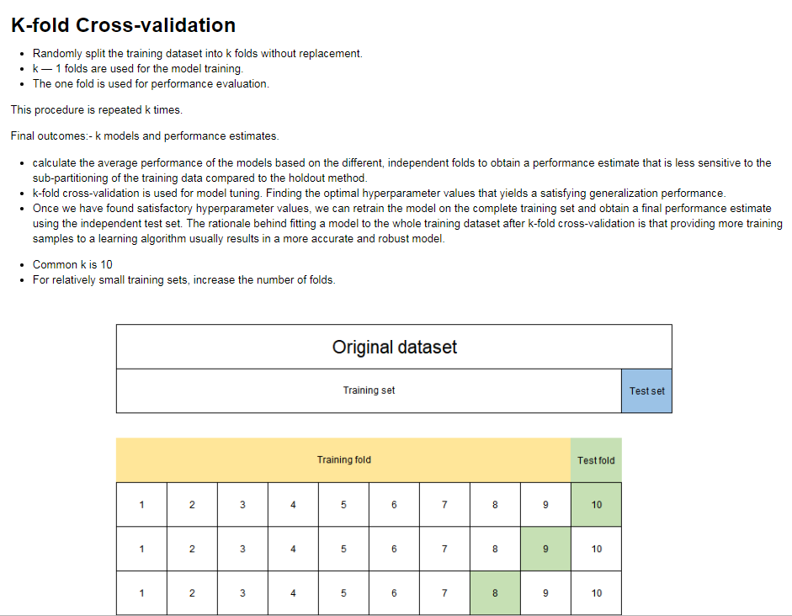

Slide 11
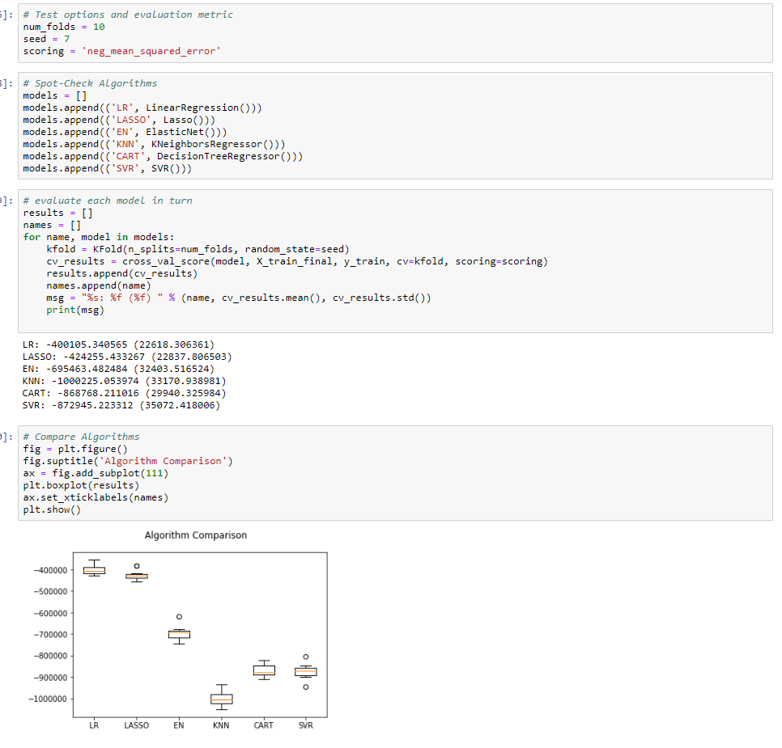
Using cross validation scores with Kfold cross validation, get primary model that gives best results. LR seems to better for now

Slide 12
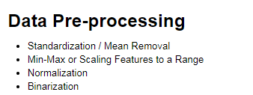
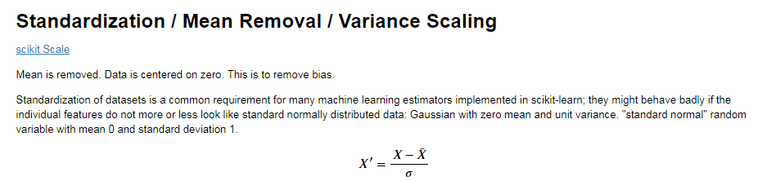
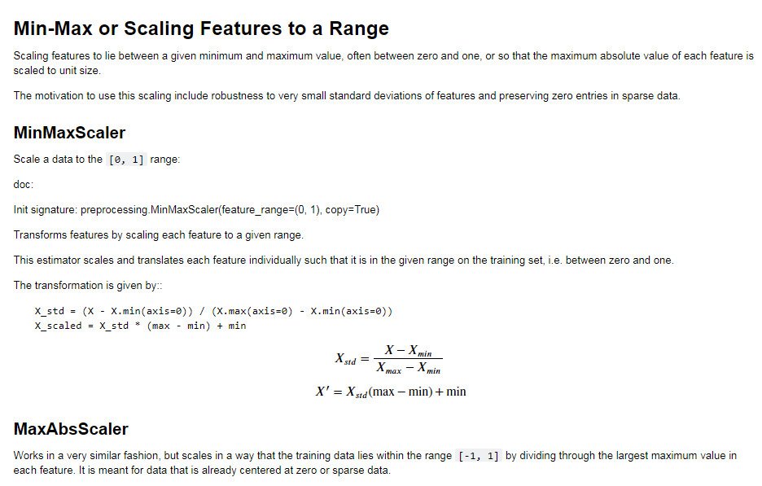
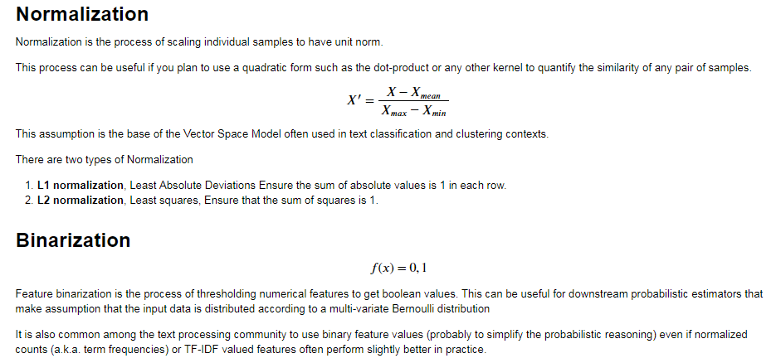

Slide 13
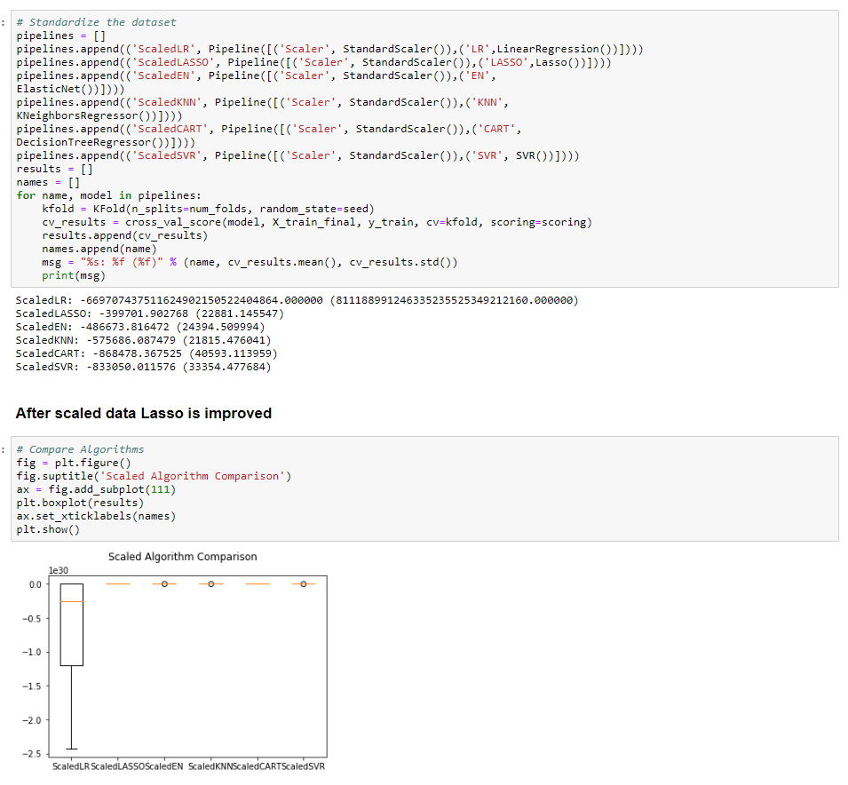
Definition of pipeline class according to scikit-learn is
Sequentially apply a list of transforms and a final estimator. Intermediate steps of pipeline must implement fit and transform methods and the final estimator only needs to implement fit.

Slide 14
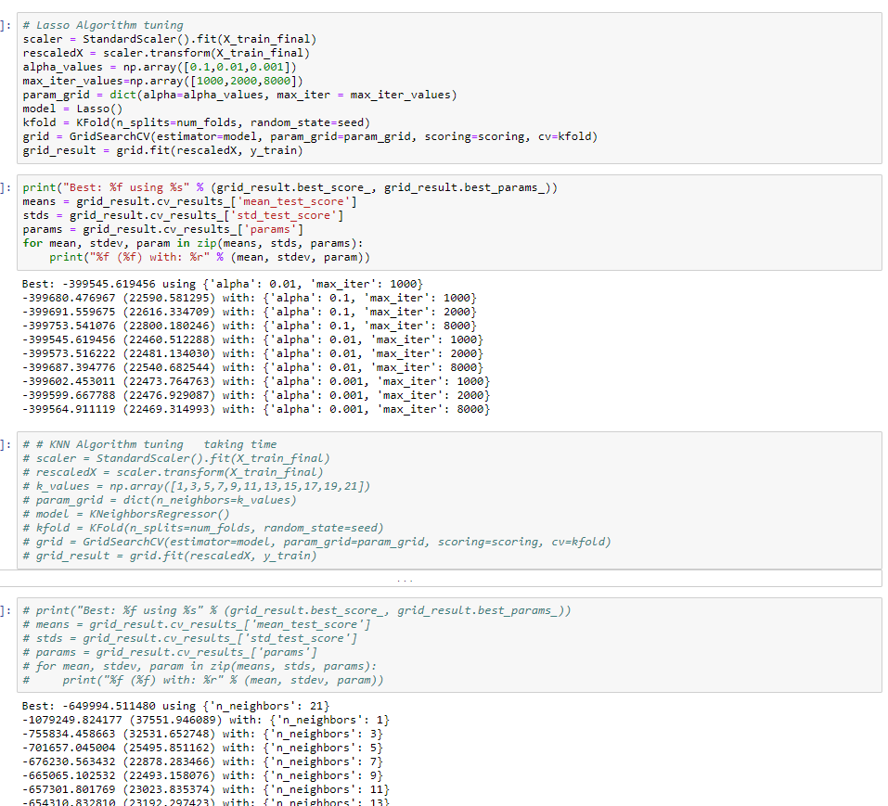
Now we tried tuning Laso for better results using different hyper parameters like alpha , max iterations etc

Slide 15
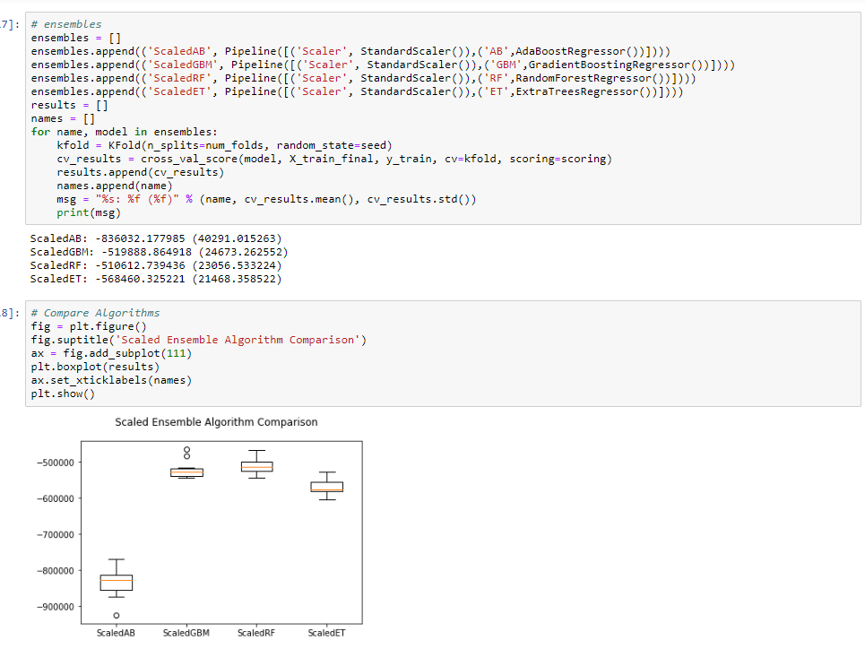
Ensemble learning uses multiple machine learning models to try to make better predictions on a dataset. An ensemble model works by training different models on a dataset and having each model make predictions individually. The predictions of these models are then combined in the ensemble model to make a final prediction.
Every model has its strengths and weaknesses. Ensemble models can be beneficial by combining individual models to help hide the weaknesses of an individual model.

Slide 16
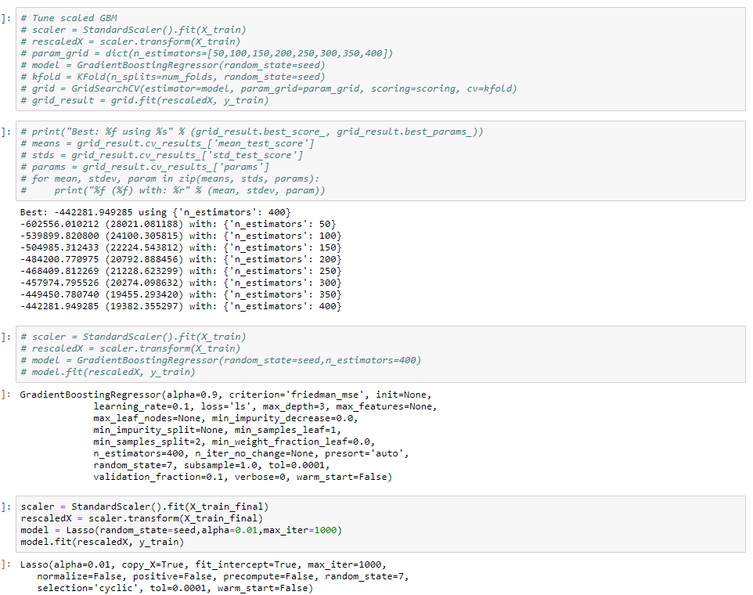
Finally we did settled with Lasso that gave best results for this data set. We finalized Lasso as our final model and going to use this model for test data to see how the model performed on test data.

Slide 17
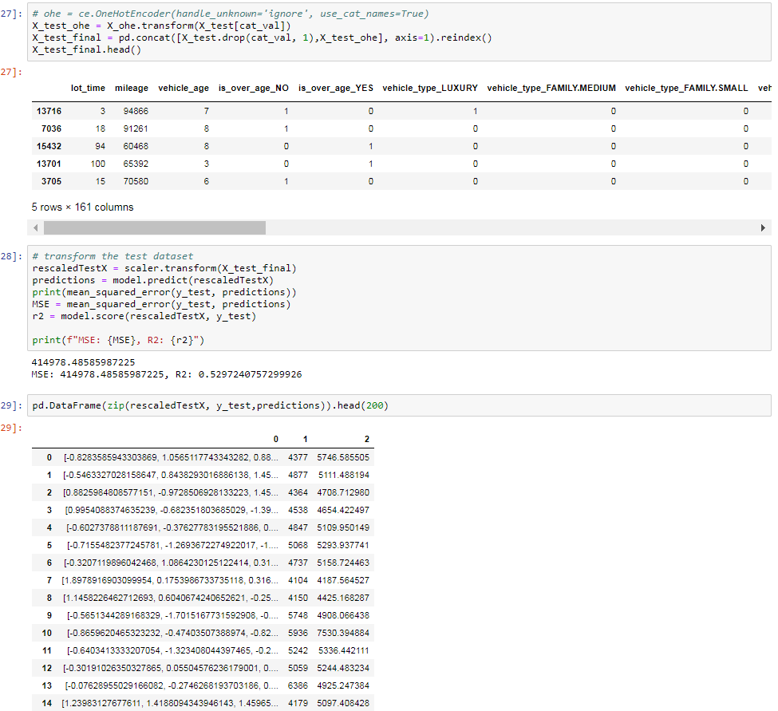
Now we decided the model, time to apply the model on test data (20 perecent of total data kept separate without fitting categorical or ohe or scaling or model.
We did apply only transform on test data. (this is required we do not want test data to give overfit or high bias results)
Accuracy on test data is 52% which we are ok with the result as our attempt here is to keep the full life cycle of regression model together.

Slide 18
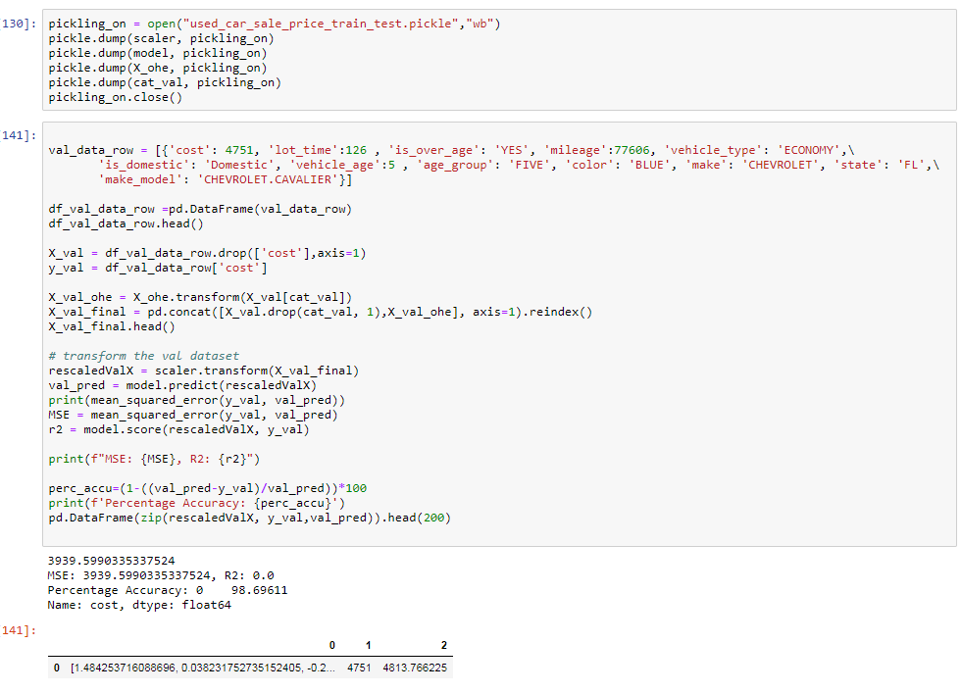
Now we have model trained on trained data and satisfied with accuracy on test data. We can use model to predict on new data (in our case we kept 31 rows separate to pass to model to get the prediction demo). Here we are showing the case of predicting one new row on our model that shows 98% accuracy for one new row
We do not need to run the same file with whole train data each time to get predictions . We did pickle objects individually (serialization in java) into separate file that is reused in next slide in separate py or jupyter notebook.

Slide 19
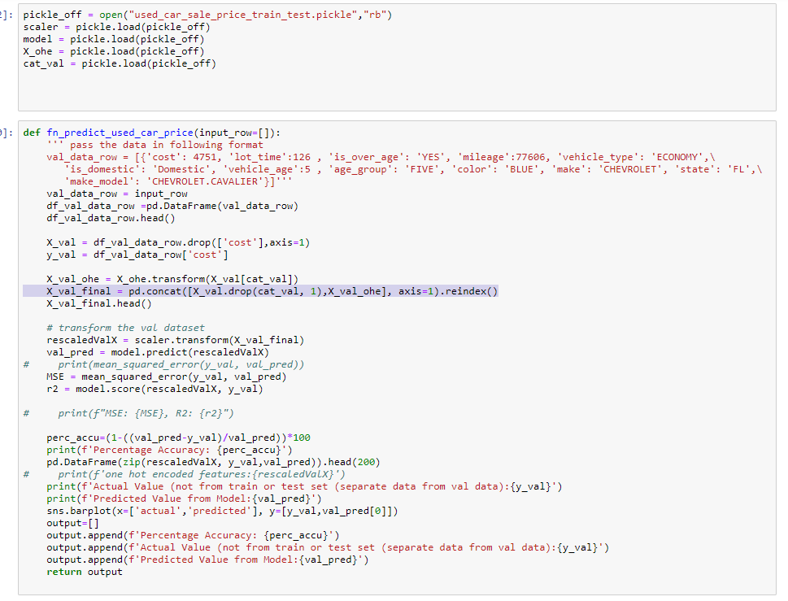
Here is the new py file that imports pickled file and get each individual object that are required for prediction.
(fitted ohe, scalar, model objects and also list of categorical values used in trained process)
A new function that takes new row as list of dictionary and uses the imported objects from pickled file to make new predictions

Slide 20
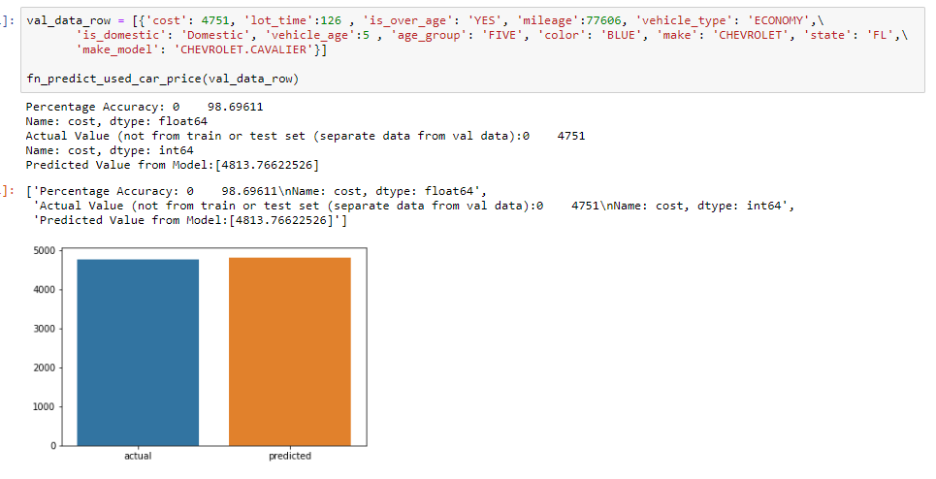
Here is the call to new function with new data row to get prediction.
Next we have created python file using flask that displays all new validation data (31 rows) , user can select ine item to get prediction, that row will be displayed in next screen (/inputdata) as showing the selected data and next screen (/inputdata/predict) will display prediction.

Slide 21
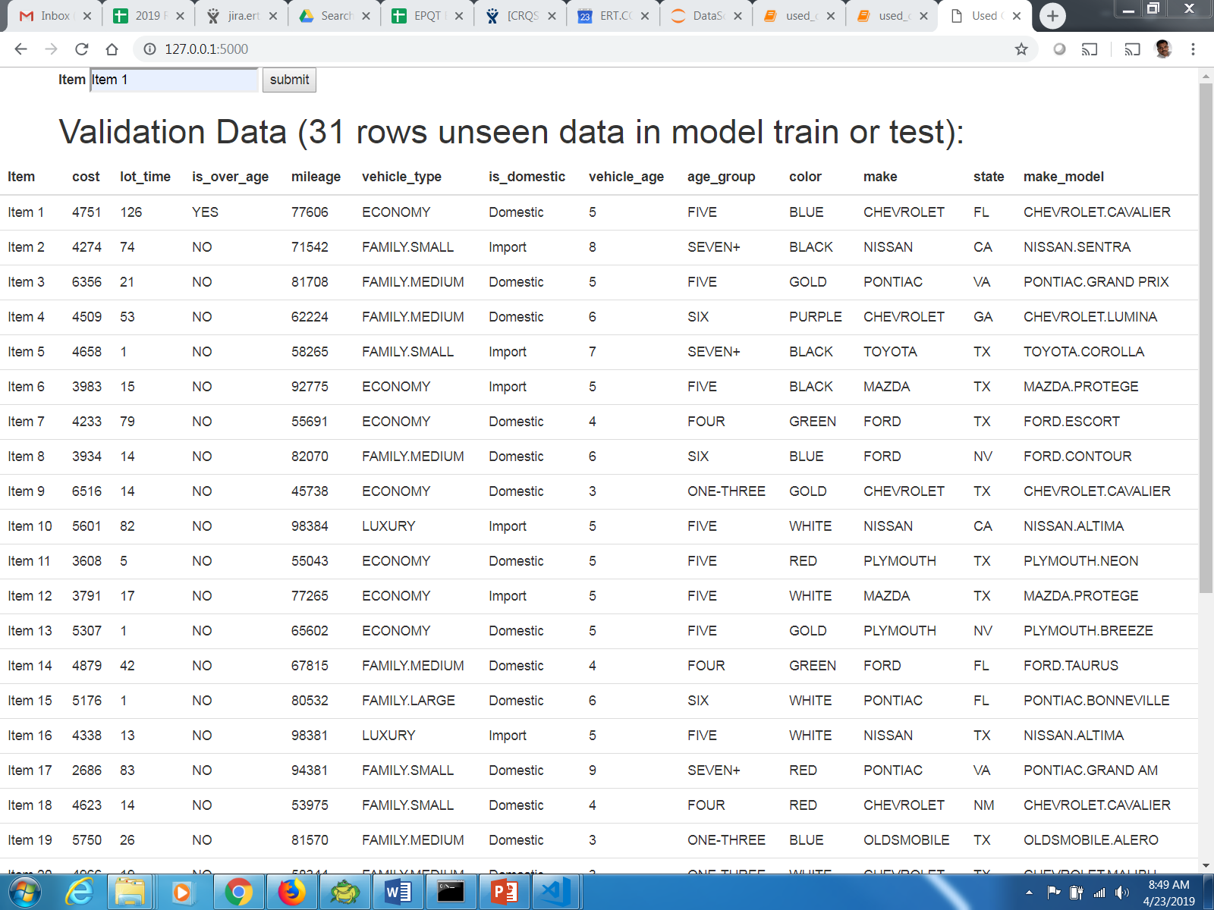
Flask base url to display data to select from (enter item that needs prediction)

Slide 22
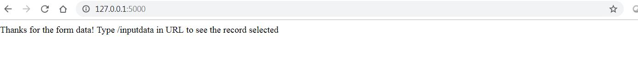
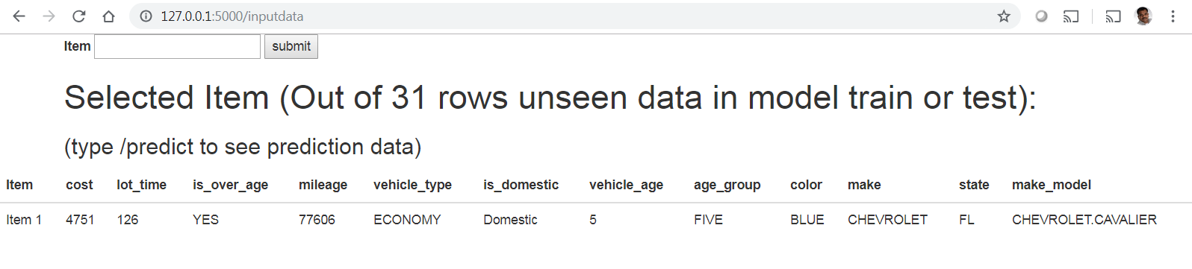
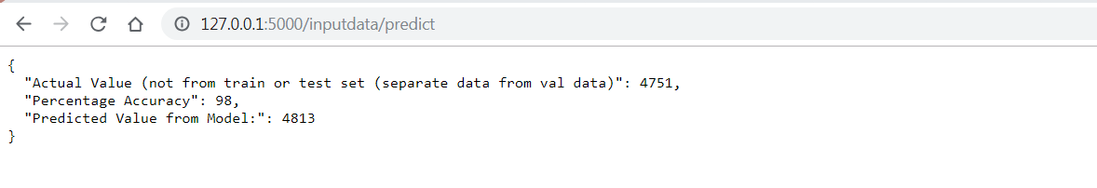
After clicking submit button the first screen shows to enter next url.
After enter /inputdata the data selected is displayed and shows next url to see predict data.
After entering /predict the predicted data is shown as jsonify object

Slide 23
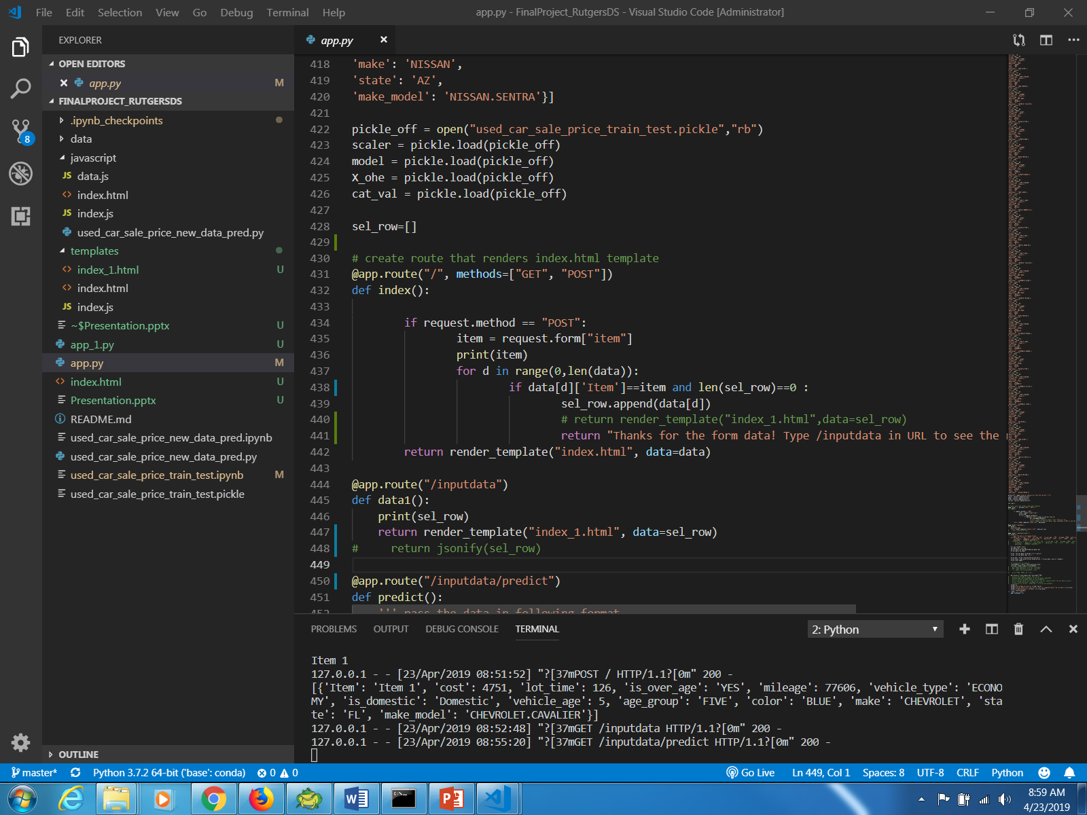
Flask code

Slide 24
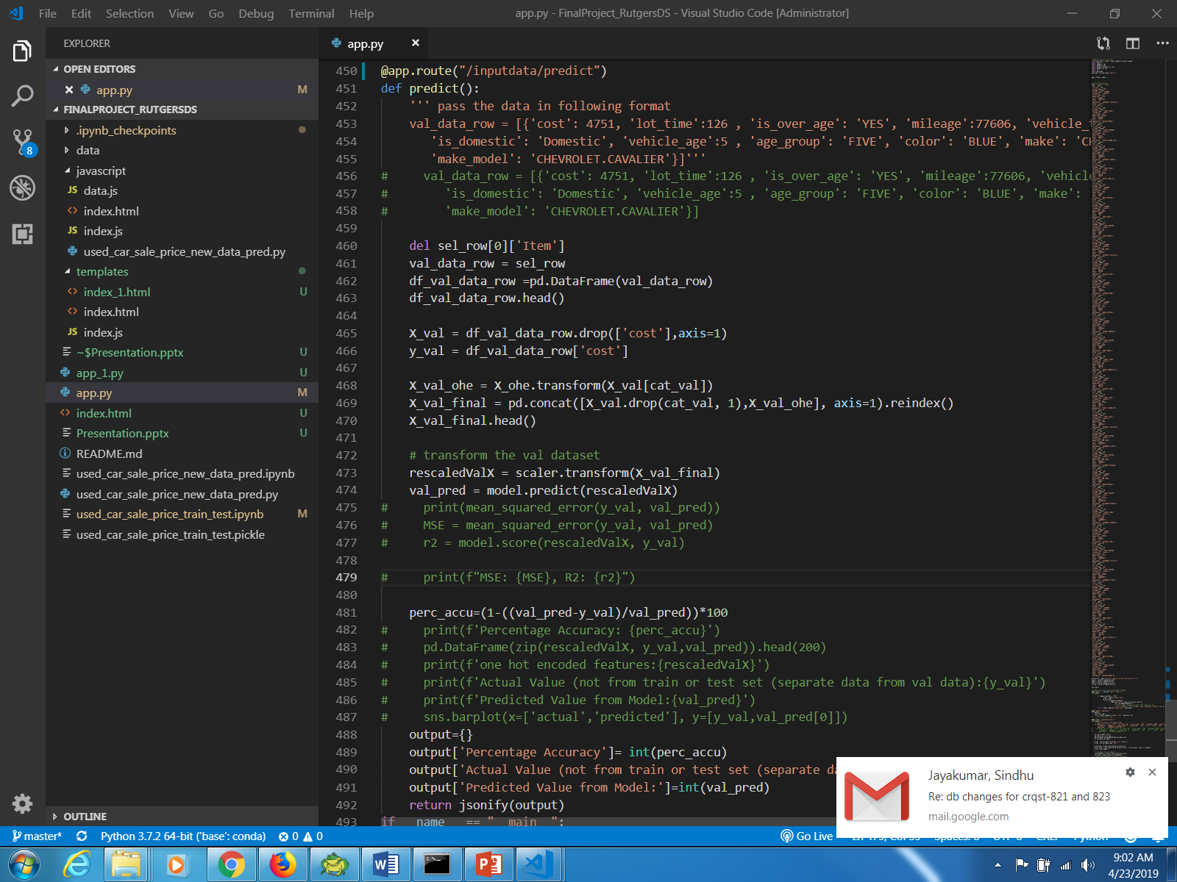
Flask code
(similar to jupyter notebook saw earlier to predict data on new row selected)

Slide 25
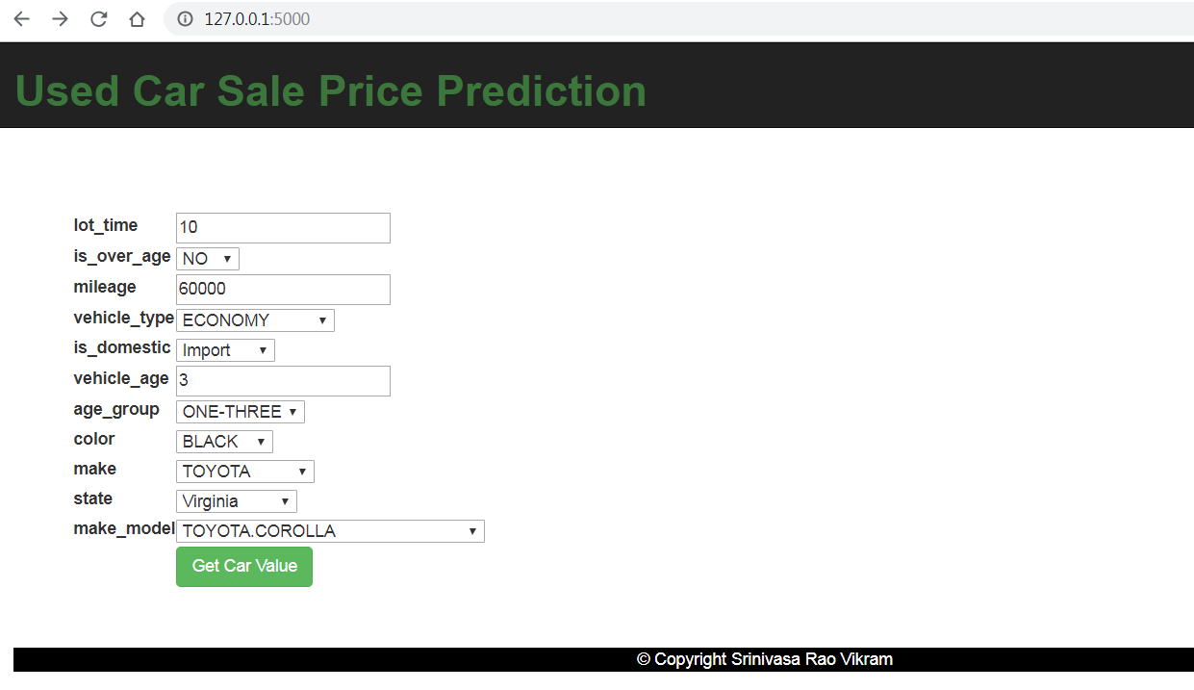
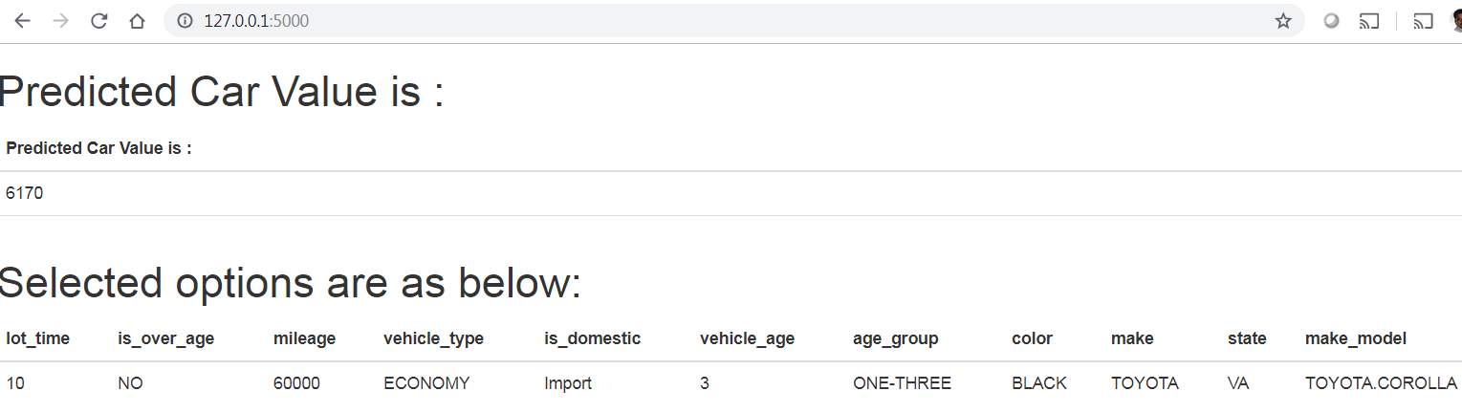
Flask App For entering new data and get predicted car value

Slide 26
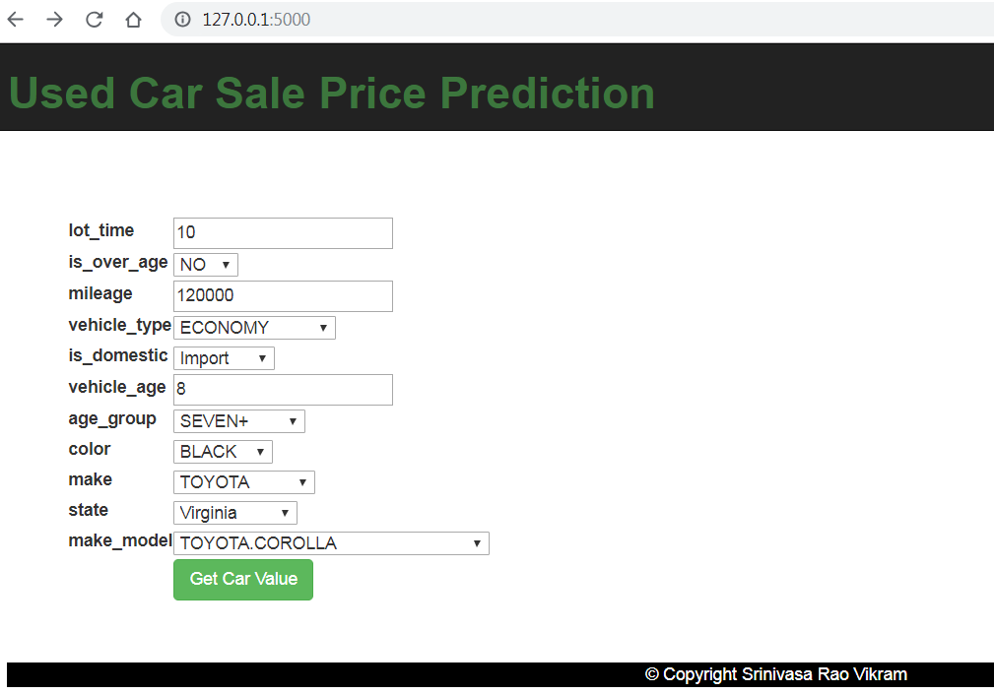
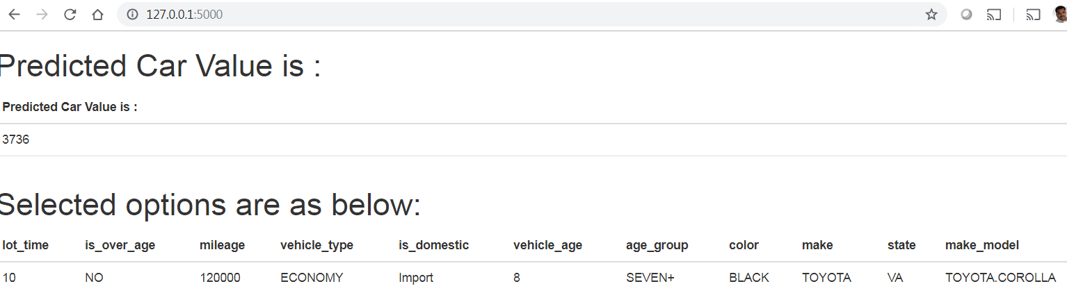
Flask App For entering new data and get predicted car value

Slide 27
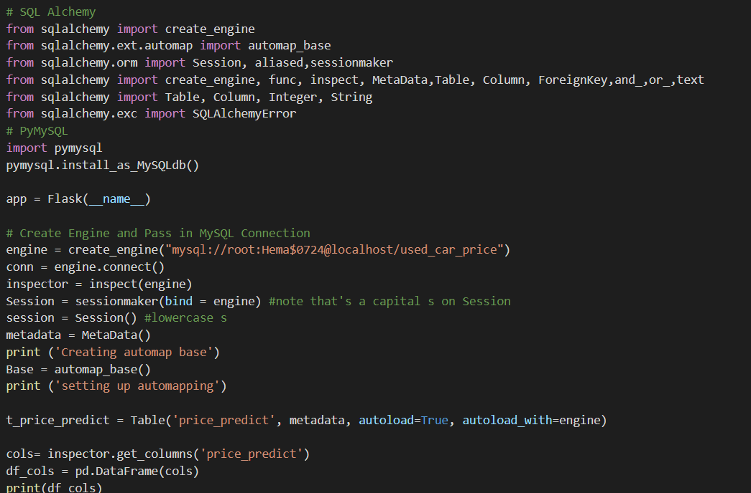
SQL Alchemy AutoMap Base

Slide 28
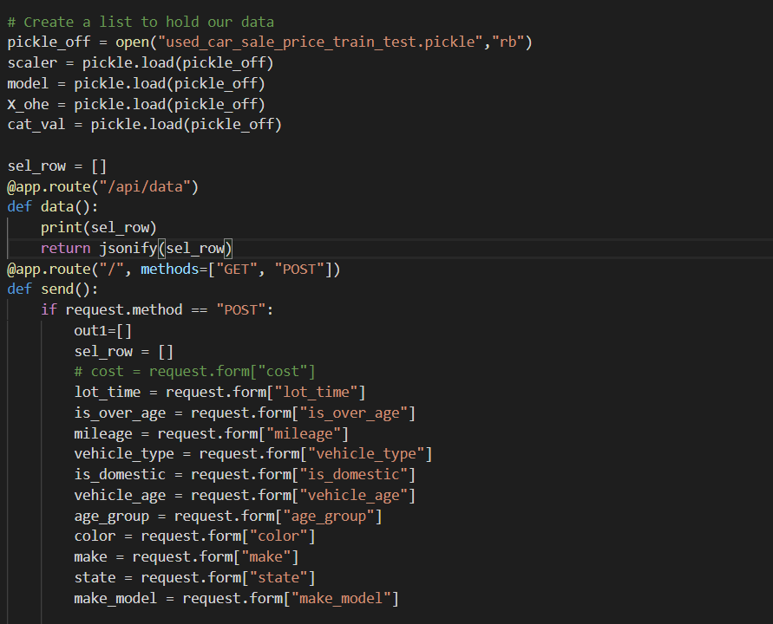
Pickle off model and create form witg required features for getting cost

Slide 29
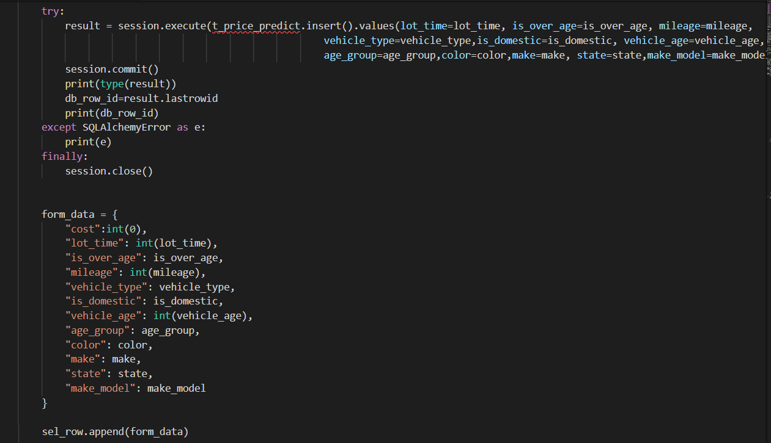
Insert into db using sql alchmey

Slide 30
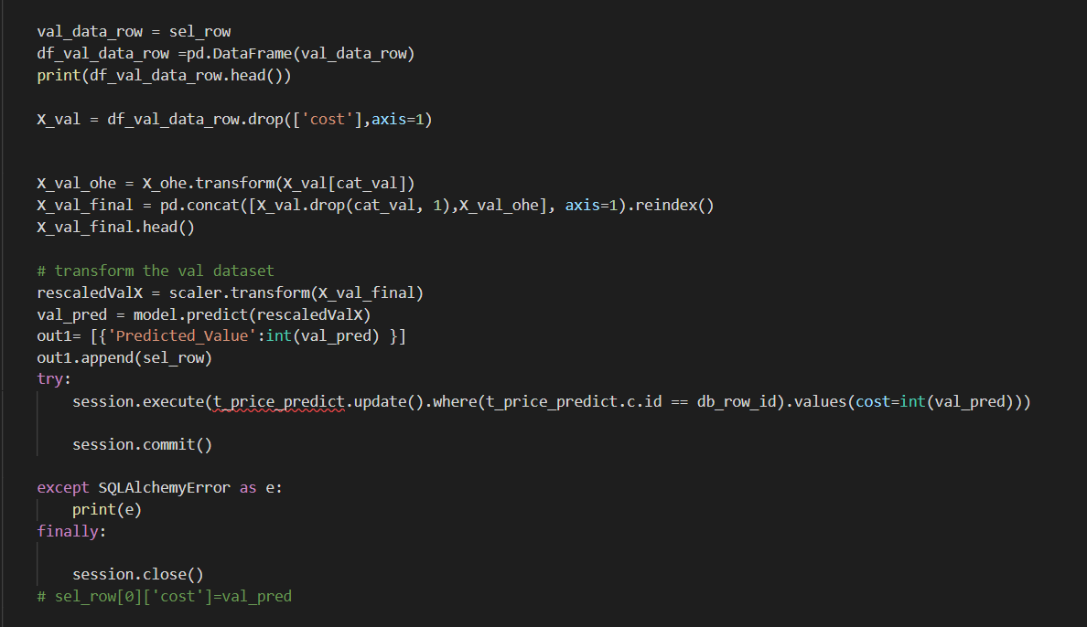
Predict cost on new features entered using pickle off object and update database cost field for
same row inserted above.

Slide 31
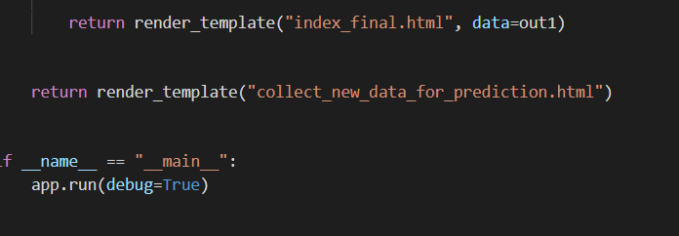
Render html if data entered is not null

Slide 32
Summary:
EDA to get some insights from graphs (like correlations between features , data distribution) etc.
Simple model has three steps.
import, initialize ,fit and predict
But Explored more robust modelling wrt to data interaction (as modelling is empirical with each data set) using data preprocessing (standard scaler, minmax scalar etc.), pipeline to combined multiple steps like scaling, model selection. Used OHE for categorical data. Used train_test_split and then k-fold cross validation to train the data. Used different hyper parameters for one of selected model with grid fit to get the bets parameter values and finalized the model based on best hyper parameters.

Slide 33
Future Scope:
Add handlers or explore a way for unseen new categorical data.
Add more validation to form during data entry like not null validations, cross field validations and tool tips.
Use similar approach with different model_selction classifiers for classification problem.

