Slide 1
20_Tableau_Homework_2
File created on: 4/16/2019 9:04:04 AM

Slide 2
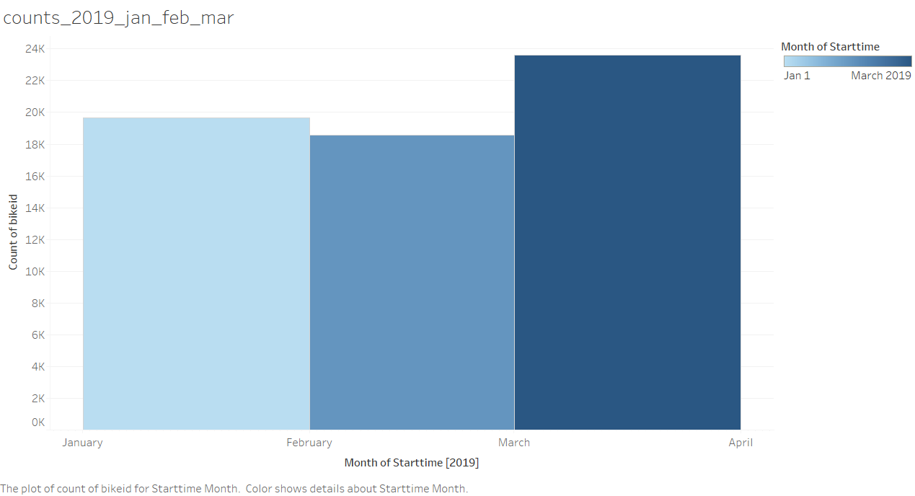

Slide 3
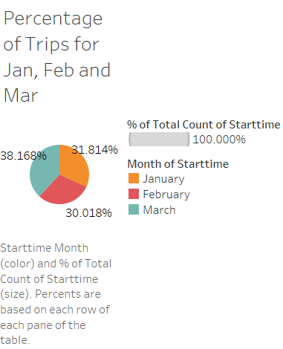

Slide 4


Slide 5
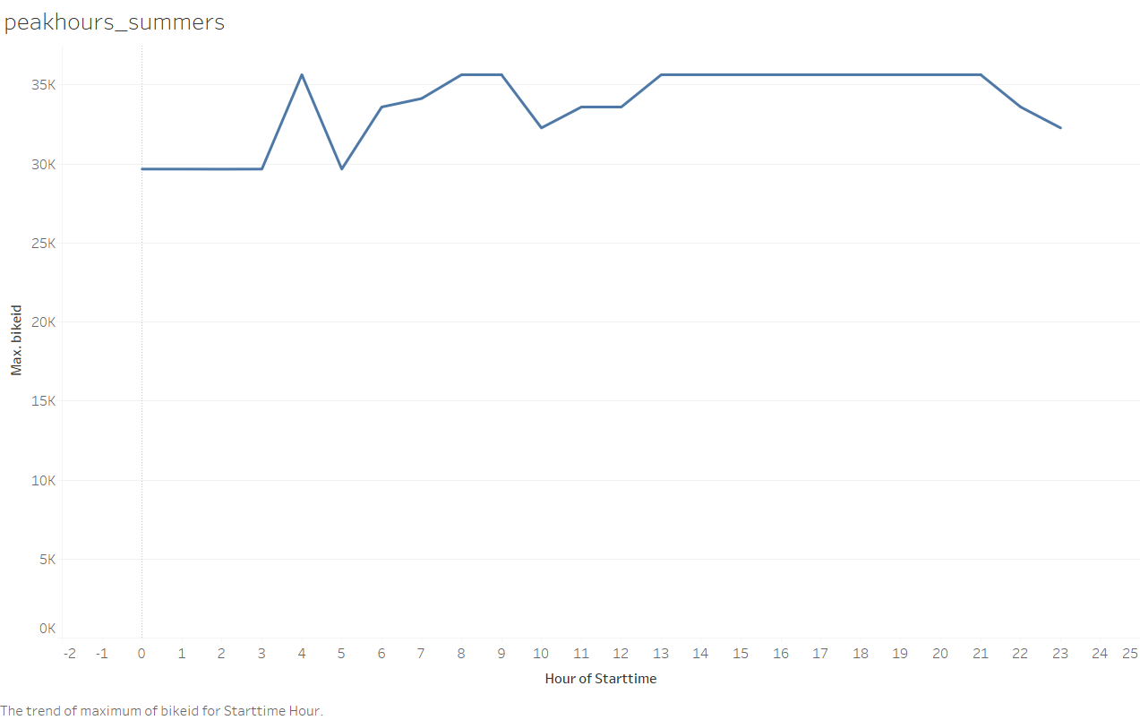

Slide 6


Slide 7
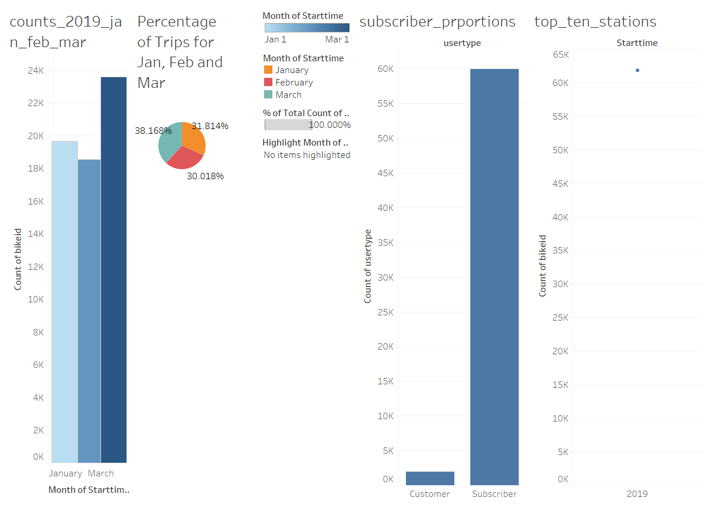

Slide 8
