Slide 1

SaafHawa
صاف ہوا
Air-quality data, turned into a decision you
can act on — in your language.
An AI layer over public air data for air-sensitive households in Lahore, Karachi & Islamabad.
Bilingual (EN + اردو) · Per-household advice · Ask-anything · Offline-safe
Theme: Technology for Civic Good · Open Data & Access to Information
Team SaafHawa · AI for Civic Innovation Hackathon 2026
Notes:
Lead with the personal story: pollen + Lahore smog turn an ordinary school run into a guessing game. Then: existing apps give you a number; SaafHawa gives you the decision. Say the one-line tagline out loud.

Slide 2
A number is not an answer.
Caregivers can see today's AQI. What they can't see is what to do about it.
1
The number is jargon
2
One size fits nobody
“AQI 168” means nothing to a parent deciding on the morning school run.
A toddler, an asthmatic grandparent, and a healthy adult need different advice — apps give one.
3
Language barrier
4
Decisions made blind
Guidance, when it exists, is English-only. Most caregivers think in Urdu.
Walks, open windows, school runs — taken daily without knowing the real risk.
Notes:
Hit the 'blind decisions' point hardest — it's the emotional core. Tie back to your own allergy/pollen experience: you've made these calls without good information.

Slide 3
SaafHawa turns the number into a plan.
Tell it who's home. It reads today's local air and answers in plain English and Urdu.
Per-household advice
One-line verdict + steps
Profiles for child, elderly, pregnant, allergy, heart/lung, outdoor worker — each changes the plan.
A clear verdict, 3–4 concrete actions, and the why — generated live for today's air.
Bilingual by default
Ask-anything chat
Every verdict in English and Urdu (Nastaliq) — not a translation toggle, a first-class output.
“Safe to walk to school now?” — answered, grounded in your air level and household.
Notes:
Frame the differentiator in one breath: existing apps show data; SaafHawa interprets it per person, in local language, instantly. The bilingual + per-household combo is what no one else does.

Slide 4
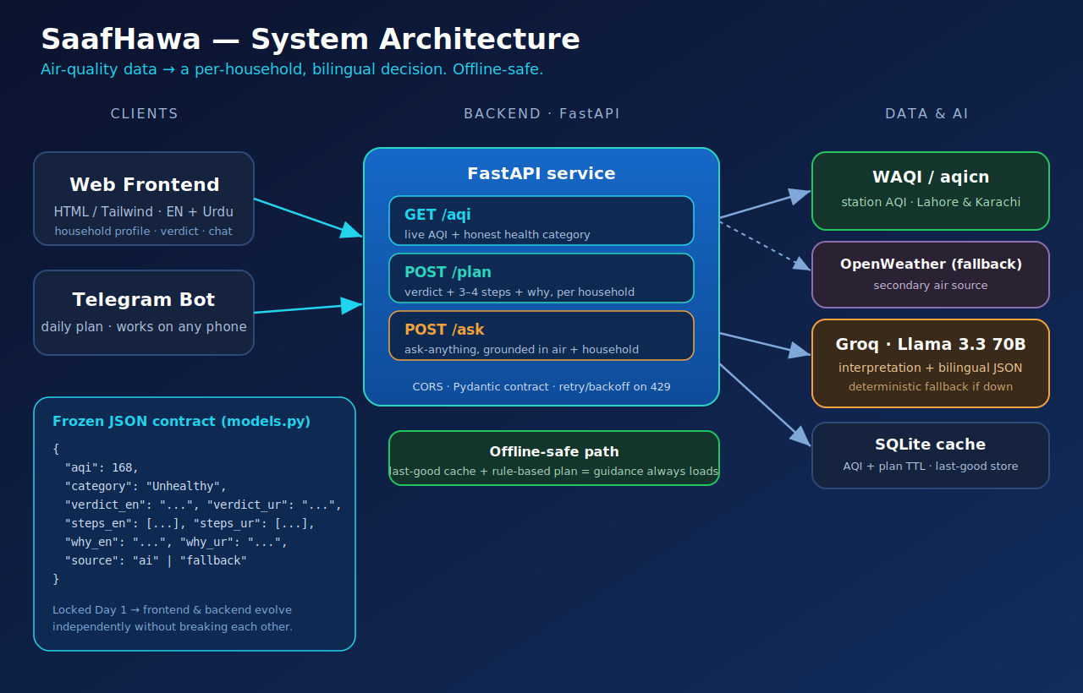
How it works
FastAPI · WAQI air data · Groq Llama 3.3 70B · SQLite — three endpoints, one frozen JSON contract.
Notes:
Don't read the diagram. Say: live air in, AI interpretation out, cached, with a fallback at every hop so the demo never shows a blank screen. Point at the green 'offline-safe' box — that's your reliability story for Q&A.

Slide 5
Live: one number → one decision
AQI
Household: young child + pollen allergy
168
Keep your child indoors until noon — mask the school run.
→
Close windows in peak hours · rinse off pollen after coming in.
Unhealthy
بچے کو دوپہر تک گھر کے اندر رکھیں
What's next
Live sensor integration
WhatsApp / SMS
Next-day forecast
More cities
Already built: live data, bilingual AI verdicts, household profiles, ask-anything, Telegram bot, offline fallback.
Notes:
Run the real app here, not the slide. If Wi-Fi fails, switch to the recorded backup video immediately — don't troubleshoot live. Change the household toggle on stage so judges SEE the advice change. End on 'built, not planned'.

Slide 6
Impact & scalability
Open public data, turned into protection for the citizens most exposed to polluted air.
Who benefits
Civic impact
Air-sensitive households in Lahore, Karachi & Islamabad — young children, elderly, pregnant members, pollen/asthma, heart & lung conditions, outdoor workers.
Technology for Civic Good + Open Data & Access to Information — making data citizens already pay for transparent and actionable, in their own language.
How it scales
By city
By reach
By language
By cost
Any location with a public AQI station — config, not code.
Telegram + planned WhatsApp/SMS — any phone, no app needed.
Bilingual layer generalizes to more local languages.
Free stack (open API, free-tier LLM, SQLite) — near-zero to run.
Notes:
This is your feasibility/scalability answer for the judges. Lead with who benefits (the most vulnerable), then the two civic themes, then the four scale axes — emphasize WhatsApp/SMS reaching phones without an app, and the zero-cost stack.

Slide 7
Built for the people who feel the air first.
A number most people can't act on, turned into a clear decision — in their language.
3
6
EN + اردو
100%
cities live
household profiles
every verdict
offline-safe
SaafHawa · صاف ہوا · github.com/mmoneka11/saafhawa
Notes:
Close on the mission line, then the stats, then invite questions. Have the repo link and the architecture slide ready for the technical Q&A on data accuracy and scaling.

