Slide 1
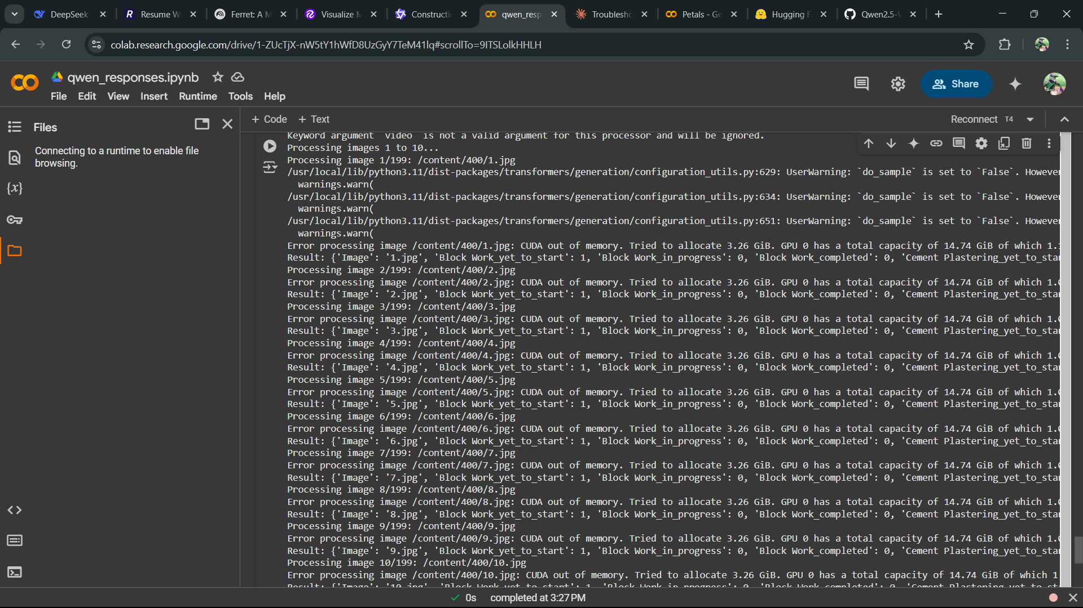
QWEn 2.5 vl 7b
CUDA runs out of memory everytime when tried to run it even locally as well as in colab

Slide 2
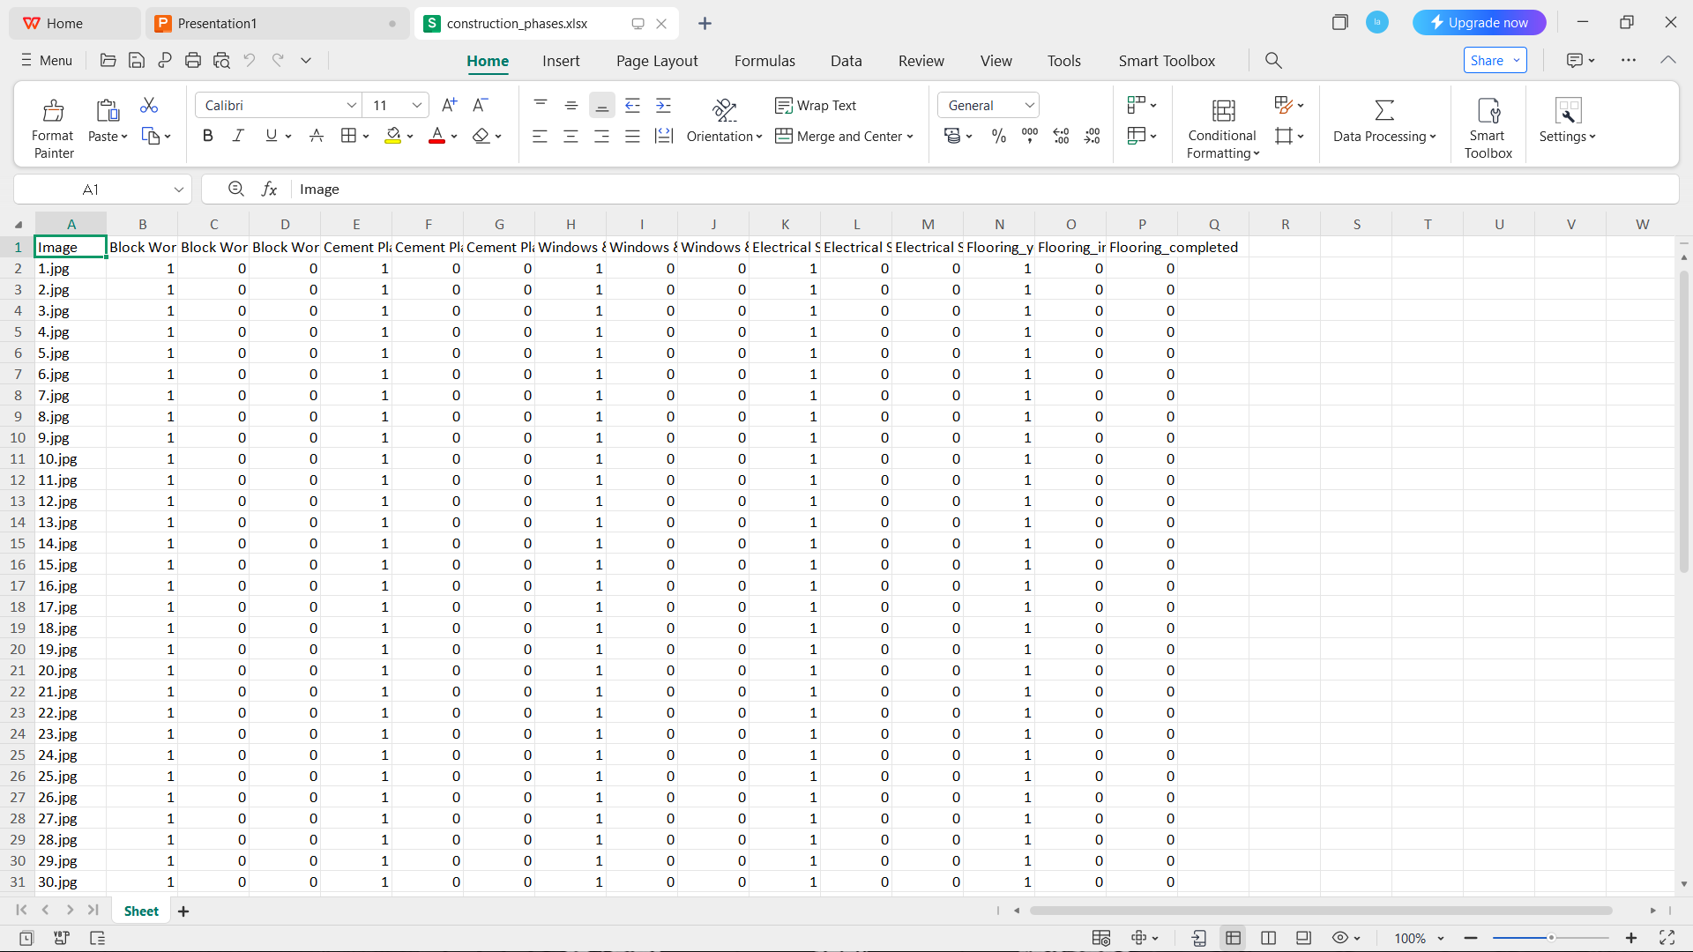
qwen 2.5 vl 3b
This model run but every output is the same

Slide 3
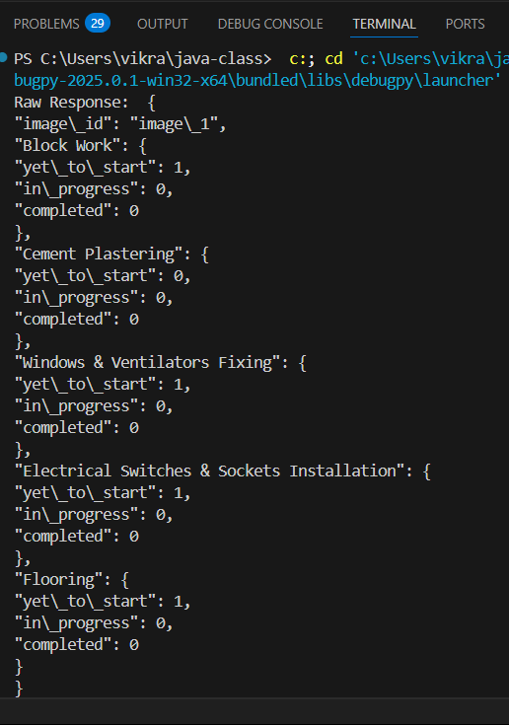
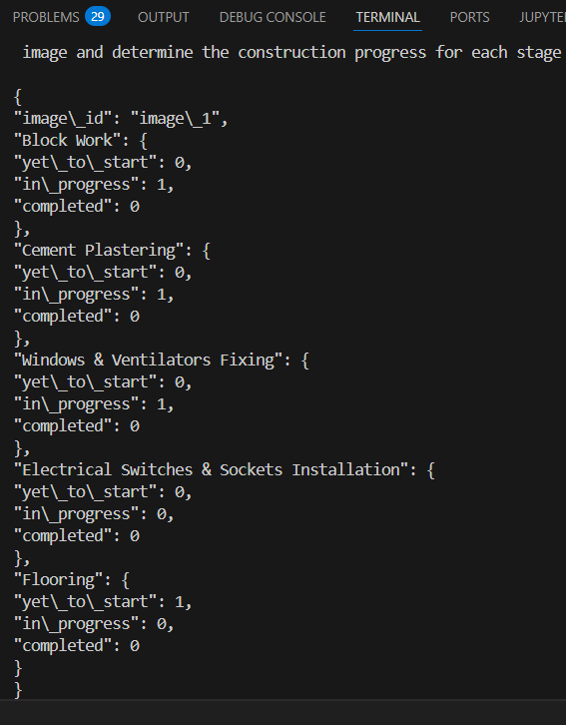
llava
Gives different inference for the same and both are wrong sometimes

Slide 4
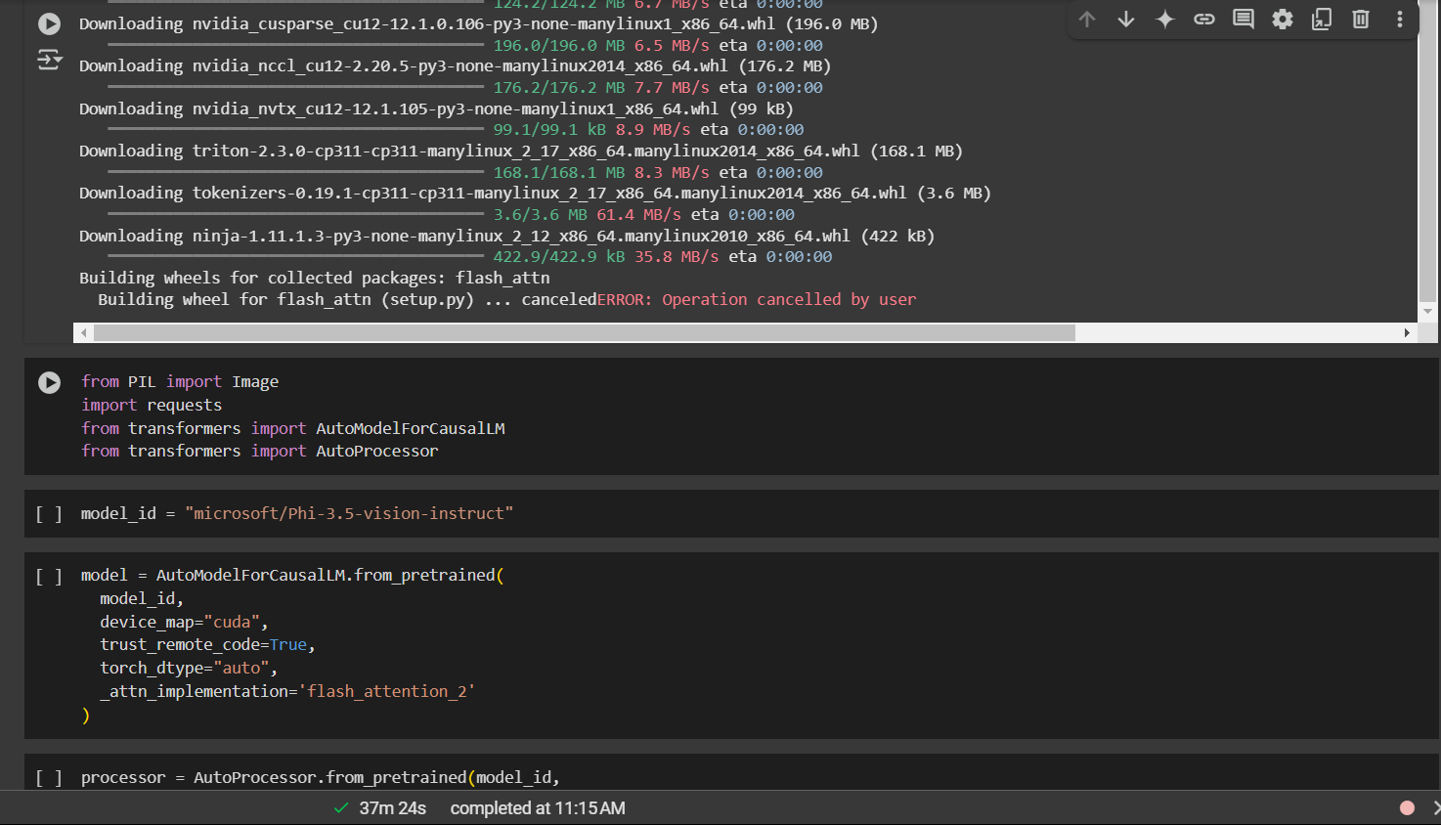
Phi3.5 vision instruct
This requires flash attention and this cant be installed locally but works some time in colab and does not work mostly and keeps on running.

Slide 5
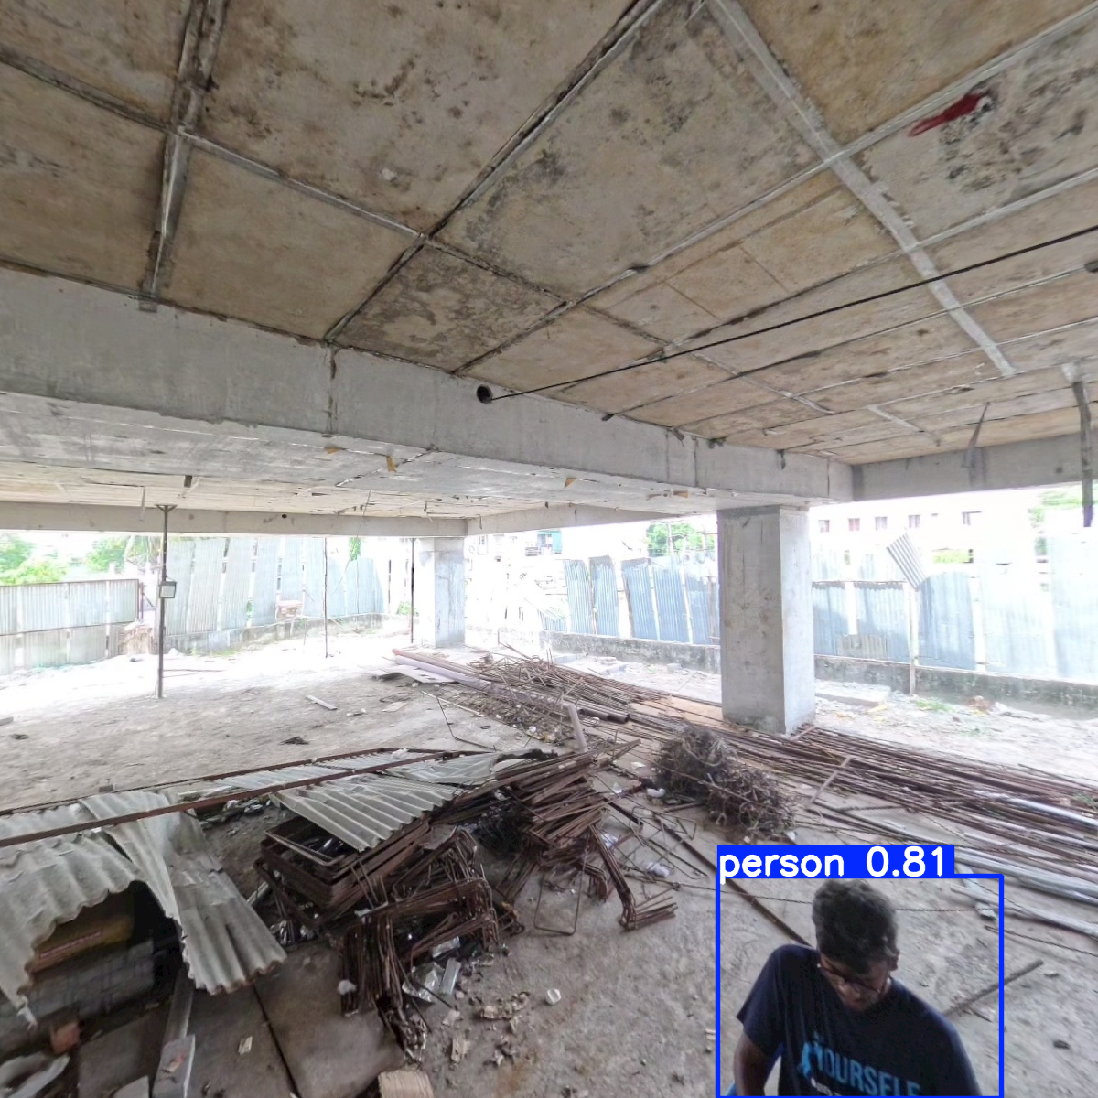
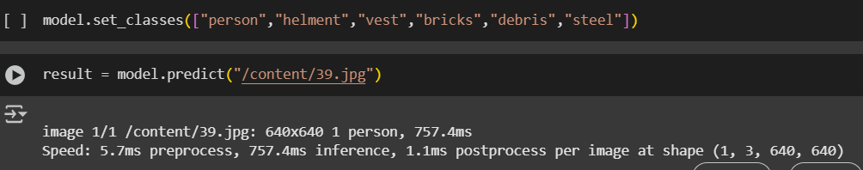
yolo world
This works for finding the common classes and for the classes we need we may need to reduce the confidence values

