Slide 1
BrewBean Coffee Shop Sales Analytics
Excel Business Analytics Project

Slide 2
1. Business Problem & Objective
BrewBean Cafe operates multiple coffee shop outlets across Tamil Nadu.
Business challenges: inconsistent sales, varying outlet performance, peak-hour congestion and fluctuating profitability.
Objective: analyze revenue trends, outlet performance, customer behaviour, product performance and promotional effectiveness.
Goal: provide evidence-based recommendations to improve sales, profitability and customer satisfaction.
2. Data Sources
Sales Transactions — transaction-level sales, customers, products, revenue, profit, payment mode, promotions, ratings and order status.
Inventory — opening stock, received stock, units sold, closing stock, wastage and reorder information.
Product Master — product, category, size, cost price, selling price, margin, supplier and shelf life.
Outlet Master — outlet, city, district, seating capacity, employees, targets, rent and operating information.
Promotions — campaign, dates, discount, applicable category/outlets, expected sales increase and business objective.

Slide 3
3. Data Cleaning Process
Created separate Raw and Cleaned sheets for Sales, Inventory, Product, Outlet and Promotions.
Sales: removed duplicate Transaction_ID records; restored the valid unique transaction so the cleaned dataset contains 800 transactions.
Filled blank Membership values with 'Non-Member'; standardized Payment Mode values such as GooglePay/GPay to 'Google Pay’.
Standardized Transaction_Date using Date/DMY conversion; checked Quantity, Selling Price, Revenue and Profit.
Kept Customer_Rating blanks because ratings were optional/missing rather than inventing values.
Created Sales_Valid to distinguish Completed and Cancelled transactions for reliable sales KPIs.
4. Data Quality Validation
Sales Transactions — transaction-level sales, customers, products, revenue, profit, payment mode, promotions, ratings and order status. Inventory — opening stock, received stock, units sold, closing stock, wastage and reorder information. Product Master — product, category, size, cost price, selling price, margin, supplier and shelf life.
Outlet Master — outlet, city, district, seating capacity, employees, targets, rent and operating information.
Promotions — campaign, dates, discount, applicable category/outlets, expected sales increase and business objective.

Slide 4
5. Data Model & Relationships
Product → Sales relationship: Cleaned_Product_Table[Product_ID] (1) to Cleaned_Sales_Table[Product_ID] (*).
Outlet → Sales relationship: Cleaned_Outlet_Table[Outlet_ID] (1) to Cleaned_Sales_Table[Outlet_ID] (*).
Product → Inventory relationship: Cleaned_Product_Table[Product_ID] (1) to Cleaned_Inventory_Table[Product_ID] (*).
Outlet → Inventory relationship: Cleaned_Outlet_Table[Outlet_ID] (1) to Cleaned_Inventory_Table[Outlet_ID] (*).
Promotions were not directly related because Applicable_Outlets could contain multi-value applicability and campaign usage was incomplete.
6. Analysis Process
Used PivotTables with Sales_Valid = Yes ,so cancelled transactions were excluded from sales KPIs.
BQ1: Outlet_Name vs Revenue and Profit.
BQ2: Product_Name vs Quantity, filtered to Top 5 products.
BQ3: Created Transaction_Hour using HOUR(Transaction_Time), then analyzed transaction count by hour.
BQ4: Promotion vs Revenue; BQ5: Membership vs Revenue; BQ6: Payment_Mode vs completed transaction count.
BQ7: Product_Name vs Average Customer_Rating; BQ8: outlet performance to identify operational priorities.

Slide 5
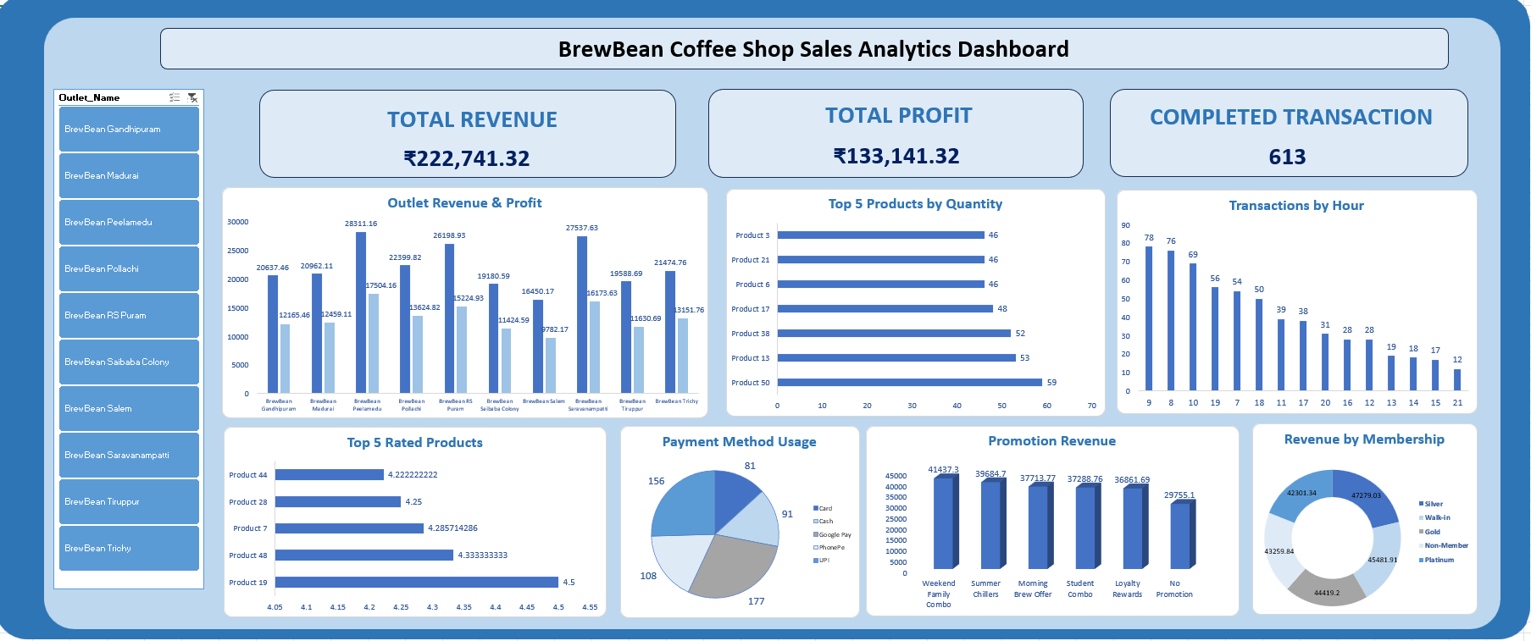
7. Dashboard Development Process
Added KPI cards: Total Revenue ₹222,741.32; Total Profit ₹133,141.32; Completed Transactions 613.Added charts for Outlet Revenue & Profit, Top 5 Products, Transactions by Hour, Promotion Revenue, Membership Revenue, Payment Method Usage and Top 5 Rated Products. Added an Outlet_Name slicer and connected it to relevant PivotTables to make the dashboard interactive. Formatted chart titles, layout, gridlines and dashboard presentation for stakeholder use.

Slide 6
8. Key Business Findings
Peelamedu is the highest-revenue and highest-profit outlet: ₹28,311.16 revenue and ₹17,504.16 profit.
Product 50 is the top-selling product with 59 units.
9 AM is the busiest hour with 78 completed transactions; 7 AM–10 AM is the main peak period.
Weekend Family Combo has the highest promotion-linked revenue at ₹41,437.30.
Silver membership has the highest revenue at ₹47,279.03.
Google Pay is the most-used payment method with 177 completed transactions.
Product 19 has the highest average rating at 4.50/5.
9. Recommendations
Peak-hour operations: increase staffing and service capacity during 7–10 AM to reduce waiting time and congestion.
Outlet performance: prioritize BrewBean Salem for an operational review; also monitor Saibaba Colony and Tiruppur.
Promotional strategy: continue and optimize Weekend Family Combo and evaluate similar family-oriented offers.
Product strategy: maintain sufficient stock and visibility for high-demand products and promote highly rated products.
Use the interactive dashboard regularly to monitor outlet performance and identify emerging operational gaps.

