Slide 1
Olist E-Commerce Analytics
Milestone Project — Project Explanation
End-to-end analysis using Python, Excel, MySQL, Statistics, Power BI and AI-assisted analytics
1

Slide 2
1. Business Problem & Objective
Leadership needs one unified view of customers, revenue, products, sellers, payments and operations.
The project converts raw e-commerce data into business KPIs, trends, diagnostics and recommendations.
Main objective: support data-driven decisions on growth, customer experience and operational performance.
The analysis follows six business areas: Customer, Revenue, Product, Seller, Customer Experience and Operations.
2

Slide 3
2. Dataset & Data Model
Seven mandatory Olist datasets were used.
Customers → Orders through customer_id.
Orders → Order Items, Payments and Reviews through order_id.
Order Items → Products through product_id and → Sellers through seller_id.
The cleaned datasets were used consistently across SQL, statistics and Power BI.
Customers
99,441
Orders
99,441
Order Items
112,650
Products
32,951
Payments
103,886
Sellers
3,095
3

Slide 4
3. Data Cleaning & Quality Assessment
Raw files were preserved and separate cleaned copies were created.
Dates were converted to datetime and delivery_delay_days was derived.
Missing lifecycle dates were retained when they were meaningful to order status.
Missing product attributes and optional review text were retained rather than artificially filled.
Referential integrity was validated across the seven datasets.
No exact duplicate rows were found; repeated review_id values were retained because the records were not exact duplicates.
4

Slide 5
4. MySQL Analytics
Created an analytical relational database with seven connected tables.
Validated table counts and relationships.
Used JOINs, aggregations, GROUP BY, filtering and subqueries.
Key analyses included revenue by state, top categories, top sellers, repeat customers, monthly revenue, payment type and review distribution.
SQL outputs were used as evidence for business insights.
5

Slide 6
5. Statistical Analysis — Key Results
Average Order Revenue
137.75
Median Order Revenue
86.90
Average Review Score
4.09 / 5
Price–Freight Correlation
0.4142
Revenue Outliers
7.96%
Repeat Customers
3.12%
6

Slide 7
6. Customer Intelligence — Main Finding
93,099 customers are one-time customers (96.88%).
2,997 customers are repeat customers (3.12%).
This indicates a major retention opportunity.
One-time customer mean order revenue: 138.62.
Repeat customer mean order revenue: 124.91.
This difference is descriptive; it should not be interpreted as proof that repeat customers are less valuable overall.
7

Slide 8
7. Revenue Intelligence
Total dashboard revenue: approximately 13.59M.
Average Order Value in the dashboard: 136.68.
Revenue is concentrated strongly in leading customer states, with São Paulo contributing the largest share.
Payment analysis shows credit card as the dominant payment type.
Revenue trend and state-level contribution help identify where commercial focus should be placed.
8

Slide 9
8. Product & Seller Intelligence
Product analysis identifies the highest-revenue categories and categories with the largest product counts.
Top revenue categories include beleza_saude, relogios_presentes and cama_mesa_banho.
Seller analysis compares revenue, order volume, seller state and average seller order value.
These views help distinguish product demand from seller contribution.
9

Slide 10
9. Customer Experience & Operations
Average review score: 4.09 / 5.
Dashboard delivery rate: 97.02%.
Delayed orders: approximately 7K in the dashboard.
Average delivery delay among delayed orders: 10.62 days.
The statistical report's overall average delivery delay is -11.8769 days; negative values indicate delivery earlier than the estimated date.
Operational trends show how order volume and delivery performance change over time.
10

Slide 11
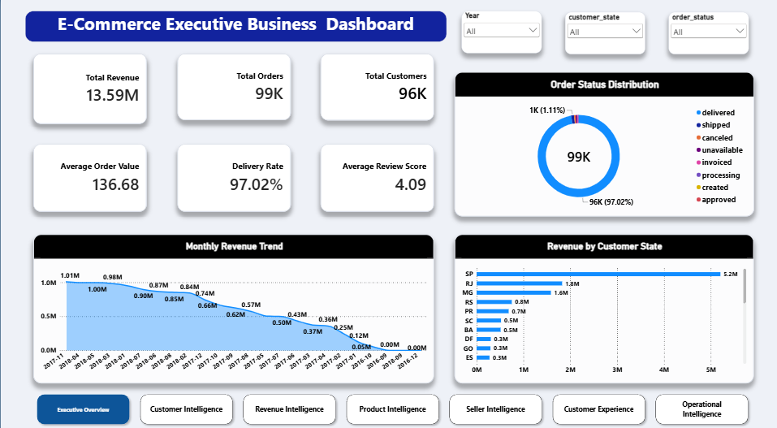
10. Power BI Executive Dashboard
11

Slide 12
11. Dashboard Structure
Page 1 — Executive Overview: overall KPIs, order status, revenue trend and state contribution.
Page 2 — Customer Intelligence: customer geography, revenue, customer type and repeat rate.
Page 3 — Revenue Intelligence: revenue trend, category revenue, payment mix and freight.
Page 4 — Product Intelligence: category revenue, orders and product count.
Page 5 — Seller Intelligence: seller revenue, orders, state contribution and seller AOV.
Page 6 — Customer Experience: reviews and delivery-delay analysis.
Page 7 — Operational Intelligence: order lifecycle, delivery rate and monthly operations.
12

Slide 13
12. Analytical Differentiation
Primary analytical lens: Customer Retention & Loyalty Analyst.
Unique KPI: Repeat Customer Rate / Repeat Purchase Ratio.
Hypothesis 1: One-time and repeat customers have different order-revenue distributions.
Hypothesis 2: Delivery performance may be associated with customer satisfaction.
Hypothesis 3: Certain regions contribute disproportionately to revenue.
AI was used for alternative interpretations and recommendation refinement, with claims validated against project evidence.
13

Slide 14
13. Business Recommendations
1. Prioritize retention: create actions that encourage a second purchase and track repeat-purchase conversion.
2. Diagnose the post-purchase journey: use delivery and review signals to identify barriers to repeat activity.
3. Focus commercial resources: prioritize high-contribution regions, products and sellers using measurable revenue outcomes.
14

Slide 15
14. If I Were the Business Head
Priority 1 — Improve repeat-purchase conversion from the 3.12% baseline.
Priority 2 — Investigate customer journey barriers after the first order.
Priority 3 — Allocate resources toward the strongest regional, product and seller opportunities.
Expected impact: stronger customer lifetime value potential, better resource allocation and more targeted operational improvement.
Risk: retention actions should be tested carefully rather than assuming correlation implies causation.
15

Slide 16
Final Takeaway
The project turns raw e-commerce data into a unified business view and identifies customer retention as the clearest strategic opportunity.
The dashboard, statistical evidence, SQL analysis and AI-assisted validation support the recommendations.
16

