Slide 1
E-Commerce Sales Performance & Customer Churn Analysis
Objective
Analyze sales performance, customer value, retention behavior, and churn risk to identify opportunities for revenue growth and customer retention.
Key Performance Indicators
Total Sales: 2.30M
Total Profit: 286.40K
Total Orders: 5.009K
Total Customers: 793
Average Sales: 229.86
Sales Performance Highlights
Sales show an overall increasing trend from 2014 to 2017, with stronger performance in the later years.
Technology is the highest-selling category with approximately 836.15K (36.4%) of sales.
Furniture contributes approximately 742K (32.3%).
Office Supplies contributes approximately 719.05K (31.3%).
West is the highest-performing region based on total sales.
Canon imageCLASS 2200 Advanced Copier is the top-selling product
Customer Value – RFM Analysis
RFM segmentation was used to classify customers based on Recency, Frequency, and Monetary value.
Customer Segment | Revenue
Loyal Customers | 649.62K
Champions | 560.50K
At Risk | 497.50K
Potential Loyalists | 337.26K
New Customers | 159.39K
Lost | 92.93

Slide 2
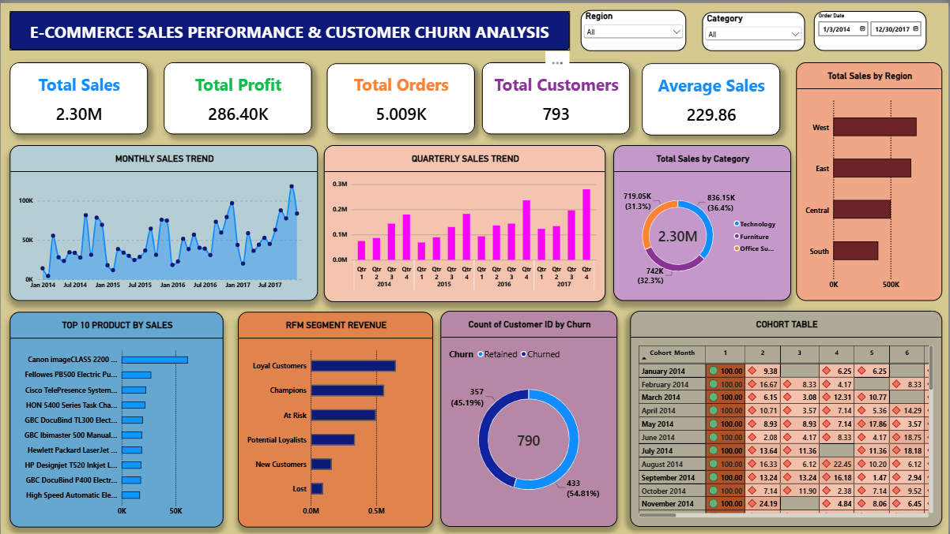
Cohort Retention Analysis
Customers were grouped according to their first purchase month.
Retention was tracked across subsequent months.
Month 1 is 100% by cohort definition.
Retention generally decreases as customers move further from their first purchase.
The Power BI cohort table helps identify periods where customer engagement declines.
Churn Prediction
A historical cutoff of October 1, 2017 was used to avoid target leakage.
Historical customer behavior was used to calculate Recency, Frequency, Monetary, Average Order Value, and Total Quantity.
Churn was defined as no purchase during the following 90 days.
357 customers (45.19%) were classified as churned.
433 customers (54.81%) were not churned.
A Decision Tree Classifier was used for churn prediction.
Business Recommendations
1. At Risk Customers Launch personalized offers and re-engagement campaigns before customers become Lost.
2. Loyal & Champion Customers Strengthen loyalty programs, cross-selling, bundles, and personalized recommendations.
3. Lost Customers Implement targeted win-back campaigns with relevant products and incentives.
4. Customer Retention Monitor cohort retention regularly to identify early engagement decline.
5. Management Monitoring Use the Power BI dashboard to track Sales, Profit, RFM, Churn, Region, Category, and Time-based KPIs.

