Slide 1




A GAN Framework for Instance Segmentation using the Mutex Watershed Algorithm
Mandikal Vikram¹ and Steffen Wolf²
15it217.vikram@nitk.edu.in, steffen.wolf@iwr.uni-heidelberg.de
¹National Institute of Technology Karnataka ²HCI/IWR Heidelberg University

Slide 2
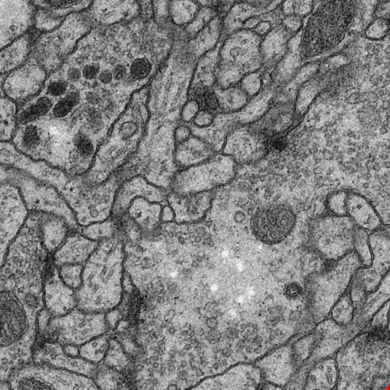
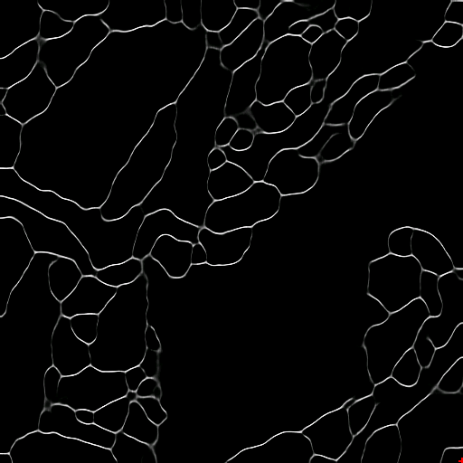
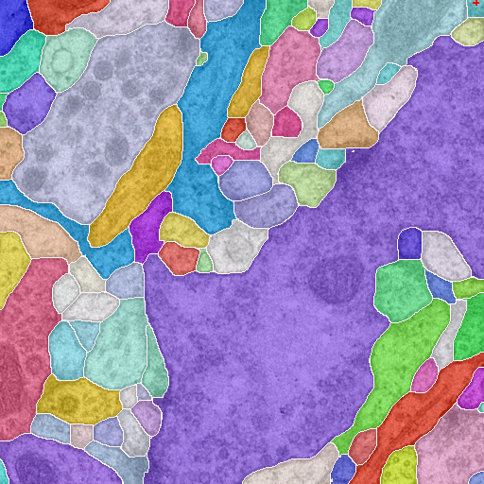
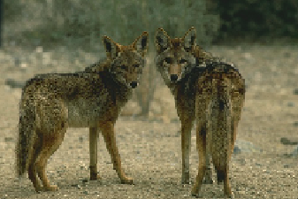
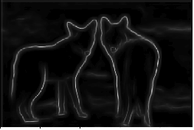
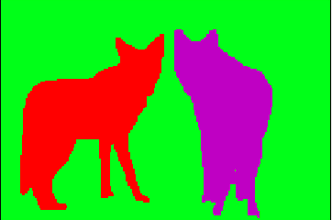
Instance Segmentation
raw
image
probability maps / affinities
segmentation

Slide 3
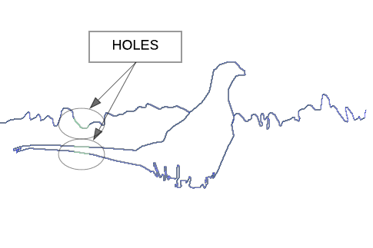
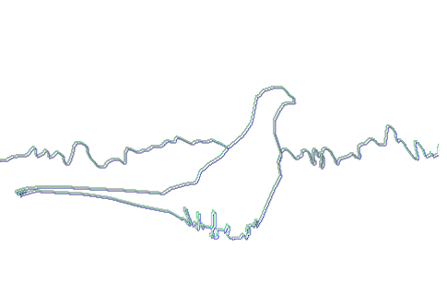


Why should we care about GANs?
Holes
Shift
Pixelwise loss
Trained Gan Discriminator

Slide 4
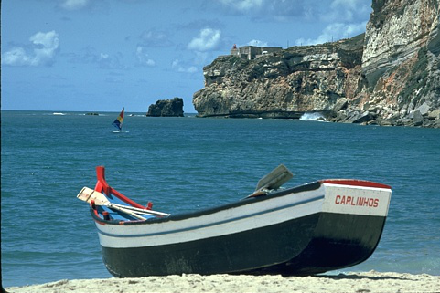
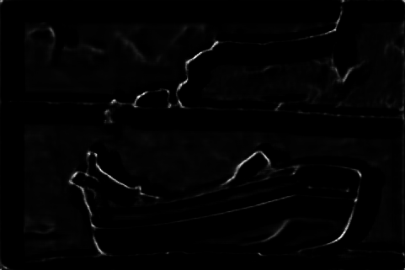
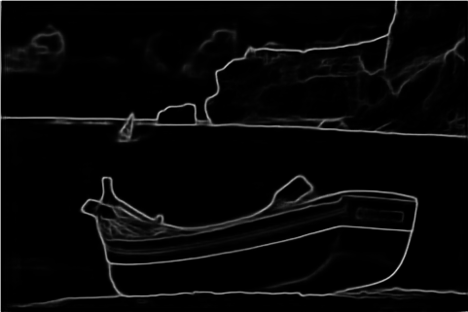
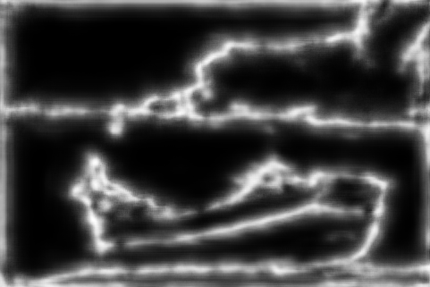
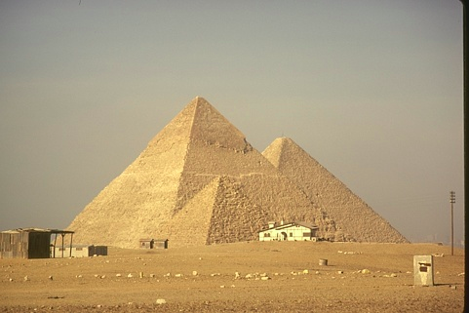
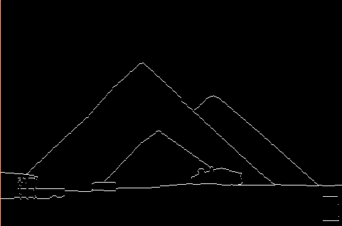

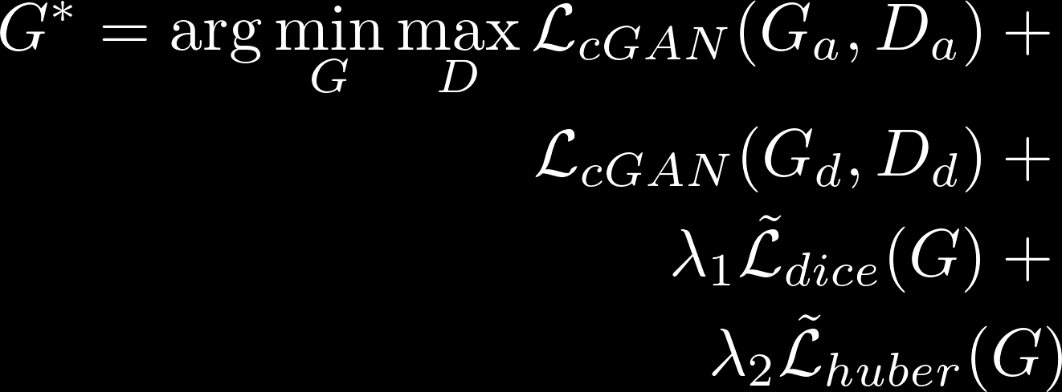
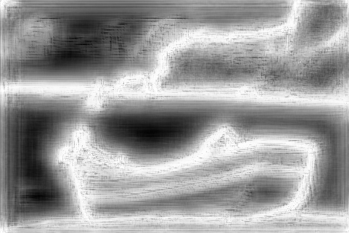
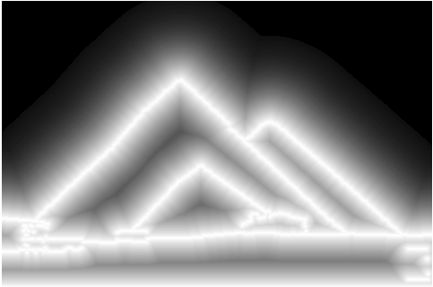

Train GAN on Closed Contours
Smooth Auxiliary Task
Pixelwise
Loss
Closed Contour Affinities
Smooth Distance Transform
Pixelwise
Loss

Slide 5
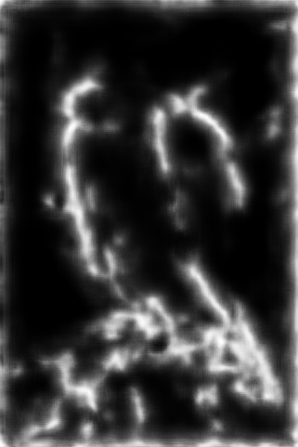
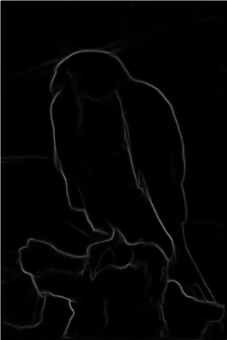
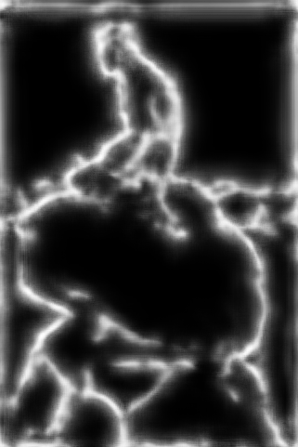
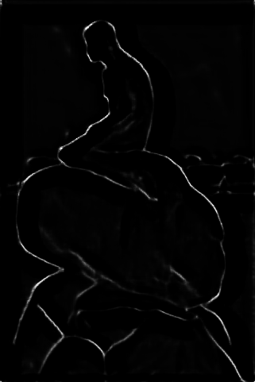
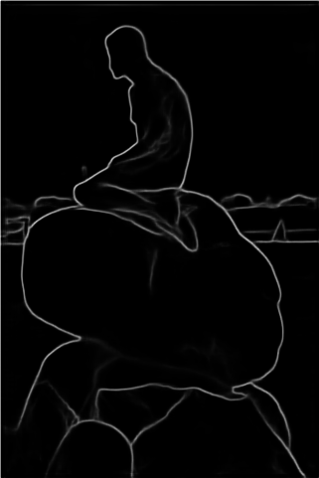
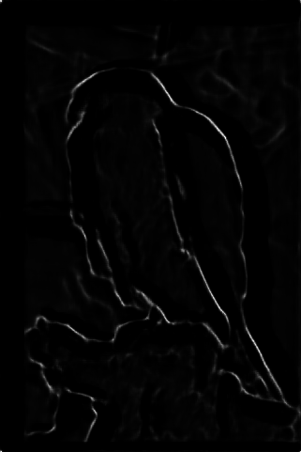
Results
Without Gan Loss
With Gan Loss
With Gan Loss
and Auxiliary Loss

Slide 6
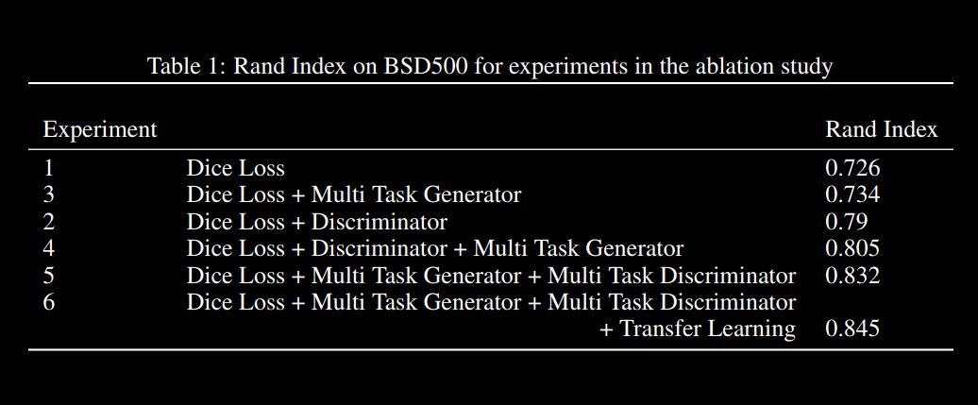
Results

Slide 7
Thank you!
Please visit our poster for more details

