Slide 1
AI RFI & Submittals Assistant
PROJECT 04 · AI PM PORTFOLIO
A concept AI layer for a Linarc-style construction platform, used by Canadian general contractors. Vikram Seenivasan · synthetic data.
Notes:
Project 04 is a concept AI feature for construction: it helps a general contractor's coordinator draft, check and route RFIs and submittals. The hero skill here is domain depth: knowing how construction paperwork moves, who carries the risk, and where AI should stop. Everything is built on synthetic data and is not an official Linarc product.

Slide 2
Rework, not reading, slows RFIs down
[01]// THE PROBLEM
~10
~35%
~1 in 5
working days
of submittals
RFIs
Average RFI turnaround on a mid-size build
Returned as revise and resubmit
Sent to the wrong reviewer first
Each bounced item adds days, and late answers leave trades idle on site. Figures are discovery hypotheses, to validate in five interviews.
Notes:
The biggest delay isn't reading time, it's rework: RFIs that bounce back incomplete, duplicates of earlier answers, and items sent to the wrong engineer. These baselines are hypotheses from discovery; the plan is to confirm them with two coordinators, a superintendent, a consultant and a subcontractor PM.

Slide 3




Four roles touch every RFI
[02]// WHO IT'S FOR
Project coordinator
Superintendent
Consultant
Subcontractor PM
Rewrites field notes and chases reviewers
Waits days for answers while trades sit idle
Gets incomplete or duplicate questions
Rejections for gaps he could have fixed
Notes:
The coordinator is the main user, but the design has to work for all four. The superintendent raises most questions, the consultant answers, and the subcontractor prepares submittals. The AI helps the coordinator send complete, correctly routed items so the consultant can answer first time.

Slide 4


The AI prepares the paperwork; people decide
[03]// SCOPE
The AI does
The AI never
Drafts RFIs from site notes
Answers a design question
Finds earlier answers
Approves a submittal
Suggests the reviewer, with a reason
Issues instructions or change orders
Pre-checks submittals against the spec
Changes contract price or time
Flags items close to due
These carry professional and contract liability.
Notes:
The scope line is the most important product decision. Under a CCDC 2 contract the consultant answers and only the owner and consultant change the work. So the AI sits in the contractor's preparation step: draft, check, route. Anything that is a design decision or changes cost or time stays with people.

Slide 5
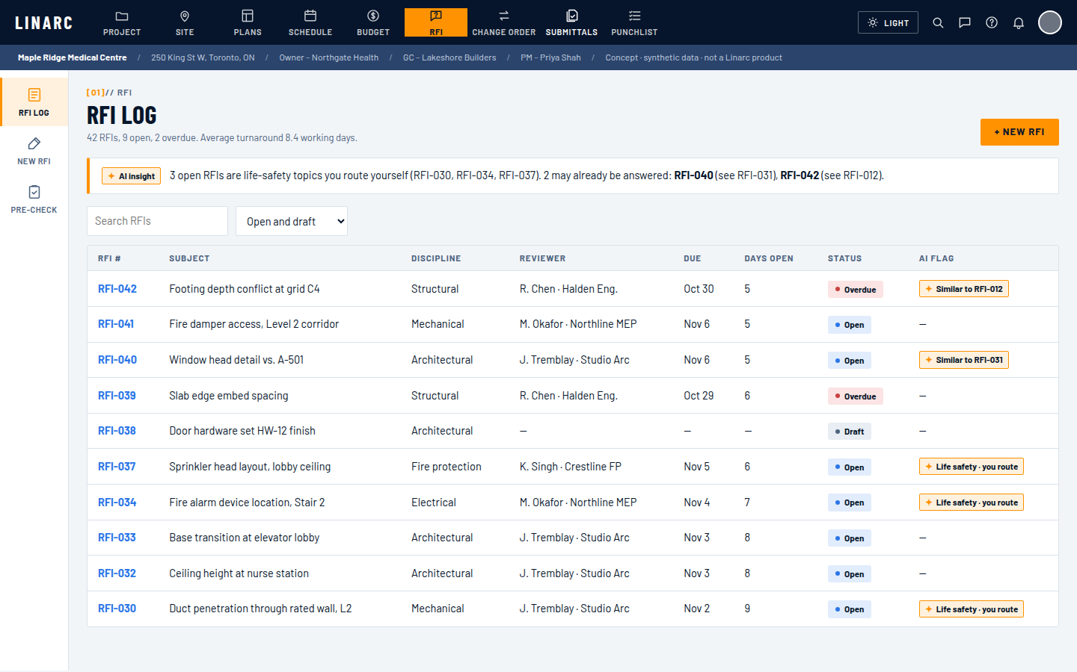
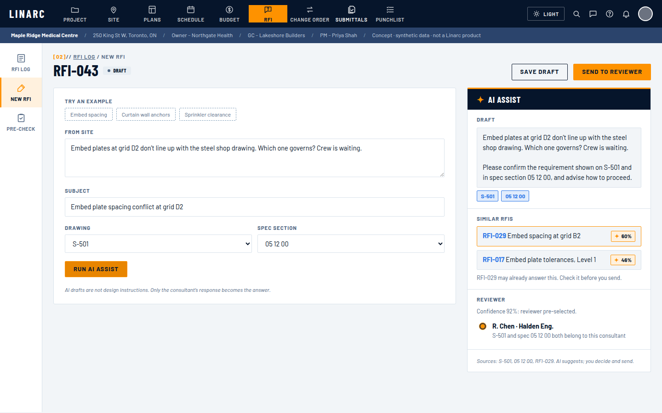
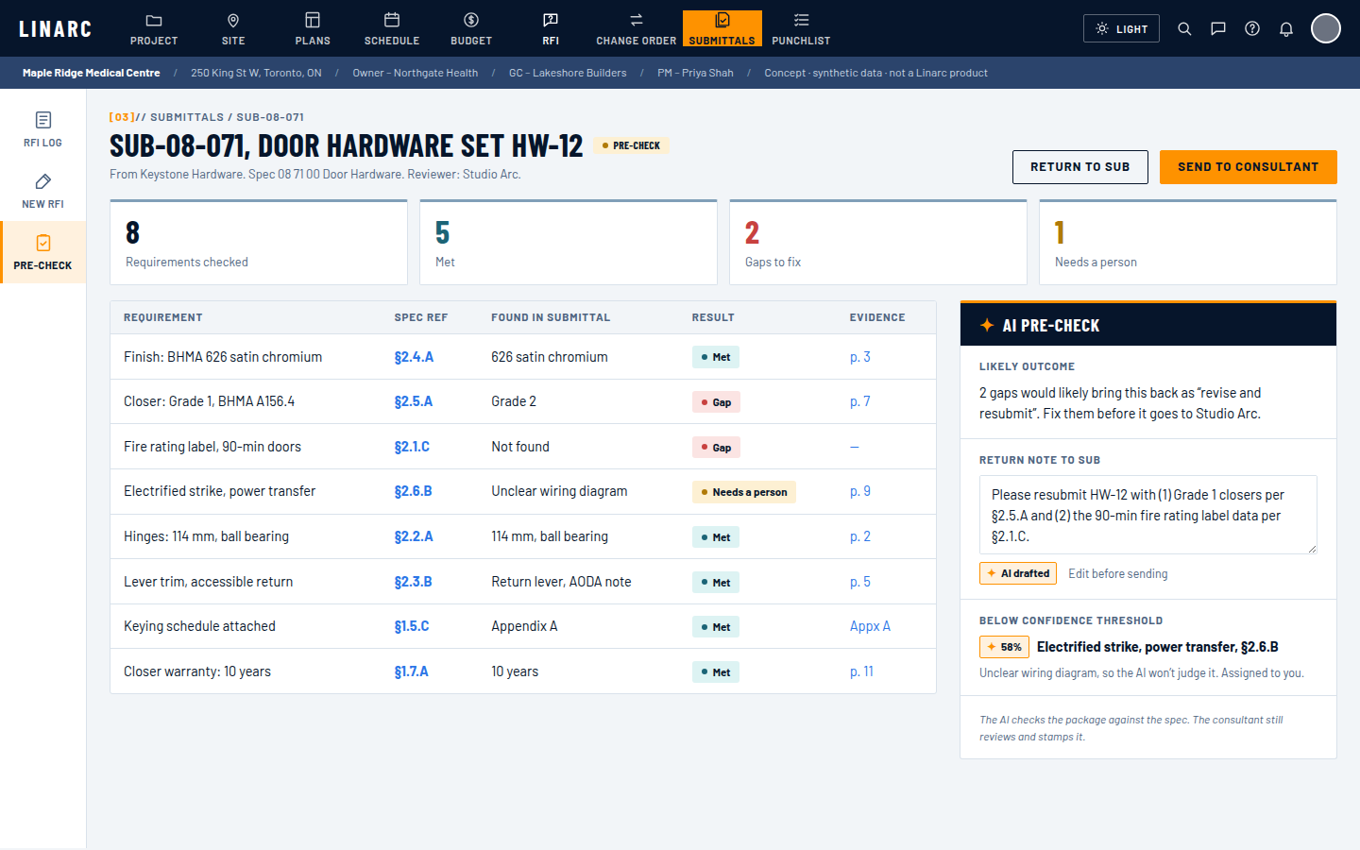
Three screens cover the whole loop
[04]// THE PRODUCT
01 · RFI Log
02 · New RFI
03 · Submittal pre-check
AI flags likely duplicates and life-safety items
Draft, earlier answers and reviewer suggestion
Gaps found before the consultant sees it
Live prototype in the Linarc palette, light and dark themes. Demo video: 1 min 45 s.
Notes:
Walk through the demo here. The log flags open items for the coordinator. The new RFI view turns a site note into a referenced draft, shows earlier answers, and suggests a reviewer. The pre-check finds two gaps in a door hardware submittal before it reaches the architect.

Slide 6
Plain rules decide how items reach a person
[05]// GUARDRAIL GATE
≥ 85%
60–84%
< 60% or life safety
One click
Pick of two
Manual
Reviewer pre-selected; coordinator confirms
Top two shown; coordinator chooses
No suggestion; coordinator routes it
33 of 42 RFIs
3 of 42 RFIs
6 of 42 RFIs
Every citation must resolve to a real sheet or spec clause, or it is dropped. The model never chooses the path.
Notes:
This is where the PM sets the rules. Confidence comes from whether the drawing and spec point to the same consultant. Life-safety topics, like sprinklers and fire separations, skip the AI suggestion entirely. Thresholds are starting values to tune on real data.

Slide 7
Agents propose, the gate filters, people approve
[06]// ARCHITECTURE
Draft writer
Guardrail gate
Rules the PM sets
Coordinator
Edits and approves
Duplicate finder
Site note or submittal
Orchestrator
Gemini, Google ADK
Reviewer router
Send + audit log
Who, what, when
Spec checker
Project knowledge (synthetic)
Notes:
The orchestrator routes RFIs through three agents in sequence and submittals to the spec checker. Each agent calls plain Python tools over the project data, so their outputs can be tested. The gate then applies the rules, and the coordinator approves before anything is sent and logged.

Slide 8
Routing: 83% today, 100% with AI suggestions
[07]// RESULTS
6 of 6
life-safety items sent to a person
2 of 3
duplicate RFIs caught, 1 false flag
100%
citations resolve to a real source
2 of 2
submittal gaps found in the pre-check
Synthetic data is cleaner than a real project. Treat these as a baseline, not a forecast.
Notes:
Every result is scored against ground-truth columns the agents never see. Routing reaches 100% here, which I'd expect to drop on real data. The honest miss is a duplicate described in different words; that is why the next iteration adds embedding search.

Slide 9
North star: RFI turnaround from 10 to 6 days
[08]// MEASURE AND SHIP
Metric | Baseline | Target
RFI turnaround (working days) | ~10 | 6
RFIs returned for more info | ~20% | under 8%
Submittals revise and resubmit | ~35% | under 20%
Drafting time per RFI | ~30 min | under 10 min
Routing first time right | ~80% | 95%
Next steps
1
Five discovery interviews to confirm baselines
2
Embedding search for duplicate RFIs
3
Shadow-mode pilot on one live project
Guardrails: zero life-safety misroutes; consultant satisfaction must not drop.
4
Tune gate thresholds on real data
Notes:
Turnaround is the north star because it's what the site feels. The guardrails matter as much: a single misrouted life-safety item is a failure, whatever the averages say. The pilot runs in shadow mode first, so the AI's suggestions are compared with what coordinators actually do before anyone relies on them.

Slide 10
Agents propose. Rules filter. People approve.
THANK YOU
Prototype, demo video and code: see the P04 GitHub repo. Questions welcome.
Notes:
Close on the principle: in construction, AI earns trust by doing the preparation well and leaving the decisions with the people who carry the liability.

