Slide 1
Integrated Disaster prediction and Donation assistance system
By,
MAVERICS
(Mansi,Namratha,Vikram)

Slide 2

Contents
Problem Statement
Solution
Important Use Cases
Scope

Slide 3



Problem Statement
Today’s world has seen an alarming increase in the number of natural disasters causing chaos and disrupting lives of millions of people .
In case of a natural disaster, lack of awareness about how and where to donate, leads to less contribution than is intended.
Studies have proved that early prediction of these natural disasters can help reduce their impact on human lives.

Slide 4
Solution
Smart Prediction system for potential disasters based on previous occurrences.
Real time alert system to keep the users of our app informed of any occurrence of natural disasters.
Provide options for the donors to make monetary donations using secure payment gateway. Along with any non–monetary donations.
Optimized distribution of necessities for the affected people at the earliest, ensuring maximum reach to the victims.

Slide 5
Object Model

Slide 6
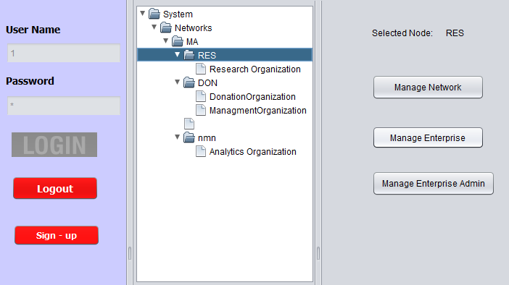
Use Cases:
System Admin Responsibilities

Slide 7
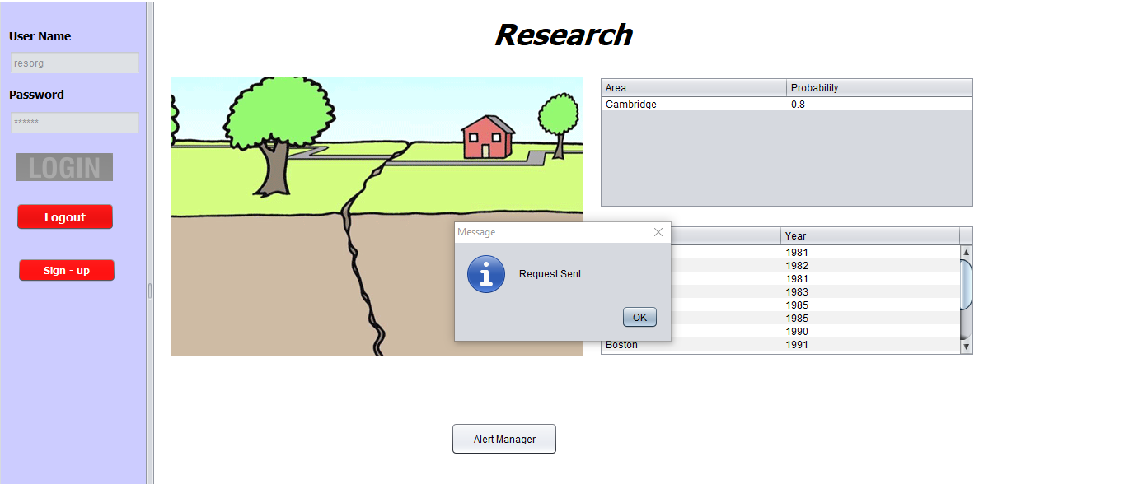
Use Case: Disaster Prediction Scientist Role

Slide 8
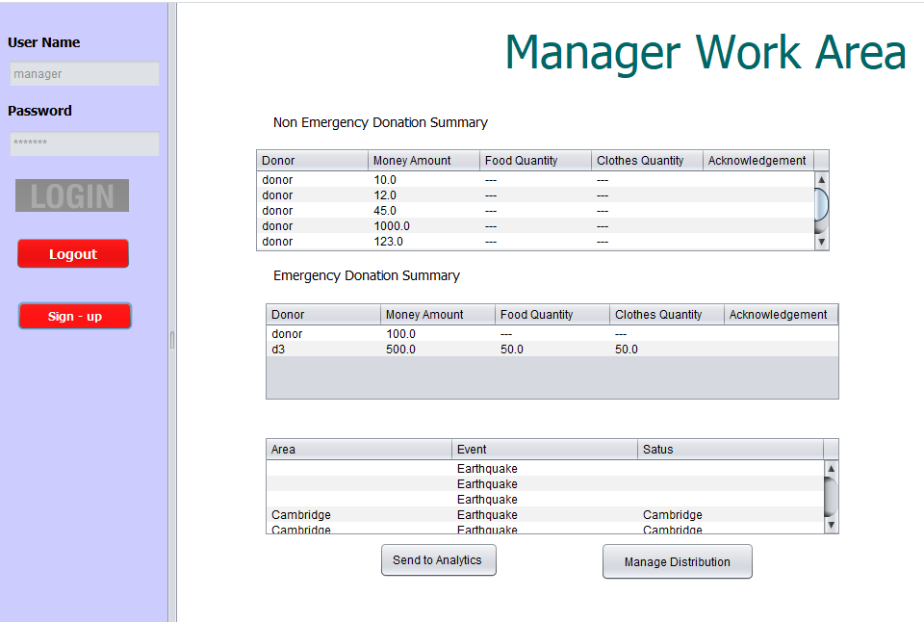
Manager Work Area before disaster alert

Slide 9
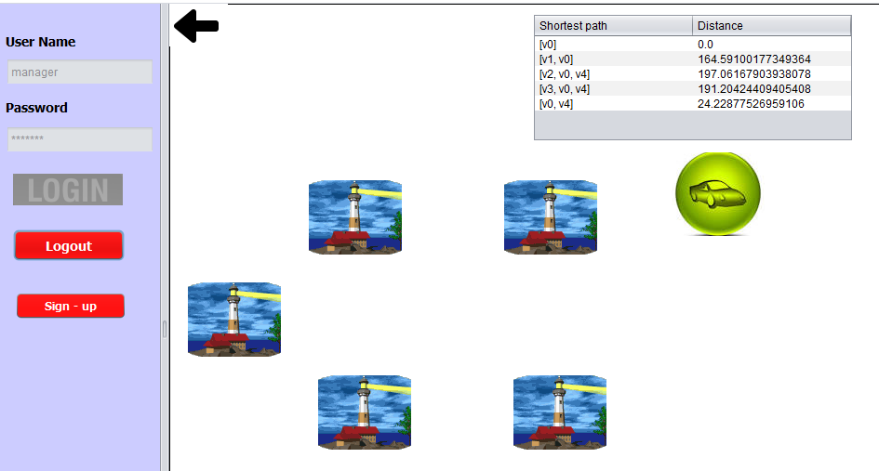
Manager Workspace : Optimized Distribution after disaster has happened.

Slide 10
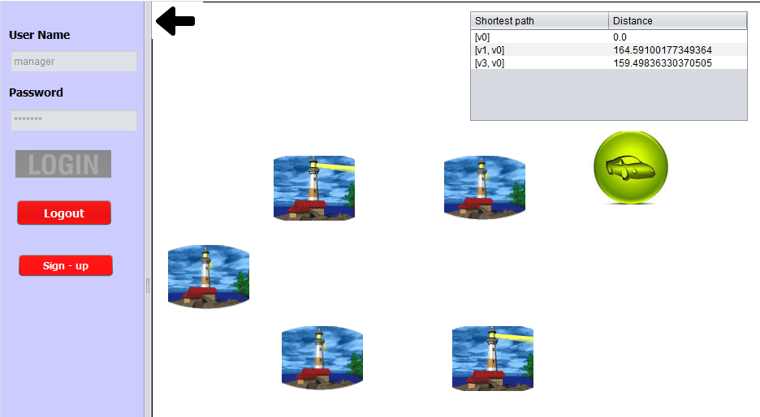
Recalculation of shortest Path After driver assignment to the longest path during disaster

Slide 11
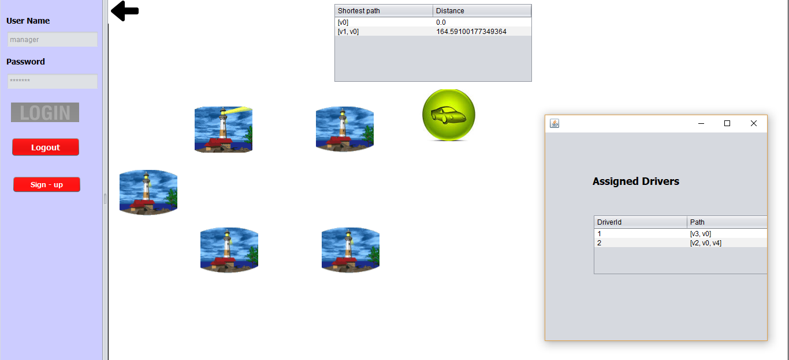
Based on calculation of shortest path ,drivers are being assigned to paths selected by the manager

Slide 12
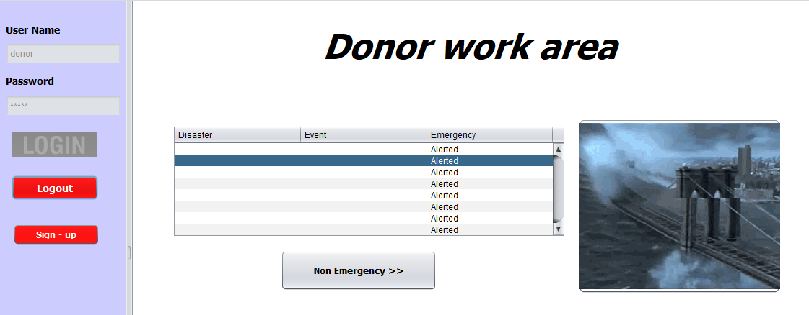
Donor get alerted and clicks on the news flash to proceed with he donation

Slide 13
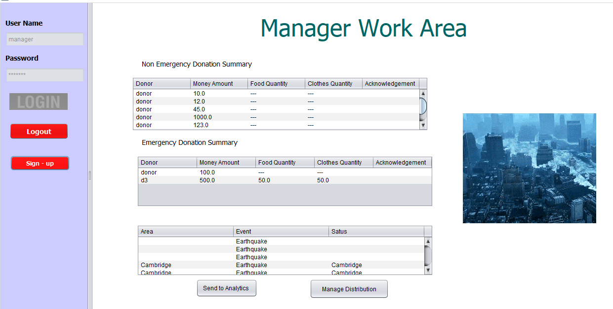
Manager Workspace after Disaster alert

Slide 14
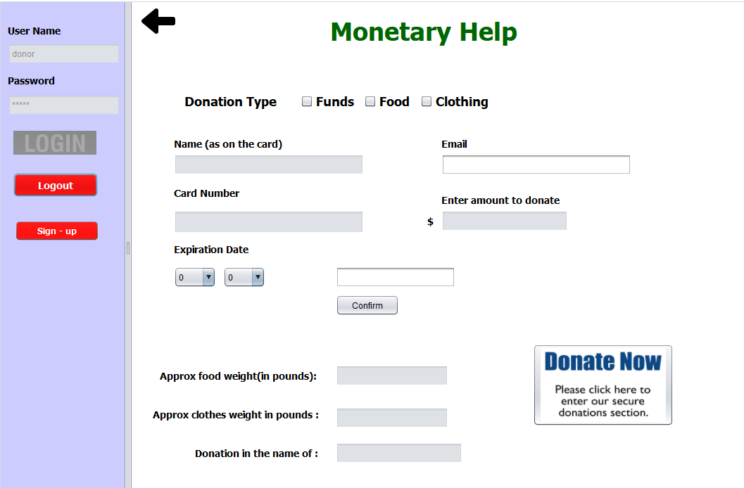
Donar Workarea Multiple filter donation selection

Slide 15
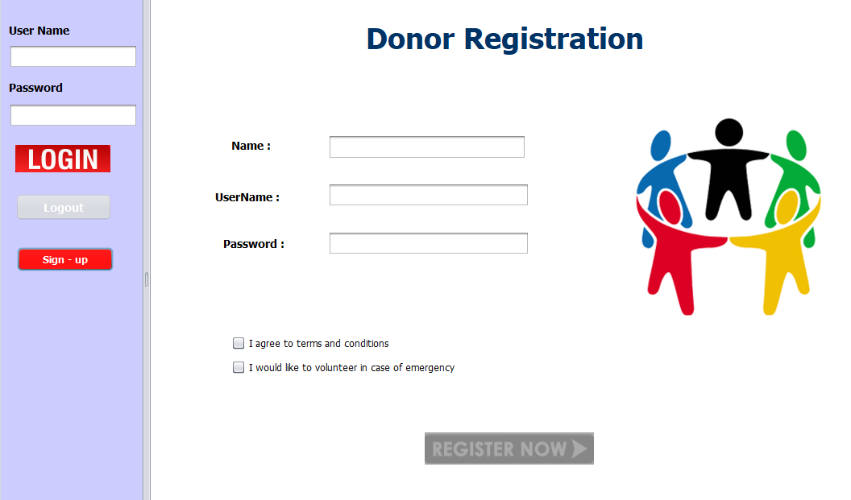
Donor and volunteer self registration

Slide 16
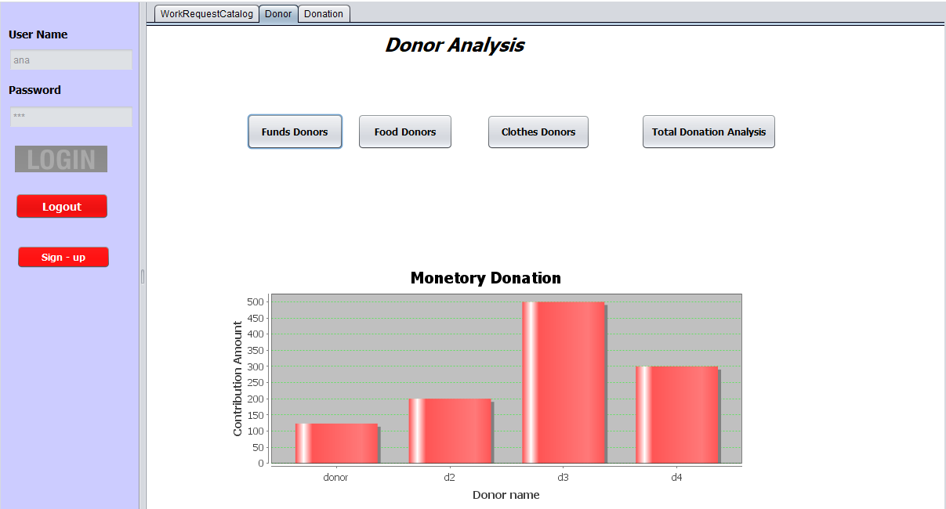
Analytics Enterprise Analyst role responsibilities

Slide 17
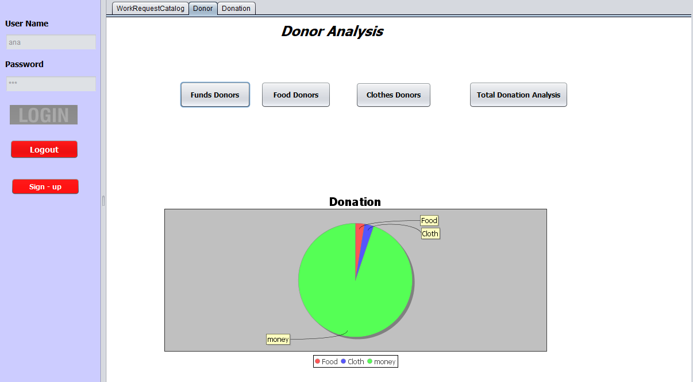
Types of analytics

Slide 18

DEMO

Slide 19


