Slide 1
A DATA SHARING PROTOCOL TO MINIMIZE THE PRIVACY RISKS OF CLOUD STORAGE IN BIG DATA ERA
IV Year B.Tech – Project Development (Phase-I)
Team Members Details
NAGA VIKRAM : 22N31A67G1
S SNEHITHA : 22N31A67F2
S MAHENDRA : 22N31A67E8
IV Year B.Tech-I Semester– CSE -DATA SCIENCE
Under the Guidance of
Mr P VIJAY KUMAR
ASSISTANT PROFFESOR - ET
Department of CSE (Data Science)

Slide 2
Outline
Abstract
Introduction
Existing System
Proposed System
Difference between Existing and Proposed
Architectural Diagram
Technical Requirements Specification
Application module
UML Diagrams.

Slide 3
Abstract
A cloud-based big data sharing system utilizes a storage facility from a cloud service provider to share data with legitimate users. In contrast to traditional solutions, cloud provider stores the shared data in the large data centers outside the trust domain of the data owner, which may trigger the problem of data confidentiality. This paper proposes a secret sharing group key management protocol (SSGK) to protect the communication process and shared data from unauthorized access. Different from the prior works, a group key is used to encrypt the shared data and a secret sharing scheme is used to distribute the group key in SSGK. The extensive security and performance analyses indicate that our protocol highly minimizes the security and privacy risks of sharing data in cloud storage and saves about 12% of storage space.

Slide 4
Introduction
Explosion of data generated from various sources like IoT, social media, sensors, and enterprise systems.
Cloud storage is widely adopted to handle this massive data due to scalability and cost-effectiveness.
Security breaches and data leaks are major concerns.
Users often lose control over their data once it's uploaded to the cloud.
Traditional encryption methods are not sufficient for dynamic data sharing scenarios.
Ensures that only authorized users can access the data.
Protects data from malicious insiders, hackers, and cloud service providers.
Balances privacy, performance, and usability.

Slide 5
Existing System
Current systems use methods like:
Attribute-Based Encryption (ABE) – allows specific users to access data based on rules.
Central authorities – one trusted center gives out keys to users.
But these have problems: If the central authority is hacked or fails, everything is at risk.
DISADVANTAGES:
There’s no group sharing system.
Some methods are slow and use too much storage.
Weak security allows hackers to guess user details.

Slide 6
Proposed System
In the proposed system, we use a method called SSGK (Secret Sharing Group Key protocol).
This system improves cloud data sharing without depending on any trusted third party (like a central server or admin).
The data owner encrypts the file using a group key.
Instead of giving the full key to anyone, the group key is split into several secret parts. These parts are given to selected users (group members).
To unlock (decrypt) the data, a minimum number of users must combine their secret parts. Also, the system verifies each part to make sure no one gives fake information.
Main Benefits : Only the data owner controls the key, not any third party.
Enhanced security.

Slide 7
Existing <vs> Proposed System
Existing System | Proposed System
Relies on central authority for key generation and management. | No central authority involved. Key management is handled by the data owner using Secret Sharing.
Full decryption key is issued to each authorized user. | Key is split into secret parts; only when a minimum number of users collaborate can the data be decrypted.
No built-in group sharing mechanism. | Supports group data sharing, allowing collaboration among trusted members.
Vulnerable to central authority compromise (single point of failure). | Decentralized control significantly reduces risk of compromise.
Some methods are slow and consume more storage due to complex encryption. | Efficient in terms of speed and storage due to optimized secret sharing and verification.
Often lacks strong verification of user-provided keys. | Uses verification to detect and reject fake or incorrect key shares.
Data control is partially in the hands of central authorities. | Full control of encryption and key distribution stays with the data owner.

Slide 8
Architecture Diagram or System Diagram

Slide 9
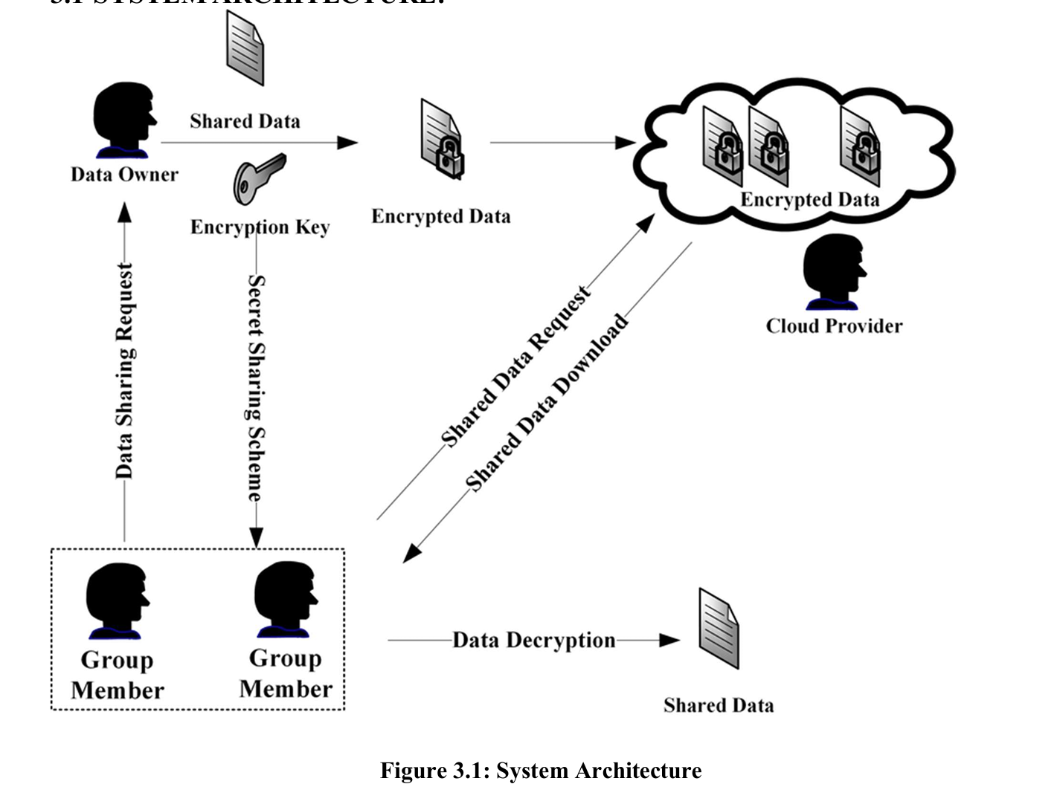
System Architecture:

Slide 10
Technical Requirements Specifications

Slide 11
Software Requirements Specification(SRS)
Operating System:
Windows/Linux (Ubuntu/CentOS recommended for TA and CSP systems)
Cryptographic Libraries:
Support for CP-ABE (Ciphertext-Policy Attribute-Based Encryption)
Libraries like OpenSSL, Charm Crypto, or similar for encryption schemes
Programming Environments:
Python/Java/C++ (for implementing ABE and cloud integration logic)
Database:
Relational or NoSQL database for metadata and user policy storage

Slide 12
Hardware Requirement Specifications(HRS)
Hardware Requirements:
Data Owner/User Devices:
Minimum: Dual-core CPU, 4GB RAM
Recommended: Quad-core CPU, 8GB+ RAM (for efficient encryption/decryption)
Cloud Infrastructure:
Distributed storage nodes with high availability.
Redundant data storage and load balancing capabilities.
Secure processing units if advanced computations on encrypted data are required

Slide 13
Application Modules
Module 1: Cloud Provider
Module 2: Data Owner
Module 3 : The Group Members(USERS)

Slide 14
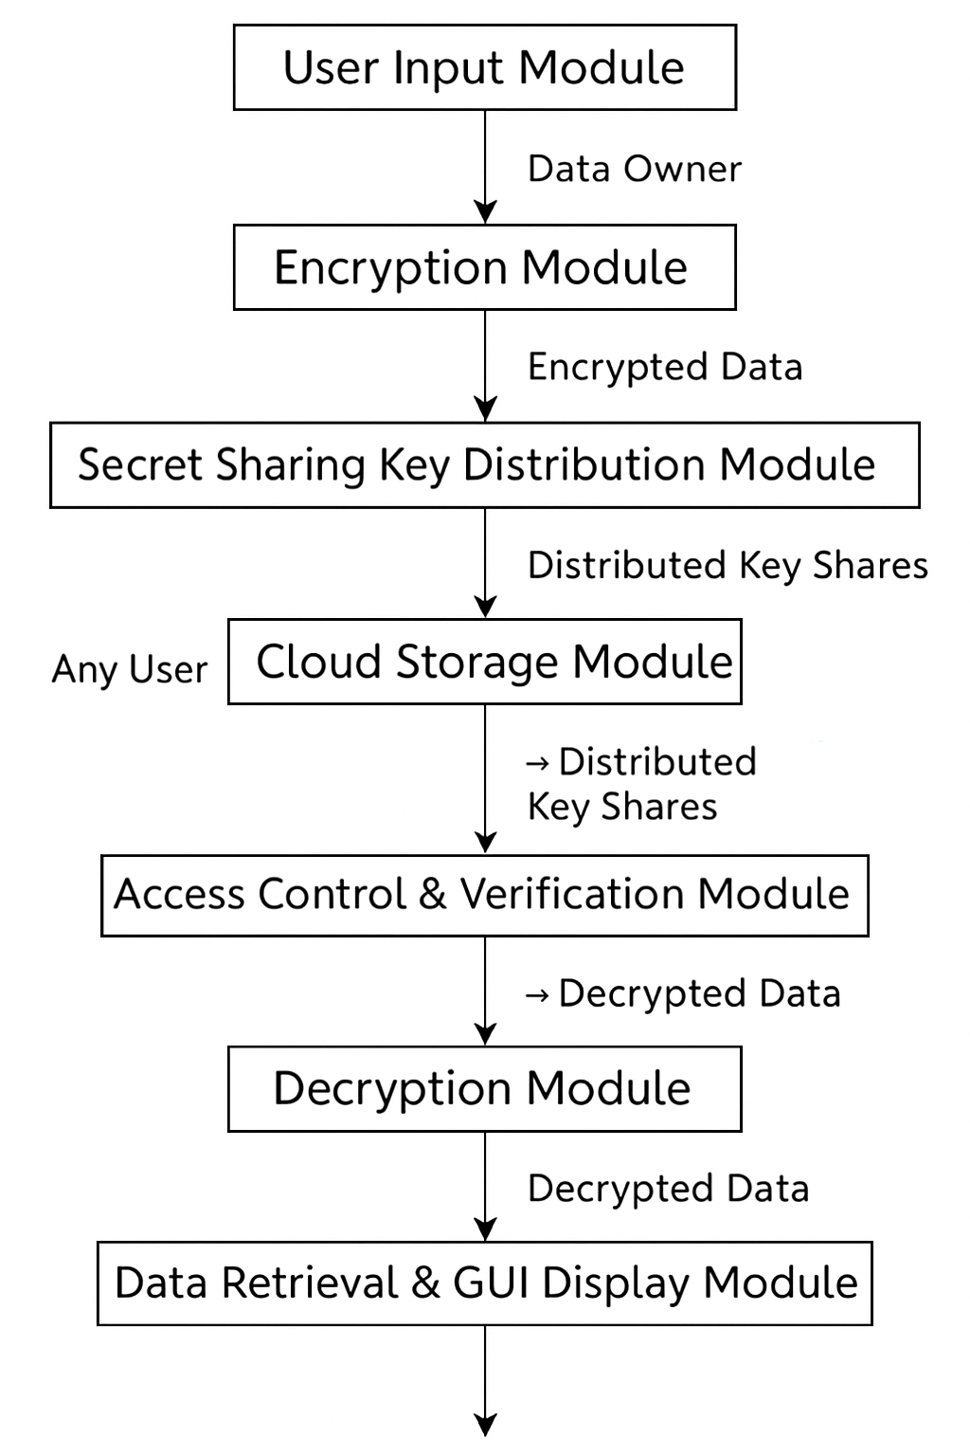
DATA FLOW

Slide 15
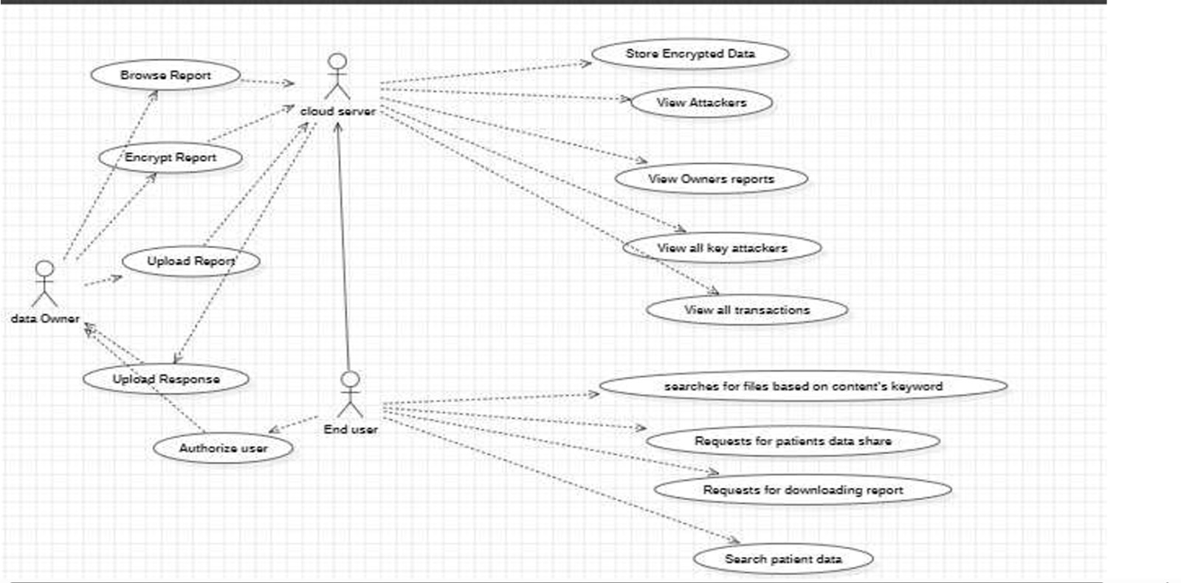
Use Case Diagram

Slide 16
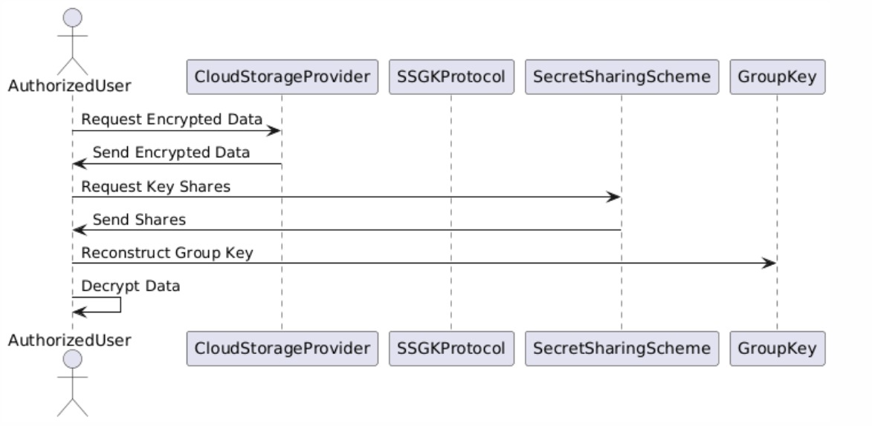
Sequence Diagram

Slide 17
Thank you
S NAGA VIKRAM : 22N31A67G1
S SNEHITHA : 22N31A67F2
S MAHENDRA : 22N31A67E8

