Slide 1
SECURE DATA HIDING IN IMAGES USING STEGANOGRAPHY
CAPSTONE PROJECT
Presented By:
Student Name : SUDDAPALLI NAGA VIKRAM
College Name & Department : MALLA REDDY COLLEGE OF ENGINEERING AND TECHNOLOGY , DEPARTMENT OF EMERGING TECHNOLOGIES

Slide 2
OUTLINE
Problem Statement
Technology used
Wow factor
End users
Result
Conclusion
Git-hub Link
Future scope

Slide 3
Problem Statement
The goal of this project is to create an Effective and safe steganography-based image-based system that enables users to conceal confidential information inside of pictures. The challenge is to employ steganography techniques to safely insert private information inside an image while keeping it concealed and imperceptible to unauthorised users. The difficulty lies in preserving the visual quality of the image while embedding the data, avoiding any discernible distortions. The technology should also enable authorised users to safely retrieve the secret data without jeopardising the integrity of the image.

Slide 4
Technology used
Languages Used : Python 3.12.4
Libraries : CV2
Technologies Used : Steganography

Slide 5
Wow factors
No Need to Enter Message Length by Hand :
Users must enter the message length independently for many projects. However, this saves the initial pixel, which makes decryption automatic. Integrated Password Security :
Many simple implementations are insecure, however in order to prevent unwanted users, this requires a passcode for decryption.
Flexible and lightweight :
Some programs require OpenCV and support several formats (JPG, PNG, etc.), while others rely on external libraries or only function with PNG pictures.

Slide 6
End users
The end users of this steganography project could be either an individual or an organisation that depends on secret and safe data transmission.
They may be top mnc companies like whatsapp, intagram, facebook for encryption and decryption of texts for privacy in personal chats.
Also used in banking and finance sector for safe and secure transaction records.
Those who wish to communicate confidential information (such as passwords or personal information).
Steganography can be used for safe data transfer by those who are interested in learning about digital forensics, encryption, and intelligence and security agencies.

Slide 7
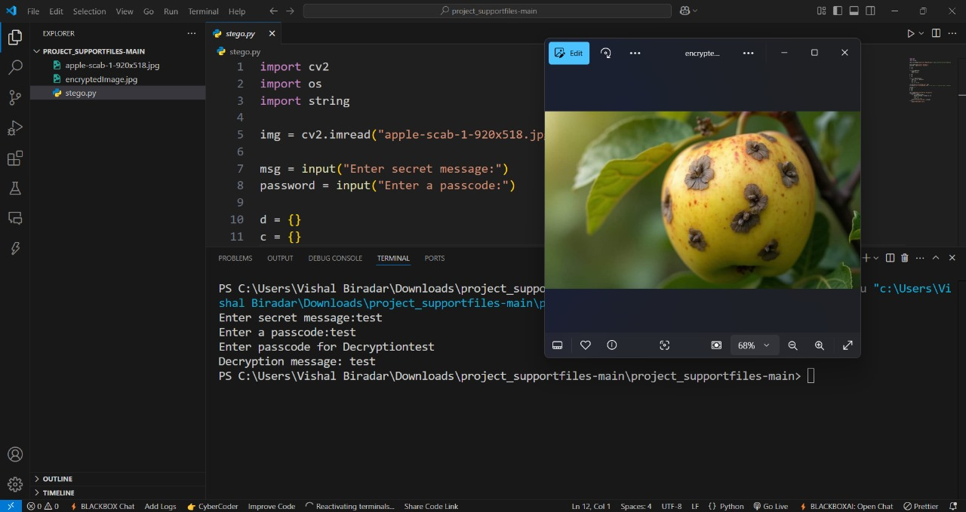

Results

Slide 8
Conclusion
This picture-based steganography project is notable for its minimum image distortion, automated message length recognition, integrated security, and effective coding.
It is safe and discrete since it guarantees that the encrypted image will not change visually when a password is needed to decrypt it.
This product has practical applications and can be utilized by people and businesses looking to communicate data securely.

Slide 9
GitHub Link
https://github.com/vikram2704/aicte_internship_project.git

Slide 10
THANK YOU

