Slide 1




Pariksha
Enhancing Knowledge Through Daily Quizzes
Submitted By:
Vikram singh(230941220211)
Akash Pawar(230941220010)

Slide 2
Index:
Pariksha ExamPortal: Enhancing Knowledge Through Daily Quizzes
1
Introduction
4
Technology Stack
2
Purpose
5
Project Phases
3
Features
6
Conclusion:

Slide 3
Introduction
Pariksha ExamPortal: A modern educational tool designed to facilitate daily learning through interactive quizzes, offering an engaging way to expand knowledge.
It helps you learn new things every day with short quizzes.
It uses new technology like Spring Boot and Angular to make it easy to use.
You can sign up easily and start learning right away.
It keeps track of your progress and shows you how you're doing.
It's making learning fun and easy for everyone.

Slide 4
Purpose:
Pariksha ExamPortal is an endeavor aimed at creating a web application for daily quizzes. The project's primary focus lies in developing a website where students can enhance their knowledge through quiz tests. Utilizing technologies such as Spring Boot for the backend, Angular for the frontend, and MySQL for the database.
The project aims to provide a seamless experience for users. Key functionalities include student registration, user and admin login, tracking quiz attempts, and displaying detailed results including date and time.

Slide 5
Features:
User Registration: Students can register on the platform to access quizzes and track their progress.
User and Admin Login: Secure login functionality for both students and administrators to access the portal.
Quiz Attempt Tracking: The system records the number of quiz attempts made by each student.
Results Display: Detailed results including date and time of quiz attempts are showcased to users.

Slide 6
Technology Stack:
Backend: Spring Boot is employed for developing the backend functionalities of the exam portal.
Frontend: Angular is utilized for crafting an interactive and user-friendly frontend interface.
Database: MySQL, coupled with Workbench, serves as the database management system to store user information and quiz data

Slide 7
Project Phases:
Phase 1: Backend Development: Focuses on building the backend infrastructure using Spring Boot technology.
Phase 2: Frontend Development: Involves the creation of a dynamic and responsive frontend using Angular.
Phase 3: Database Integration: Integrating MySQL database with the application to store and manage data efficiently.

Slide 8
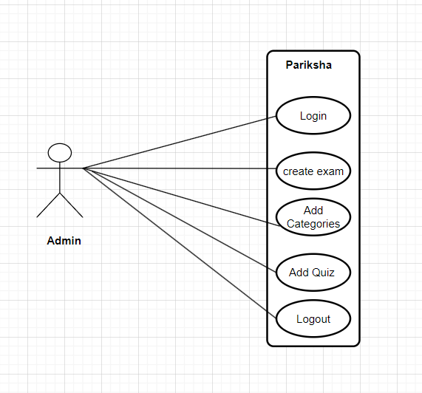
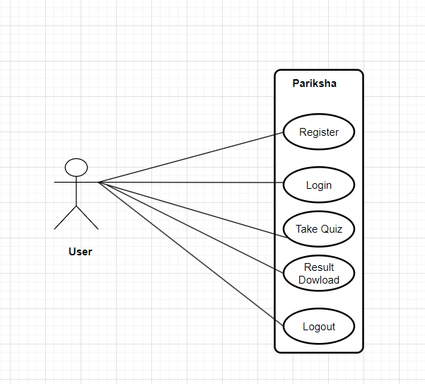
Use Case:
Admin
User

Slide 9
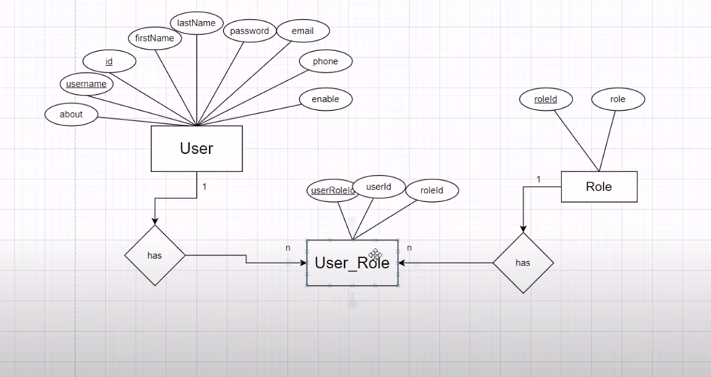
E-R Diagram

Slide 10
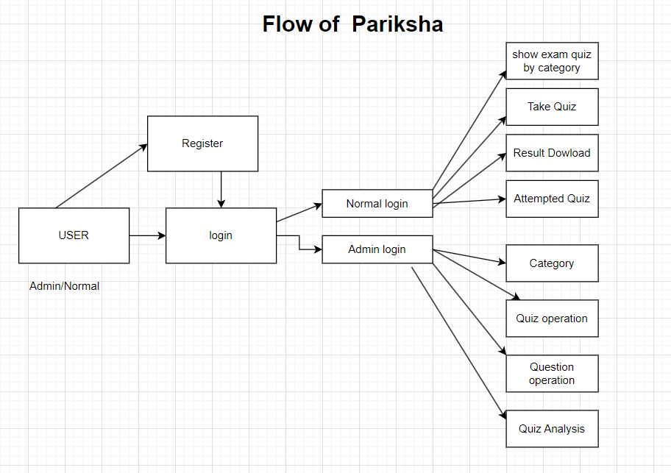

Slide 11
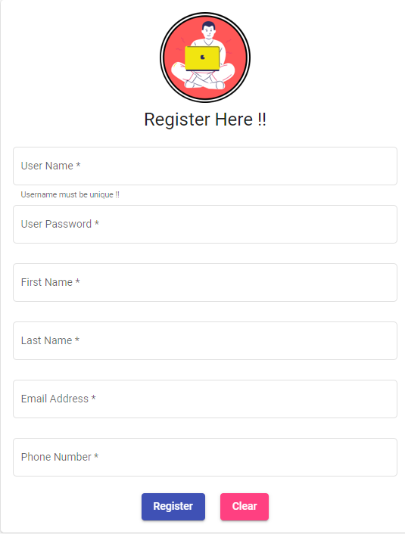
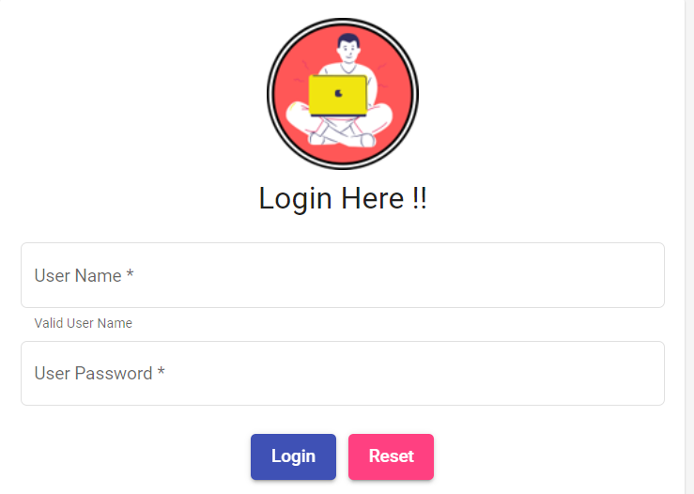
UI Screen Shots

Slide 12
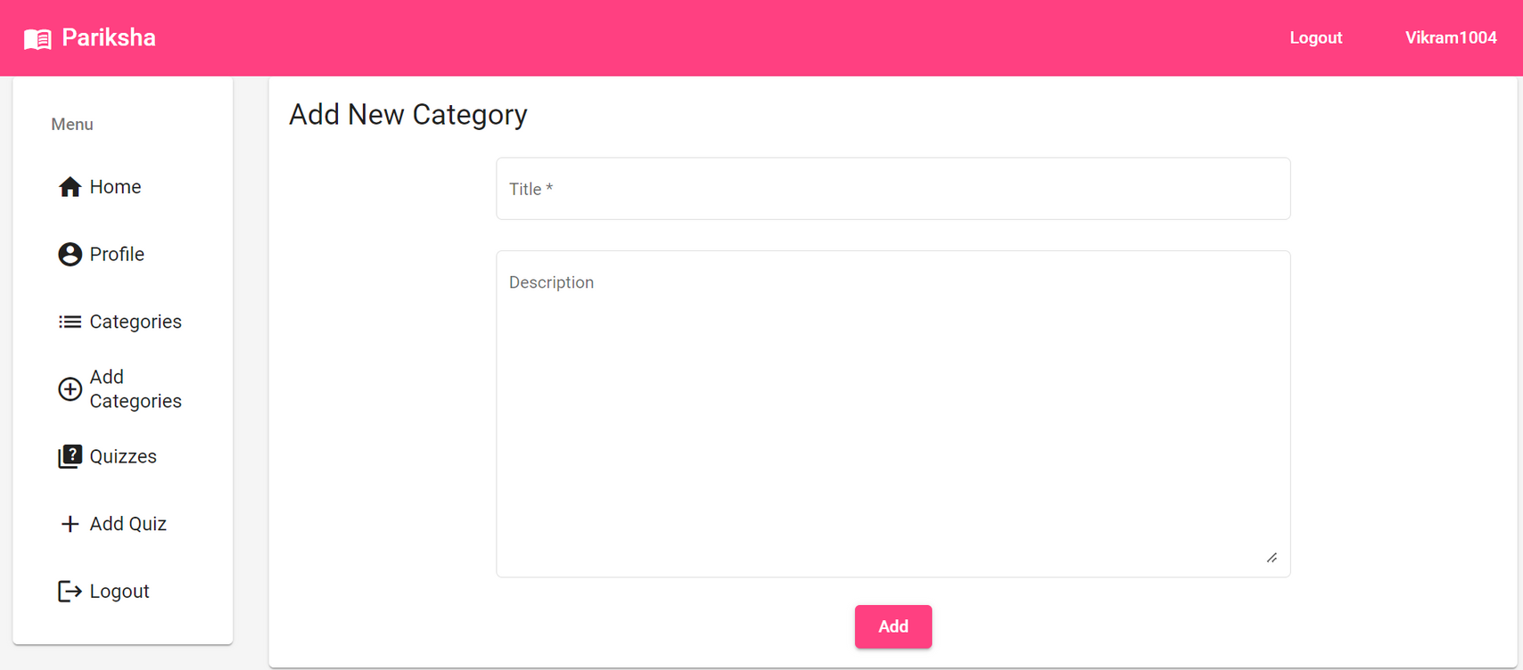

Slide 13
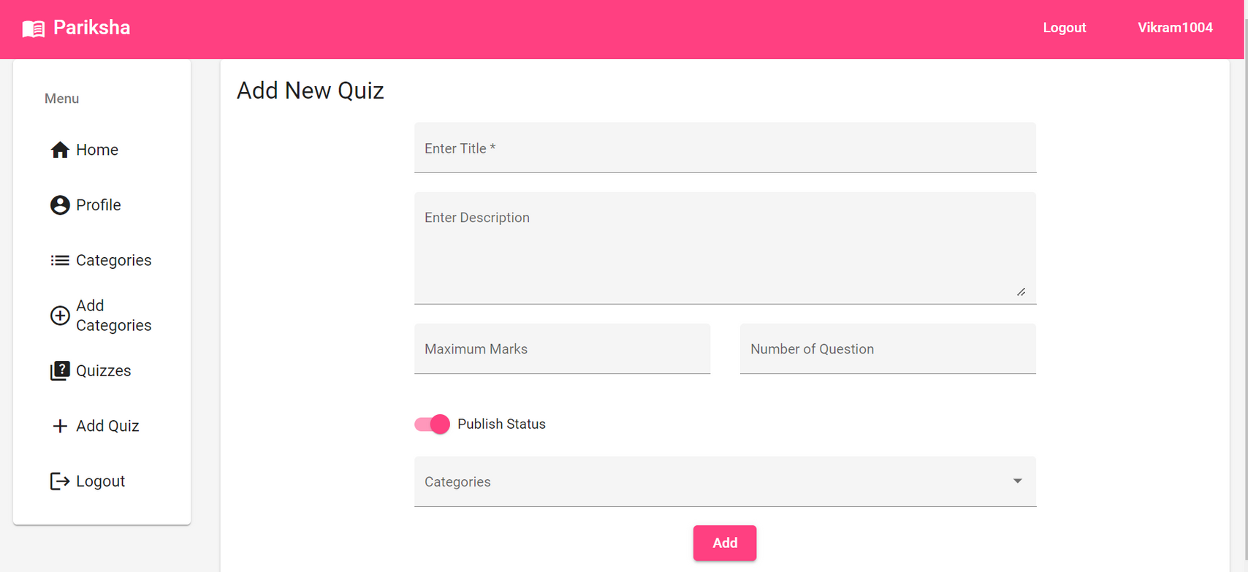

Slide 14
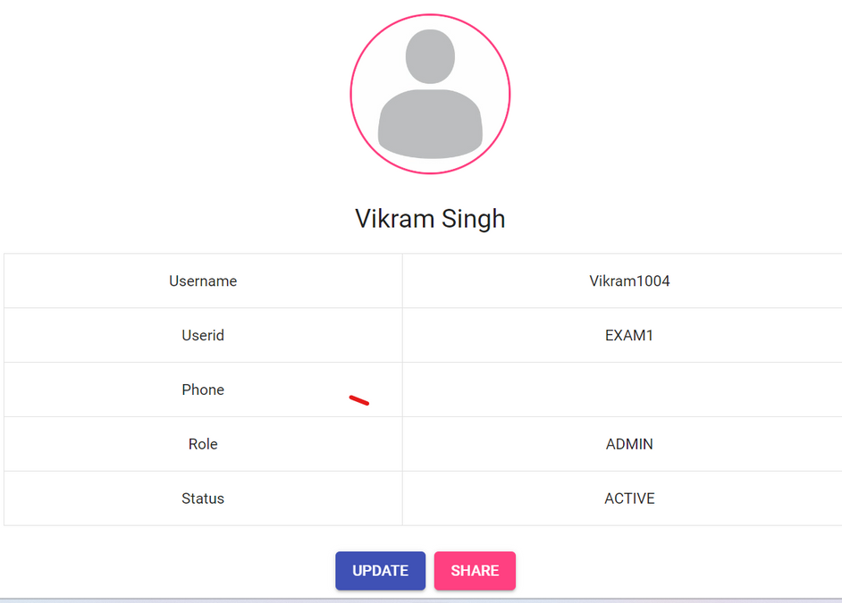
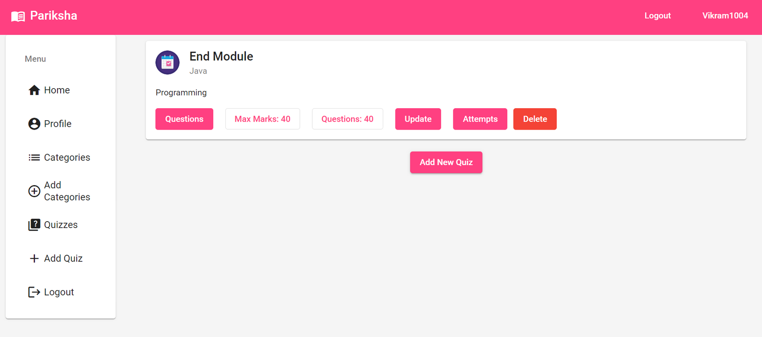

Slide 15
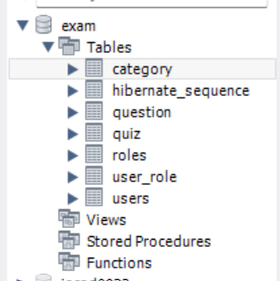
Database:

Slide 16
Future Scope:
Advanced Analytics: Implementing analytics for student performance insights.
Expanded Question Bank: Adding diverse question types and adaptive testing.
Mobile App Development: Creating a mobile app for easy access.
Collaborative Learning: Introducing group study features.
LMS Integration: Connecting with Learning Management Systems.
Gamification: Adding gamification for user engagement.

Slide 17
Conclusion:
Pariksha ExamPortal endeavors to revolutionize the way students engage with quiz tests, providing a user-centric platform for knowledge enhancement. Through its robust technology stack and comprehensive features, the portal aims to cater to the diverse needs of both students and administrators, fostering a conducive learning environment.

Slide 18


Thank you!

