Slide 1
SRI KRISHNA COLLEGE OF TECHNOLOGY
Coimbatore Tamil Nadu
Team – TechnoFreakz
Smart India Milter
Made by young India for New India

Slide 2
PROBLEM STATEMENT
Spoofed Email with swapped email id (IP too) can come any users inbox. Suggest a mechanism to filter the spoofed email at server side

Slide 3

EMAIL SPOOFING
Impersonating a legitimate user’s Email ID for
Illegal Activities

Slide 4
POPULAR SPOOFING ATTACKS
Flipkart CEO Attack
Snapchat Spear Phishing – Payroll information compromised
Democratic National Committee – Hillary Clinton Email Account spoofed
North Korea – Compromised 1000s of Government officials’ email account

Slide 5
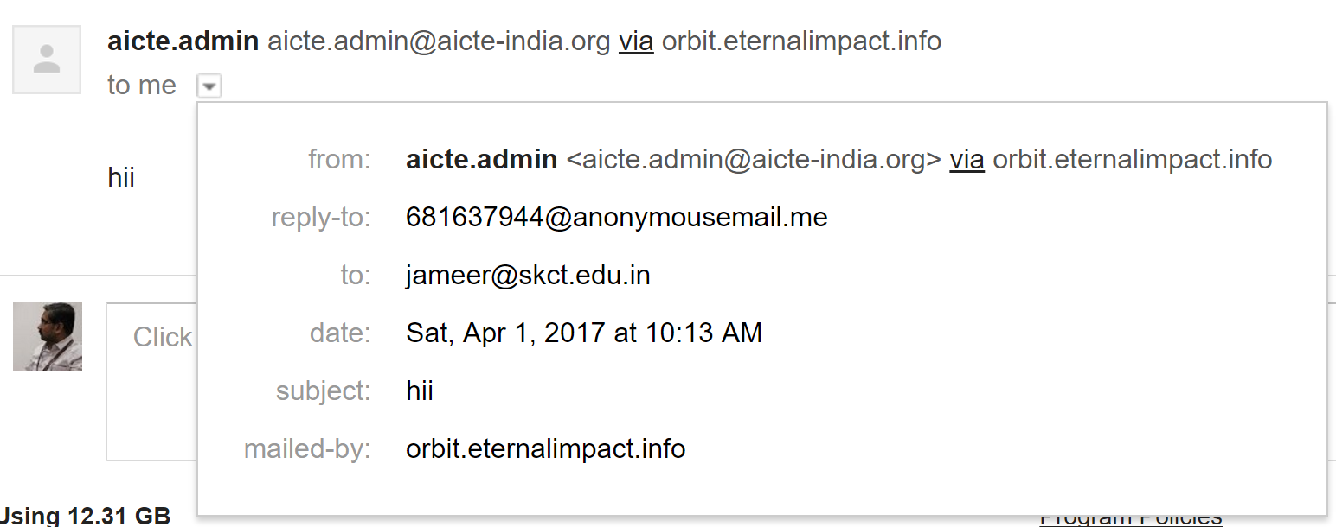
AND THE LATEST ONE…

Slide 6
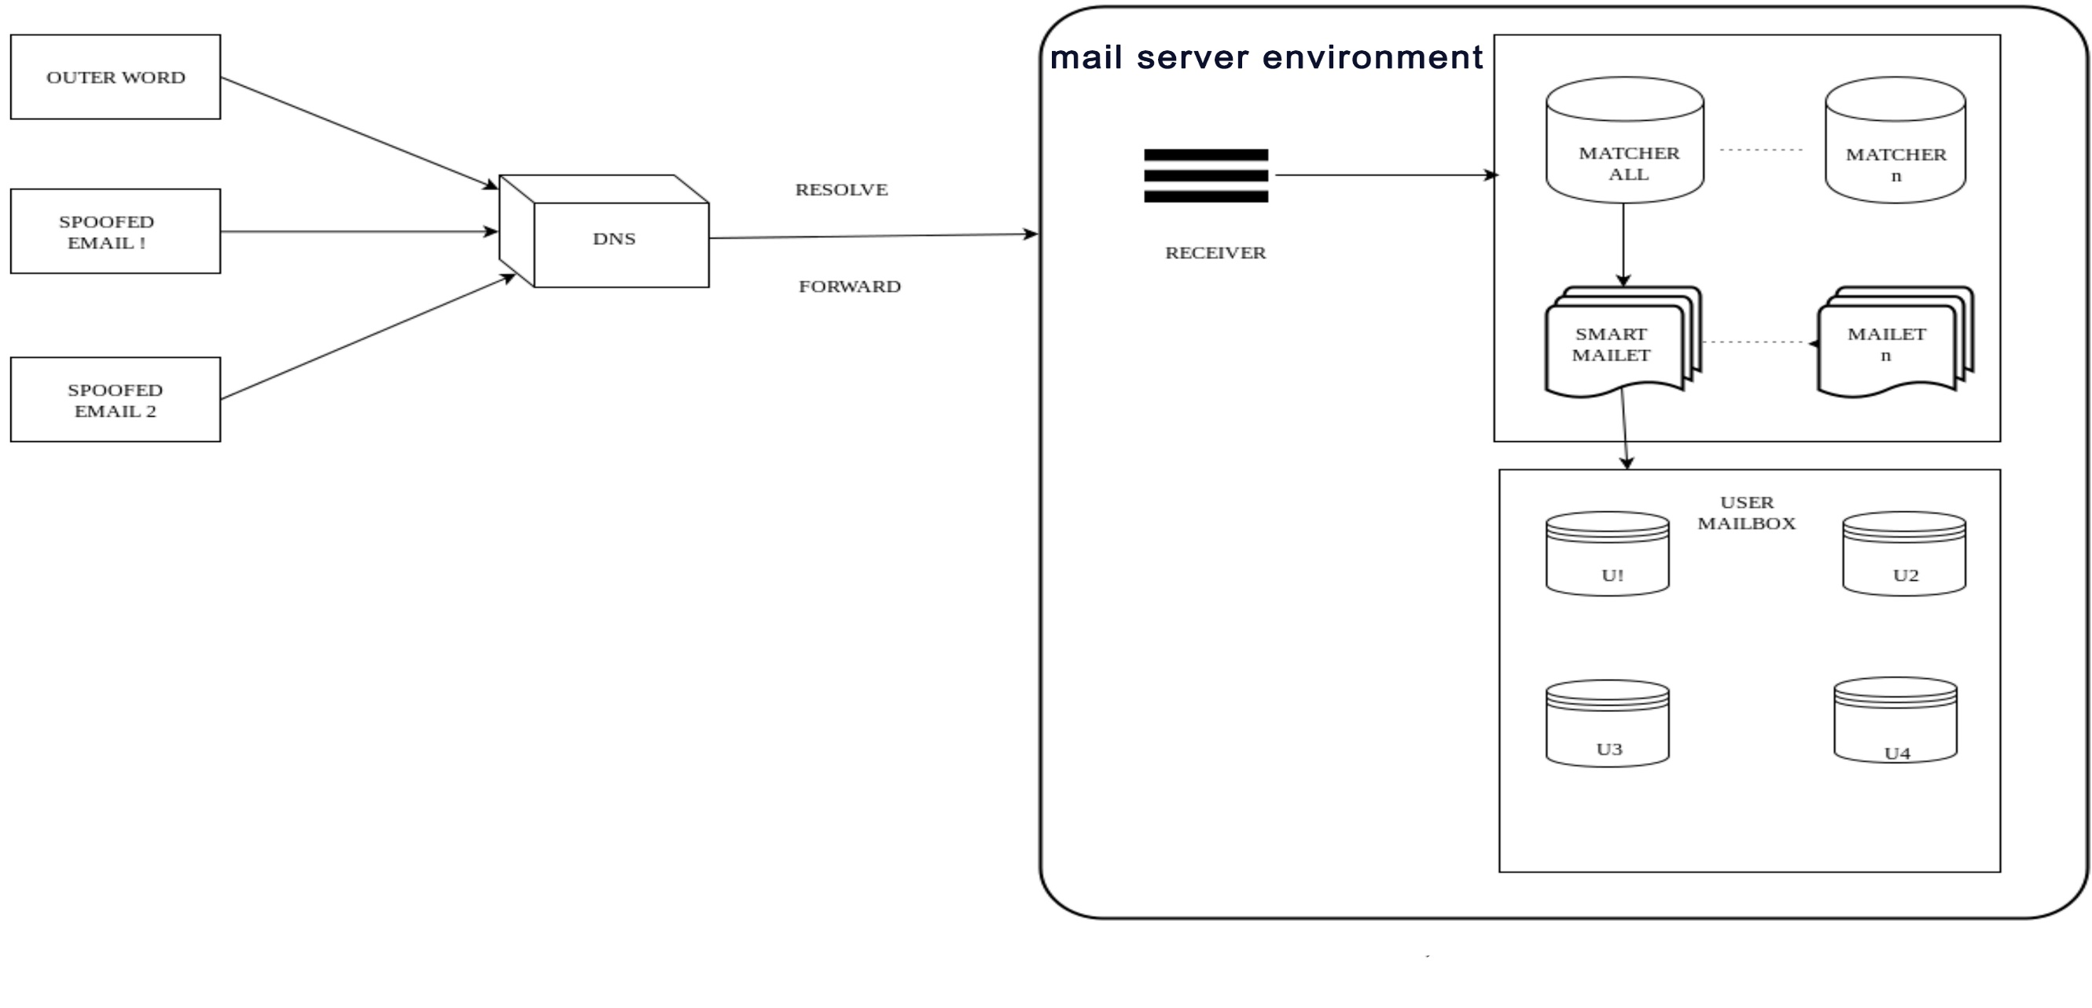
EMAIL ARCHITECTURE

Slide 7
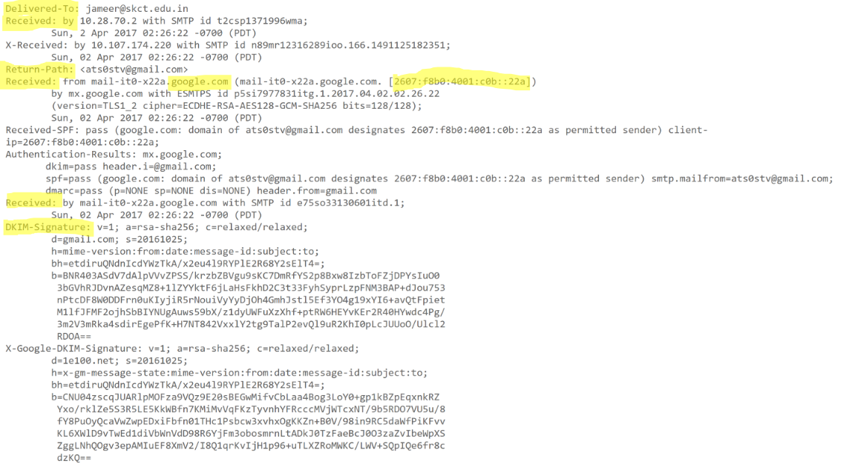
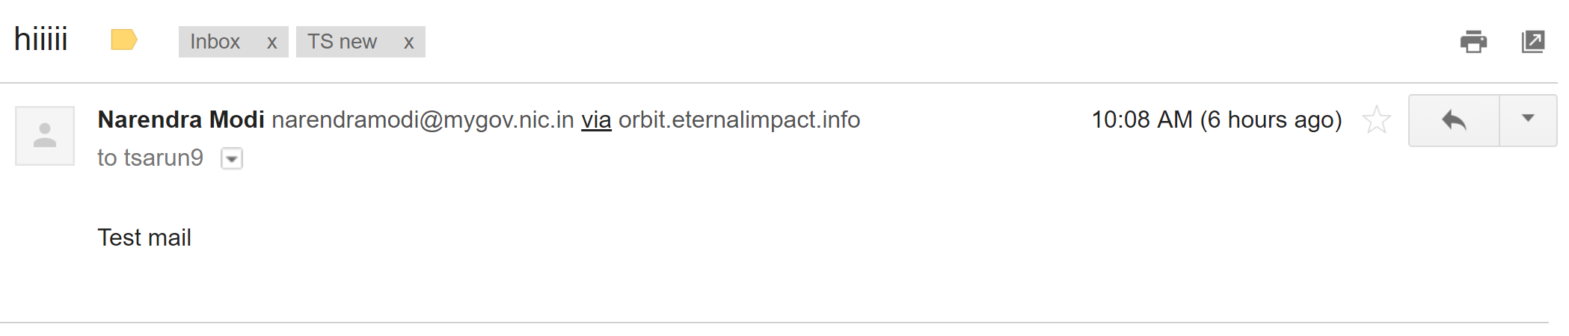
MIME – The Raw Format

Slide 8
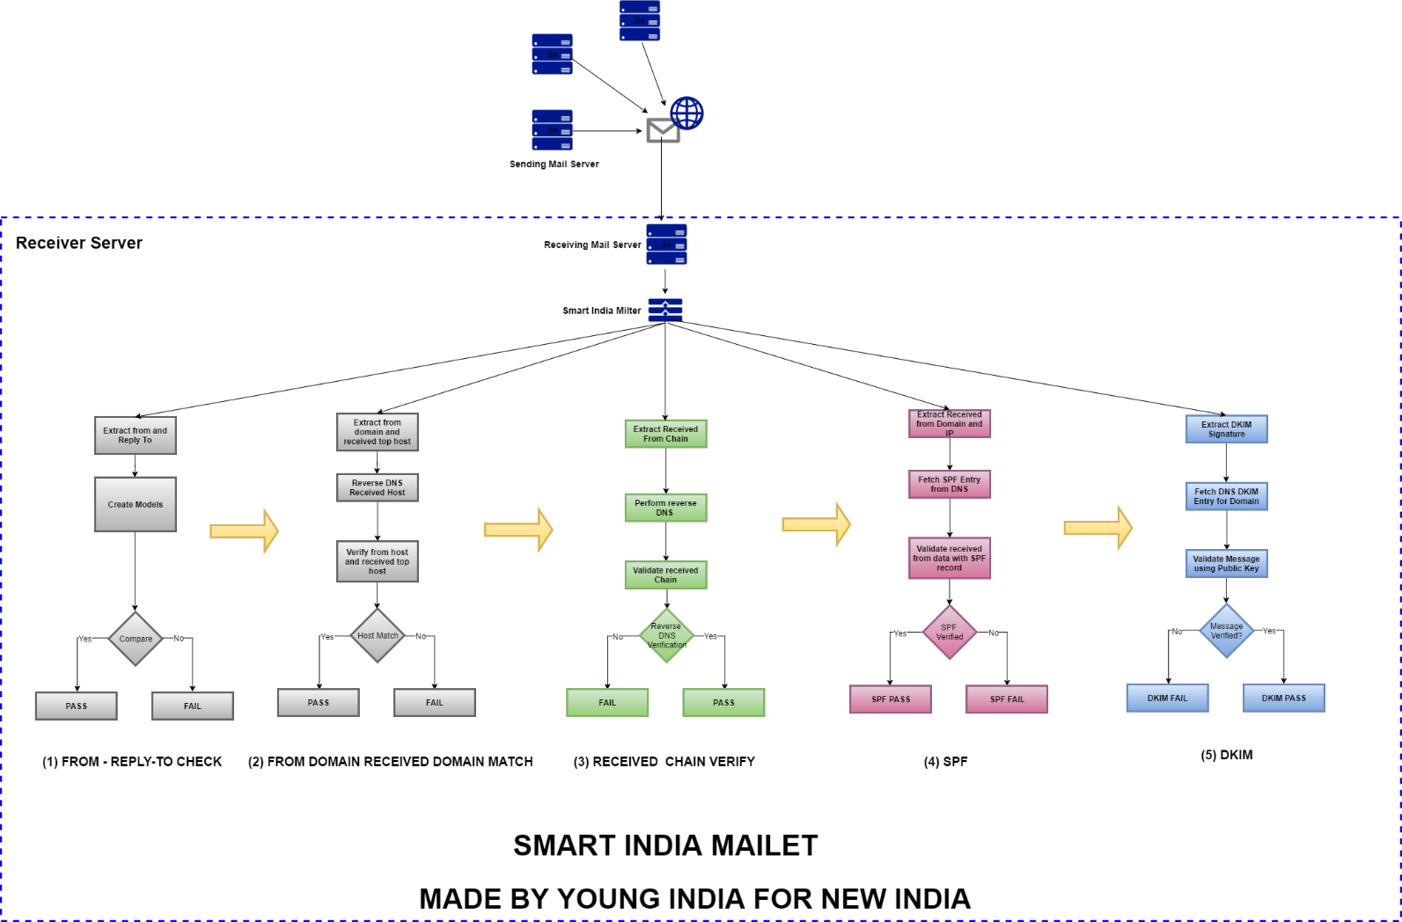

Slide 9
REAL TIME SCENARIOS
Receiving a email from legitimate server to our domain mail server (@effeye.com)
Sending a spoof email to gmail
Sending a spoofed email to our mail server with different reply path
Sending a Spoofed email to our mail server with reply path same as from ID

Slide 10
Thank You!

