Slide 1


EMAIL SPOOFING DETECTION
Techno freakz
SRI KRISHNA COLLEGE OF TECHNOLOGY
COIMBATORE
TAMILNADU

Slide 2
EMAIL SPOOFING

Slide 3
TOP 10PHISHING ATTACK 2016
Snapchat spear-phishing company’s CEO - payroll information leaked
Democratic National Committee (DNC) - Hillary Clinton personal Gmail account breached - released internal communications of the Democratic Party
Seagate Technology - exposure of W2 tax documents
Sony PlayStation - hackers hijacking accounts and denying players’ - currency stolen
North Korea - compromised thousands of government officials’ email accounts

Slide 4
EMAIL SPOOOFING

Slide 5
How does normal mail looks..
In mail transfer, we send the mail through MTA agent and received by the respective receiver.
It show the details of header name, subject of the mail to the genuine client

Slide 6
Ways to spoof a mail
By ip address
By domain name
By changing header name

Slide 7

WHAT IS EMAIL SPOOFING?

Slide 8
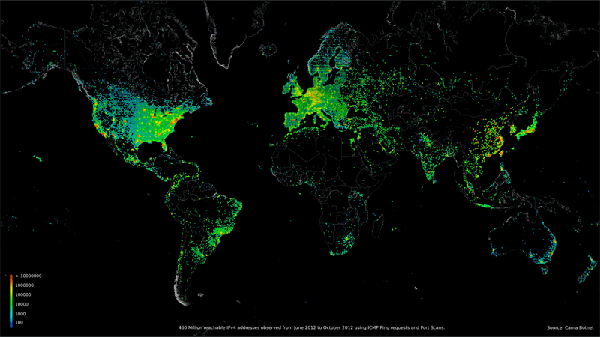

Slide 9
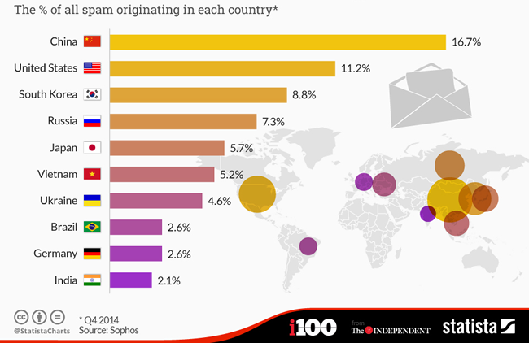
DEMOGRAPHICS

Slide 10
PROPOSED SOLUTION!!!
-Obtain MIME(Multipurpose Internet Mail Extension) format
-Fetch IP address under Received from
-DNS lookup
-Analyse sender hostname.
-Compare return-path.
-Delivers to mailbox/spam

Slide 11
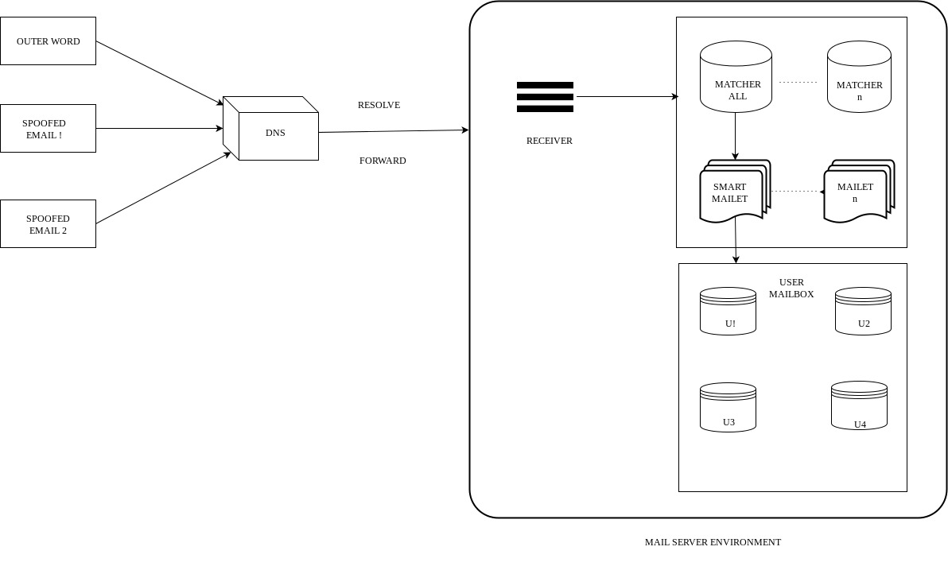
ARCHITECTURE

Slide 12
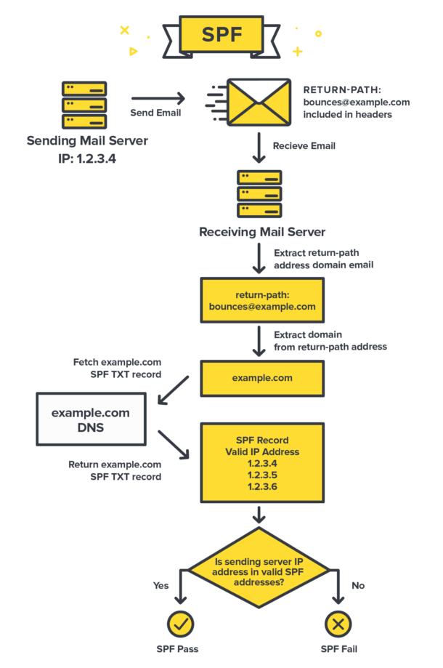
Algorithm1-SPF

Slide 13
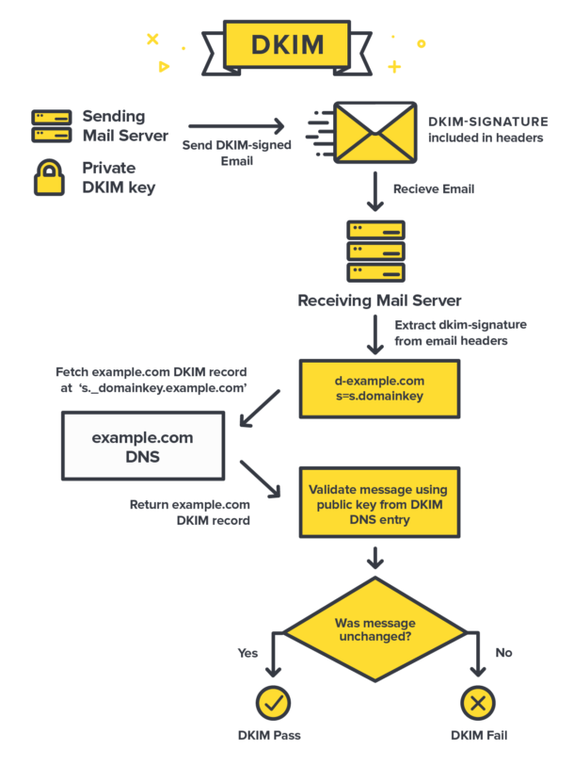
Algorithm2-DKIM

Slide 14
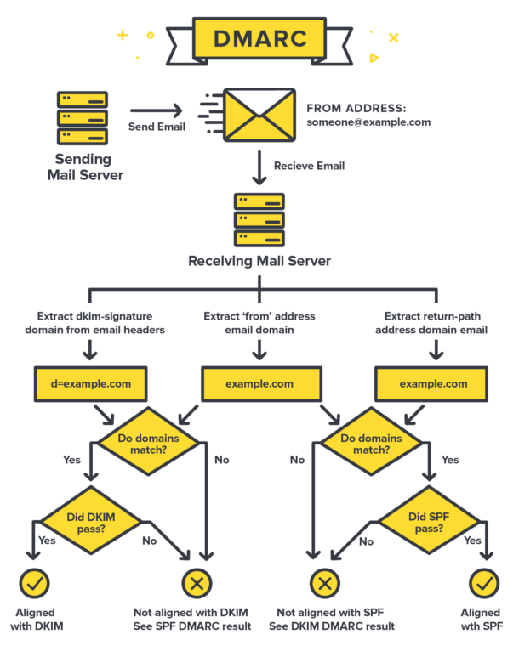
Algorithm3-DMARC

Slide 15
Thank you

Slide 16
Add a Slide Title - 5

