Slide 1
MINISTRY CATEGORY: MINISTRY OF EXTERNAL AFFAIRS
PROBLEM CODE :#MEA16
Current AICTE Application No : 2722
TEAM LEADER NAME : Seenivasan P
PROBLEM STATEMENT:
SPOOFED EMAIL WITH SWAPPED EMAIL ID (AND IP TOO) CAN COME TO ANY USER’S INBOX. SUGGEST A MECHANISM TO FILTER THE SPOOFED EMAIL AT SERVER ONLY.
PROTOTYPE:
This system aims in providing an Authentication towards the email in the server, when an email is logged in from a system whose IP address is different from the IP address that is stored in the SPF record. Owner has to provide successful authentication.
This mechanism can be employed to filter the spoofed email at the receiver side, by using Network Device Investigation where the sender IP address is mapped with the SPF record ,once the IP address matches with IP in the record ,the mail is transferred from the server.
Through Header Analysis mechanism the envelope and headers in the message body contains information about the sender along which the message which are analysed with the server through the pre-existing records that are stored. Only when the data in the header are matched with the server records the mail is transferred to the receiver inbox, else the mail is considered as spoofed or spam and is filtered.

Slide 2
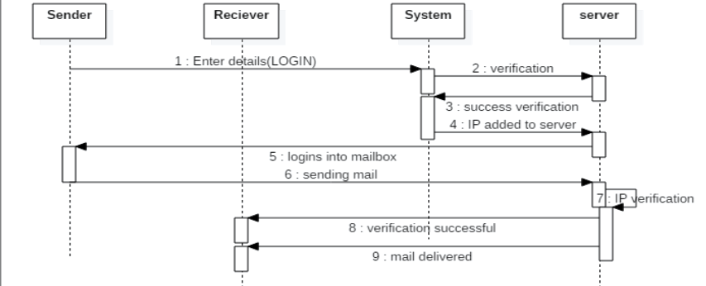
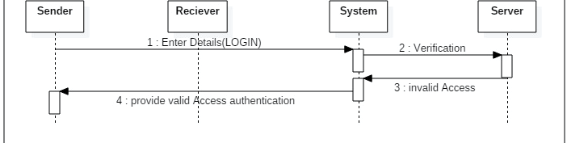
System architecture:
VALID ACCESS:
INVALID ACCESS:
Dependencies:
It relies on the Domain Servers for communication basis i.e. for sending and receiving of mails.
SPF record is maintained at both the sender and the receiver side in order to verify the existing IP addresses and the received mail’s IP address.

