Slide 1
Email spoofing detection

Slide 2
PROBLEM STATEMENT
Spoofed email with swapped email id(and ip too) can come to any user’s inbox. Suggest a mechanism to filter the spoofed email at server side.

Slide 3
Email spoofing
Pretending to act as an authorized Mail-user.
Retrieving confidential datum of authorized user from them.

Slide 4
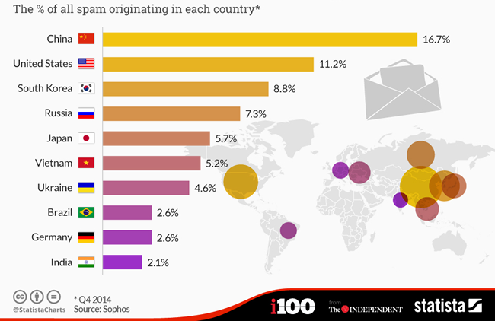
Cyber War
In upcoming years INDIA is going face a big CYBER WAR due to the LACK of CYBER-SECURITY.
There is no anti-spoof software that is MADE IN INDIA which leads to lag Cyber Security.

Slide 5
Famous Spoofing attacks
CEO attack – Flipkart CEO Bansal’s Email account was spoofed.
Snapchat spear-phishing company’s CEO - payroll information leaked
Democratic National Committee (DNC) - Hillary Clinton personal Gmail account breached - released internal communications of the Democratic Party
Seagate Technology - exposure of W2 tax documents
North Korea - compromised thousands of government officials’ email accounts

Slide 6
PROPOSED SYSTEM
Extract the raw MIME format of receiver side.
Retrieving the Header file from the received mail.
Fetch the corresponding Received_from ip address and perform dns-lookup.
Fetch the domain name of the return-path.
Compare the domain names of both Received_from and return-path and we make the further process in our own mailet.

Slide 7
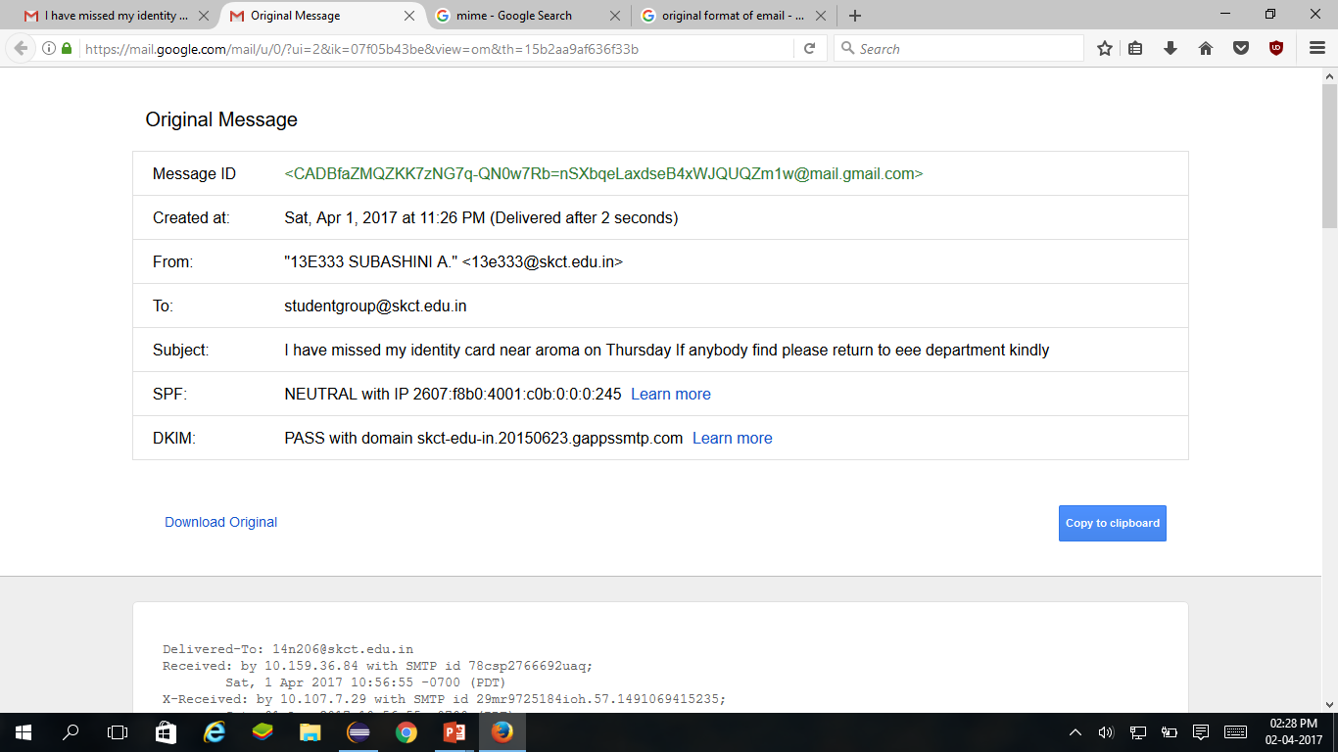
MIME(Multipurpose Internet Mail Extensions)
It’s protocol used to exchange different types of data fields.
Standard structure of mail transferring.

Slide 8
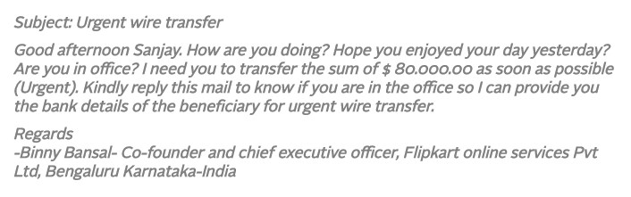
Delivered-To: sathish756756@gmail.com
Received: by 10.79.7.210 with SMTP id 201csp1320930ivh; Fri, 4 Nov 2016 09:01:56 -0700 (PDT)
X-Received: by 10.37.219.129 with SMTP id g123mr13659920ybf.181.1478275316021; Fri, 04 Nov 2016 09:01:56 -0700 (PDT)
Return-Path: <sathishsk.756@gmail.com>
Received: from mail-yb0-x230.google.com (mail-yb0-x230.google.com. [2607:f8b0:4002:c09::230]) by mx.google.com with ESMTPS id w12si2853360ywa.158.2016.11.04.09.01.55 for <sathish756756@gmail.com> (version=TLS1_2 cipher=ECDHE-RSA-AES128-GCM-SHA256 bits=128/128); Fri, 04 Nov 2016 09:01:55 -0700 (PDT) Received-SPF: pass (google.com: domain of sathishsk.756@gmail.com designates 2607:f8b0:4002:c09::230 as permitted sender) client-ip=2607:f8b0:4002:c09::230; Authentication-Results: mx.google.com; dkim=pass header.i=@gmail.com; spf=pass (google.com: domain of sathishsk.756@gmail.com designates 2607:f8b0:4002:c09::230 as permitted sender) smtp.mailfrom=sathishsk.756@gmail.com; dmarc=pass (p=NONE dis=NONE) header.from=gmail.com Received: by mail-yb0-x230.google.com with SMTP id d128so25485213ybh.2 for <sathish756756@gmail.com>; Fri, 04 Nov 2016 09:01:55 -0700 (PDT)

Slide 9
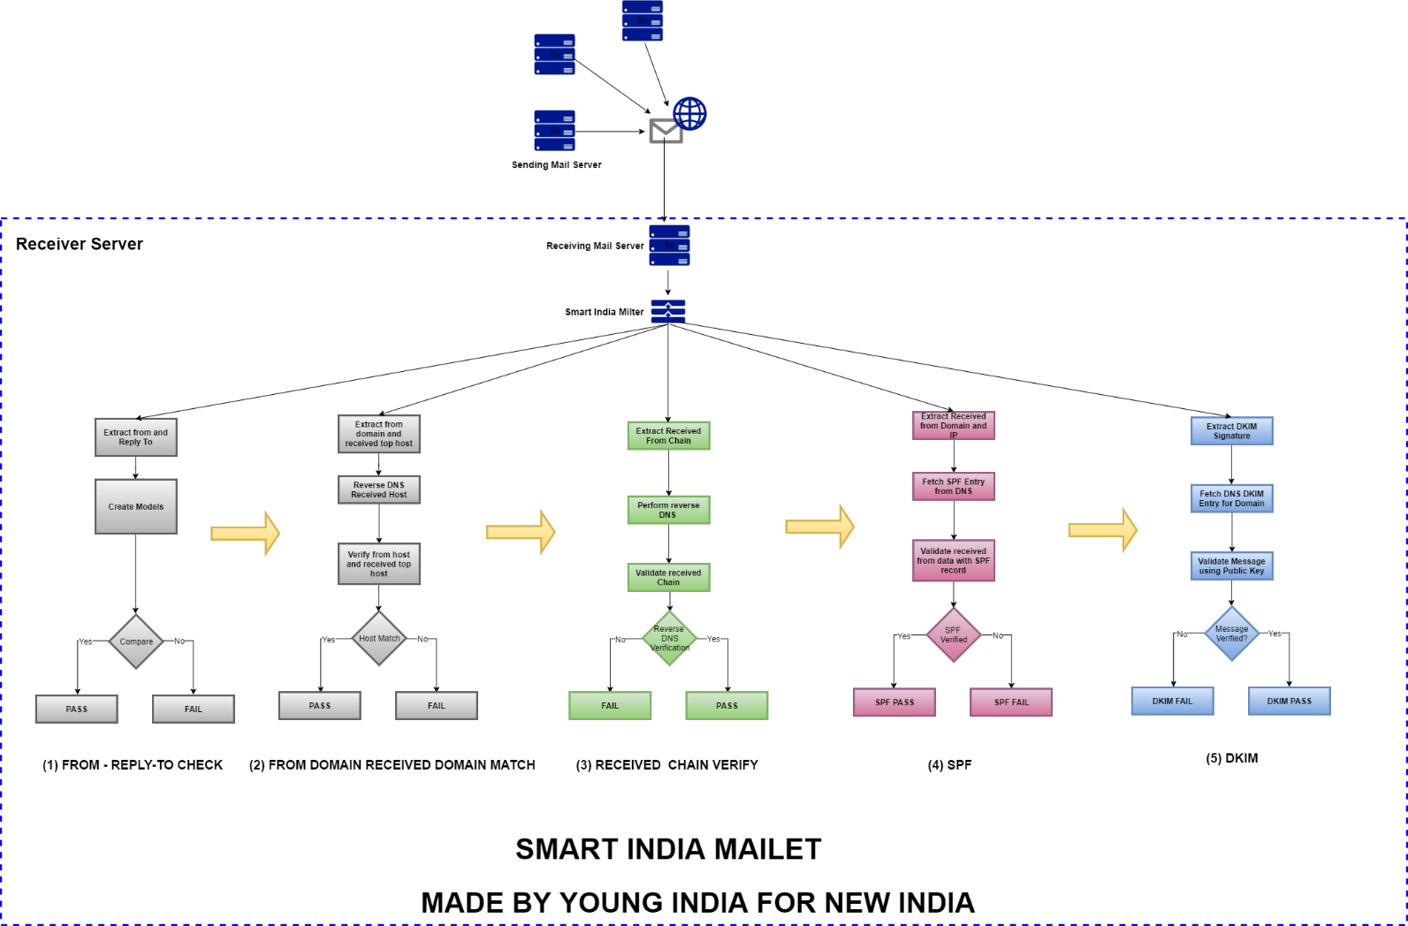

Slide 10
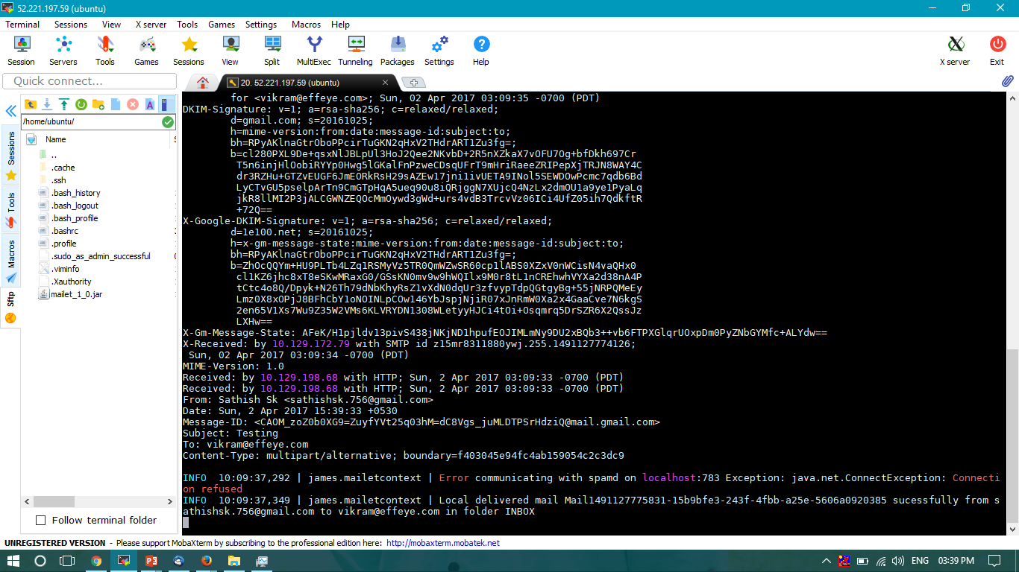

Slide 11
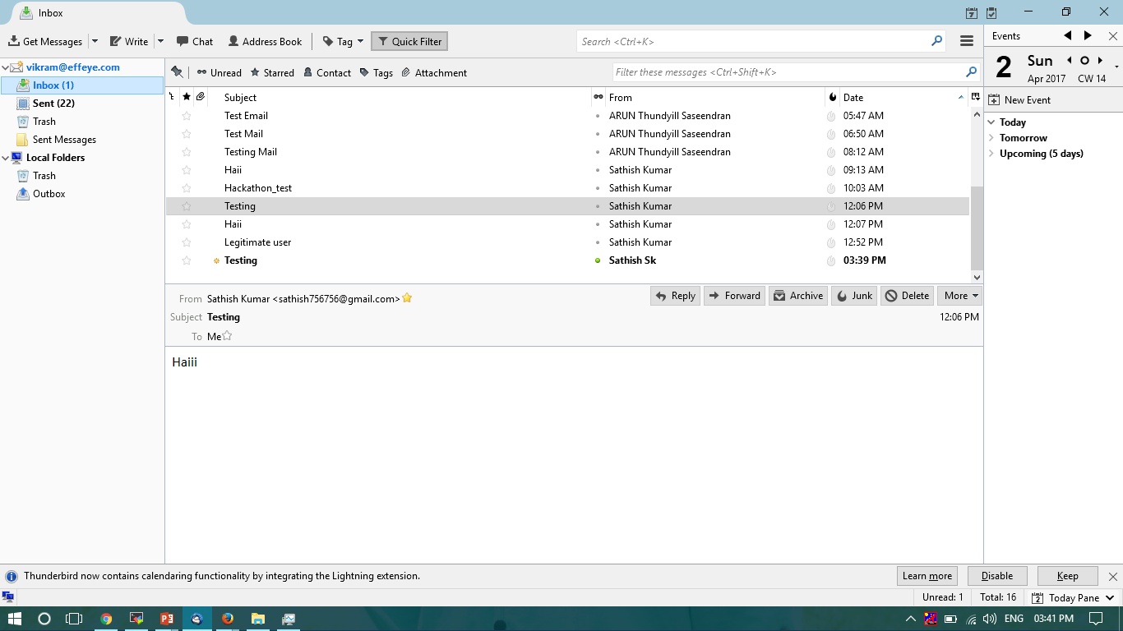

Slide 12
TESTING CASES
TEST CASE 1:
sending mail from normal server to the our own server.
TEST CASE 2:
Return_path and Received from are different.
TEST CASE 3:
Return_path and received from are same.

