Slide 1
EMAIL SPOOFING DETECTION

Slide 2
PROBLEM STATEMENT
PROBLEM STATEMENT
Spoofed email with swapped mail id (and IP too) can come to any user’s inbox.
Suggest a mechanism to filter the spoofed email at server only.

Slide 3
PROTOTYPE PROVIDED
Authentication is aimed towards email in the server
When mail logged in from a system whose IP is different from that stored in SPF, owner has to provide successful authentication.
Using Network Device Investigation, it can be possible.

Slide 4
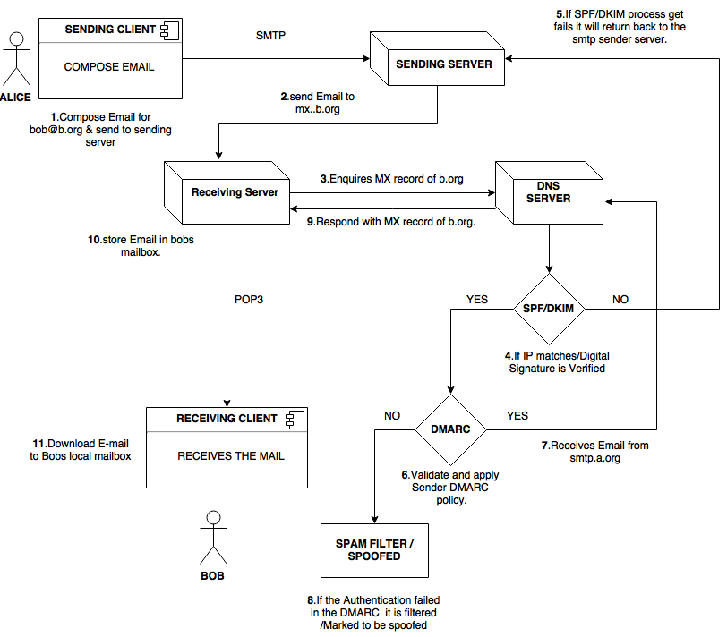
PROCEDURE

Slide 5
CONTD..
Sender side server-->Zimbra mail server
Receiver side server-->Oracle convergence server
Spam detection is done on Oracle convergence server

Slide 6
SPOOFED MAIL
Changing of headers
IP spoofing
Through Fake websites

