Slide 2
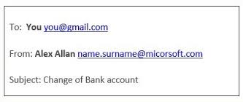
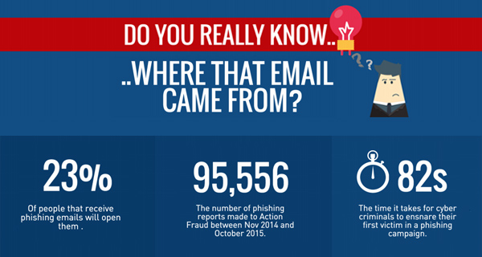
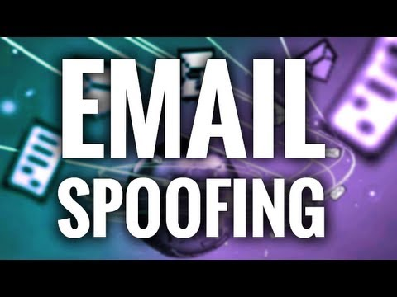
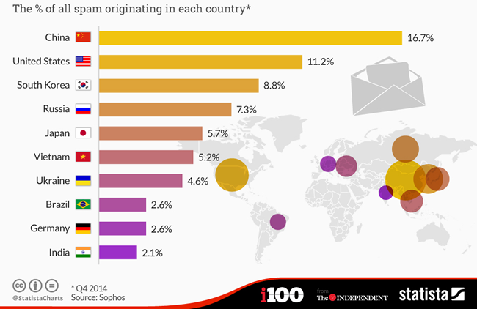

Slide 3
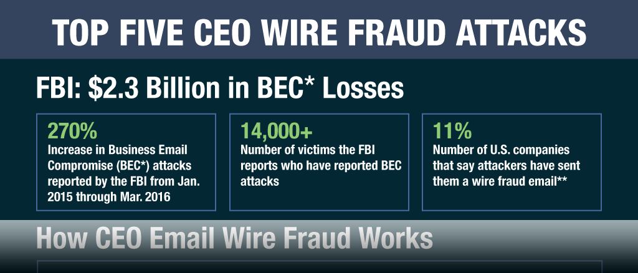
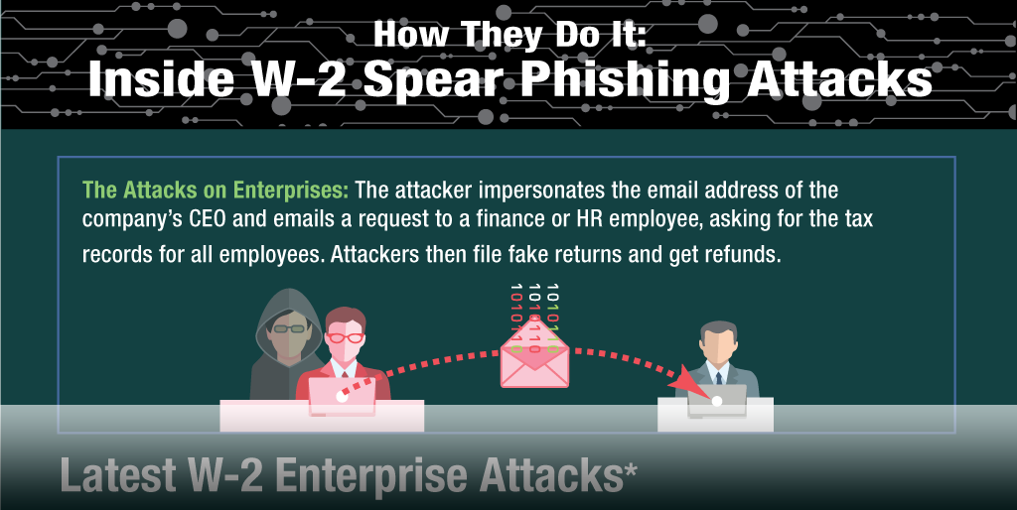
276 of Top 500 domain ranked by Alexa are vulnerable

Slide 4
The Top Phishing Attacks of 2016
Snapchat spear-phishing company’s CEO - payroll information leaked
Democratic National Committee (DNC) - Hillary Clinton personal Gmail account breached - released internal communications of the Democratic Party
Seagate Technology - exposure of W2 tax documents
Sony PlayStation - hackers hijacking accounts and denying players’ - currency stolen
North Korea - compromised thousands of government officials’ email accounts

Slide 5
Sender Policy Framework (SPF)
DomainKeys Identified Mail
Domain-based Message Authentication, Reporting and Conformance

