Slide 1
AISatyagrah Export
Date: 2025-10-12

Slide 2
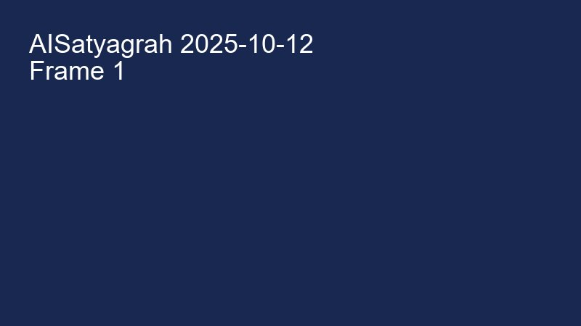
frame_001.png (11 KB)

Slide 3

frame_002.png (12 KB)

Slide 4
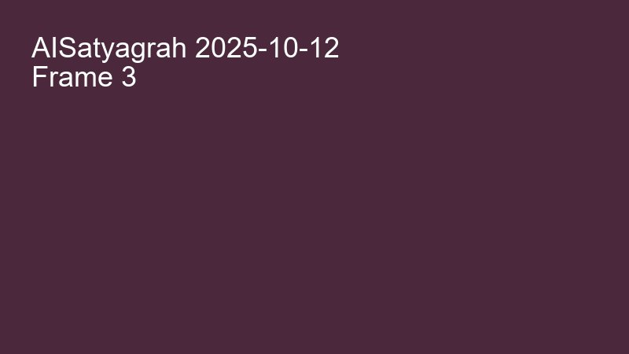
frame_003.png (12 KB)

Slide 5

frame_004.png (12 KB)

Slide 6

frame_005.png (12 KB)

Slide 7

frame_006.png (12 KB)

