Slide 1
Tikakaran
Name: Vikram Badhan
Enroll No: 05415003114
Maharaja Surajmal Institute of
Technology
IT-3rd year, Morning Shift

Slide 2
What is Tikakaran????
Tikakaran is the administration of antigenic material (a tika) to stimulate an individual's immune system to develop adaptive immunity to a pathogen. Tika can prevent or ameliorate morbidity from infection.
Tika create immunity that protects us from an infection without causing the suffering of the disease itself.
Here's how tika work:
Mostly tika contain a little bit of a disease germ that is weak or dead. It does not contain the type of germ that makes you sick. Some do not contain any germs.
Having this little bit of the germ inside your body makes your body's defence system build antibodies to fight off this kind of germ. Antibodies help trap and kill germs that could lead to disease.
Your body can make antibodies in two ways: by getting the disease or by getting the tika. Getting the tika is a much safer way to make antibodies without having the suffering of the disease itself and the risk of becoming disabled or even dying.

Slide 3
Why Tikakaran
Tikakaran protect us from specific diseases that can make us very sick, disable or even kill us. They boost our body's own defence system, which is also called the immune system.
More Facts
Newborn babies are immune to many diseases because they have antibodies they got from their mothers. However, this immunity goes away during the first year of life.
If an unvaccinated child is exposed to a disease germ, the child's body may not be strong enough to fight the disease. Before vaccines, many children died from diseases that vaccines now prevent, such as whooping cough, measles, and polio. Those same germs exist today, but because babies are protected by vaccines, we don’t see these diseases nearly as often.
Immunizing individual children also helps to protect the health of our community, especially those people who cannot be immunized (children who are too young to be vaccinated, or those who can’t receive certain vaccines for medical reasons).

Slide 4
Tikakaran Portal

Slide 5
Features Added
(i) Home: This shows the introduction part of our web project-Tikakaran
(ii) About us - This feature provide a detailed information regarding Tikakaran
(iii) Contact- This feature is provided as a helpline

Slide 6
Services
(i) Tika Scheduler
(ii) Tika Reminder
(iii) Tika locator
(iv) Tika at Home

Slide 7
Tika Scheduler
This schedular provides generally recommended dates for tikakaran based on child's birth .

Slide 8
Tika Reminder
This service sends the reminder message to the user . So that user knows about tika date of a child.

Slide 9
Tika Locator
This service locates the nearby tika center for the child

Slide 10
Tika at Home
This service is home

Slide 11
Flow of website

Slide 12
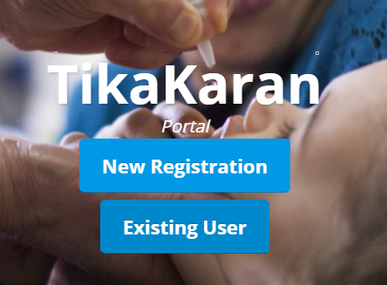
For new registration
If user is not registered

Slide 13
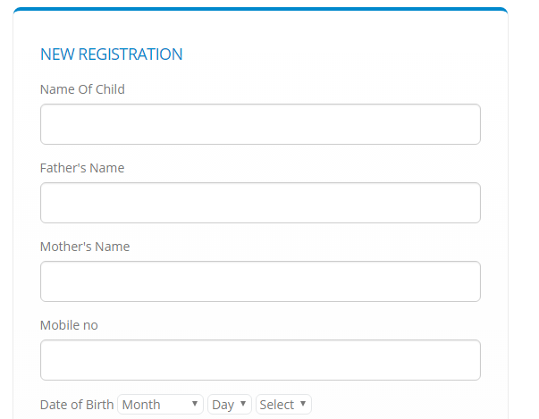
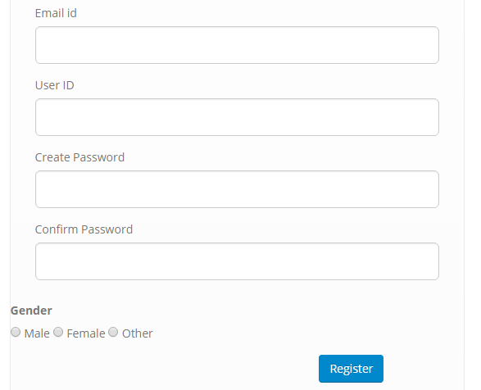
By clicking on New Registration
In this , user enter all the details
Like name of child , father’s name etc.
By clicking on Register button , page direct to log in page.

Slide 14
If the user already Exists
Then user clicked on this

Slide 15
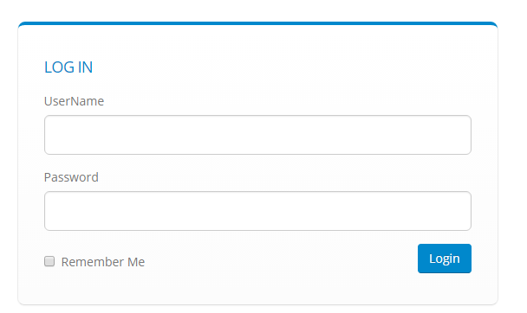
By clicking on existing user
User enter the same details
as mentioned in registration
time .
By clicking on login button,
user get the scheduler of
tikakaran for child.

Slide 16
THANK YOU !!!

