Slide 1
فيلورا
WEEKLY UPDATE · AUGUST 2026 · ABU DHABI
Velora ▸
ELEVATING EVERY JOURNEY
EXECUTIVE AGENT · AGENTICAD PHASE 1
Executive Agent
on SAP
A secure, auditable Microsoft-based agent that answers executive questions live from SAP — nine capabilities, delivered to a 30 September issuance date.
Design principle
—
No new access rights. Every answer is trimmed by the user's existing SAP authorisations and recorded on both sides — auditable end to end. This week's MCP server build carries that principle into the SAP integration layer itself.
Prepared for Velora · Abu Dhabi, United Arab Emirates

Slide 2
PHASE 1 · CAPABILITY COVERAGE
فيلورا
Velora ▸
The AI agent — nine capabilities
ELEVATING EVERY JOURNEY
Covered
Partial
Next phase
5 covered · 2 partial · 2 next phase
01
ENTERPRISE DATA QUERY
COVERED
02
PROACTIVE RECOMMENDATION
COVERED
03
EVALUATION ENGINE
COVERED
AR, AP, P&L, budget variance, Emiratisation, headcount — answered from SAP, trimmed to the executive's own permissions.
Covered on the six agreed KPIs. On an Emiratisation review it flags hiring/headcount and the change % unprompted.
Evaluates against existing data — e.g. Emiratisation at 80% of the UAE standard, current vs target.
04
BRIEFING & SYNTHESIS
COVERED
05
AGENT CREATION
NEXT PHASE
06
INSTITUTIONAL MEMORY
COVERED
Connected to the executive inbox for briefs, digests and synthesis ahead of meetings.
Deferred until data governance is in place, so agents are created within a governed scope.
Meeting notes and documents searchable for executives and their successors from go-live.
07
MEETING INTELLIGENCE
PARTIAL
08
PEER BENCHMARKING
NEXT PHASE
09
DECISION TRACEABILITY
PARTIAL
Minutes and action tracking covered. Completely covered with an external party (MDS) for live call-join and follow-up.
Deferred until approved benchmark data is provided.
Copilot-side covered. Completely covered when Purview is provisioned — full dual audit.
Velora · AgenticAD Executive Agent · Phase 1 coverage
Confidential · August 2026

Slide 3
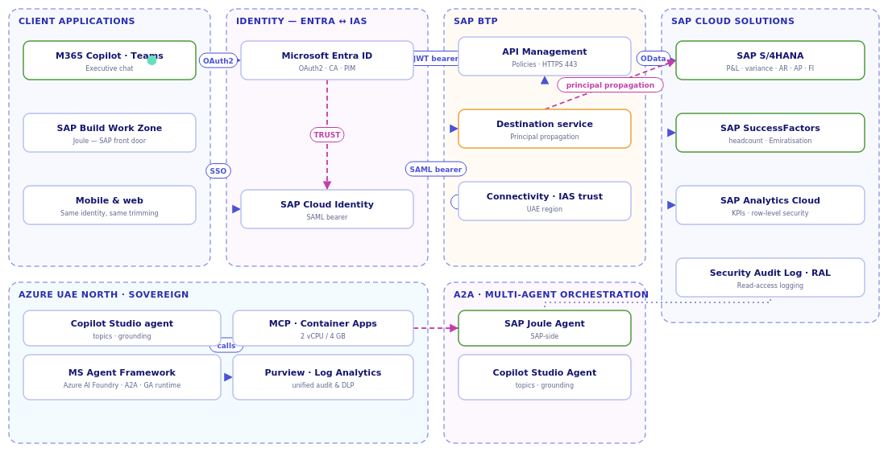
ARCHITECTURE · DELEGATED IDENTITY
فيلورا
Velora ▸
The Executive Agent — end to end
ELEVATING EVERY JOURNEY
API / data call
Identity trust / delegation
Audit & telemetry
No new access — the query runs in SAP as the named executive, trimmed by the user's own PFCG/RBP authorisations, and recorded twice — SAP's Read-Access Log and Purview.
Velora · delegated identity · no service account on the interactive read path
Confidential · August 2026

Slide 4
SAP ACTIVITIES · COVERED
فيلورا
Velora ▸
Six executive queries, live from SAP
ELEVATING EVERY JOURNEY
SAP-side services are active and ready. The executive asks in M365 Copilot; the agent queries S/4HANA and SuccessFactors under the executive's own SAP roles and returns a sourced, permission-trimmed answer.
01
02
03
Headcount
Emiratisation
Receivables / Revenue
Headcount and position-count queries, trimmed by SuccessFactors role-based permissions.
Emiratisation ratio served as an aggregate KPI only — the PDPL rule enforced by design, no personal records.
Receivables aging buckets — who owes what, how overdue — without raising a report request.
SuccessFactors · EmpJob
SuccessFactors OData
S/4HANA · FI Accounts Receivable
04
05
06
Payables
P&L
Budget Variance
Open payables and their aging — upcoming payment exposure visible in one question.
Live profit & loss view on demand — revenue, cost and margin by period, from the finance ledger.
Budget vs actual with the variance drivers, cited to source.
S/4HANA · FI Accounts Payable
S/4HANA · Finance
S/4HANA · Finance
Front door: M365 Copilot / Teams
Permission-trimmed at source — PFCG & RBP
Every answer: reasoning · sources · confidence → C9 audit log
Velora · C1 Enterprise Data Query · SAP services active
Confidential · August 2026

Slide 5
WEEKLY STATUS
فيلورا
Velora ▸
Where we are this week
ELEVATING EVERY JOURNEY
Done this week
Planned next week
Issues & blockers
delivered
this coming week
called out
MCP server for SAP S/4HANA — built and confirmed working.
MCP server for SAP SuccessFactors — built and integrated with QA data; testing in progress.
Detailed working session held with the infra team.
Restore SAP DEV/QA and complete unit testing on both MCP servers.
Deploy the MCP server(s) to Azure Container Apps.
Test SAP data routes via the intranet/private path, not the public internet.
Chase Cyber Security for a firm VM/container/Dataverse sign-off date.
HR to supply the Emiratisation data source; ADD to supply the audit format.
SAP DEV/QA environment down since Mon 3 Aug — still down; blocking unit testing.
VM/container/Dataverse — infra complete, Cyber Security sign-off pending.
SF MCP server holds QA data only; PROD connection needs approval.
Emiratisation % not tracked by HR function today — must be supplied.
C9 audit storage/reporting format awaited from ADD.
We are in Sprint 1 · Spine & SAP. MCP-based SAP integration is built and testing; Sprint 0's environment/security items are still open and are now the pacing risk alongside the DEV/QA outage.
Velora · AgenticAD Executive Agent · weekly status
Confidential · August 2026

Slide 6
SCHEDULE TRACKING · NEW THIS WEEK
فيلورا
Velora ▸
Baseline vs. actual
ELEVATING EVERY JOURNEY
Baseline anchor: 15 July 2026 (confirmed). Deviation is measured against the Sprint 0–5 schedule issued at kickoff.
M0 · Foundations gate
RED
M1 · Sprint 1 exit
AMBER
Baseline: 24 Jul 2026
Baseline: 7 Aug 2026 — closes today
Open — Cyber Security sign-off pending on VM / container / Dataverse
MCP servers built; unit testing incomplete — SAP DEV/QA down since Mon 3 Aug
Deviation: 10+ working days behind, still open
Deviation: At risk of slipping past today's baseline
Milestone | Baseline | This week's status | Deviation
M2 — Sprint 2 exit | 21 Aug 2026 | Not started | —
M3 — Development complete (code freeze) | 4 Sep 2026 | Not started | —
M4 — System test complete | 18 Sep 2026 | Not started | —
M5 — Executive UAT sign-off | 24 Sep 2026 | Not started | —
M6 — Deployed / issued | 29 Sep 2026 | Not started | —
ADAA deadline | 30 Sep 2026 | 5-day buffer intact — under pressure from M0/M1 slip | Watch
Velora · schedule baseline vs actual · interactive toggle in the HTML file
Confidential · August 2026

Slide 7
PREREQUISITES · ARCHITECTURE & DEVELOPMENT VIEW
فيلورا
Velora ▸
What we need, and by when
ELEVATING EVERY JOURNEY
Blockers older than 5 working days escalate to the sponsor. Completed items shown in green.
Software licences
INFRA
by 20 Jul
Developer access & workspace
CYBER SEC
escalated
✓ M365 Copilot — provided (3 dev/test + 1 CEO).
Power Platform premium + Dataverse — Dataverse is the ADAA audit database.
✓ Entra ID P1/P2 — already in place by default.
Data Science VM, container app environment & Dataverse — infra build complete.
Now pending Cyber Security review and sign-off — this week's critical path.
Entra ID access — Client ID + Client secret for the on-behalf-of flow.
Purview access — audit-log read for the dual audit trail.
Azure & SAP readiness
SAP LEAD
in progress
Written confirmations · AgenticAD PMO
DAVID
by 15 Aug
✓ SAP-side enablement — OData for six queries, least-privilege user. Active & ready.
✓ SAP S/4 MCP server — built and working.
SAP SuccessFactors MCP server — built, QA data connected; PROD access needs approval.
Sub-agent rule — executive-created agents count as “without IT involvement”.
ADAA evidence format — how evidence is packaged; pack built per capability.
C9 audit storage & reporting format — requested from ADD, awaited.
Critical path: Cyber Security sign-off on VM/container/Dataverse, and the SAP DEV/QA outage, are the two items pacing this week's build.
Velora · prerequisites · owners & target dates
Confidential · August 2026

Slide 8
DELIVERY BOARD · WHO IS DOING WHAT
فيلورا
Velora ▸
Six sprints — all tasks, owners & status
ELEVATING EVERY JOURNEY
Complete
In progress
Not started
Blocked
35 tasks across S0–S5 · full sprint & owner filters in the interactive HTML
FOUNDATIONS & ENVIRONMENTS · S0
6 · Cyber Sec pending
AUTOMATION · S2
Not started
F1 · Delivery baseline, sprint plan & kickoff
PMO Lead
5 tasks
F2 · Licence position & capacity forecast
PMO Lead
C2 recommendation engine, C7 flows, C5 logging, C1 hardening — Maker B
F3 · Power Platform Dev/Test/Prod, DLP & ALM
Architect
F4 · Dataverse solution shell & logging schema
Maker B
F5 · Security baseline — Purview, conditional access
Security Lead
F6 · Developer workstation & named tenant identity
Architect
INSTRUCTION LAYER · S3
Not started
SAP READINESS · S0
5 · complete
5 tasks
P1 · Integration lead nominated; OData list drafted
SAP Lead
C3 Evaluation, C6 Institutional Memory, C5 journey, C8 Benchmarking — Maker A
P2 · Least-privilege technical user created
SAP Lead
P3 · OData services activated for the six queries
SAP Lead
P4 · Network path confirmed — private endpoint
Architect
P5 · Representative demo dataset agreed (fallback)
Data Owner
SYSTEM TEST · S4
Not started
AGENT BUILD · SPINE & SAP · S0–S1
8 · MCP layer live
1 task
A1 · Master Agent shell baselined (Copilot Studio)
PMO Lead
Capability scripts, regression, security & injection probes — Security Lead
A2 · C9 Decision Traceability — reasoning, sources
Maker B
A3 · SAP S/4 MCP server built & working
Maker B
A4 · SAP SF MCP server — QA data; PROD pending
Maker B
UAT & DEPLOY · S5
Not started
A5 · C1 Enterprise Data Query — SAP OData connection
Maker B
5 tasks
A6 · C4 Briefing & Synthesis — Copilot native config
Maker A
Executive UAT, production deploy, Adoption Index, hypercare, evidence pack
A7 · Master Agent orchestration v1
Maker A
A8 · Leave handover — deputy brief
PMO Lead
Velora · delivery board · owners & status · full interactive board in the HTML file
Confidential · August 2026

Slide 9
RAID
فيلورا
Velora ▸
Risks & issues under management
ELEVATING EVERY JOURNEY
REF
RISK / ISSUE
RAG
MITIGATION & POSITION
R8
Prerequisites outstanding beyond the escalation threshold
Red
Infra-side build (VM/container/Dataverse) complete. Now blocked on Cyber Security review — recommend a named owner and date.
R12
SAP DEV/QA environment down, blocking unit testing
Red
Down since Mon 3 Aug. Needed to complete MCP server unit testing for C1/C9.
R2
SAP OData exposure / technical user delayed by hypercare
Green
Resolved — SAP OData for the six queries, plus SAC, active. MCP servers now built on top.
R9
Emiratisation % not maintained in SAP SuccessFactors
Amber
Not currently tracked by the HR function. HR to supply source and refresh cadence before C1/C3 can serve it as SAP-governed.
R10
C9 audit trail storage & reporting design open
Amber
Format to be provided by ADD — requested, not yet received. Target design already specified in the Architect Brief.
R11
SF MCP server connected to QA data only
Amber
PROD data connection requires approval before this capability can move beyond testing.
R1
Stricter reading of the sub-agent requirement
Amber
Written confirmation requested and chased weekly. Fallback design already scoped.
R3
August leave thins build capacity in the critical window
Amber
Sprint 1 sequenced before leave; Sprint 2 developer-only; Deputy carries the delivery tier.
R5
Adoption reporting template arrives late
Amber
Broad telemetry instrumented now so most index formulas are computable retrospectively.
R7
Prompt injection or data exfiltration via connected paths
Amber
Least privilege, permission trimming, DLP; MCP endpoints now live — Sprint 4 test scope to include container isolation & transport security checks.
R4
Credit burn on the daily autonomous scan exceeds forecast
Green
Forecast prepared; scan scope and frequency tunable. Checkpoint mid Sprint 2.
R6
Validation format unknown — demo, document or site visit
Green
Evidence pack built per capability from Sprint 1 so any format can be served.
Velora · RAID · R8/R12 red · R2/R4/R6 green · remainder amber
Confidential · August 2026

