Slide 1
Project Name :Chicago Crime Analyzer
Name- Vikram Pratap Singh
Master in Data Science- Guvi
Email – sify.vikram@gmail.com

Slide 2
Problem Understanding
Notable surge in crime activity observed in recent Chicago records.
Assigned as Senior Investigation Officer to Chicago on special assignment.
Analyze historical and current crime data to unveil patterns, trends, and high-risk areas.
Guide strategic decisions, optimize resource distribution, and enhance public safety through data-driven insights.

Slide 3
Solution
The resale flat market in Singapore is highly competitive, and it can be challenging to accurately estimate the resale value of a flat. There are many factors that can affect resale prices, such as location, flat type, floor area, and lease duration.
A predictive model can help to overcome these challenges by providing users with an estimated resale price based on these factors.
Analyze historical and current crime data to unveil patterns, trends, and high-risk areas.
This model leverages historical data and advanced machine learning algorithms to analyze and predict the resale prices, offering a valuable tool for both buyers and sellers navigating the market.

Slide 4
Goal of the project
Data Collection and Preprocessing: Collect a dataset of resale flat transactions from the Singapore Housing and Development Board (HDB) for the years 1990 to Till Date. Preprocess the data to clean and structure it for machine learning.
Feature Engineering: Extract relevant features from the dataset, including town, flat type, storey range, floor area, flat model, and lease commence date. Create any additional features that may enhance prediction accuracy.
Model Selection and Training: Choose an appropriate machine learning model for regression (e.g., linear regression, decision trees, or random forests). Train the model on the historical data, using a portion of the dataset for training.

Slide 5
Goal of the project
Temporal Analysis
Examine crime trends over time by plotting the number of crimes per year, month, or day to identify trends or seasonal variations.
Determine peak crime hours by analyzing the 'Date' and 'Time' fields to understand when crimes are most frequently reported.
Geospatial Analysis
Identify crime hotspots using latitude and longitude coordinates, utilizing tools like heatmaps or kernel density estimation.
Compare crime rates across different districts and wards to identify areas more prone to specific types of crimes.
Crime Type Analysis
Analyze the frequency of different crime types to understand the most common types of crimes.
Investigate the distribution of severe crimes versus less severe crimes to understand the severity of criminal activity.
Arrest and Domestic Incident Analysis
Calculate arrest rates by crime type, location, and time period to assess law enforcement effectiveness.
Compare characteristics and frequencies of domestic-related incidents versus non-domestic incidents.
Location-Specific Analysis
Investigate common crime locations (e.g., streets, parking lots) and how crime types vary by location.
Analyze crime data by beat and community area to identify localized crime patterns and hotspots.

Slide 6
Goal of the project
Seasonal and Weather Impact
Examine whether certain types of crimes are more prevalent in specific seasons to understand seasonal trends.
Investigate the impact of weather conditions on crime occurrences.
Repeat Offenders and Recidivism
Identify locations repeatedly associated with criminal activity to understand repeat crime locations.
Analyze recidivism rates and factors contributing to repeat offenses if data on repeat offenders is available.
Predictive Modeling and Risk Assessment
Develop models to predict future crime incidents based on historical data and relevant factors.
Assess the risk of different areas and times for specific types of crimes to aid resource allocation for law enforcement.
Visualization and Reporting
Create interactive dashboards to dynamically visualize and explore crime data.
Generate detailed reports highlighting key trends, hotspots, and critical insights for stakeholders.
Potential Insights:
Trends and seasonal variations in crime occurrences.
High-risk areas and hotspots for different types of crimes.
Effectiveness of law enforcement in making arrests.
Patterns of domestic-related crimes.
Common locations for specific types of crimes.

Slide 7
Benefit from the project:
Improved Understanding of Crime Trends
Effective Resource Allocation
Enhanced Crime Prevention Strategies
Improved Law Enforcement Response
Identification of Repeat Offenders and Hotspots
Enhanced Predictive Capabilities
Increased Transparency and Accountability

Slide 8
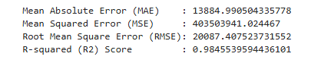
Model Evaluation
The MAE shows the average absolute error between predicted and actual values.
The MSE and RMSE provide insight into the average squared and root squared errors, respectively, with RMSE being in the same units as the target variable, making it more interpretable.
The R² score indicates that approximately 98.46% of the variance in the resale prices can be explained by the model, demonstrating a high level of predictive accuracy.

Slide 9
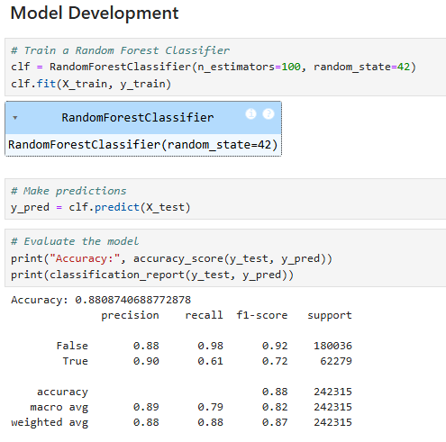
Best Model

