Slide 1
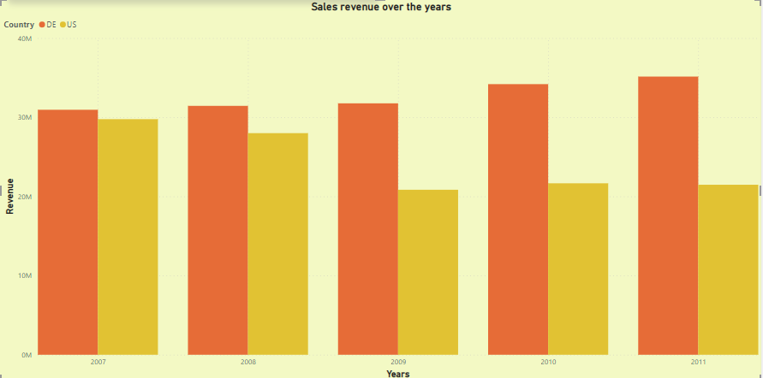
Section - A
1. Highlight the behavior of the two countries' sales revenue over the years.
After the Lehman Crisis, The US market fell continuously and decreased revenue year on year, The side Lehman Crisis didn’t affect the Germany(DE) market the revenue increased year on year,
You show in the Graph.

Slide 2
2. Try to identify reasons for this behavior in the data?
Economic Recession: The U.S. experienced a significant rise in unemployment, declining GDP growth, and a housing market collapse, resulting in a prolonged period of economic downturn.
Government Response: The Federal Reserve implemented monetary policy measures, such as lowering interest rates and implementing quantitative easing, to stimulate the economy and restore liquidity.
Public Confidence: There was public outcry over the use of taxpayer money to bail out failing banks, leading to calls for increased regulation and accountability in the financial sector.
Economic Impact: The German economy experienced a severe contraction as global trade declined, demand for German exports decreased, and access to credit tightened. Industries such as manufacturing and automotive, which heavily rely on exports, faced significant challenges.
Banking Sector: German banks were exposed to the global financial crisis due to their investments in U.S. mortgage-backed securities and complex financial instruments. Some German banks faced liquidity problems, and others incurred substantial losses, requiring government interventions and support to prevent systemic risks.

Slide 3
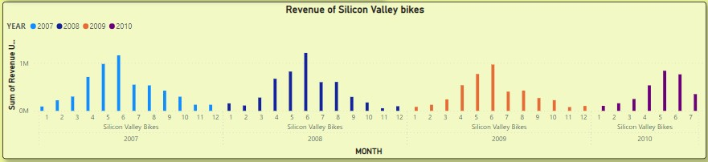
3. For this question exclude this customer (Silicon Valley Bikes) from the subsequent step, look at the monthly Sales Revenue compared to the previous year. Relate your result to the Lehman Crisis in 2008
Before the Lehman Crisis, The revenue of Silicon Valley Bikes is more than after the Lehman Crisis,
You see in the bar Graph.

Slide 4
Section - B
1. Which product sold the least number (in terms of overall quantity) each year?
- The less sold item in 2009, the product is BOTL1000. You can see it in the dashboard.
2. Which product category provided the most revenue each year?
- The top-sold product category is TRE in 2007. You can see it in the dashboard.
3(a). For in 2011, What percentage did sales of the product category: 'off-road bikes' contribute to the overall bicycle sales quantity?
- The Off-road bikes (ORB) are contributing 28.9% in sales of the product category in the year 2011.
You can see it in the dashboard.
3(b). For 2011, in which 3 cities was this percentage significantly above the average?
- The 3 cities in this percentage are.
München -12.54%
Homburg -9.84%
Stuttgart -7%

Slide 5
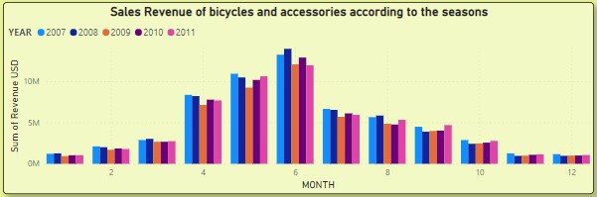
4. One would normally expect that bicycles and accessories would more likely be purchased during spring and summer, rather than during fall and winter time. To investigate whether this hypothesis holds for all products,
- The Revenue of Sales based on the season.
Spring Season
Summer Season
You can see here sale revenue increases between the spring season and summer seasons.
And you can see it clearly in the dashboard.

Slide 6
5. As an Analyst Generate Insight and recommendations from the provided data.
- Your data was clean, I don’t need to clean the data.
I converted your data into visual form for better understanding.
There were answers to your questions, It is the best insight of your dataset.
Thank you
Vikram Dhakad

