Slide 1
COLLABORATIVE STUDY VAULT
Student Details:
DINGARI VIKRAM (24EG105K19)
Project Guide:
[Guide Name]
[Designation]
Department of Computer Science and Engineering
Anurag University

Slide 2
Index
1. Introduction
2. Problem Statement
3. Objectives
4. Scope of the Project
5. Existing System
6. Proposed System
7. Software & Hardware Requirements
8. System Design
9. Flowchart & Algorithm
10. Modules Description
11. Results / Output Screens
12. Advantages & Limitations
13. Internship & Learning Outcomes
14. Conclusion
15. References

Slide 3
1. Introduction
• The rapid advancement of technology has transformed education, but study tools remain fragmented.
• Students constantly switch between Notion (notes), Miro (whiteboards), and Quizlet (flashcards).
• This context-switching increases cognitive load and reduces study efficiency.
• Collaborative Study Vault is an all-in-one web platform designed to eliminate this fragmentation by integrating notes, live whiteboards, chat, and AI (Google Gemini).

Slide 4
2. Problem Statement
• Platform Fragmentation: Students juggle 5-7 different apps per session.
• Manual Effort: Creating quizzes and flashcards from notes is time-consuming.
• Eye Strain: Most platforms default to bright white interfaces.
• Security Risks: Many platforms use insecure localStorage for JWTs.

Slide 5
3. Objectives
• Develop a MERN-stack collaborative workspace in a single resizable window.
• Implement a real-time collaborative HTML5 Canvas whiteboard via WebSockets.
• Integrate Google Gemini 1.5 Flash AI to generate summaries, quizzes, and flashcards.
• Engineer a secure system using HttpOnly JWT cookies and CSRF protection.

Slide 6
4. Scope of the Project
• Secure user authentication, role-based access, and guest login.
• Workspace management with alphanumeric invite codes.
• Real-time collaborative note editing with pessimistic locking.
• AI-assisted study features and whiteboard vision analysis.

Slide 7
5. Existing System
• Notion: Excellent for notes, but lacks an integrated live whiteboard and free AI quiz generation.
• Miro: Great for whiteboarding, but lacks structured rich-text notes.
• Quizlet: Good for flashcards, but disconnected from where the actual notes are written.
• Disadvantages: Extreme cognitive fragmentation, expensive premium subscriptions for AI.

Slide 8
6. Proposed System
• A unified platform where notes, whiteboard, and AI are side-by-side.
• Powered by the MERN stack (MongoDB, Express, React, Node.js).
• Deep Navy Glassmorphism UI designed to reduce eye strain.
• Instant AI Active Recall: Convert any note to a 5-question quiz or 3D flashcards instantly via Gemini AI.

Slide 9
7. Software & Hardware Requirements
Software:
• Node.js, Express.js, React.js (Vite), MongoDB Atlas
• Socket.io (WebSockets), Google Gemini API
Hardware:
• Intel i3 / AMD Ryzen 3 or higher
• 8 GB RAM, 20 GB Disk Space
• Minimum 10 Mbps broadband connection

Slide 10
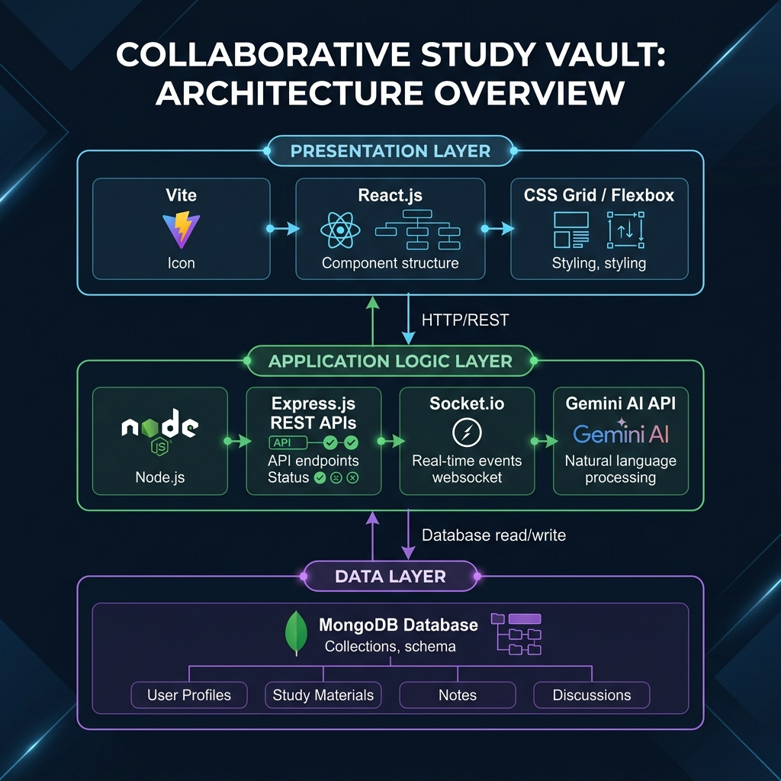
8. System Design & Architecture
• Presentation Tier: React.js SPA managing UI and Socket.io clients.
• Application Tier: Node/Express server handling REST APIs, CSRF validation, and WebSocket broadcasting.
• Data Tier: MongoDB Atlas storing Users, Workspaces, Notes, and Stroke Vectors.

Slide 11
10. Modules Description
• Auth Module: JWT HttpOnly cookies, bcrypt hashing, guest accounts.
• Workspace Module: Resizable 3-panel layout, invite codes, role management.
• Whiteboard Module: HTML5 Canvas, stroke normalization, Socket.io sync.
• AI Recall Module: Gemini Flash integration for summaries, quizzes, flashcards, and tutor chat.

Slide 12

11a. Results: Landing Page

Slide 13
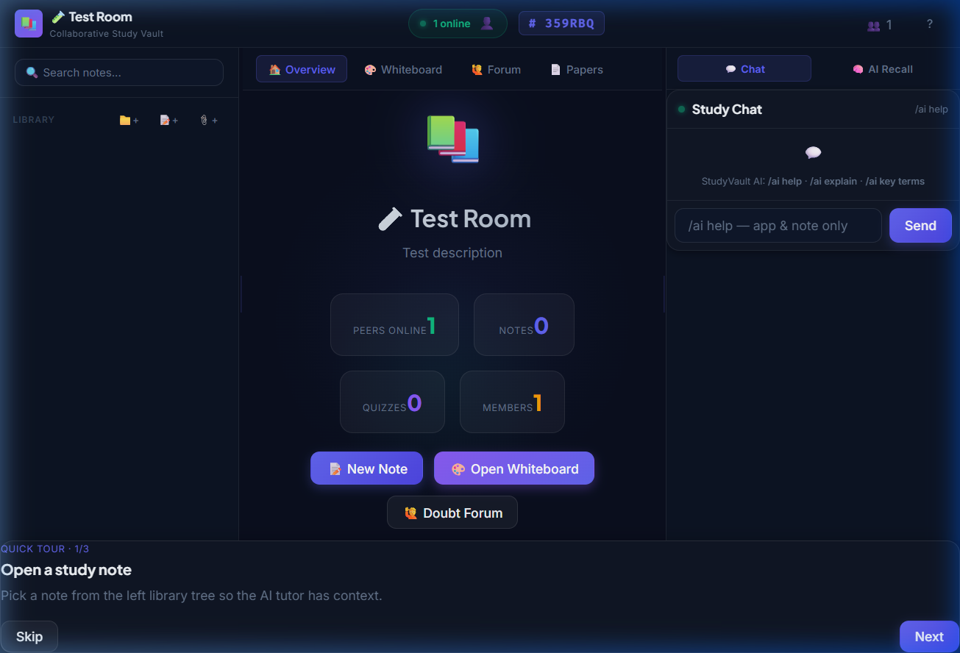
11b. Results: 3-Panel Workspace

Slide 14
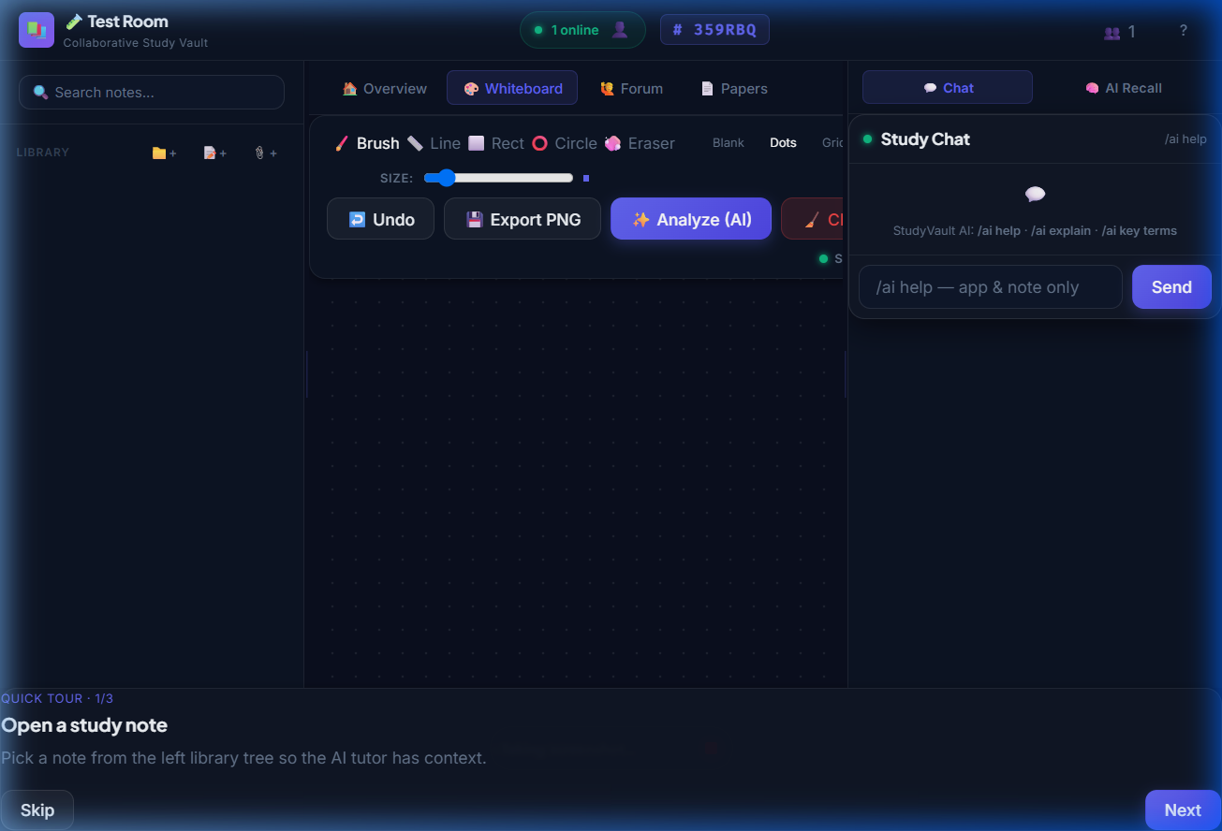
11c. Results: Whiteboard & AI

Slide 15
12. Advantages & Limitations
Advantages:
• Eliminates context-switching; dark-mode reduces eye strain.
• AI drastically reduces time taken to create study aids.
Limitations:
• AI features depend heavily on a valid Google Gemini API key.
• No offline mode (requires constant internet connection).

Slide 16
13. Internship & Learning Outcomes
• Objectives: Gain hands-on experience in full-stack web development (MERN).
• Work Carried Out: Designed UI/UX, built backend REST APIs, integrated WebSockets and AI.
• Tech Learning: Mastered React hooks, Socket.io rooms, MongoDB schemas, and API rate-limiting.
• Challenges: Normalizing whiteboard coordinates across different screen sizes and managing CSRF securely.

Slide 17
14. Future Enhancements
• Integrate WebRTC for real-time audio and video conferencing in study rooms.
• Implement CRDTs (like Yjs) for true simultaneous multi-cursor note editing.
• Develop an offline-capable Progressive Web App (PWA).
• Add an AI-driven Spaced Repetition scheduling algorithm for flashcards.

Slide 18
15. Conclusion
• Collaborative Study Vault successfully unifies critical study tools into a single, cohesive, highly secure workspace.
• By combining the real-time capabilities of the MERN stack with the generative power of Gemini AI, it provides a differentiated and highly effective learning environment.
• The project demonstrates the immense potential of modern web technologies to solve practical educational challenges.

Slide 19
16. References
• React.js Official Documentation (react.dev)
• Express.js and Node.js API Reference
• Google Gemini API Documentation (ai.google.dev)
• Socket.io Documentation for WebSockets
• MDN Web Docs: HTML5 Canvas API
• OWASP Cross-Site Request Forgery Prevention Guidelines

