Slide 1
COLLABORATIVE STUDY VAULT
Student Details
DINGARI VIKRAM (24EG105K19)
Project Guide
[Guide Name]
[Designation]

Slide 2
Index
Introduction
Problem Statement
Objectives
Scope of the Project
Existing System
Proposed System
Software & Hardware Requirements
System Design
Flowchart & Algorithm
Modules Description
Results / Output Screens
Advantages & Limitations
Future Enhancements
Conclusion
References

Slide 3
1. Introduction
The rapid advancement of technology has transformed education, but study tools remain fragmented.
Students constantly switch between Notion (notes), Miro (whiteboards), and Quizlet (flashcards).
This context-switching increases cognitive load and reduces study efficiency.
Collaborative Study Vault is an all-in-one web platform designed to eliminate this fragmentation by integrating notes, live whiteboards, chat, and AI (Google Gemini).

Slide 4
2. Problem Statement
Platform Fragmentation: Students juggle 5-7 different apps per session.
Manual Effort: Creating quizzes and flashcards from notes is time-consuming.
Eye Strain: Most platforms default to bright white interfaces.
Security Risks: Many platforms use insecure localStorage for JWTs.

Slide 5
3. Objectives
Develop a MERN-stack collaborative workspace in a single resizable window.
Implement a real-time collaborative HTML5 Canvas whiteboard via WebSockets.
Integrate Google Gemini 1.5 Flash AI to generate summaries, quizzes, and flashcards.
Engineer a secure system using HttpOnly JWT cookies and CSRF protection.

Slide 6
4. Scope of the Project
Secure user authentication, role-based access, and guest login.
Workspace management with alphanumeric invite codes.
Real-time collaborative note editing with pessimistic locking.
AI-assisted study features and whiteboard vision analysis.

Slide 7
5. Existing System
Notion: Excellent for notes, but lacks an integrated live whiteboard and free AI quiz generation.
Miro: Great for whiteboarding, but lacks structured rich-text notes.
Quizlet: Good for flashcards, but disconnected from where the actual notes are written.
Disadvantages: Extreme cognitive fragmentation, expensive premium subscriptions for AI.

Slide 8
6. Proposed System
A unified platform where notes, whiteboard, and AI are side-by-side.
Powered by the MERN stack (MongoDB, Express, React, Node.js).
Deep Navy Glassmorphism UI designed to reduce eye strain.
Instant AI Active Recall: Convert any note to a 5-question quiz or 3D flashcards instantly via Gemini AI.

Slide 9
7. Software & Hardware Requirements
Software:
• Node.js, Express.js, React.js (Vite), MongoDB Atlas
• Socket.io (WebSockets), Google Gemini API
Hardware:
• Intel i3 / AMD Ryzen 3 or higher
• 8 GB RAM, 20 GB Disk Space
• Minimum 10 Mbps broadband connection

Slide 10
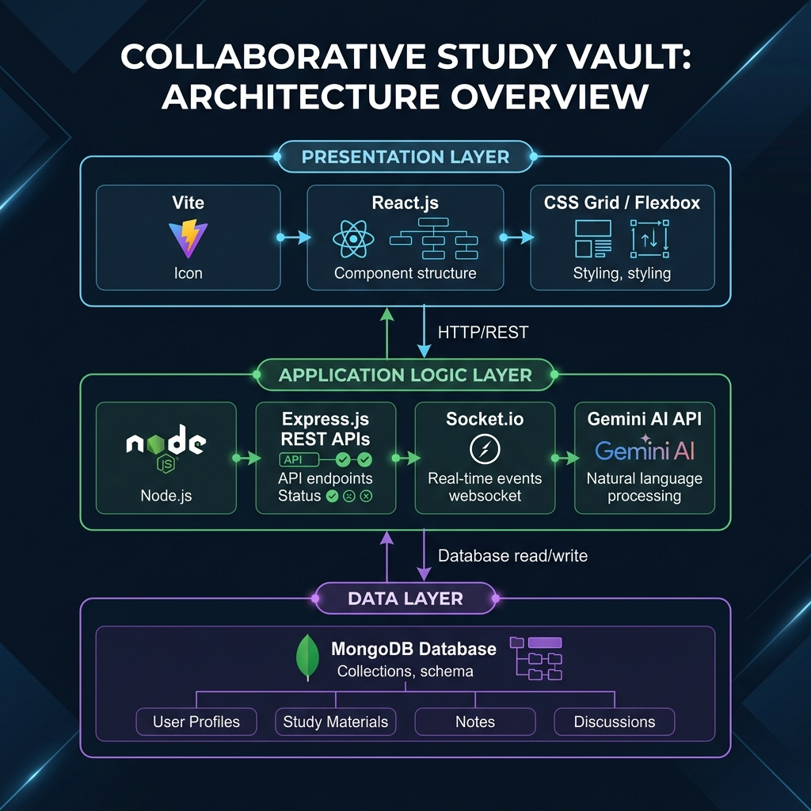
8. System Design & Architecture
Presentation Tier: React.js SPA managing UI and Socket.io clients.
Application Tier: Node/Express server handling REST APIs, CSRF validation, and WebSocket broadcasting.
Data Tier: MongoDB Atlas storing Users, Workspaces, Notes, and Stroke Vectors.

Slide 11
10. Modules Description
Auth Module: JWT HttpOnly cookies, bcrypt hashing, guest accounts.
Workspace Module: Resizable 3-panel layout, invite codes, role management.
Whiteboard Module: HTML5 Canvas, stroke normalization, Socket.io sync.
AI Recall Module: Gemini Flash integration for summaries, quizzes, flashcards, and tutor chat.

Slide 12

11a. Results: Landing Page

Slide 13
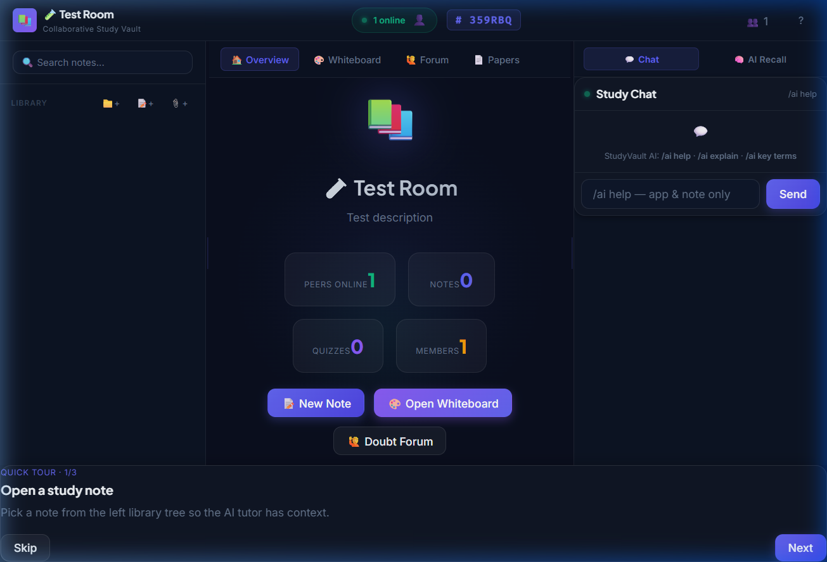
11b. Results: 3-Panel Workspace

Slide 14
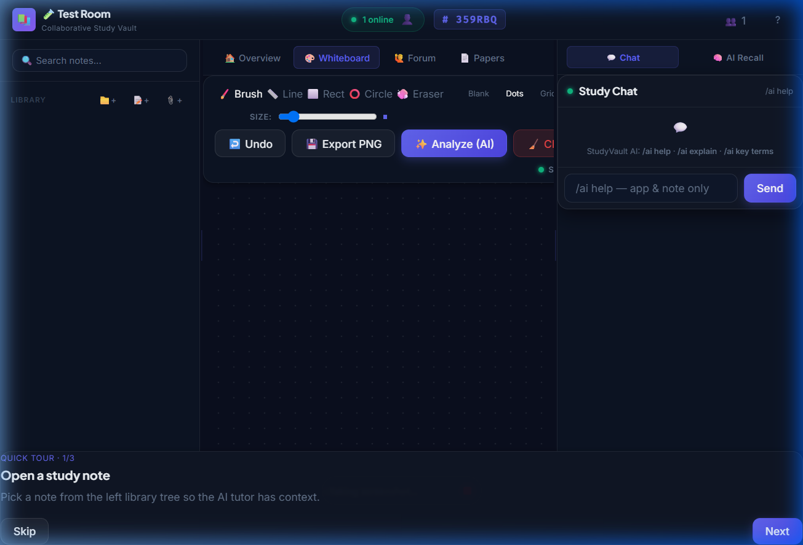
11c. Results: Whiteboard & AI

Slide 15
12. Advantages & Limitations
Advantages:
• Eliminates context-switching; dark-mode reduces eye strain.
• AI drastically reduces time taken to create study aids.
Limitations:
• AI features depend heavily on a valid Google Gemini API key.
• No offline mode (requires constant internet connection).

Slide 16
13. Internship & Learning Outcomes
Objectives: Gain hands-on experience in full-stack web development (MERN).
Work Carried Out: Designed UI/UX, built backend REST APIs, integrated WebSockets and AI.
Tech Learning: Mastered React hooks, Socket.io rooms, MongoDB schemas, and API rate-limiting.
Challenges: Normalizing whiteboard coordinates across different screen sizes and managing CSRF securely.

Slide 17
14. Future Enhancements
Integrate WebRTC for real-time audio and video conferencing in study rooms.
Implement CRDTs (like Yjs) for true simultaneous multi-cursor note editing.
Develop an offline-capable Progressive Web App (PWA).
Add an AI-driven Spaced Repetition scheduling algorithm for flashcards.

Slide 18
15. Conclusion
Collaborative Study Vault successfully unifies critical study tools into a single, cohesive, highly secure workspace.
By combining the real-time capabilities of the MERN stack with the generative power of Gemini AI, it provides a differentiated and highly effective learning environment.
The project demonstrates the immense potential of modern web technologies to solve practical educational challenges.

Slide 19
16. References
React.js Official Documentation (react.dev)
Express.js and Node.js API Reference
Google Gemini API Documentation (ai.google.dev)
Socket.io Documentation for WebSockets
MDN Web Docs: HTML5 Canvas API
OWASP Cross-Site Request Forgery Prevention Guidelines

