Slide 1
pHD
Vigneshwar

Slide 2
Prediction of collision, Pattern Extraction on vehicle Data
Predicting – collision level – Severity, Serious & Slight injury

Slide 3
Problem Statement
Predicting the severity of the injury due to collision by recognizing the key factors that influence accident severity.
This approach is to achieve the prevention of collision, preventing a potential unsafe road conditions from occurring in the first place
Independent Variables :
Collision Reference No., Policing Area, Collision Severity, Weekday of Collision
Month of Collision, Hour of Collision (24 hour), Carriageway Type
Speed Limit, Junction Detail, Junction Control, Pedestrian Crossing ? Human Control
Pedestrian Crossing ? Physical Control, Light Conditions ,
Weather Conditions, Road Surface Conditions , Special Conditions at Site
Dependent variable:
collision level – Fatal, Serious & Slight injury

Slide 4
Exploratory data analysis data pre_processing
Most of the independent variables are categorical with more than 3 levels
Conversion of datatypes in to categorical and numerical
Speed is the only variable with numerical data type
Imputation of categorical variables with mode as imputation of missing values
Prediction target variable has high class imbalance
Using SMOTE to upsample the minority data to bring it to equal proportion with the majority data

Slide 5
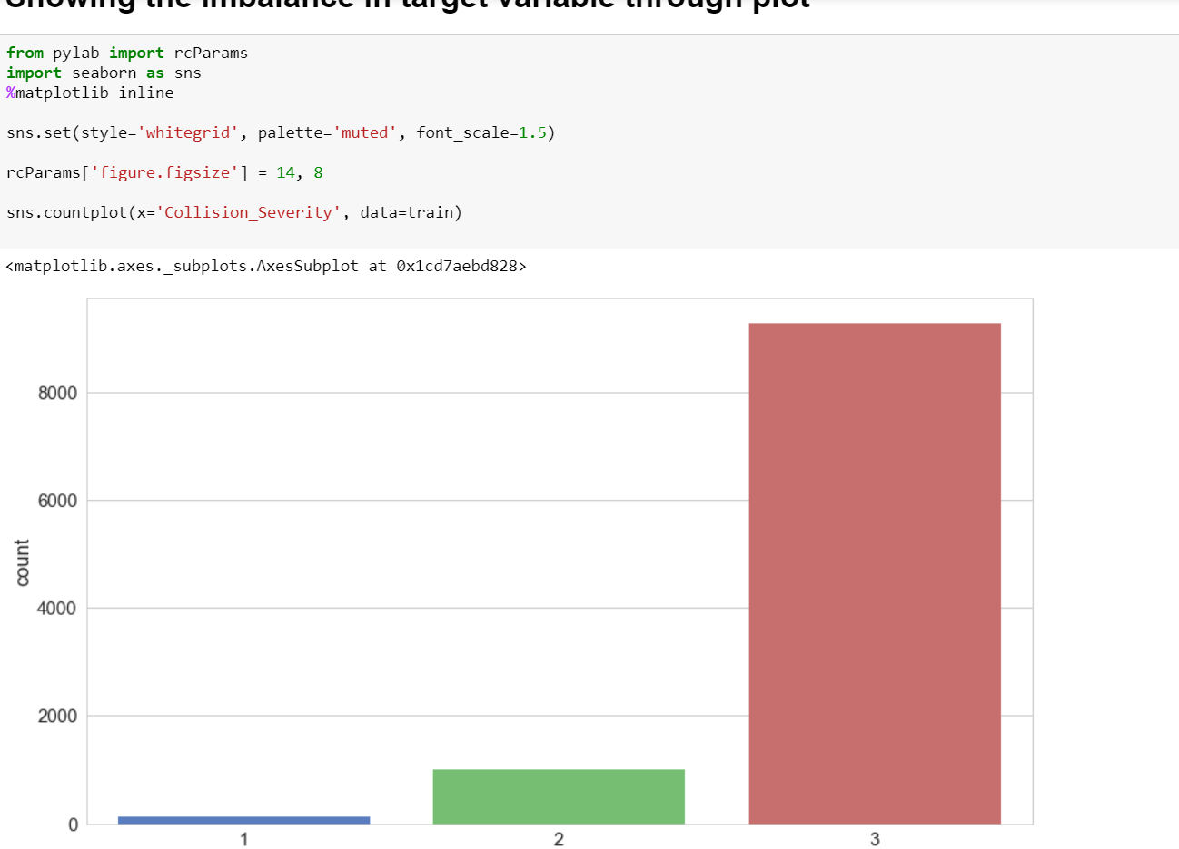
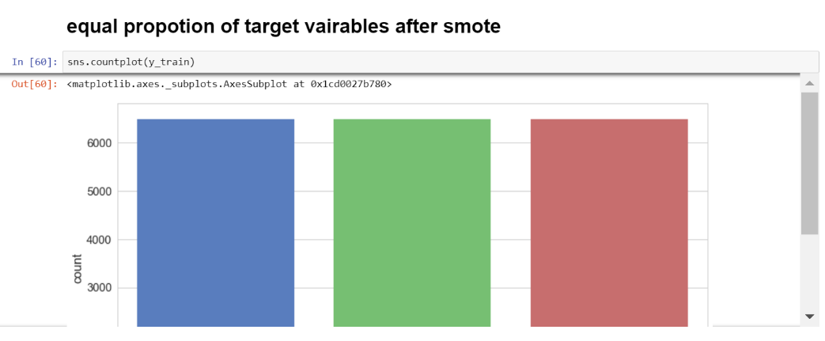
PreProcessing Steps
Class Imbalance
Class Balance

Slide 6
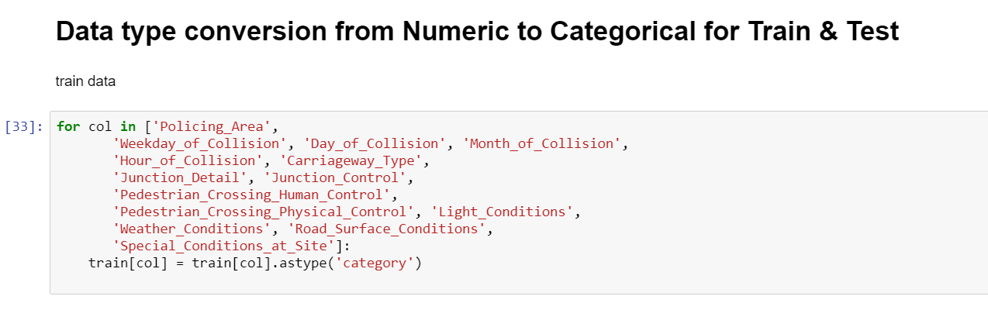
Pre Processing Models
Data conversion – converting all variables to categorical except Speed since it is a continuous data

Slide 7
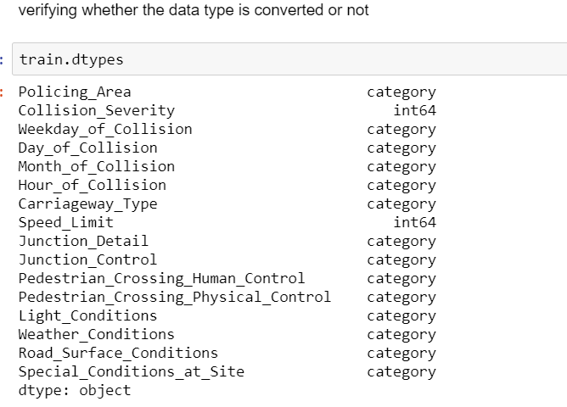
Pre Processing steps–
Datatype conversion
Train Test Validation Split
Imputation
Centering, scaling the numerical

Slide 8
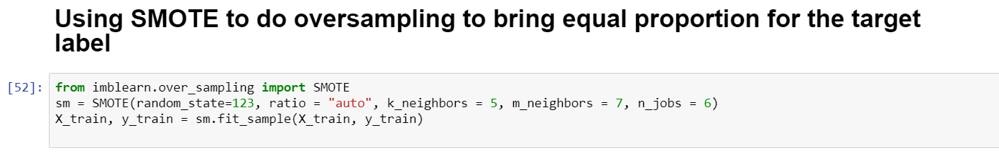
Preprocessing steps
SMOTE algorithm to balance the class proportion

Slide 9
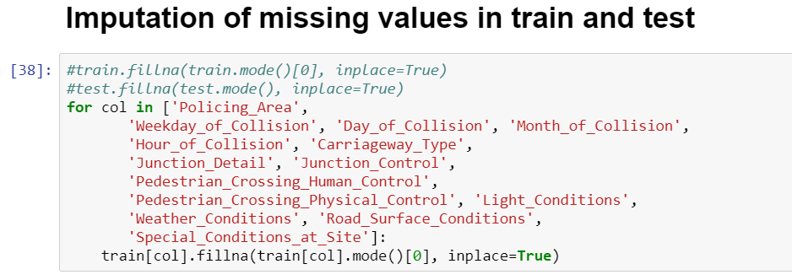
Preprocessing steps
Imputing the missing data of categorical using mode

Slide 10
Evaluation Metrics
Since it is classification problem we have to measure the accuracy of the model with help of
Accuracy
Specificity
Sensitivity
by comparing our predicted data and actual data of the splitted test data from the dataset
Package used for evaluating the metric:
ConfusionMatrix() function from Caret Package
Recall and precision are auxilliary metrics
F1 stat is used for evaluation

Slide 11
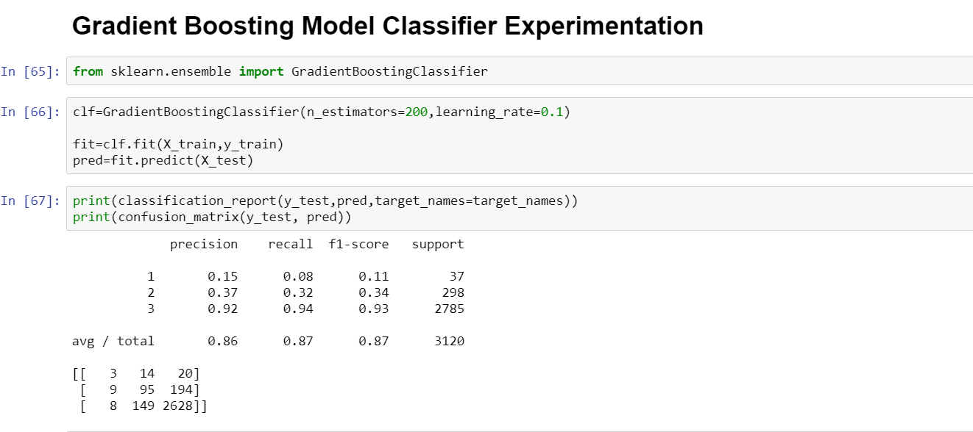
Final Model – Gradient Boosting Model
Gradient boosting model –
N_rounds – 200
Learning_rate – 0.1

Slide 12
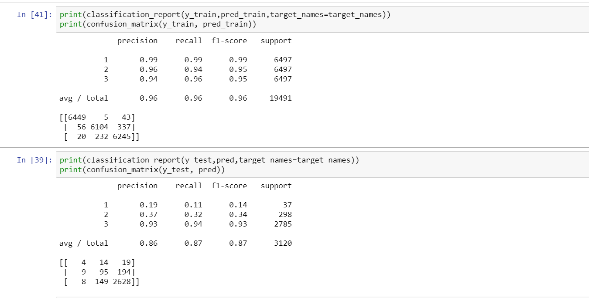
Evaluation Metrics

Slide 13
Pattern Generation
Pattern generation for the each class levels in target attribute.
Merging all the tables using the ref no
base_data_altered <- base_data[,!colnames(base_data) %in% c("Vehicle.Type","Vehicle.Reference.No")]
accident_data_1 <-merge(new_base_data, accident_data, by = "Collision.Reference.No.")
accident_data_2 <-merge(accident_data_1, collision_data, by = "Collision.Reference.No.")
accident_data_final <-merge(accident_data_2, base_data_altered, by = "Collision.Reference.No.")

Slide 14
PreProcessing
Imputation of the data using median and mode
accident_data_fin1 <-compute(accident_data_final, method = "median/mode" )
accident_data_fin <-impute(accident_data_final, object = NULL, method = "median/mode", flag = FALSE )

Slide 15
Suport, Confidence & Lift
Support, Confidence & Lift
Support = p(A and B)/Total Data = how many data support this rule
Condifence = support(A,B)/p(A and B) = how much confidence we can say it supports the rule
Lift = Confidence(A,B)/support(Y)
So we need to take the top 5 rules for each classes levels which supports high Support, Confidence & Lift.

Slide 16
Class 1
Rule 1: (2, lift 73.6)
Number.of.Vehicles = 6
Junction.Location.of.Vehicle.at.Time.of.Impact = 2
First.Object.Hit.in.Carriageway = 1
-> class 1 [0.750]
Rule 2: (5/1, lift 70.1)
Weather.Conditions in {1, 2}
Towing.and.Articulation = 2
Junction.Location.of.Vehicle.at.Time.of.Impact = 1
Skidding...Overturning = 1
First.Object.Hit.in.Carriageway = 1
Vehicle.Leaving.Carriageway = 1
Foreign.Registered. Vehicle = 1
-> class 1 [0.714]

Slide 17
Class 2
Rule 4: (14, lift 11.3)
Junction.Location.of.Vehicle.at.Time.of.Impact = 1
First.Object.Hit.in.Carriageway in {14, 15, 8}
-> class 2 [0.938]
Rule 5: (675/42, lift 11.3)
Number.of.Vehicles in {1, 2, 3, 4}
Towing.and.Articulation in {1, 2, 6}
Junction.Location.of.Vehicle.at.Time.of.Impact in {2, 3, 4, 5, 6, 7}
First.Object.Hit.in.Carriageway = 1
-> class 2 [0.936]

Slide 18
Class 3
Rule 13: (10917/20, lift 1.1)
Weather.Conditions in {1, 10, 2, 3, 9}
First.Object.Hit.in.Carriageway in {10, 11, 13, 14, 15, 3, 7, 8, 9}
First.Object.Hit.off.Carriageway in {10, 11, 2, 3, 4, 5, 6, 7, 8, 9}
-> class 3 [0.998]
Rule 14: (202, lift 1.1)
Carriageway.Type = 1
Junction.Control = 1
-> class 3 [0.995]
Rule 15: (101, lift 1.1)
Policing.Area in {ARBC, BMEN, DCST, FOYL, LISC}
Junction.Control = 7
Junction.Location.of.Vehicle.at.Time.of.Impact = 1
Vehicle.Leaving.Carriageway = 1
-> class 3 [0.990]

