Slide 1
CSE 7321 CUTe
Team no:13
Vigneshwar
Jaison
Anvesh

Slide 2
Supervised Multi classification
On LHSC services - Ticketing prediction based on the calls

Slide 3
Problem Statement
In LHSC Services, The Tickets have the details of Summary of the call and description of the calls written by various staff members
Based on the description of the call, we need to find the appropriate category(out of 6 Categories)
Independent Variables :
Total variables: 1
Datatype : String – Text Conversation
Dependent variable:
Datatype: Categorical (6 categories)
Predict the type of Call category based on the Call description and sumary

Slide 4
Exploratory data analysis data pre_processing
Converse Feature –
Word Tokenization – to assign unique numbers to each word
Text to Sequence – to frame the numbers based on the sentences for each observations
pad sequencing – to bring equal number of columns for all observations
Label Encoding for Target variable
Dummification of Target Variable
CountVectorizer
TfIdfTransformer

Slide 5
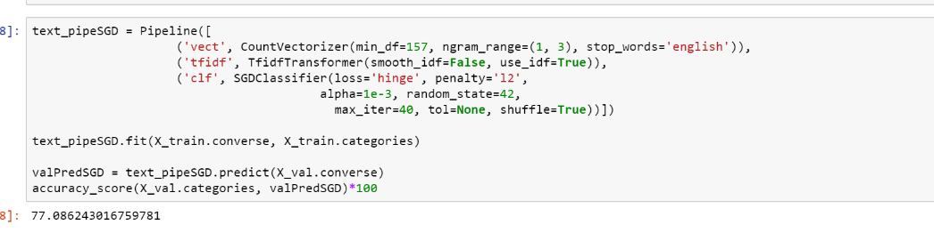
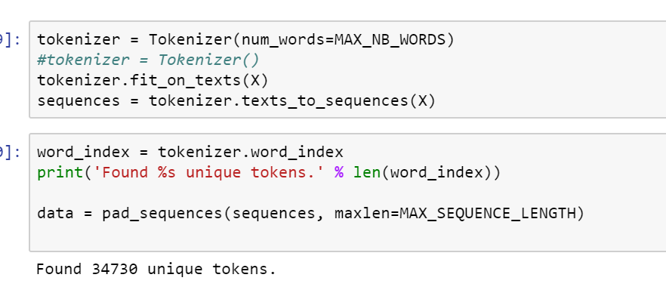
PreProcessing Steps
Using TfIdf Transformer
Using Tokenizer

Slide 6
Models which we tried for classification
ANN – Embedding layer, Flatten
CNN – Embedding layer, Flatten, Conv1D
RNN - Embedding layer, Flatten, LSTM
Stacked Models – SGD, RandomForest, AdaBoost & ANN – Dense Layer.

Slide 7
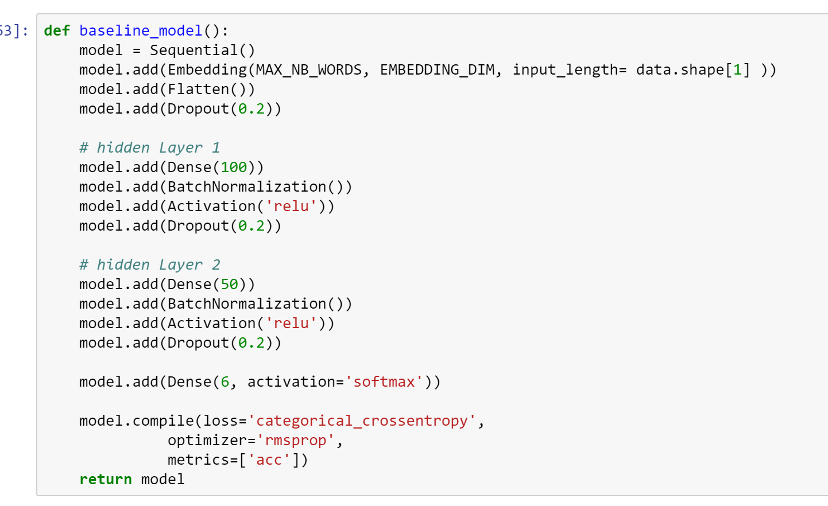
Model Building – ANN Model
Train Test Validation Split
Using ANN
Embedding
Flatten
Drop Out
Optimizer – rmsprop
Final Layer – 6 nodes with SoftMax activation
KerasClassifier

Slide 8
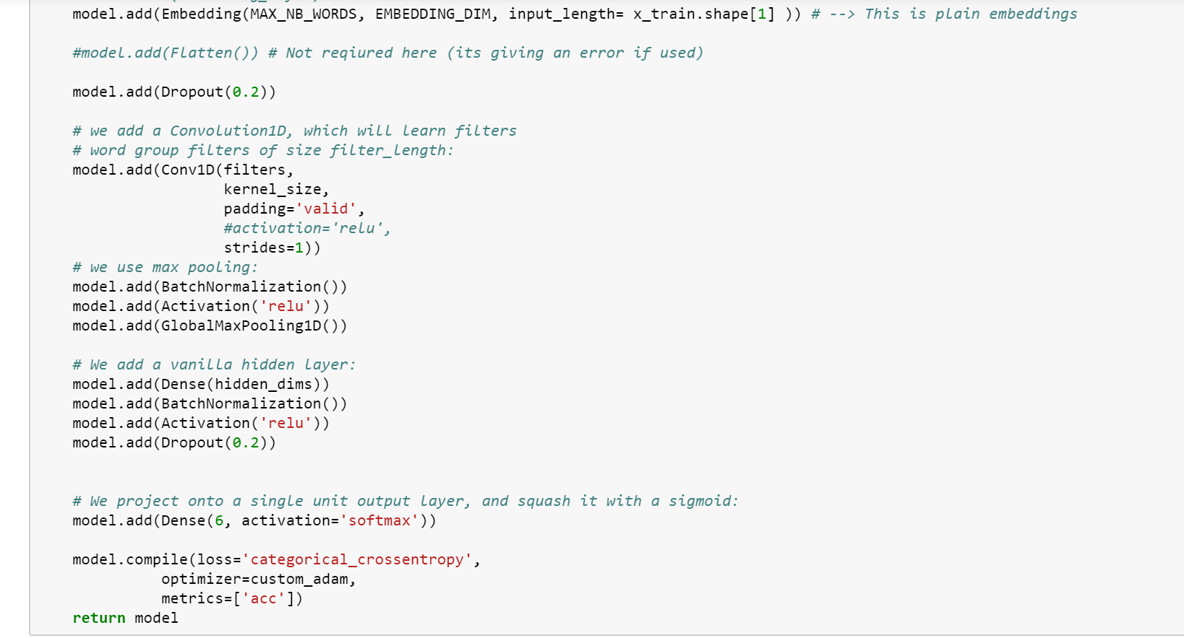
CNN

Slide 9
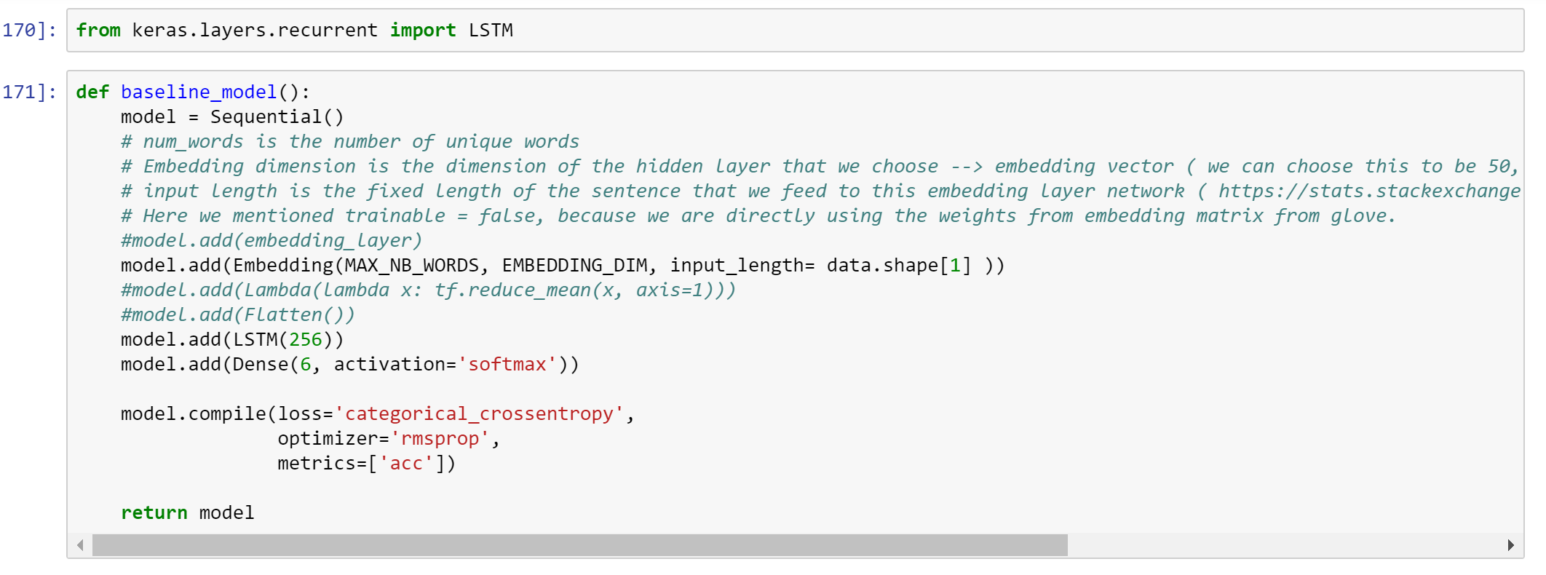
RNN model

Slide 10
Evaluation Metrics
Since it is classification problem we have to measure the accuracy of the model with help of
Accuracy
Specificity
Sensitivity
by comparing our predicted data and actual data of the splitted test data from the dataset
Package used for evaluating the metric:
ConfusionMatrix() function from Caret Package
Recall and precision are auxilliary metrics
F1 stat is used for evaluation

Slide 11
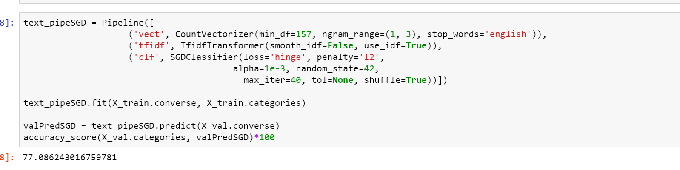
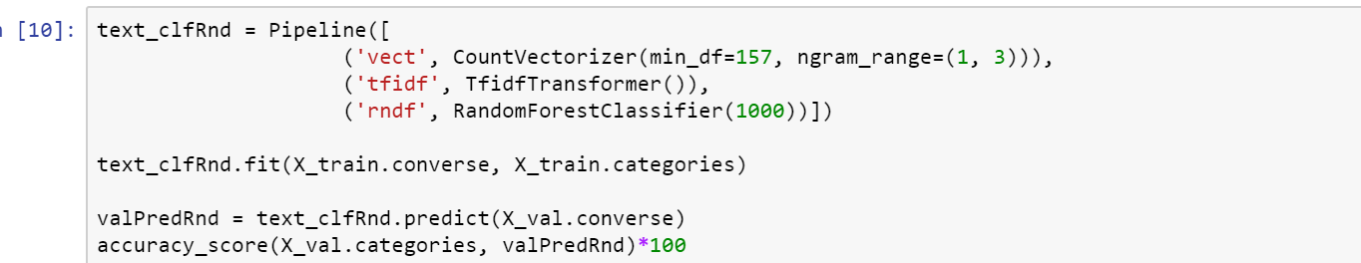
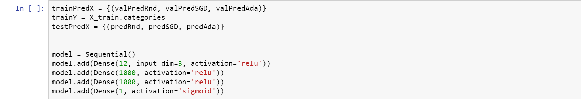
Final Model – Stacking ML models with NN

Slide 12
Evaluation Metrics
Parameters | ANN | CNN | RNN | Stacking Models
Recall | 40 | 55 | 43 | 62.5
Accuracy | 51 | 68 | 54 | 78

