Slide 1
Browser reverse proxy
url rewriting from proxy dns to actual dns
Eg: jiraproxy.com -> jira.com
Global acceptList/blocklist URLs
User client certificate validation passed from the browser

Slide 2
Local Configuration Setup
Local DNS
/etc/hosts file
Browser reverse Proxy App
Mock Corporate Portal
Browser
Postman Tool

Slide 3
Proxying considered for POC
Static html page based proxy
API based proxy
Dynamic page proxy – Angular/React JS based app

Slide 4
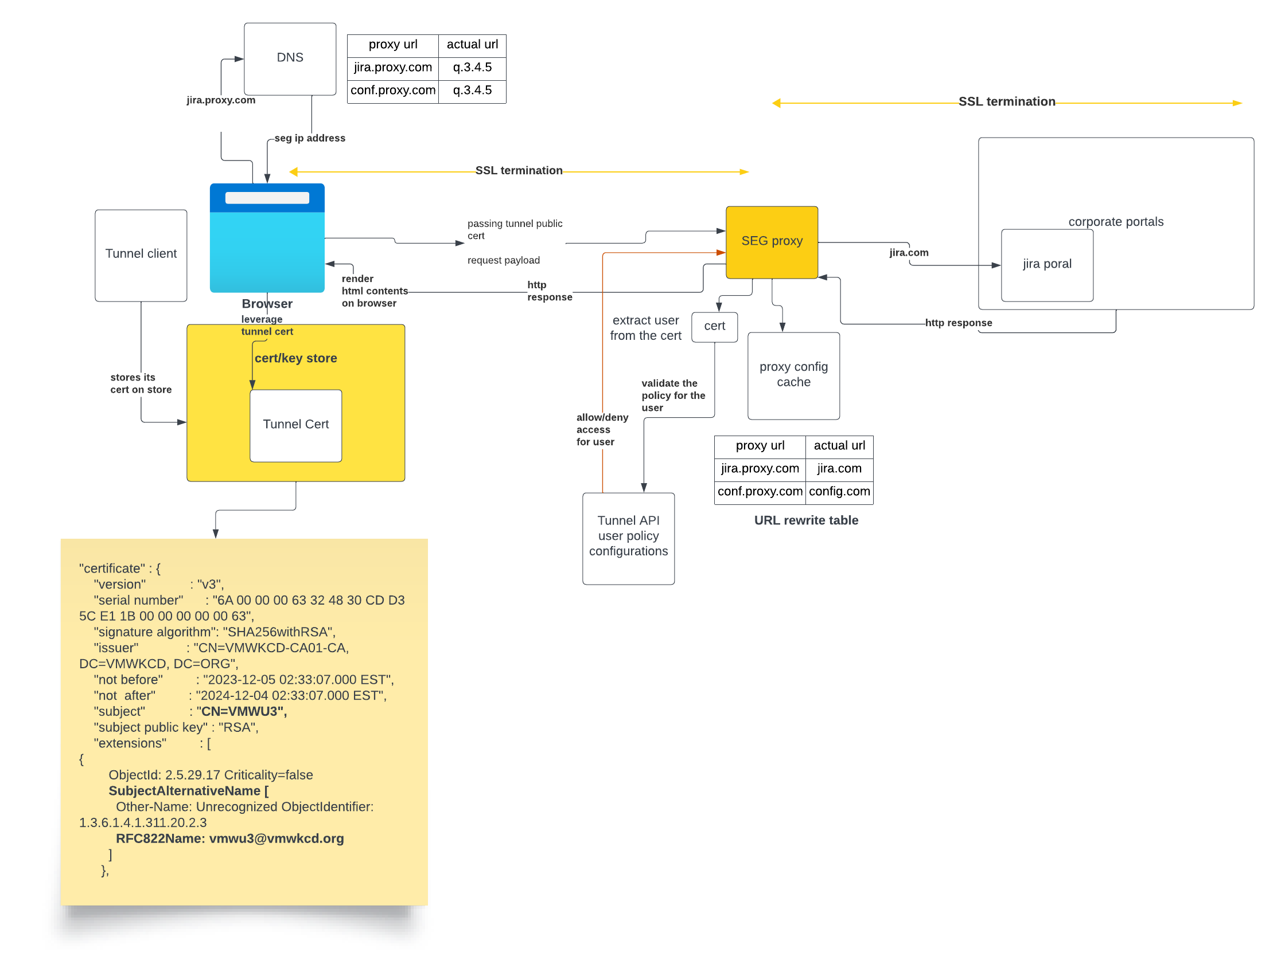
Reverse Proxy Browser

Slide 5
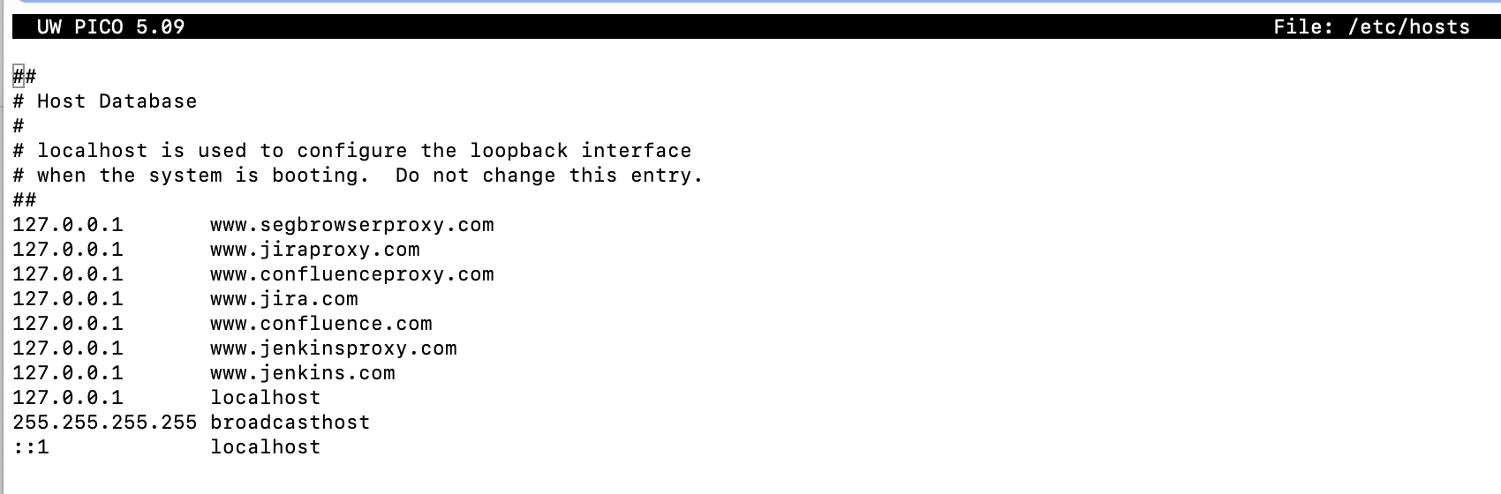
Local DNS

Slide 6
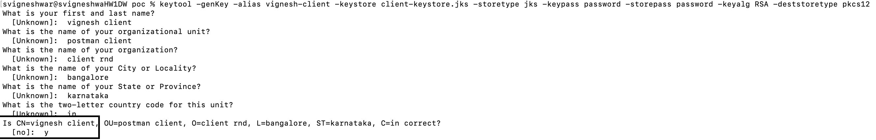
User client certificate
Assumptions
Tunnel stored this user specific client certificate in common cert store
Browser picks this client certificate and pass it to proxy URL

Slide 7
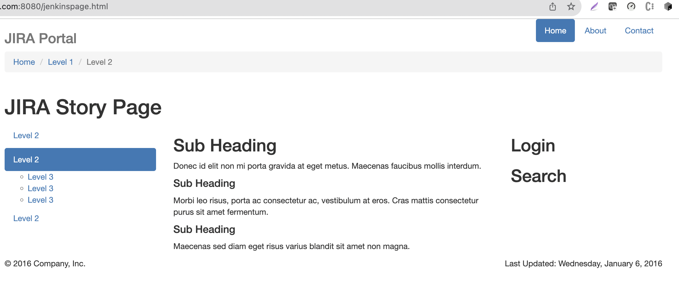
Jira.com

Slide 8
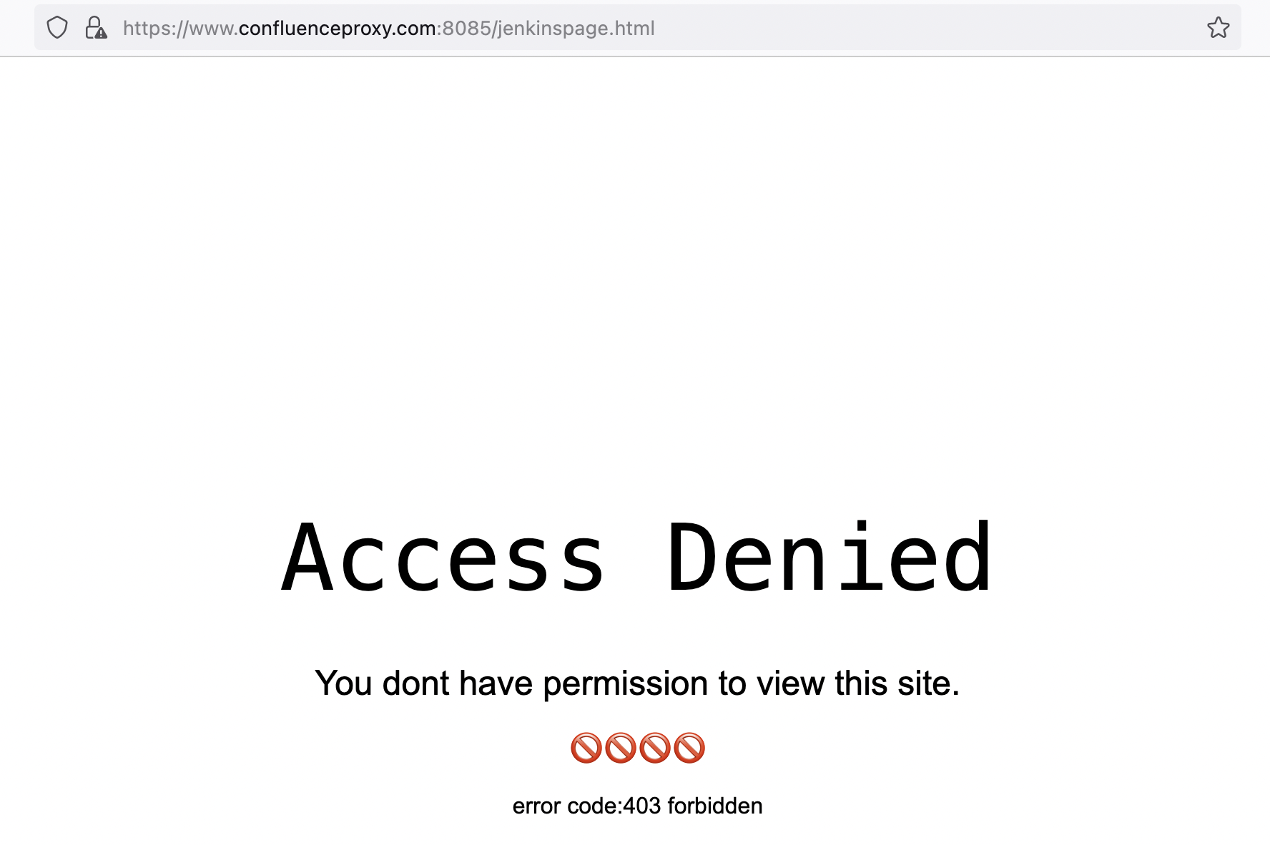
Access Denied

