Slide 1
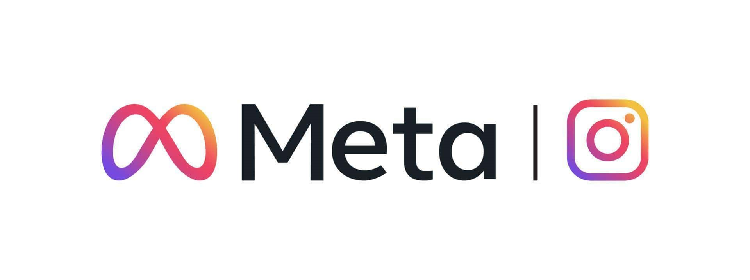
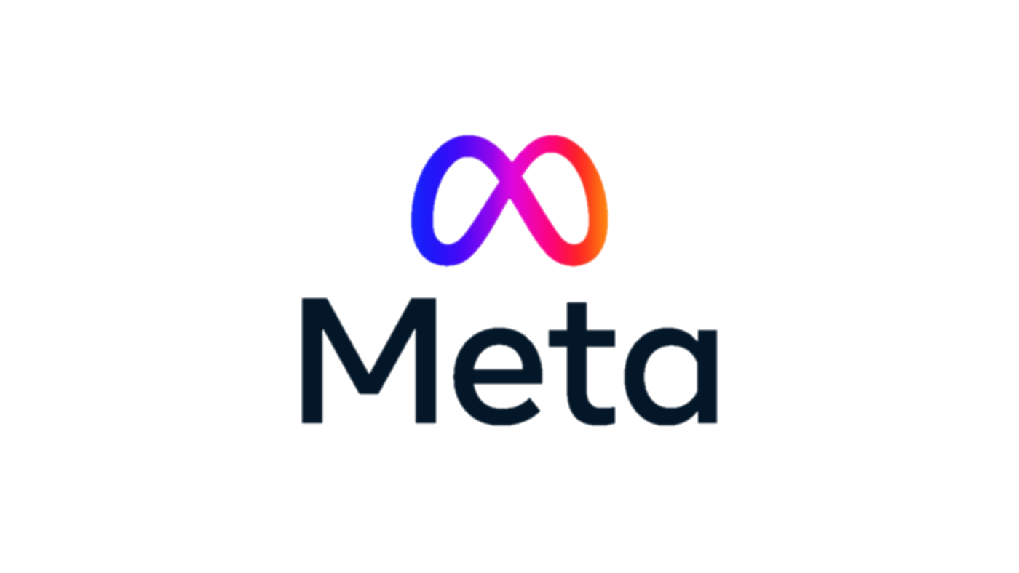
Social Media Data Analysis
By Vikram Gharami

Slide 2

About Meta
Meta, formerly known as Facebook, is a technology company founded by Mark Zuckerberg in 2004. It rebranded to Meta in October 2021 to emphasize its focus on building the "metaverse," a virtual reality space where users can interact in a shared, immersive environment. Meta's ecosystem includes social media platforms like Facebook, Instagram, and WhatsApp, as well as technologies for augmented and virtual reality, such as Oculus.
Social media is a platform for sharing photos, videos, and stories, allowing users to connect, follow others, and engage through likes, comments, and direct messages. It features hashtags for content discovery, offers filters for enhancing posts, and supports influencer marketing. Additionally, users can share temporary stories and explore content based on their interests.

Slide 3
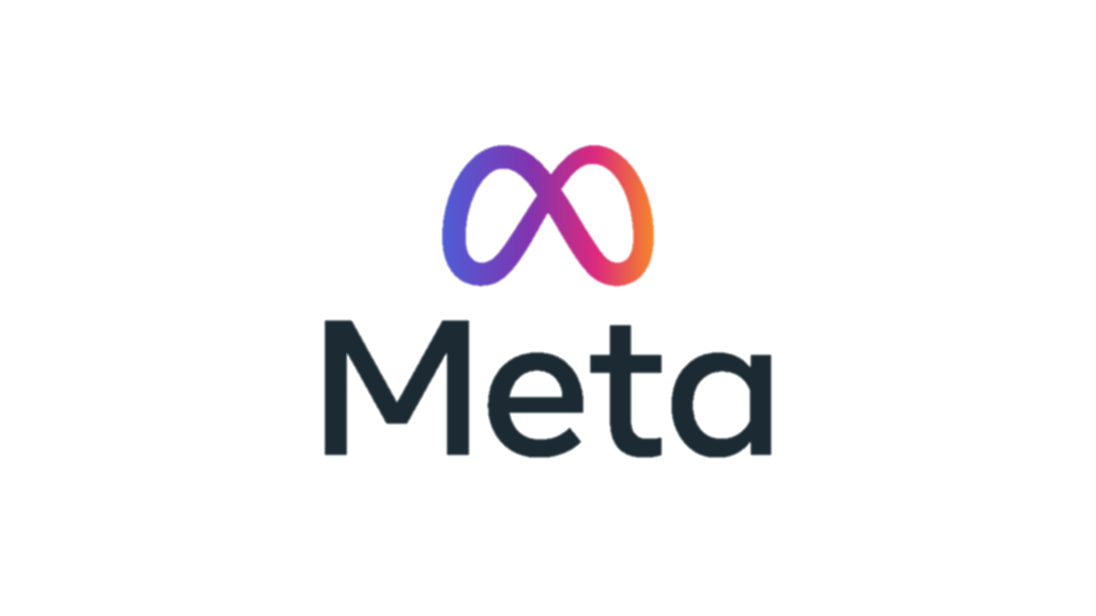
Problem Statement
You are hired as a data analyst at Meta and asked to collaborate with Marketing team. Marketing teams wants to leverage Instagram's user data to develop targeted marketing strategies that will increase user engagement, retention, and acquisition. Provide insights and recommendations to address the following objectives.
Key Focus:
Increase User Engagement: Analyze user behavior to identify content preferences and encourage more interactions (likes, comments, shares).
Improve User Retention: Provide insights on user drop-off points and recommend personalized strategies to enhance retention.
Enhance User Acquisition: Use demographic and behavior data to target new users and drive app installs.
Optimize Marketing Campaigns: Develop data-driven recommendations to refine ad targeting and messaging for better conversion rates.

Slide 4
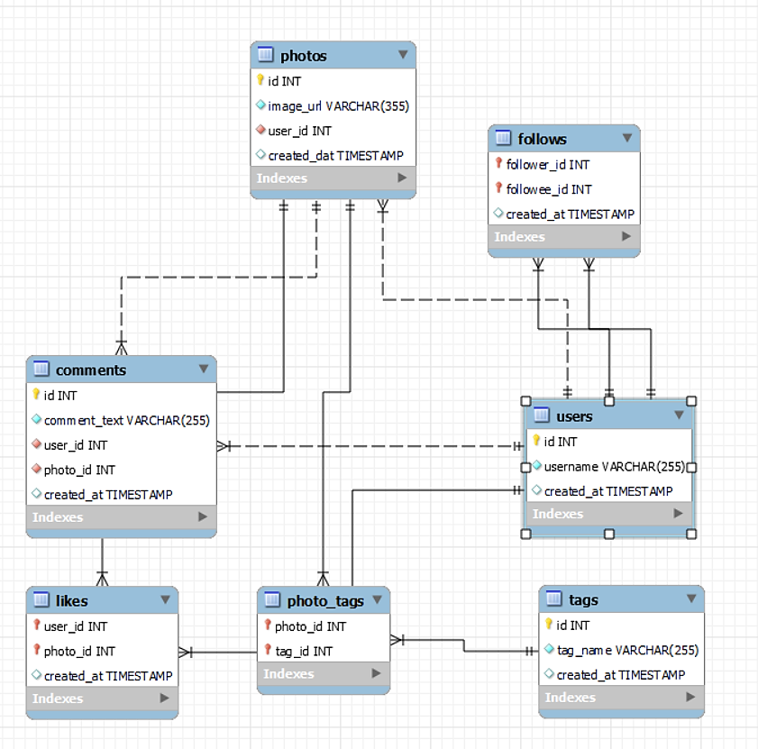
Data Description
Important data attributes
Database schema
comments_id : unique identifier for each comment
comment_text : text content of a given comment
user_id : unique identifier for each user
photo_id : unique identifier for each photo
created_at : date of interaction in the form like, photos, tags
follower_id : user_id of the follower for a certain user
followee_id : user_id of followee for a certain user
tag_id : unique identifier for each tag
image_url : link to the image posted on the platform
username : username chosen by the user

Slide 5
Methodology
01
Data Cleaning:
Removed duplicates, nulls and standardized formats.
Validated foreign key constraints.
Analytical
Methods
02
Data Enrichment:
Integrated additional user information.
Categorized photos with tags.
03
Analysis Conducted:
SQL queries for user engagement analysis.
Utilized CTE, JOIN, GROUP BY, and WINDOWS fn. clauses for data aggregation.
Applied aggregate functions like COUNT(), SUM(), ROUND() and AVG().
Tech Stack Used
MySQL Server
(Version 8.0)
MySQL Workbench
SQL
Queries
Google
Sheet

Slide 6



Data Overview
Total Users: 100
Total Likes: 8782
Total Posts: 257
Total Comments: 7488
Top 5 tags: Smile, beach, Party, Fun, Food
Total Tags: 21
likes
photos
photo_tags
users
tags
follows
comments

Slide 7
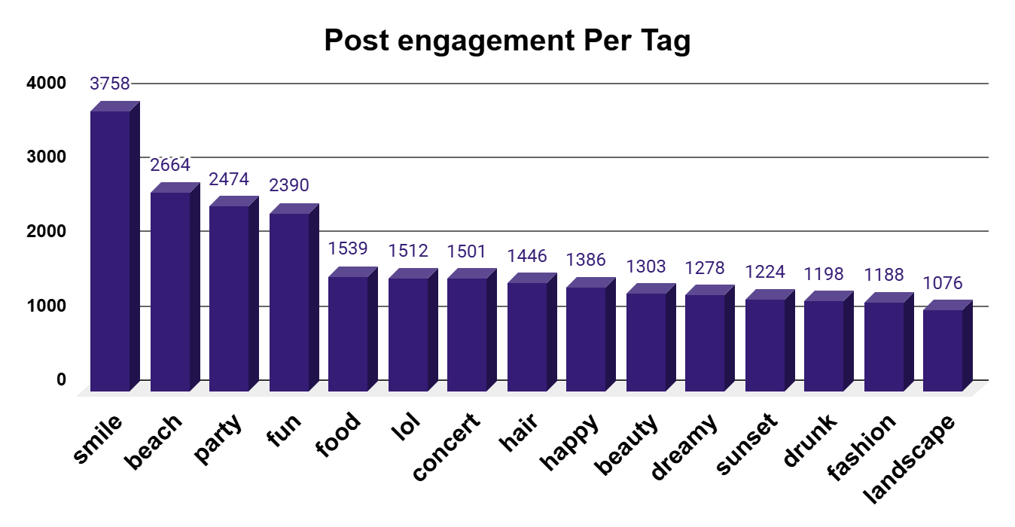
Content/Hashtag Strategy
#SMILE
#BEACHS
Average Tags per Post
2.64
Hashtags Researching
#PARTY
#FUN
#Food
#CONCERT
Smile, Beach, Party, Fun, and Concert are the top 5 tags used most frequently.
The tag ‘smile’ has been used by many users as shown in the ‘Tags used by users’ table.
Average tags per post is 2.64.
The partner brand should prioritize top hashtags like #smile, #beach, and #party to boost reach and engagement.

Slide 8
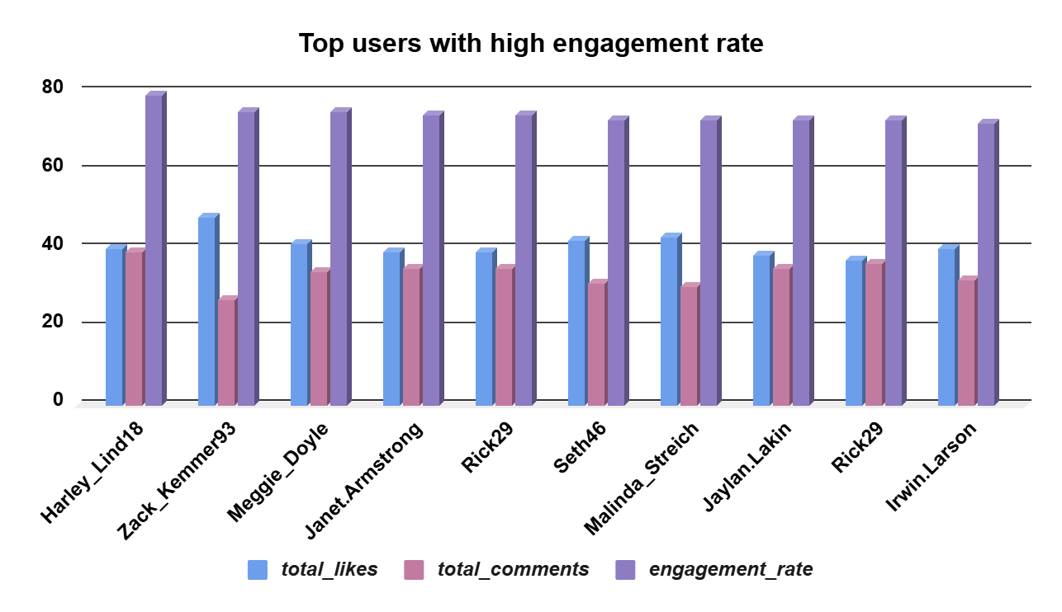
User Activity & Engagement
Usernane as Harley_Lind18, Zack_Kemmer93, Meggie_Doyle, Janet.Armstrong, Rick29, Seth46, Malinda_Streich, Jaylan.Lakin, Rick29, and Irwin.Larson have the most number of likes and comments.
User's engagement levels vary significantly, with some users showing high interaction even with a similar number of posts.
This suggests that certain users are consistently more interactive, while others engage minimally, creating distinct activity patterns across the base.

Slide 9
Inactive Users: Identifying with Zero Likes Given
Inactive Users :
The table lists users who have shown no engagement in terms of likes.
User IDs are matched with Usernames to identify those who haven't interacted through the platform's liking system.
These inactive users are a potential target group for engagement strategies.
id | username
1 | Kenton_Kirlin
7 | Kasandra_Homenick
23 | Eveline95
25 | Tierra.Trantow
29 | Jaime53
34 | Pearl7
45 | David.Osinski47
49 | Morgan.Kassulke
51 | Mariano_Koch3
53 | Linnea59
58 | Aurelie71
59 | Cesar93
64 | Florence99
68 | Franco_Keebler64
74 | Hulda.Macejkovic
77 | Donald.Fritsch
80 | Darby_Herzog
81 | Esther.Zulauf61
83 | Bartholome.Bernhard
86 | Delfina_VonRueden68
88 | Clint27
89 | Jessyca_West
90 | Esmeralda.Mraz57
To re-engage inactive users:
Personalized Outreach: Send personalized messages or content recommendations.
Exclusive Offers: Provide special incentives, like discounts or early access to new features, to encourage a return.
Curated Content Highlights: Share trending or personalized content based on their past interests to spark curiosity and re-engage them.

Slide 10
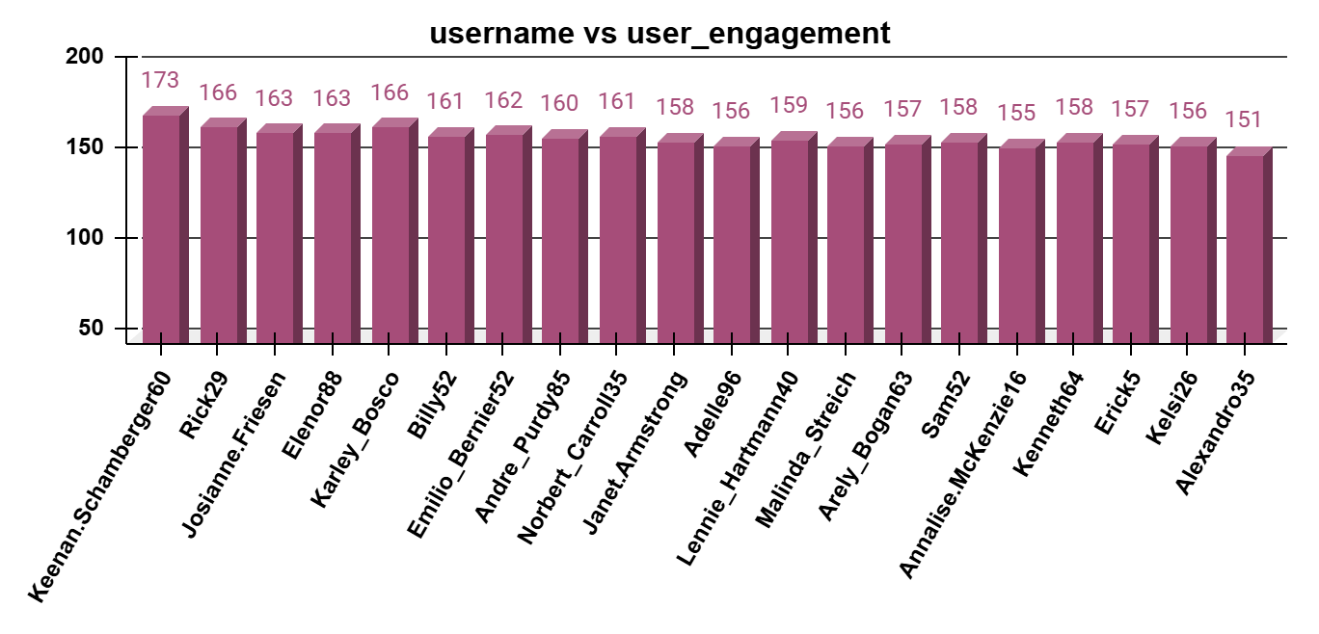
Loyal user Analysis
username | user_activity_level | user_engagement | user_loyalty_rank
Keenan.Schamberger60 | 176 | 173 | 1
Rick29 | 170 | 166 | 2
Josianne.Friesen | 168 | 163 | 3
Elenor88 | 167 | 163 | 4
Karley_Bosco | 167 | 166 | 5
Billy52 | 165 | 161 | 6
Emilio_Bernier52 | 165 | 162 | 7
Andre_Purdy85 | 164 | 160 | 8
Norbert_Carroll35 | 164 | 161 | 9
Janet.Armstrong | 163 | 158 | 10
Username such as Keenan.Schamberger60, Rick29, Josianne.Friesen, Elenor88, and Karley_Bosco are the top 5 most loya users with high activity level and engagement rate.
The most loyal user that is user id 96, has done 98 likes, 75 comments, used 6 tags, and posted three photos.
The tags used by user id 96 are style, stunning, food, fasion, dreamy, and delicious.

Slide 11
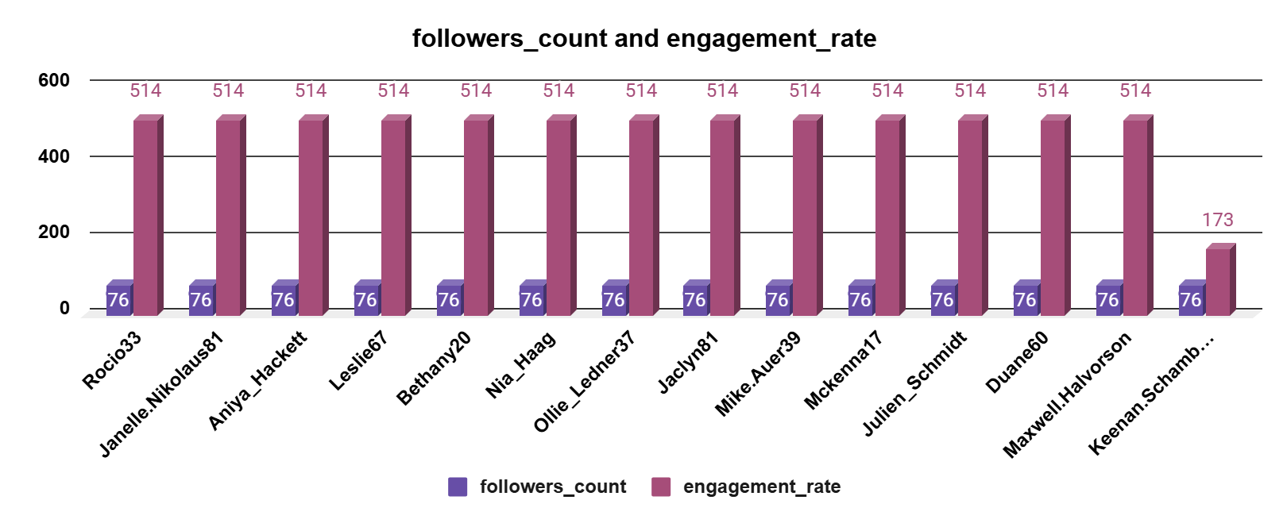
Ideal Candidate: Influencer Marketing
Users with large followings and high engagement (likes + comments) are ideal for influencer marketing, maximizing reach and impact.
These influencers show potential for consistent, authentic brand partnerships due to their strong connection with followers.
To approach influencers:
Tailored Outreach: Connect with influencers directly, using a personalized message that acknowledges their unique impact.
Develop Authentic Relationships: Build genuine connections by actively engaging with their content and showing real interest in their audience.
Set Transparent Goals: Clearly outline your campaign objectives, expectations, and collaboration terms to ensure alignment.

Slide 12
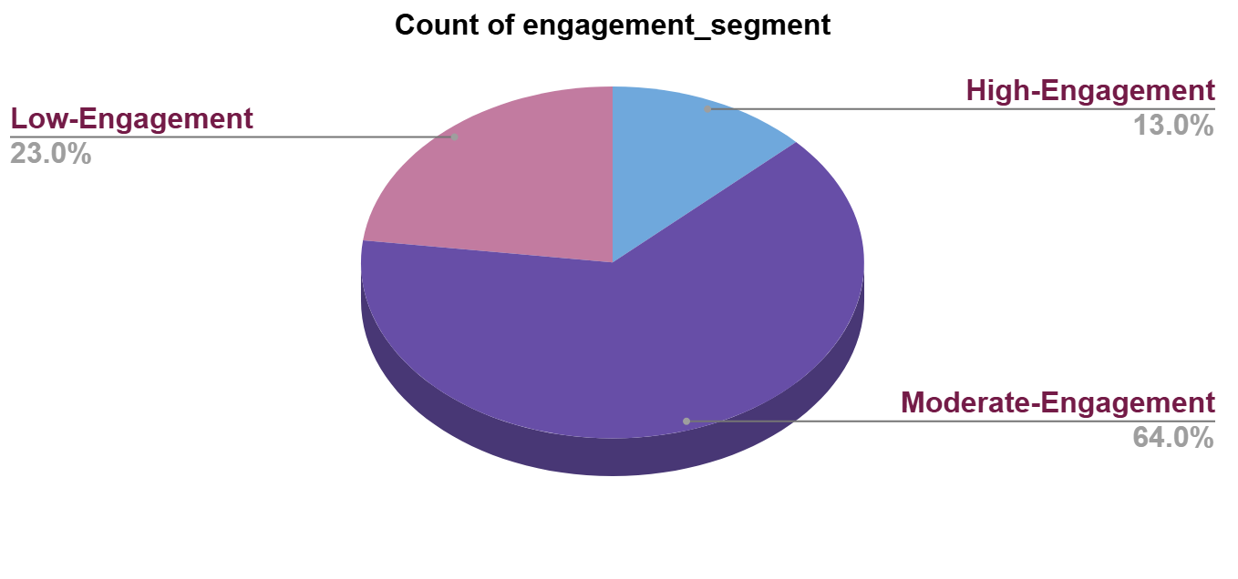
Advertisement Strategy
username | hashtag | tag_count
Clint27 | beach | 30
Eveline95 | smile | 13
Clint27 | dreamy | 14
Cesar93 | fun | 18
Gus93 | stunning | 1
Andre_Purdy85 | fun | 2
Andre_Purdy85 | smile | 2
Eveline95 | lol | 7
Tabitha_Schamberger11 | smile | 4
Adelle96 | smile | 29
Ad campaigns on the basis of user’s category.
Utilise user data for personalised ad and content.
To leverage user-generated content for personalized ad campaigns, we identified popular tags, tag usage using a column chart, and average engagement to those tags.
These tags help us identify users' interest in the specific content type, which helps create personalized ads with good engagement.

Slide 13

Conclusion
Successfully analyzed user engagement and activity levels.
Identified the most frequently used tags.
Recognized influential users with a potential impact on others.
This data analysis provided valuable insights into user behaviour's, engagement patterns, and key trends.
Ads and Campaigns should regularly be made optimizing with trends.
Achieved the objectives by identifying loyal users, popular tags, and other essential data for targeted strategies.
10K Likes

Slide 14
Thank You

