Slide 1
Airbnb New User Bookings
PREDICTING USER DESTINATION
Springboard DSC
Vikram Lucky
Dr.vlucky@gmail.com

Slide 2
Airbnb
World’s biggest accommodation-sharing site, enabling people to short-term lodging including vacation rentals, apartment rentals, homestays, hostels etc
More affordable alternative when compared to standard hotel bookings
Projecting to earn as much as $3.5 billion a year by 2020

Slide 3
Problem Statement & Goals
Given user data such as: user browsing session records, demographic data etc, predict which country the user will book her/his first Airbnb travel experience
So that more personalized content can be recommended
Overall the booking process can be optimized

Slide 4
DATA
The dataset was obtained from Kaggle
Data is composed of 5 csv files (including 1 test file not used in this project)
Training file has 213,451 rows and 16 columns
Requires data wrangling for further analysis

Slide 5
Data Wrangling
Columns containing invalid values were converted to the most relevant values depending on the columns
Missing values were imputed

Slide 6
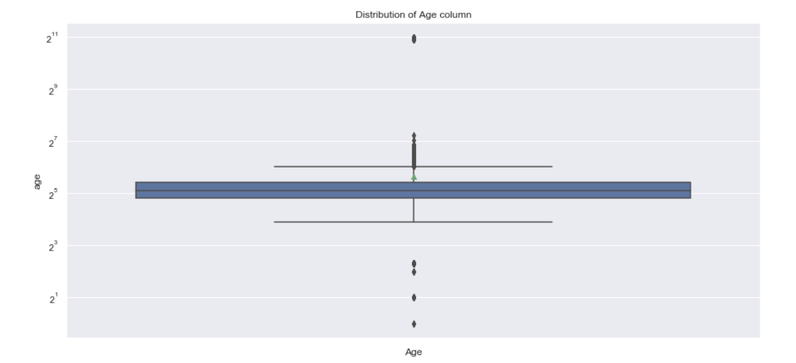
Distribution of Age column, Values > 90 were dropped

Slide 7
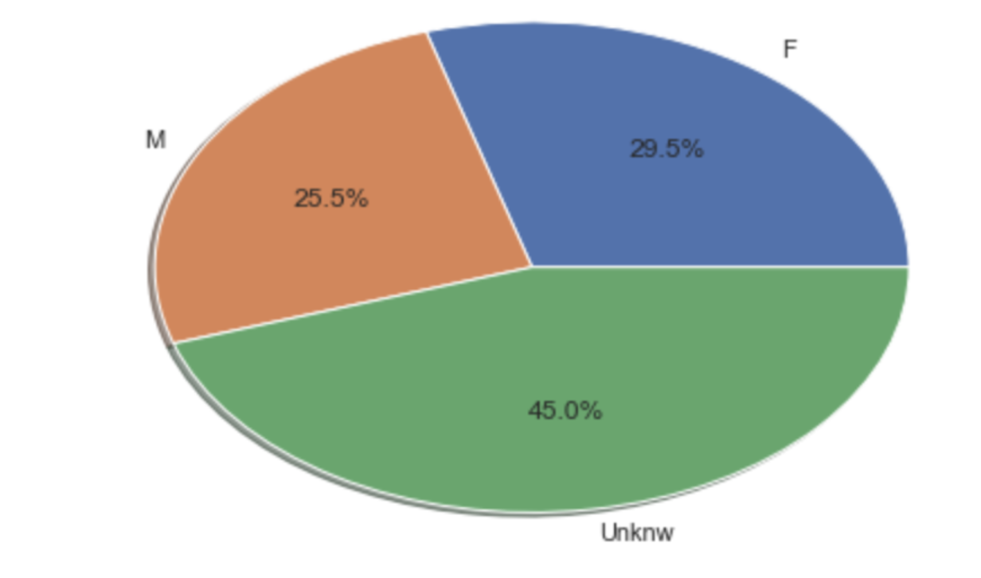
Distribution of Genders, NaN values were imputed with ‘unknown’ value

Slide 8
EDA and Inferential Statistics
Distribution of the target column: Country Destination
Target column is highly imbalanced.
NDF (Users who never booked) is majority class followed by users who booked within USA
Frequent devices used for reservation
Apple products: Iphone & Ipads; followed by Android devices
Frequent devices used for browsing
Apple: Macs & Windows Desktops ,followed by small devices

Slide 9
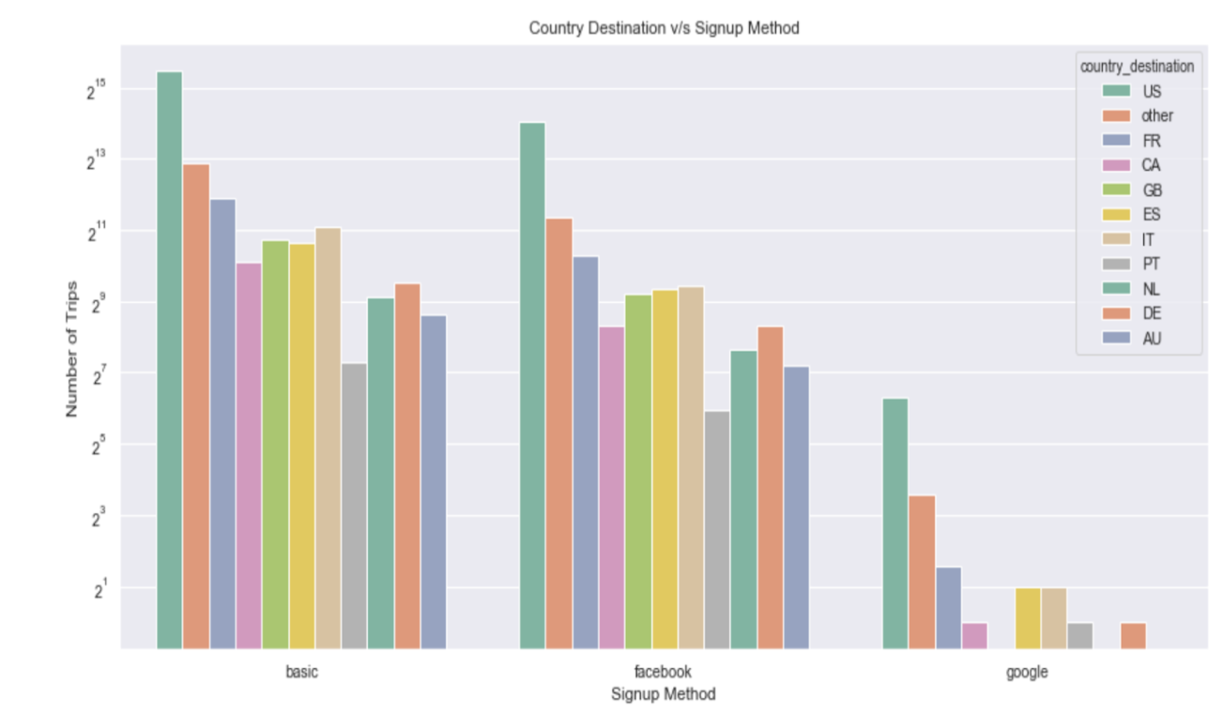
Country destinations and signup method

Slide 10
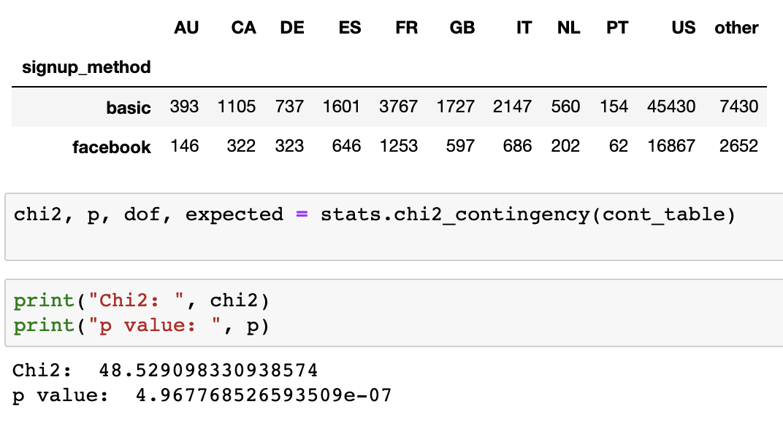
Is there a relationship between country destination and Signup method?

Slide 11
ML Modeling
Original Problem Multiclass w/ all the classes
Logistic Regression w/ default parameters & Random Forest
Highly biased towards majority class. F1 score : ~0.58
Dropped majority class ‘NDF’
Used SMOTE and Undersampling along hypermeters
Models performance did not improve
Highly biased towards majority class ‘US’

Slide 12
ML Modeling
Binary classification Problem ‘US’ vs ‘Rest’
Model’s performance did improve, the best score achieved was ~.70 using Random forest classifier with hyperparameters such as max_features: ‘log2’, n_estimators: 194, between US and others

Slide 13
Recommendations
Desktop users book far more often than other device users, which suggests that users prefer to explore on smaller devices but when it comes to actual booking they prefer desktops. So, the UX on different devices must be tuned accordingly to achieve best results.
Most of the Airbnb users in US tend to book within the US. Therefore, it makes most sense to give users more recommendations within the country.
The majority of Airbnb’s users are on Apple devices. Android users are the minority and do not book that often compare to Apple device users. So, makes perfect business sense to invest more resources in improving the UX on Android devices So the number of booking using Android devices can be improved.

Slide 14
Thank you!

