Slide 1
Gartner L2
Amazon Product Reviews Case Study
Vikram Lucky
9175450618
dr.vlucky@gmail.com

Slide 2
Context
Amazon is a very large online retailing platform and has become increasingly important to the sales and distribution plans of brands in various categories. However, since Amazon is a platform that allows third-party selling, brands are subject to risks of counterfeiting or gray market selling.

Slide 3
Agenda
Identify to what extent is the brand susceptible to the risk of counterfeiting and gray market selling
Identify the factors that increase the risk of becoming a target of gray market sellers
Identify the key topics affecting consumer decisions
How do the above trends differ between different product categories?

Slide 4
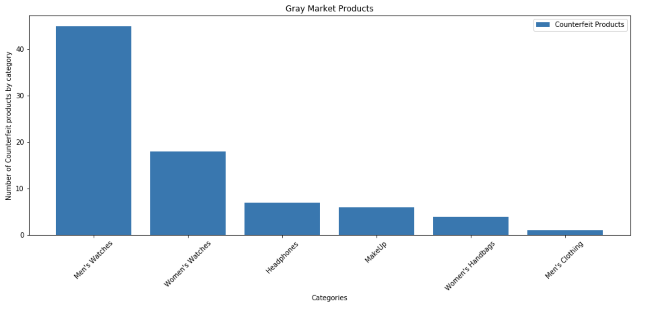
To what extent is the brand susceptible to the risk of counterfeiting and gray market selling

Slide 5
To what extent is the brand susceptible to the risk of counterfeiting and gray market selling
Overall risk 13.26% among all brands
High end watch brands are at higher risk

Slide 6
Factors that increase the risk of becoming a target of gray market sellers

Slide 7
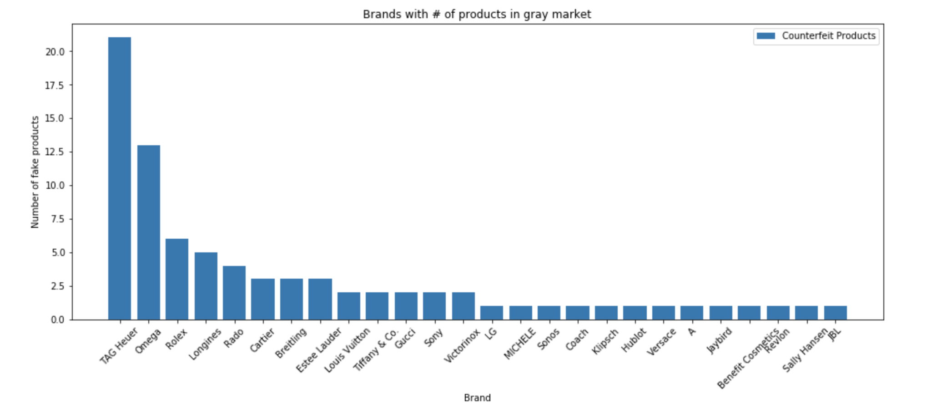
Brands with the most number of counterfeit products
.

Slide 8
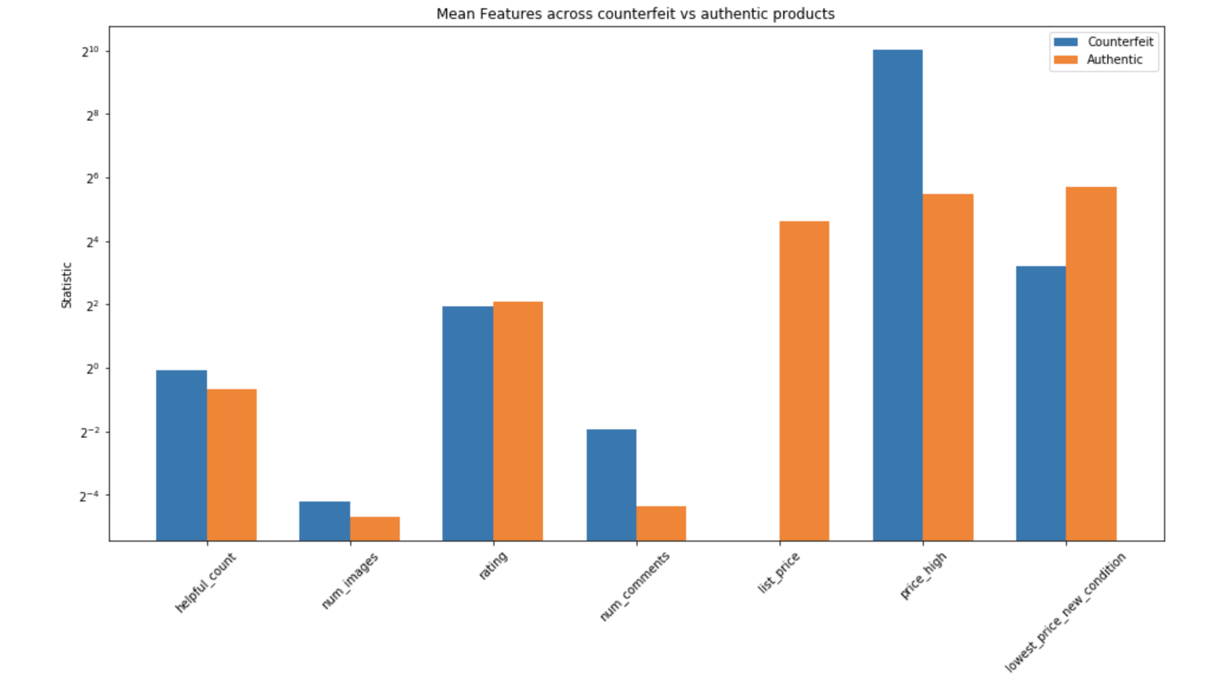
Factors that increases the risk

Slide 9
Risk Factors?
Price is one of the biggest factor that increases the risk of becoming targeted of gray market sellers
-Higher the price higher the risk
Rating and Number of comments
- A product that is higher in price, has received high ratings and it’s popular among consumer with be targeted more by grey market sellers

Slide 10
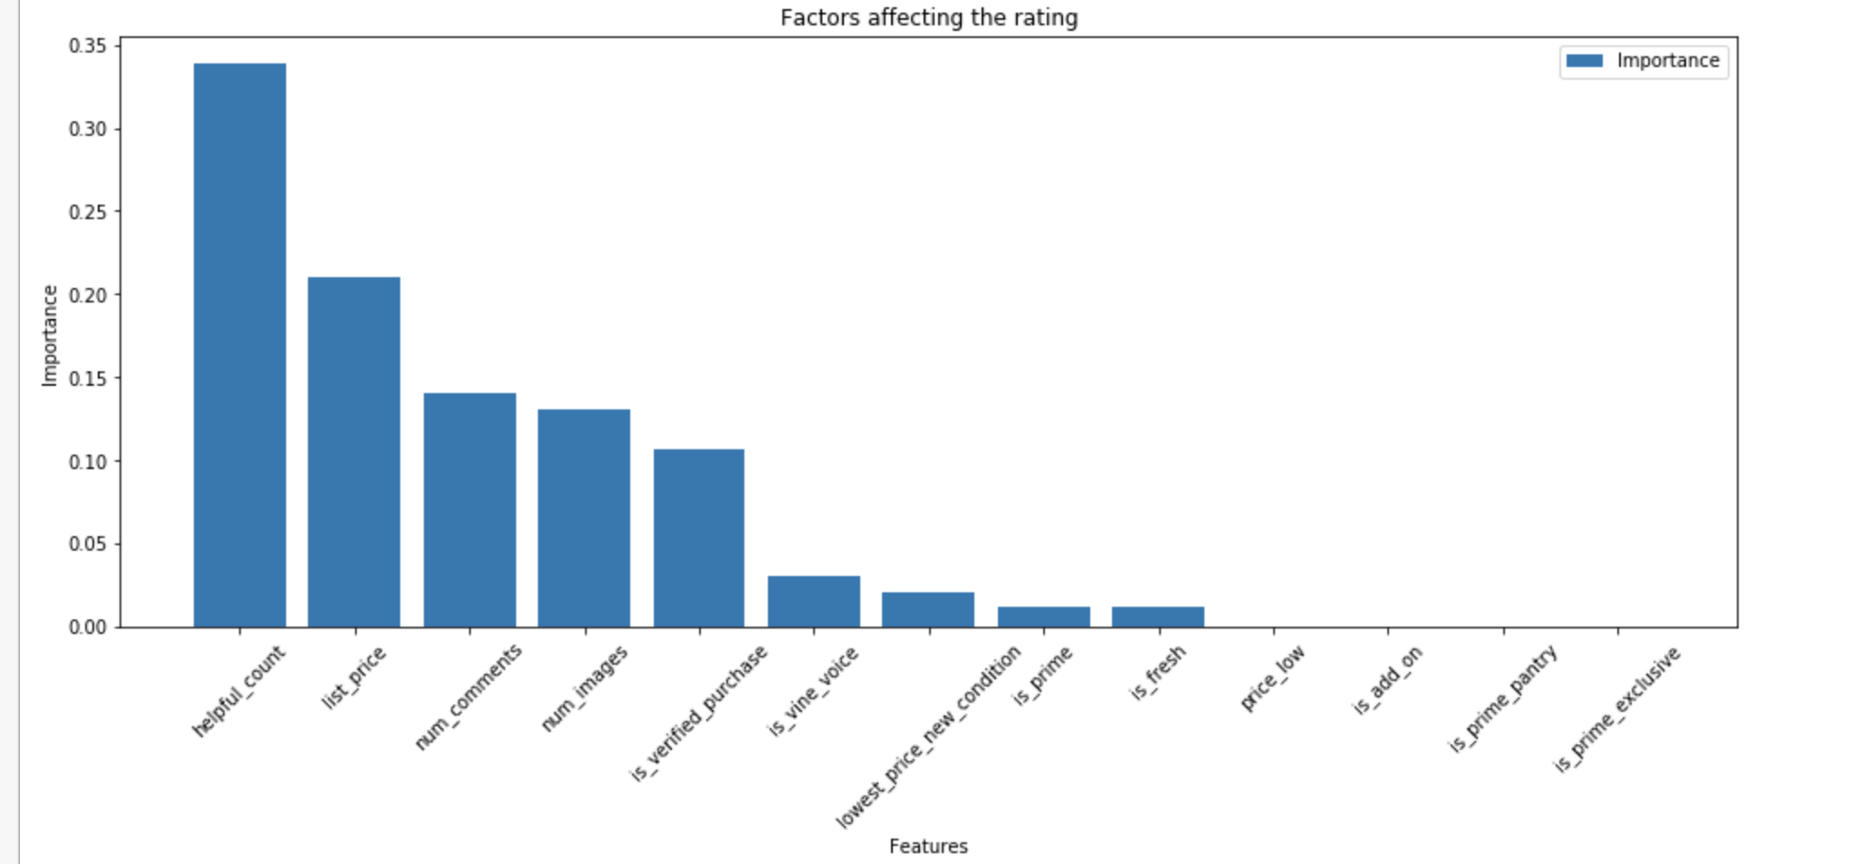
Factors affecting consumer decision

Slide 11
Factors affecting consumer decision
Consumer’s decision is mostly based upon:
- Product’s review and how many like that particular review has
-Price
-Number of images in description
-If it’s verified purchase
- Lowest price that particular product is available in new condition

Slide 12
Trends between different product categories

Slide 13
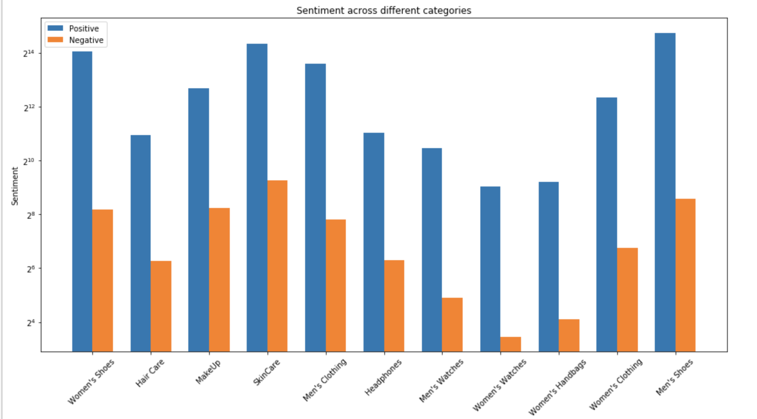
Sentiment analysis on comments column

Slide 14
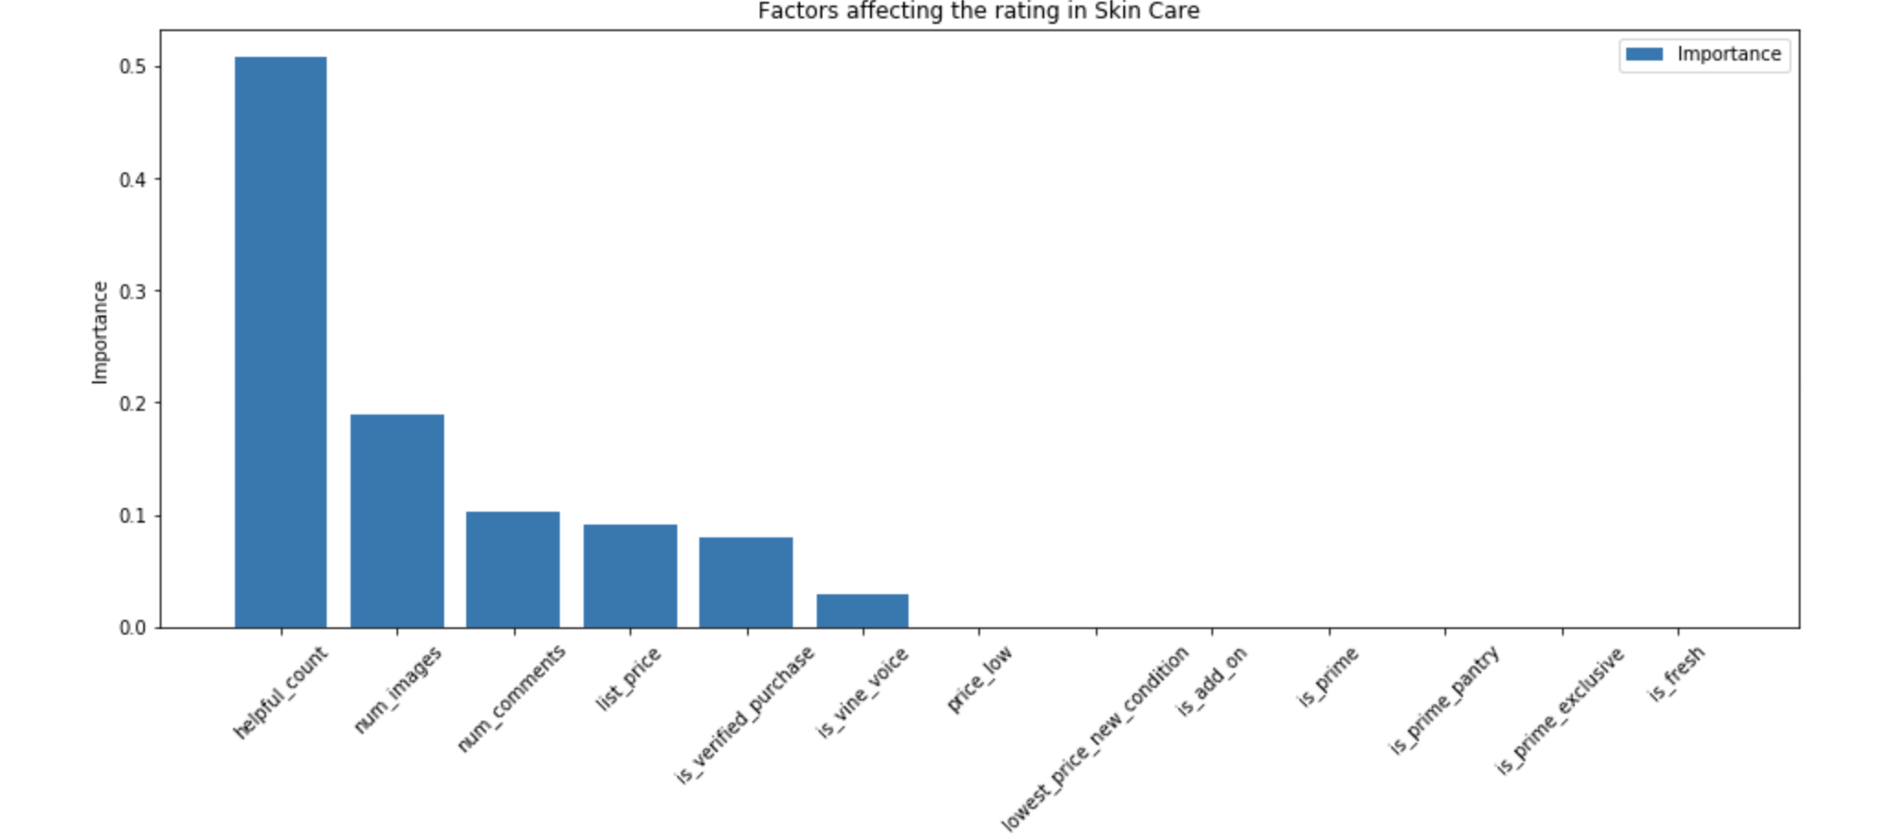
Factors affecting consumers decision in skin care category

Slide 15
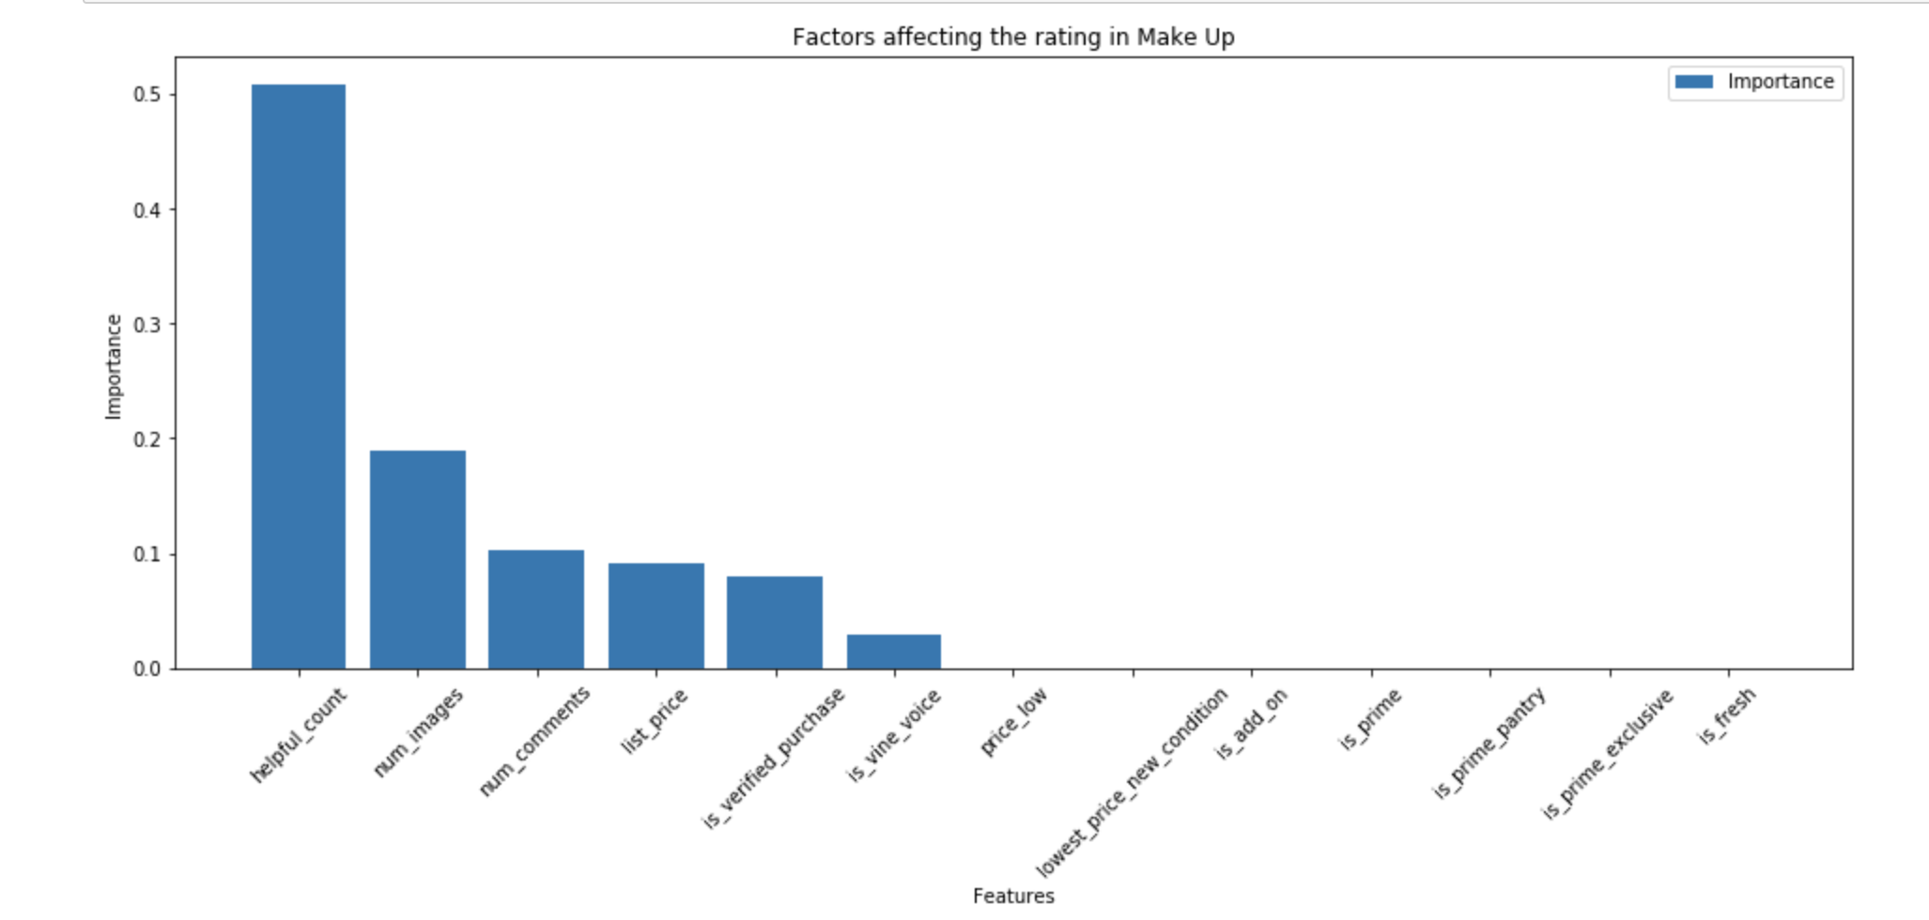
Factors affecting consumers decision in Makeup category

Slide 16
Findings?
Luxury Products that are high in demand are victims of grey market sellers.
Price, comments and Rating are the biggest factors that increases the risk of becoming target of gray market sellers. (Expensive Popular item will be targeted more )
Helpful count (# of likes on comments), List price, number of comments and rating are the keys factors of consumers decision. Example: A counterfeit Rolex watch for $49, will attract customers as long as it has positive reviews, That’s the downside for brand.
Above trend does not differ much between different categories (Makeup & Skin care)

Slide 17
Tools
Python (Data analysis skills for question 1 and 2)
Machine Learning (XGboost Regression- feature importance for question 3 and 4)
Text Blob: NLP for sentiment analysis on comments for number 4

Slide 18
Thank you!

