Slide 1
Live Wireframing
Lean BI using AI
https://github.com/vikramnayak-com/lean-bi

Slide 2
Today’s Agenda
Exploring some “vexing” BI problems
How Lean principles help improve BI outcomes
Wireframing as part of Lean BI
The Lean BI System
BYOBI (Build Your Own BI) – Hands-on
More examples

Slide 3
“Vexing” BI issue #1: Adoption is low
“Doesn't solve my problem” not useful
“Too difficult to find/use, doesn't fit into my workflow” not usable
“Can't make sense out of it” not understandable
“I don't trust the numbers” trust
“It's no longer relevant” relevance

Slide 4
“Vexing” BI issue #2: It’s too much effort
Lots of ad-hoc work
Lots of manual work
Lots of rework
More workarounds than intentional solutions

Slide 5
“Vexing” BI issue #3: Hard to quantify ROI
Measurement and attribution is hard
“What would have happened without it?”. Can’t be certain
But we can increase ROI without needing to measure it
We know parts of the numerator and denominator
Increase adoption and value delivered
Decrease effort and cost

Slide 6

The BI Iceberg
What's easy to see / focus on
  Technology
  Data sources, SQL, Dimensional models, Pipelines, DBT, Kafka, Big data, Warehouse, Lakehouse, Power BI/Tableau
What’s also needed but often ignored
  People
  Priorities, Biases, Insecurities, Communication, Personal ambitions, Resistance to change, Trust
  Process
  Systems, Culture, Change management, Buy-in, Journey vs End-state, As-is vs To-be

Slide 7
Is BI operating in a vacuum?
What are we incorporating from other disciplines?
  Product thinking? (discovery, motivations, owning outcomes, iteration, “living” outputs)
  Lean? (validation, replay)
  UX? (user research, empathy, design, usability, experience)
  Change management? (psychology, behavioural science, culture)
  GTM? (Launch, communication plan)
  Customer Success (usage monitoring, feedback, training, troubleshooting, problem solving)

Slide 8
Lean helps!
Lean: "How can we get to a successful outcome while minimizing waste?“
Ways to achieve this:
  Good inputs (Discovery, requirements and research)
  Good frameworks (Mental models and systems thinking)
  Good outputs (Structure, representation, interaction)
  Good practices (Validation with req replay + wireframes, AI as a new capability + accelerator)

Slide 9
How does wireframing fit in with Lean BI?
Shows a mirror both upstream and downstream
  Creates a traceable chain: interview -> requirements -> spec -> wireframe -> dashboard + data model
  Shows the weak links in the chain
Creates the engagement and involvement that drives success. Stakeholders and users:
    Are involved throughout the process
    See progress
    Feel like co-owners
    Are invested

Slide 10

So, what is a wireframe?
It's a visual representation of each screen with its individual components, sections, elements
Levels: sketch, wireframe, prototype
Level up:
  wire flow (connected screens)
  storyboard (one user journey through
  the dashboard)

Slide 11
The "Lean BI” process
1. Discovery Interviews
2. Dashboard Requirements Document
3. Dashboard
“Spec”
6. Generate wireframe
5. Generate Tab Layouts
4. Choose Component Representations
7. Prioritization and Scoring
8. Feedback and Iteration

Slide 12
1. Discovery
2 sets of interviews or 2 angles
  Stakeholders
    Goals for the project
    Decisions and actions enabled
    Success criteria and business outcomes
    How that overall area of the business works
  Users
    Data questions, metrics, analyses which are needed
    Decisions and actions that will be enabled
    Elements to be highlighted
    Priority levels and representations

Slide 13
1. Discovery (contd.)
With AI
  Interviews with one or more stakeholders and users
  Use starting interview guide
  Ask questions in order
  Record and transcribe the interview
  Paste interview notes into Evaluator for completeness and clarity’
  If complete, collate all the questions and answers
  If incomplete, generate follow up questions for each persona and repeat
Extension points:
  More inputs like existing reports and user notes, for LLM to synthesize

Slide 14
2. Dashboard Requirements Document
Business requirements and goals
Project success criteria
Users, Goals
Business questions
Data sources
Metric definitions
Components
Data questions
Interpretation and use
Decision/action supported
Key criteria and levels
Behavior
Priority Level
Filters
Existing reports and processes

Slide 15
2. Dashboard Requirements Document
With AI
  Summarize the interview notes
  Extract details for each section of DRD
Extension Points:
  Splitting monolith into design-specific DRD and dev-specific DRD
  Provide references to source material

Slide 16
3. Dashboard Spec
Construct:
“Think of it like a bulleted indented list that specifies the WHAT of the dashboard”
Tabs
Components
ID (globally unique)
Precise data questions
Decision / action
Key criteria / conditions / levels
Behavior (hover, drill down, filter)
Priority Level
Filters
Fields
Type of filter (multi-select / drop-down / expression)
Condition (e.g., Last 12 months)

Slide 17
3. Dashboard Spec
With AI
  From DRD, extract all structural components
  Arrange them like a bulleted, indented list
  Tabs -> components -> details
Extension point:
  Using structured inputs/output like JSON as the language of choice between components

Slide 18
4. Representation Chooser
Construct:
“Given all the details of a component, what is the best representation for it?”. Also accounts for user preferences/requests
Type of representation
Chart
Table
KPI
Map
Additional elements:
context elements
highlight / storytelling elements
design choices
(Loop)
For each component, get a ranked list of options

Slide 19
4. Representation Chooser
With AI
  Use data question + user preferences (if any) + decision / action to …
  Decide type of component (chart/table/KPI/map)
  Decide subtype of component (line chart, heat map, etc)
Extension points:
  More sophisticated chart/KPI/table chooser

Slide 20
5. Layout Generator + Component Mapper
- Layout Variations:
- KPIs present? Top or left?
- Number of rows?
- Height of each row?
- Number of columns in each row?
- Size of each box? (small/big)
- Filter location? Top or left?
- Scrollable?
- Largely Depends on:
- Dominant "Type" of dashboard
- Strategic
- Tactical
- Operational

Slide 21
5. Layout Generator + Component Mapper
With AI
  No generic layouts – use dynamically generate layouts instead
  Each component type (chart/table/KPI/map) has sizing rules that inform layout
  Unique address of each box = Tab Number + Row Number + Col Number
  Map components to layout based on importance / visibility
  Each component has a unique ID
Extension point:
  More fine-grained sizing options for each component type
  Elements of strategic / tactical / operational considerations for layout

Slide 22
6. Wireframe Renderer
Render wireframe using:
  Spec
  Layout
  Component Mapping
  Component Representation

Slide 23
6. Wireframe Renderer
With AI
  Generate HTML structure to scaffold the dashboard (boxes)
  Generate the component representations using appropriate libraries (e.g. chart.js for charts)
Extension points:
  Using “sketch” style visuals to keep focus on the WHAT
  Accompanying html, js, css files for web app

Slide 24
7. Component scoring - Benefits
(On a scale of 1 to 3. Multiplied by 3 for scaling)
Benefit:
⭐⭐⭐ HIGH (3 points)
"We MUST have this. Can't function without it.“ Examples: Core sales metrics, critical KPIs
⭐⭐ MEDIUM (2 points)
"We SHOULD have this. It's really useful.“ Examples: Helpful trend charts, performance tracking
⭐ LOW (1 point)
"We COULD have this. It's nice, but optional.“ Examples: Experimental views, extra detail

Slide 25
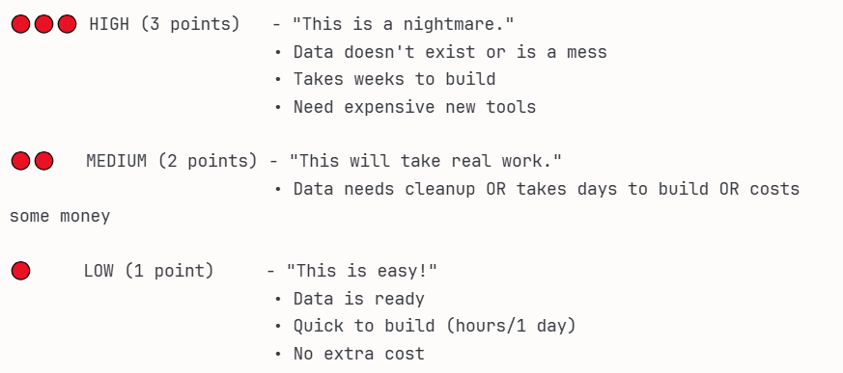
7. Component scoring - Costs
(All of these on a scale of 1 to 3)
Costs:
Data availability
Effort
Financial cost

Slide 26
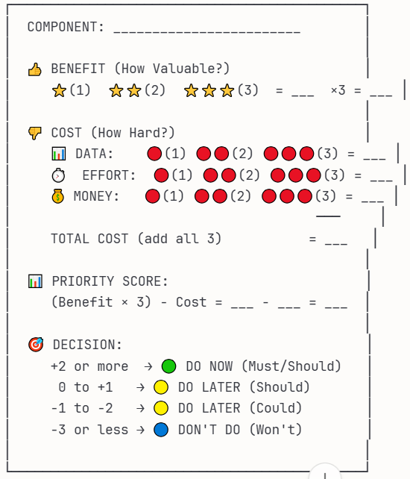
7. Component Scoring - Decision

Slide 27
7. Component Scoring
With AI:
  Benefits for each component extracted from DRD
  Costs are updated manually and consultatively
  Priority Score for component = Benefit - Cost
  Visually indicate (colored borders) what is immediately viable, what can be done with some effort and what is not worth it.
Extension points:
  Customized scoring based on priorities, preferences. E.g., Benefits X 4

Slide 28
8. Feedback and Iteration
Wireframes show the mirror:
  “I don’t think this table is actually needed”
  “This chart isn’t the one I want”
  “This chart needs a comparison to last year’s sales”
  “This KPI card also needs a comparison against targets”

Slide 29
8. Feedback and Iteration
With AI
  Add JS code to enable visual editing - moving boxes around and resizing them
  Allow prompt-based editing as well. Identify component and then make changes

Slide 30
In summary: The Lean BI system
1. Discovery Interviews
2. Dashboard Requirements Document
3. Dashboard
“Spec”
6. Generate wireframe
5. Generate Tab Layouts
4. Choose Component Representations
7. Prioritization and Scoring
8. Feedback and Iteration

Slide 31
Next steps
Explore adding your own company-specific interview guide
Discovery Evaluation using your own criteria
DRD in your company format
Representation chooser with your own chooser / preferences
Custom scoring system based on your org priorities
Moving this to n8n / Lang Flow

Slide 32
Thanks!
Contact me
  vikram@chartboss.ai
  9916940826
  https://linkedin.com/in/vikramnayak85

Slide 33

Feedback please!

