Slide 1
NBFC – Foreclosure Prediction
Vikram Radhakrishnan
Capstone Project

Slide 2
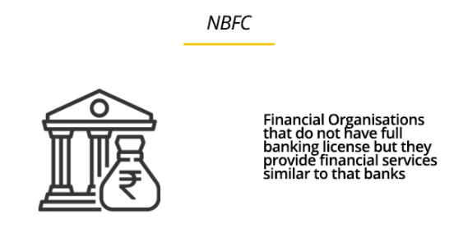
Business Problem
Foreclosure possibility check for loan approvals in NBFC (Non Banking Financial Companies)
Predict whether a new loan application can be disbursed to an applicant based on his application parameters and historical trend on the basis of previous records
Given – Dataset with aggregate past loan allotment records with multiple features/parameters. Also contains information on whether those loans defaulted or not. Current dataset has around 22000 records with close to 50 fields/features, with both static and dynamic data

Slide 3




Business Problem - Use of Analytics
Why Analytics/AI/ML?
Automate the process of prediction of loan defaults. Ability to rapidly update model quickly based on recent transactions
Disbursal or rejection with higher confidence and accuracy based on patterns of historical transactions leading to reduction in losses due to foreclosure
Faster processing rates to remain competitive and customer friendly
Automation
Accuracy
Faster Processing
Higher returns for NBFC

Slide 4
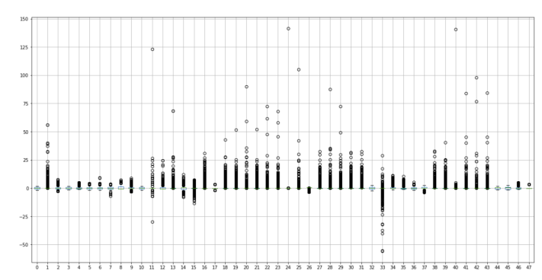
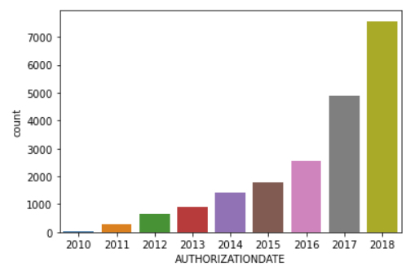
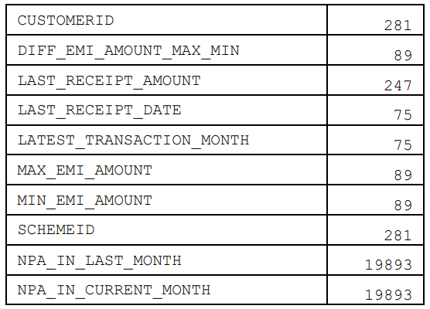
EDA and Data Preparation
Understanding and Pre-Processing data:
Descriptive Modelling and Exploratory data analysis (EDA)
Understanding features, removing unwanted columns, renaming as appropriate
Check for null values or missing values and take appropriate action
Outlier detection, Scaling the data – Standard or Z scaler is used
Outlier Treatment – 1.5 IQR technique (on either side) is used to adjust the outliers
EDA – Loans authorization over years
Plotting Outliers
Null value detection in features

Slide 5



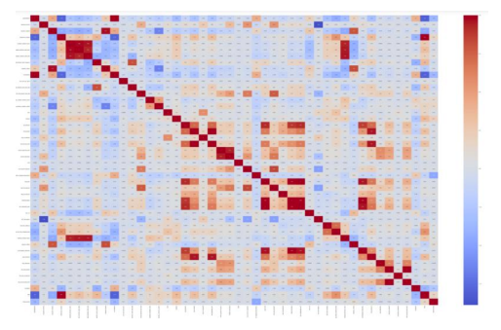
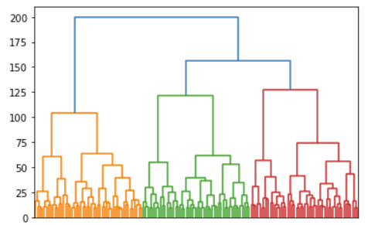
EDA and Data Preparation
Understanding and Pre-Processing data:
Descriptive Modelling and Exploratory data analysis (EDA)
Variable Transformation – Convert categorical variables to numeric through label encoding
Clustering data in groups for general understanding
Correlation map between features(heatmap), Feature importance ranking
Checking Class Balance to see if oversampling/undersampling req. Not necessary in this case
Label Encoding
Class Balance Checking
Clustering
Correlation heatmap

Slide 6
Modeling Approach
Approach
Supervised learning where independent variables are used to predict a dependent variable (Foreclosure)
We model this as a Classification problem where we predict a class label (0 or 1), to predict whether the loan will stay ‘status-quo’ or ‘default’
Feature Engineering
We identify (through heatmap) and reduce through removal, few of the redundant highly correlated features
We employ Sci-kit learn’s feature importance ranking and choose 15 features from the list. Care is taken that these features are understood while picking them (for example, loan ID may rank high, but is not important for modeling).
Alternatively, other methods such as PCA or Chi-square tests can be used to do feature selection and removal.

Slide 7
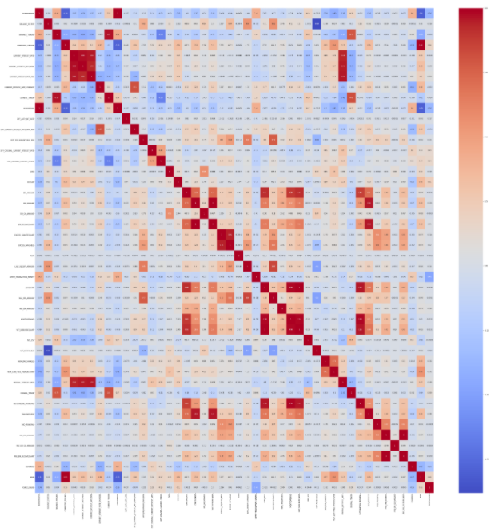
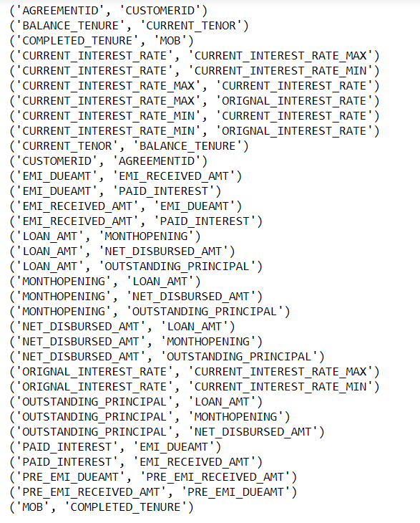
Modeling Approach
Some of the features such as Agreement ID or Customer ID are not required for prediction and serve only as identifiers. These can be removed while model building too.
Correlation > 0.95
Some of the important features we use after feature extraction are :
'BALANCE_TENURE', 'COMPLETED_TENURE', 'CURRENT_INTEREST_RATE', 'CURRENT_INTEREST_RATE_MAX', 'CURRENT_INTEREST_RATE_MIN', 'CURRENT_INTEREST_RATE_CHANGES', 'DIFF_CURRENT_INTEREST_RATE_MAX_MIN', 'DIFF_ORIGINAL_CURRENT_INTEREST_RATE', 'DIFF_ORIGINAL_CURRENT_TENOR', 'ORIGNAL_INTEREST_RATE', 'PAID_INTEREST', 'PAID_PRINCIPAL', 'PRODUCT', 'MOB'
List of Highly correlated pairs – some of which can be removed to reduce redundancy

Slide 8
Machine Learning Model
The data is split into training and test data in a 80:20 ratio. This is agreeable since we have sufficient records.
Various classification algorithms are experimented on this data :
CLASSIC MODELS
1. Decision Trees (CART)
2. Logistic Regression (Logit)
3. Linear Discriminant Analysis (LDA)
4. Support Vector Machine (SVM)
5. Artificial Neural Networks (ANN)
6. Gauss Naïve Bayes (NB)
7. K Nearest Neigbour (KNN)
ADVANCED MODELS
Random Forest (with tuning)
Bagging (with RF)
Boosting (XGBoost)
Cross Validation and Grid Search are applied in models with high scores for further improving scores

Slide 9
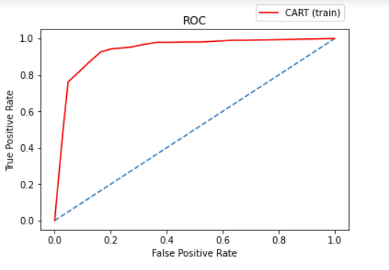
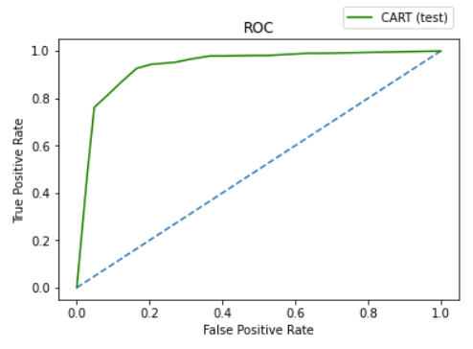
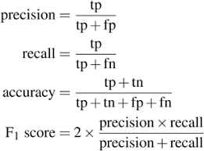

Metrics
Classification Metrics used & Compared:
Accuracy
Recall
Precision
Support
F1 Score
ROC (Receiver operating Characteristics)
AUC (Area under Curve)
ROC curve for Decision Trees (CART)
Area Under Curve (CART) : Train & Test

Slide 10
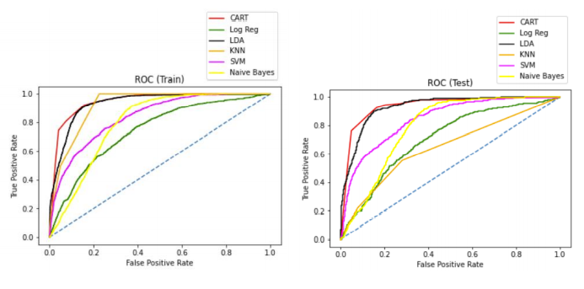
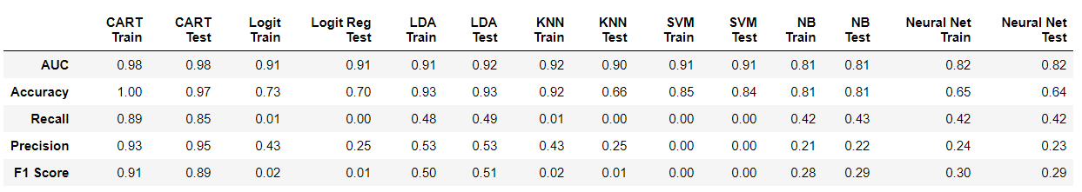
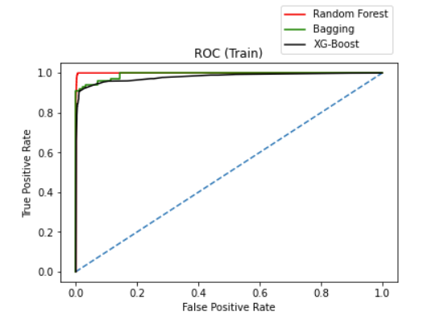
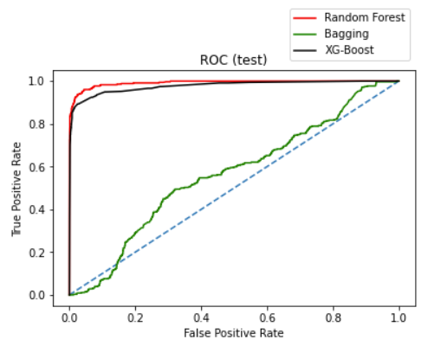
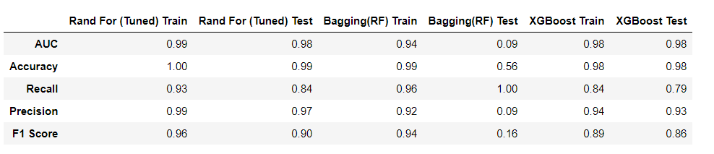
Metrics
METRICS - CLASSIC MODELS
METRICS – ADVANCED MODELS

Slide 11
Insights from Metrics
Some algorithms, such as SVM perform better with balanced data after using SMOTE. We do not use SMOTE for other models, because the data is sufficiently balanced (~10% foreclosures in training data). SMOTE is usually applied when one class is around 1-2% of the data.
Methods such as Neural Networks and Logit can be further tuned to improve, but are not further used here due to availability of other models
CART performs well amongst the classic models.
While accuracy of many models are similar, ensemble models such as Random Forest and XG-Boost perform the best when looking at all metrics overall. Random Forest has equally good training and test scores for almost all metrics including accuracy and recall .

Slide 12
Recommendations
In this study, we prefer that the prediction leads us to reject a loan assuming foreclosure (even its a wrong prediction) than clearing a loan application wrongly.
With classification problems such as this, where False Negatives are a lot more expensive than False Positives because it will lead to a greater loss for the bank. We prefer a model with a high recall more than high precision.
Amongst the models tried, the Random Forest model performs best for all metrics including Accuracy and Recall, we can use this as a model of choice for this problem.
It is recommended that this model is updated frequently with new data to improve the prediction and take decisions on deciding on approval of loans with confidence.

Slide 13
APPENDIX

Slide 14
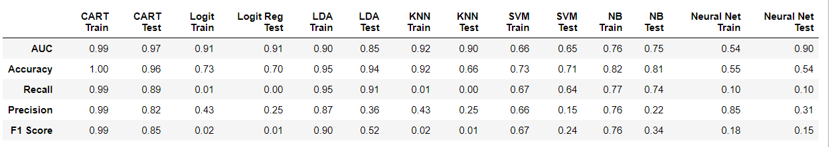
Appendix: SMOTE on data
Without SMOTE
With SMOTE

Slide 15
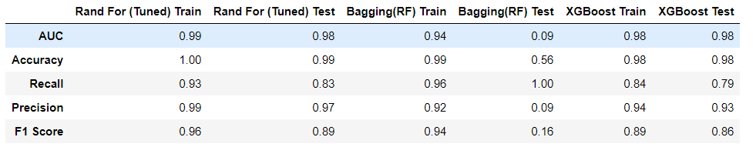
Appendix: SMOTE on data
Without SMOTE
With SMOTE

Slide 16
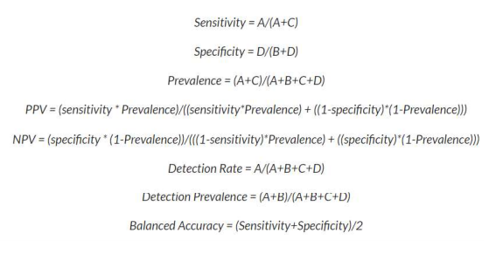
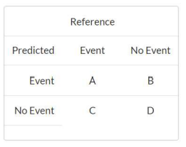
Classification Table, Metrics - Reference

Slide 17
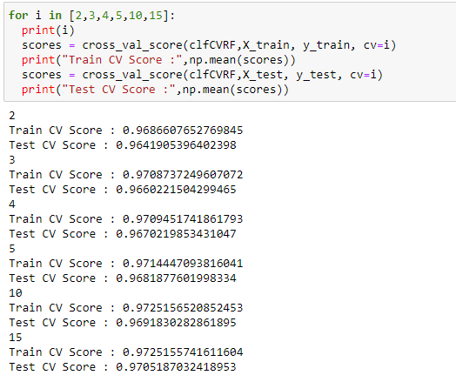
Cross Validation testing in RF

Slide 18
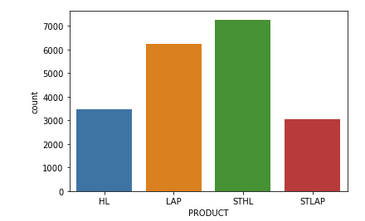
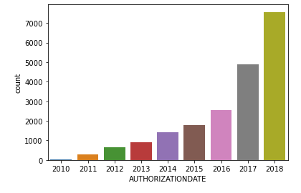
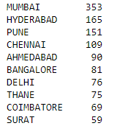
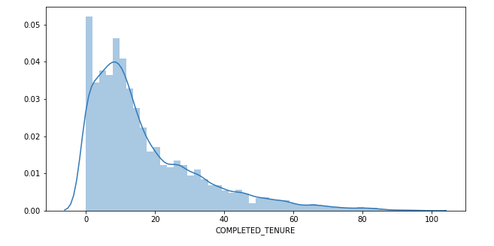
EDA
Comparison of Products Loaned Out
Trend of Loans authorized pear year – Increasing exponentially
Cities with most Foreclosures
Completed Tenure – Histogram of records

