Slide 1
Lead Conversion case Study
Shailesh Khulbe
Rohit Gupta
Vikram Rajawat

Slide 2
Problem Statement
Identify the most promising leads and targeting them from the pool of generated leads that can will be joining the course which in turn will save manpower and cost involved in communication with the leads.
Approach Used
DATA Analysis
Data Cleaning: Missing Value Treatment, Outlier Treatment
Univariate, Bi Variate, Multi Variate Analysis
Final Data Preparation
Model Building
RFE for feature Selection
Iterations to Select Final Model
Metrices for Model strength
Prediction On Test Set

Slide 3
Problem Solving Method
Data Import : Import data from csv file and check if data loaded correctly.
Data Preparation : Remove unwanted columns which has more than 99.5% in a single category, apply data cleaning on remaining columns such as missing value treatment, outlier treatment , binning if required and segregate numerical and categorical columns.
Analysis : Perform univariate, bi variate and multivariate to understand the range of data and how it is related to TARGET variable and decide which variables have impact on Target variab
Final Data Preparation:-Converting categorical variables to Dummy variables and making data ready for modelling.
Model Building : Building model with remaining variables, scaling the variables, using RFE , Analysing VIF and P value , Iterating to reach the final model.
Validation : Validating the model on various metrices and test data.

Slide 4
Data Preparation Steps
Removing Columns
Remove columns with 40% missing values as we have 2 numerical columns meeting the criteria.
Removing columns which have more than 99.5% in one category and ID columns
Missing Value/Outlier Treatment
Impute missing values for remaining columns with mean or median.
Replace with mean when variable is continuous and does not have outlier otherwise with median
Univariate/Bivariate
Analyse cleaned data using Histogram, box plot, pair plot etc.
For numerical variables use histogram, box plot, scatter plot, pair plot etc.
Outliers are values that are different from the normal population. Replace outliers quantiles or by capping using +,-(IQR*1.5 ) for 25th and 75th percentile or business understanding whichever is applicable.
Delete rows for columns that have very few missing values.
Deleting columns which have SELECT as value and missing resulting in more than 40% missing values.
Grouping categories with less than 5% values to OTHER category.
Replace with mode when variable is categorical
For categorical use value counts, bar plot, pi chart ,group by etc.
Find variables which have high influence on TARGET VARIABLE.

Slide 5
Data Preparation For Modelling
Dummy Variables
Train Test Split
Scaling Variables
Creating dummy variables for Categorical Variables
Splitting data inti training and test
Scaling variables to make the scale even for all variables

Slide 6
Model Building
1
3
2
Use RFE for variable selection
Remove variables with high VIF and P value
Re run the model to receive a stable model
Validate the results on various matrices
4
Validate the result on Test data
5

Slide 7
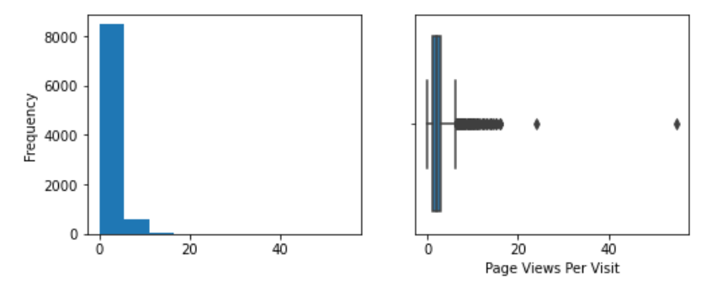
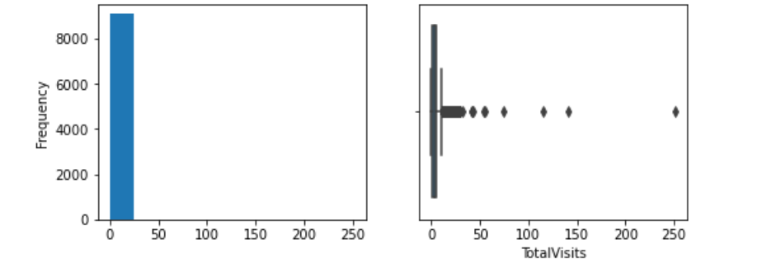
Numerical Variable Analysis
Outliers using box plot

Slide 8
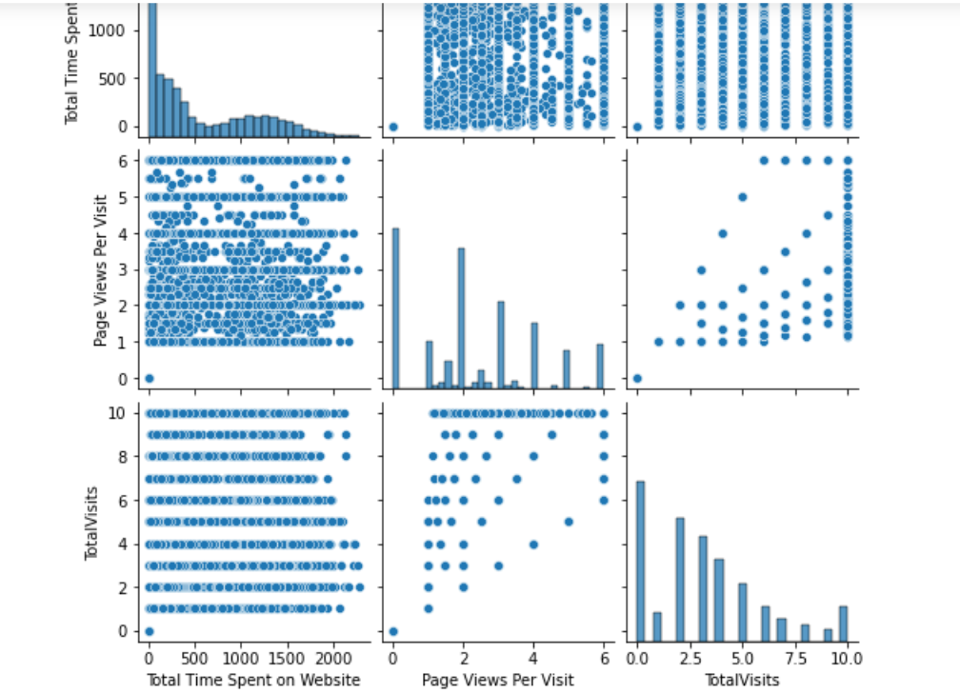
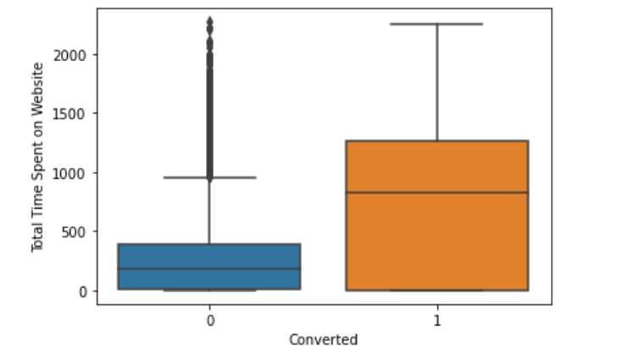
Numerical Bi-variate And Target Variable Analysis

Slide 9
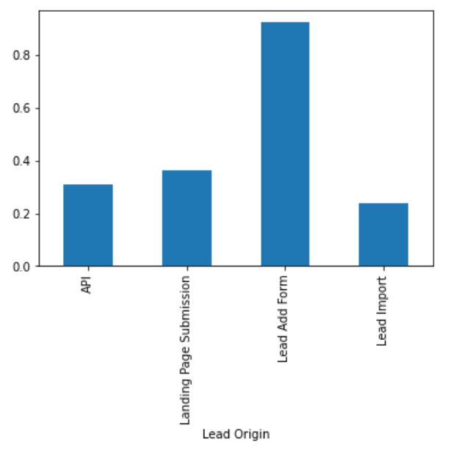
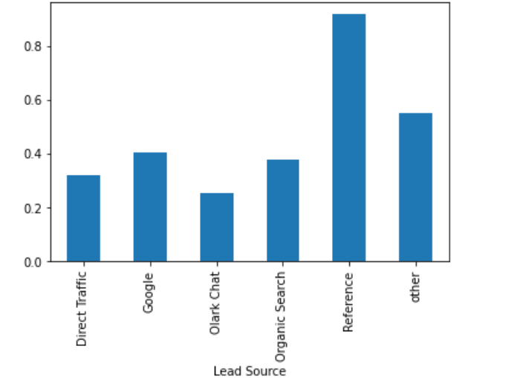
Categorical Variable Analysis With Target Variable

Slide 10
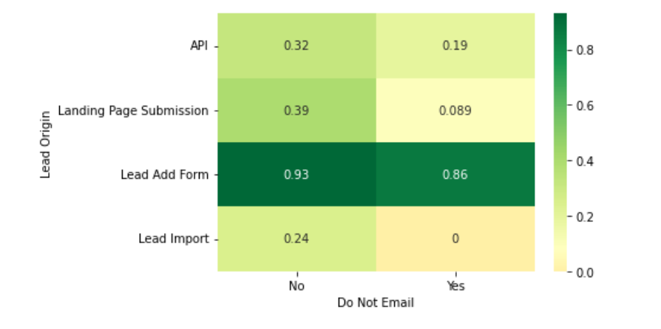
Multivariate Analysis With Target Variable

Slide 11
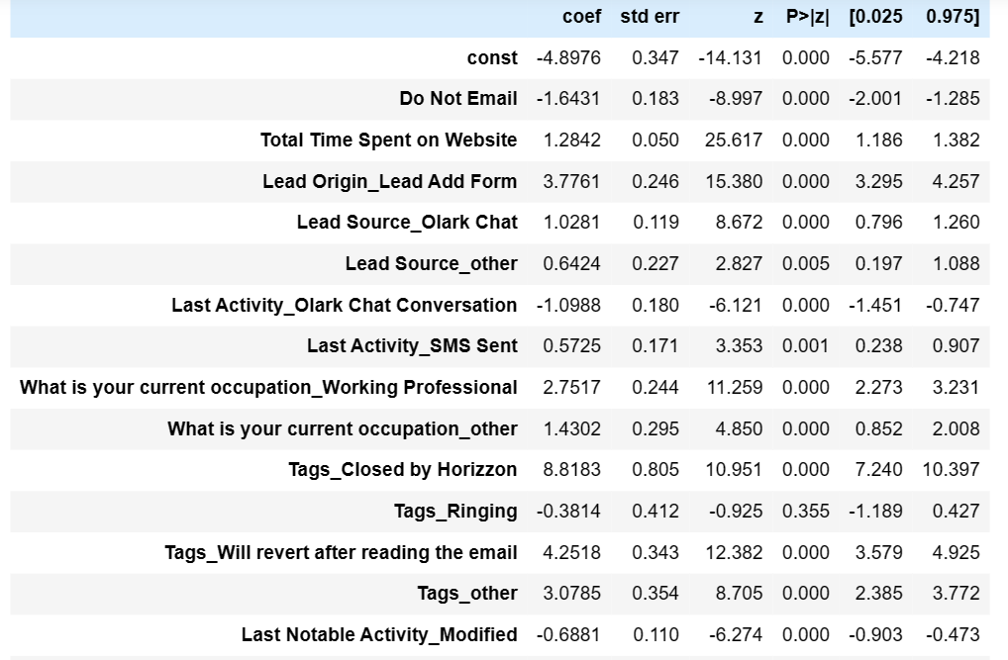
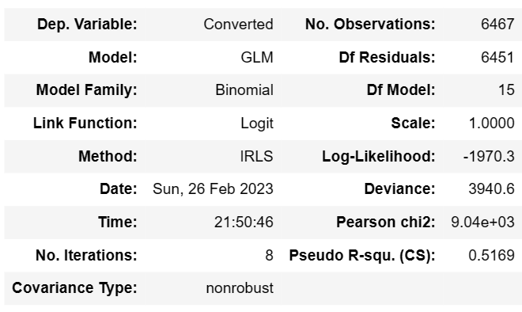
First Iterations Results

Slide 12
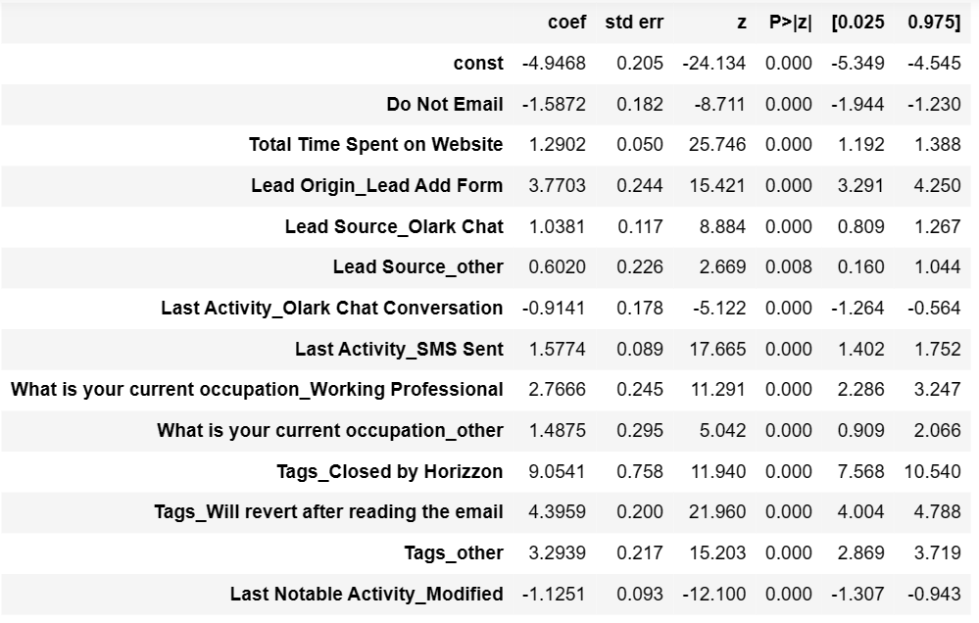
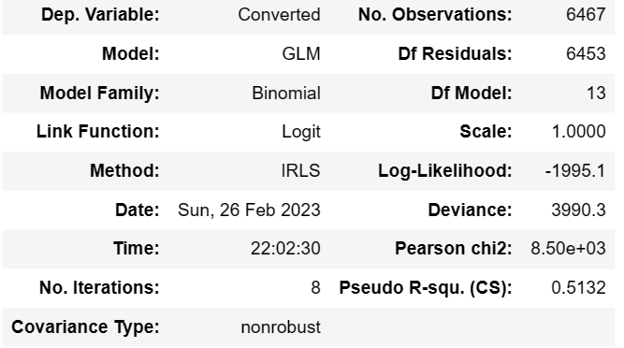
Final Iterations Results

Slide 13
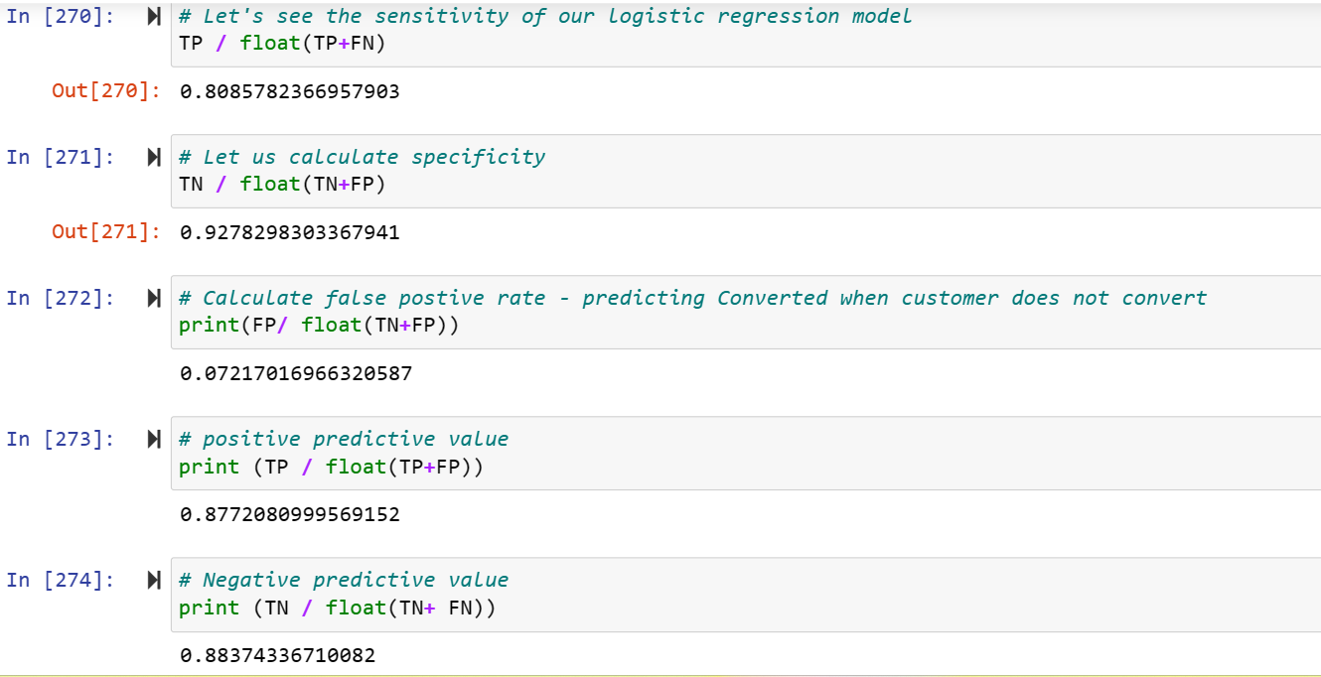
Validations Results
AMT_ANNUITY

Slide 14
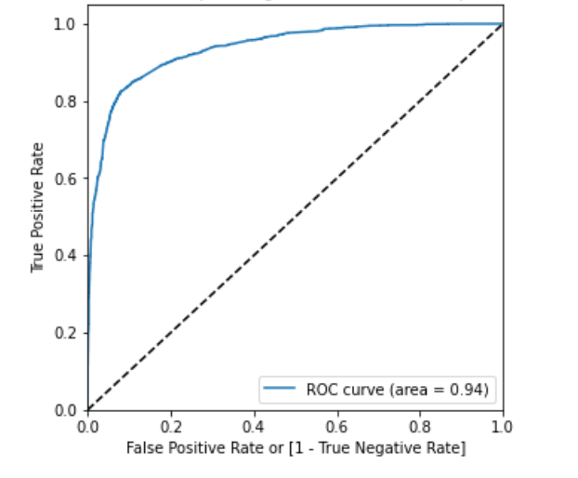
ROC Curve

Slide 15
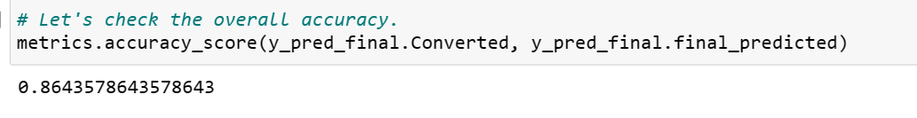
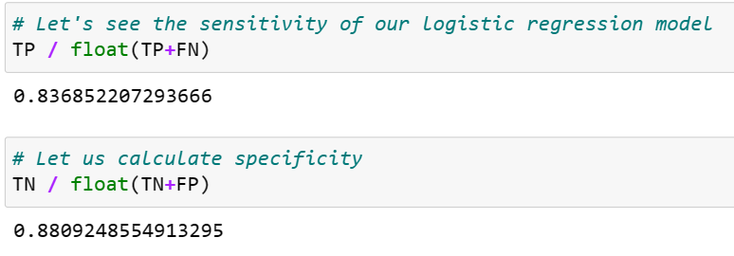
Prediction On test Set

Slide 16
Result in Business Terms
 | coef | Absolute
const | -4.3972 | 4.3972
Tags_Will revert after reading the email | 4.3024 | 4.3024
Lead Origin_Lead Add Form | 4.2262 | 4.2262
Tags_other | 3.7069 | 3.7069
What is your current occupation_Working Professional | 2.9169 | 2.9169
Last Activity_Olark Chat Conversation | -2.1973 | 2.1973
Last Activity_Page Visited on Website | -1.4706 | 1.4706
Last Activity_other | -1.4646 | 1.4646
Total Time Spent on Website | 1.2784 | 1.2784
Do Not Email | -1.2691 | 1.2691
What is your current occupation_other | 1.2638 | 1.2638
Lead Source_Olark Chat | 0.9581 | 0.9581
Last Notable Activity_other | 0.6534 | 0.6534
Lead Source_other | 0.3445 | 0.3445
Overall we see 13 variables coming the final model equation. Few top variables of these are
Tags assigned to the customer indicating the current status of the lead
Lead Origin – The origin identifier with which the customer was identified. So, one which is added by add form is is contributing
Current Occupation Working Profession is adding a lot of value

