Slide 1

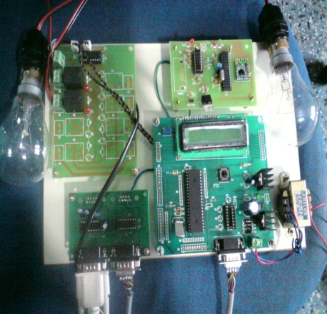
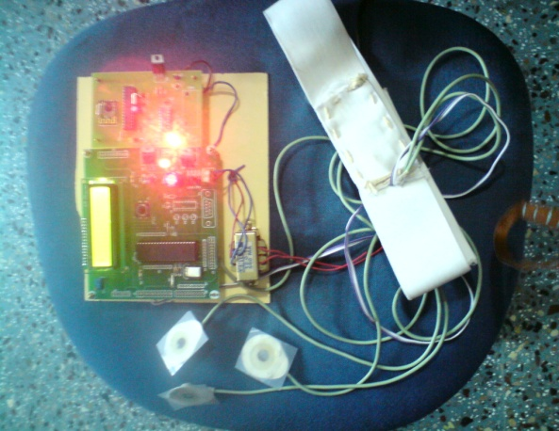
Magna College of Engineering.
Project Title:
A Portable Wireless Eye Movement Based
Human Computer Interface.
By
R.Vikram
G.Varun Kumar
K.Vinoth Kumar

Slide 2
Introduction
Human Computer Interface:
It can be described as the point of communication between
the human user and the computer.
HCI’s based on movements of hand, leg and eye
Boon for the disabled.
Eye movement based HCI beneficial to people
with problems as:
Cerebral Palsy
Brainstem stroke
Motor paralysis
EOG based HCI.

Slide 3
Existing system
For Eye Movement Detection there are various techniques:
Infrared oculography
Electrooculography (EOG)
Image based methods.
The features of the EOG based method are:
convenient, low cost and easy to setup
accurate

Slide 4
Proposed system
An EOG based HCI which is:
Cheap
Portable
Efficient
Non-Invasive
Wider scope of applications.

Slide 5
Features
The main difference between our system and others are:
Non-invasive technique of signal extraction
Designing and implementing a mathematical morphology method to preprocess original EOG signals
Including a wireless module based on the ZigBee protocol to increase the scope of applications (communication aid, smart home applications, etc.) of this system.

Slide 6
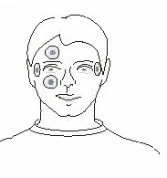
Block Diagram
Microcontroller
(PIC16F877)
Wireless Zigbee module
Amplifier
Personal
Computer
(With MATLAB software)
Wireless Zigbee module
Microcontroller
(PIC16F877)
Communication Aid
Smart Home Application
Device

Slide 7
Working
Here we develop an EOG based HCI.
Initially the EOG are measured by electrodes placed around eye. The microcontroller detects the direction of eye movement and transmits it to the receiver side using wireless Zigbee module.
In the receiver side this data is taken by a microcontroller through which we can demonstrate our desired application.
For demonstration purpose in this project we implement and show two applications:
Communication Aid.
Smart home application.

Slide 8
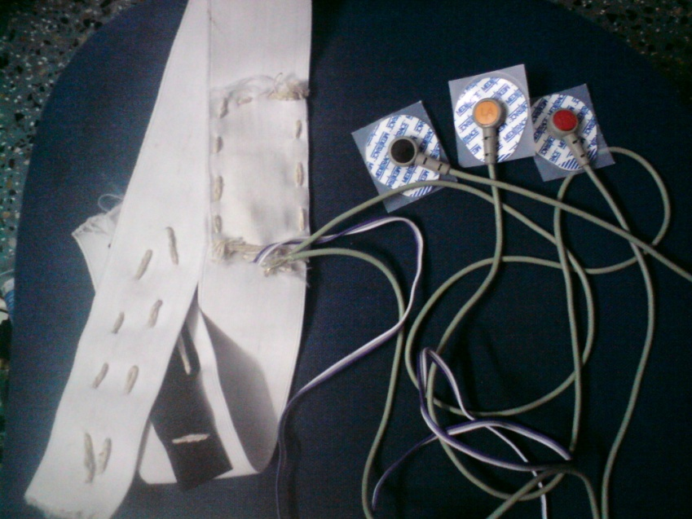
Hardware Module Electrodes:
Surface electrodes similar to those used in ECG are utilized.
3 electrodes are placed Above the eye; below the eye; Near the ear
EOG principle used.

Slide 9
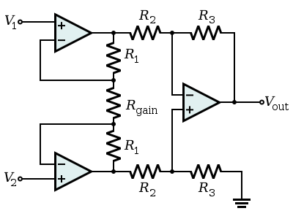
Amplifier
Instrumentation amplifier with high gain is used for this purpose.
The circuit of a 3 opamp instrumentation amplifier is shown below:

Slide 10
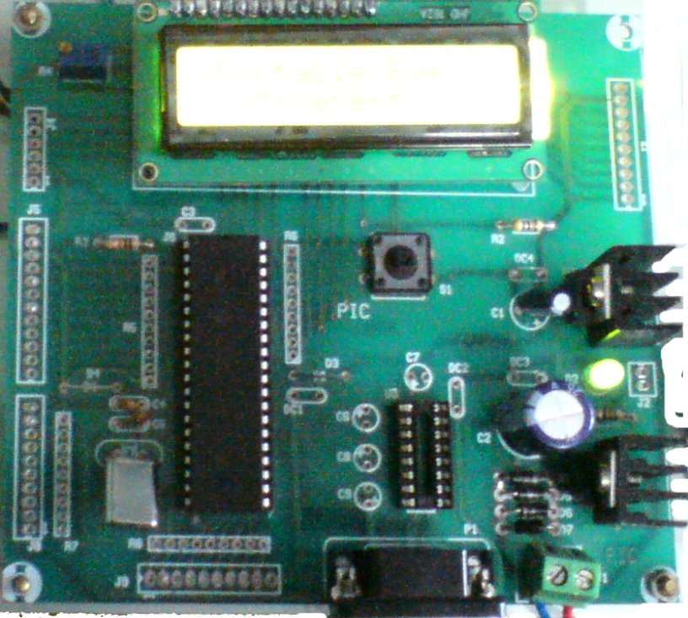
Microcontroller
PIC16F877 Microcontroller is used because of its
High speed.
Better peripheral features.
Low power consumption.
Higher memory.
Easy and compact for use.

Slide 11
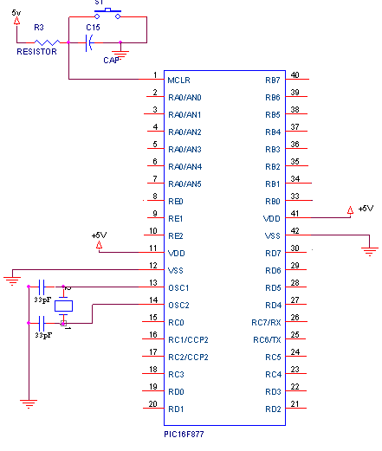
Pin diagram of PIC16F877 Microcontroller is shown below:

Slide 12
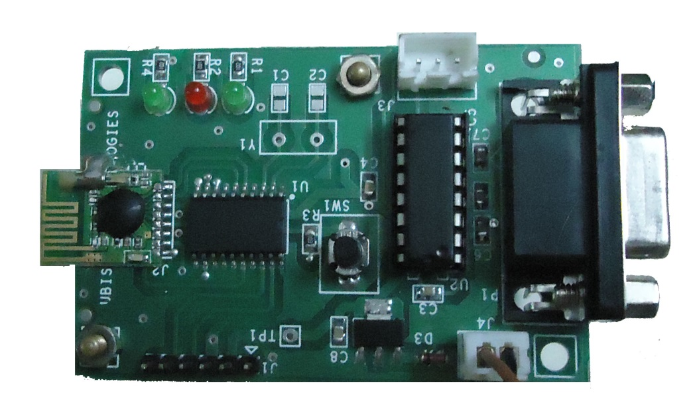
Wireless Zigbee Module
Transreceiver module
It is:
Efficient
Low power consuming
Can connect large number of nodes.
Generally covers 30 feet, can be extended to 100 feet.

Slide 13
Software Used
The Software required are :
C language(used for coding on user level).
MPLAB compiler, (used for converting C coding into processor language)
Windows operating system
MATLAB.(for communication aid Implementation)
Software Requirements
Operating system : Windows XP/Vista/7/8
IDE : MPLAB IDE
Programming Language : Embedded C

Slide 14
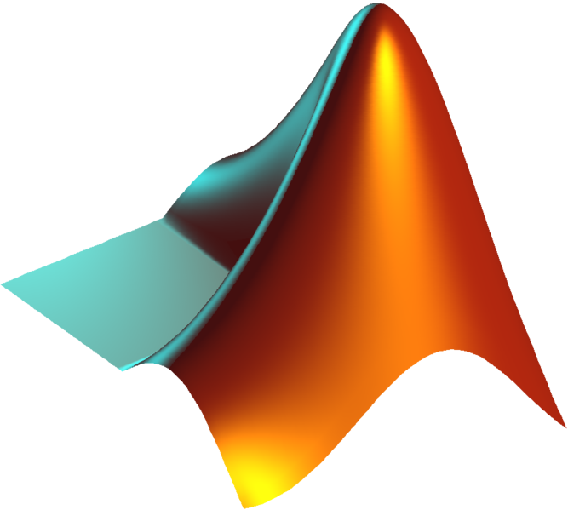
Matlab
It stands for Matrix Laboratory
Its a numerical computing environment and a fourth generation programming language developed by MathWorks.
It allows matrix manipulations, plotting of functions and data, implementation of algorithms, creation of user interfaces, and interfacing with programs written in other languages, including C, C++,Java, and Fortran.

Slide 15
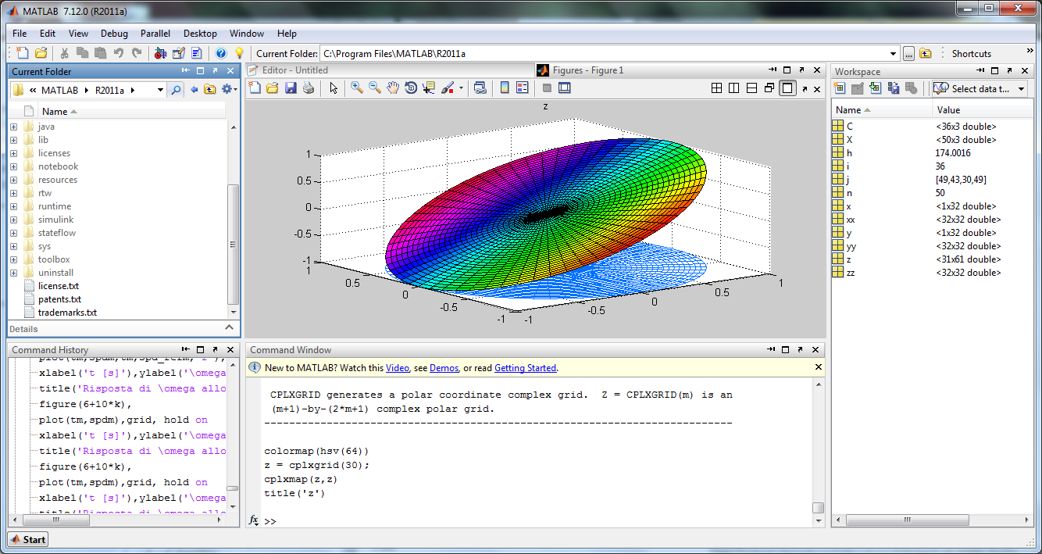
Screenshot of a MATLAB program

Slide 16
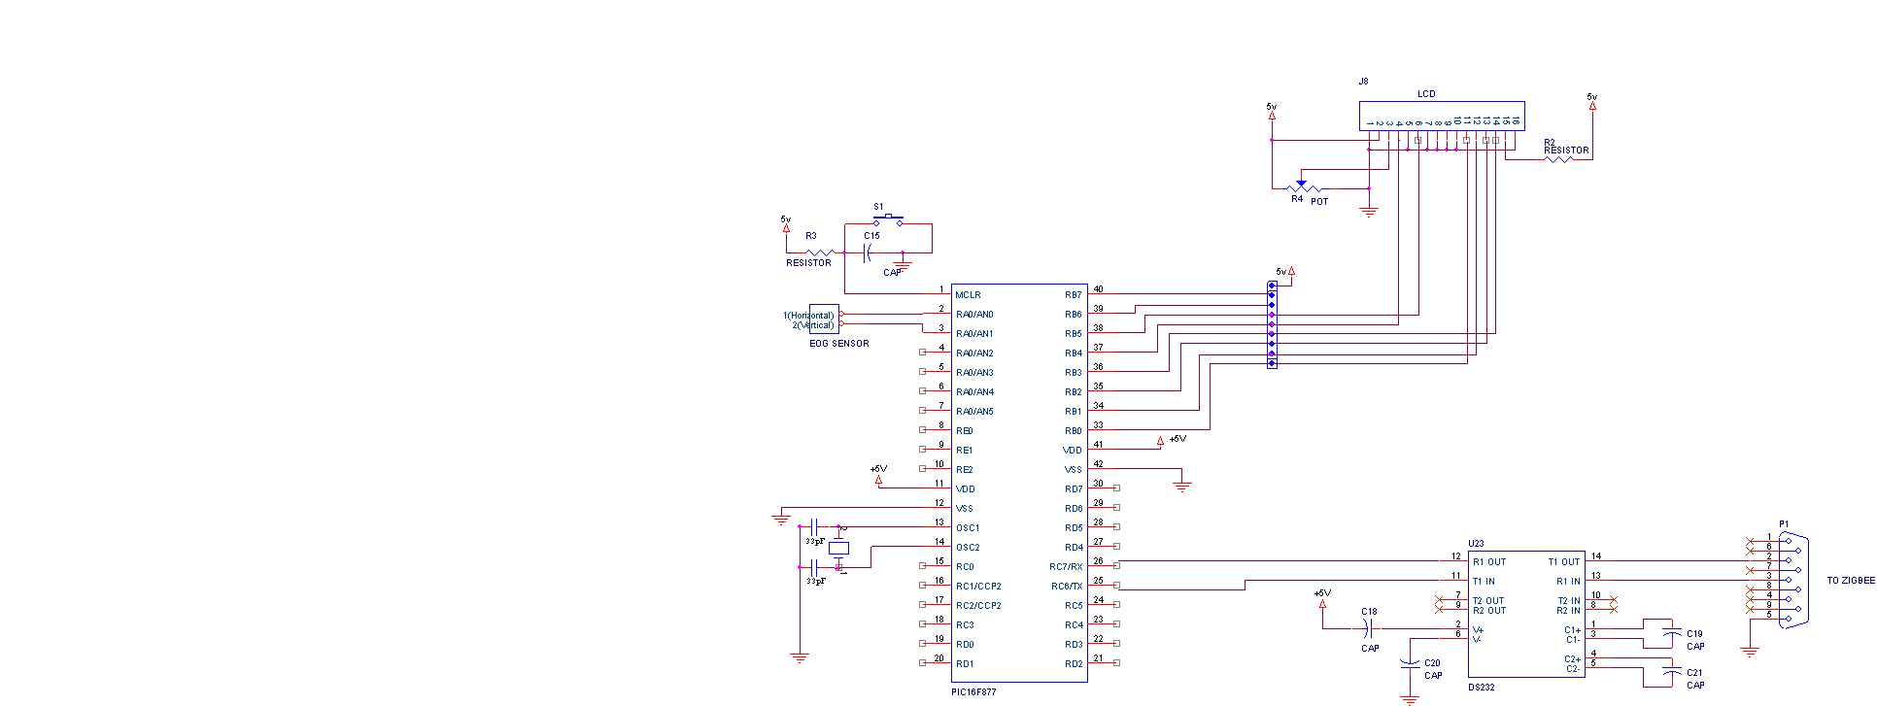
Full Circuit Diagram (Human Side)

Slide 17
Input Section Flowchart
START
Input from surface electrode`
EOG signals amplified in amplifier
To PIC
Input sent to ADC block in PIC
Digital o/p
Digital value compared and eye movement detected.
UP/DOWN/NORMAL displayed in LCD
U/D/N sent to zigbee accordingly.
Zigbee transmits to other side.
A

Slide 18
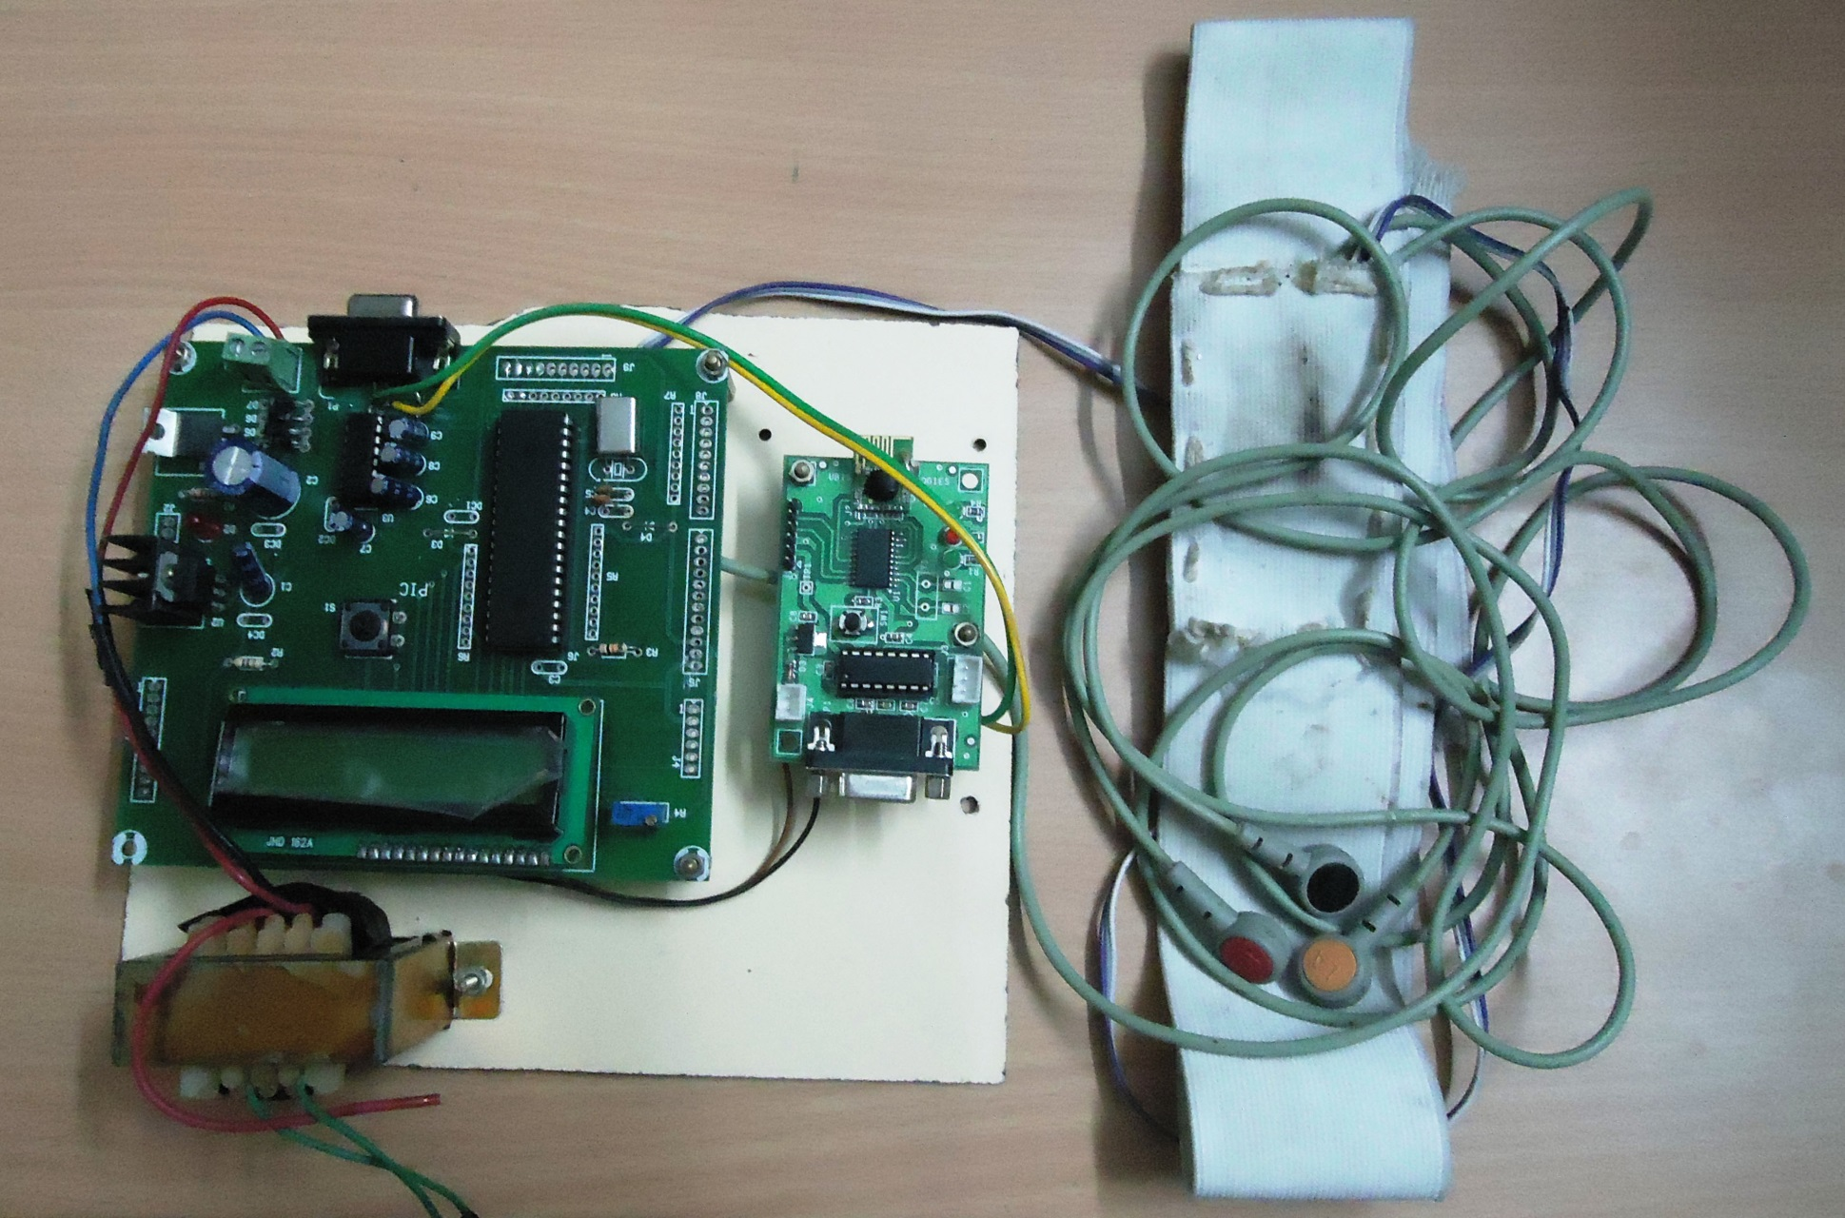
Human Side
Wireless
Zigbee Module
Amplifier
Electrodes
PIC16F877 Microcontroller
Board

Slide 19
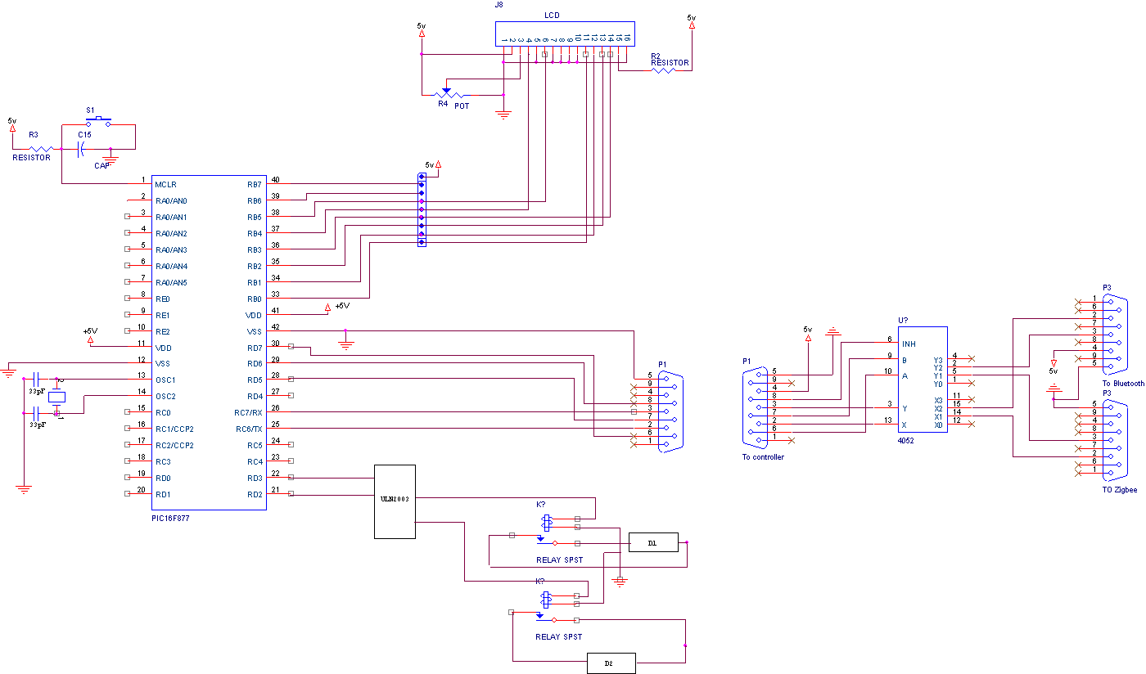
Full Circuit Diagram (Receiver Side)

Slide 20
Output Section Flowchart
A
Zigbee on receiver side gets U/D/N.
Data sent to Pc which receives the U/D/N.
1st application
Pc checks which application
2nd application.
To PIC
B
C

Slide 21
Output Section Flowchart:
C
B
a/b/c (code) sent by Pc to PIC .
Communication Aid implemented in Pc using MATLAB.
PIC sends command 1/0 to respective relay
Respective device switched ON/OFF.

Slide 22
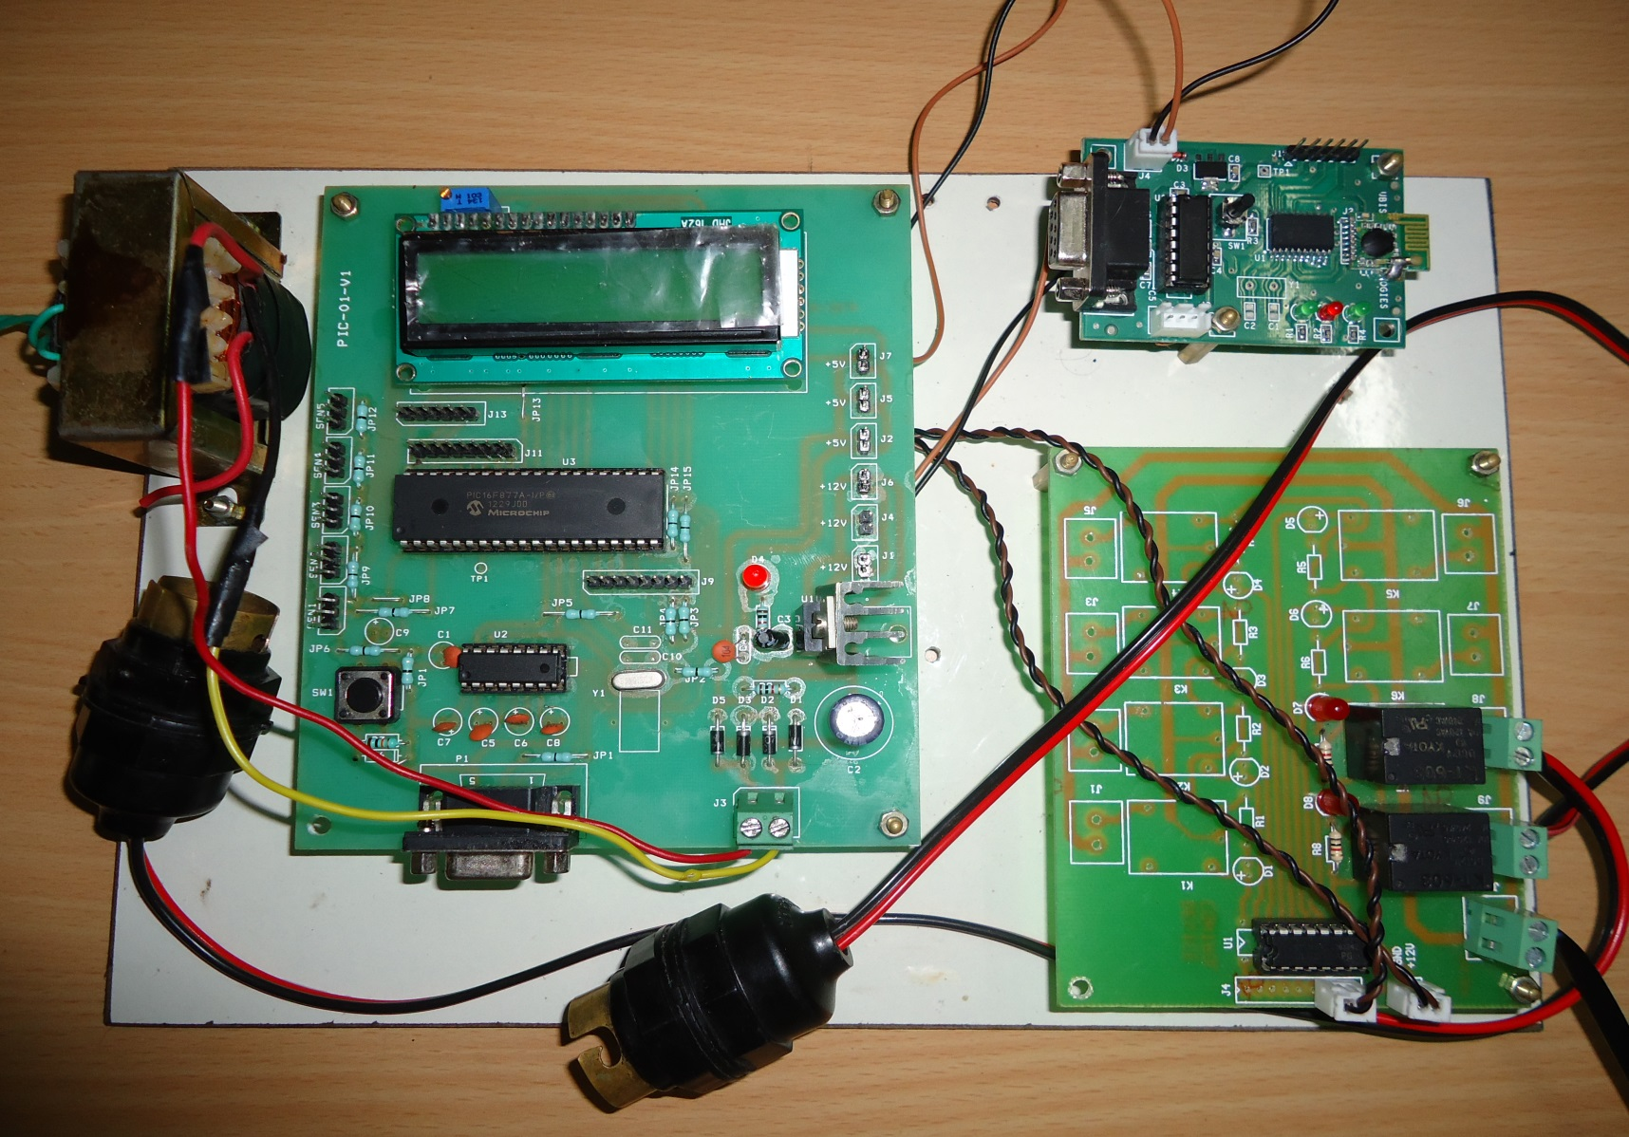
Receiver Side
Wireless Zigbee Module
PIC16F877 Microcontroller
Board
Relay Board

Slide 23
Implementation
2 applications are demonstrated:
Communication aid (word speller or online keyboard) According to direction of eye movement data is selected thus information communicated.
Smart Home Application According to direction of eye movement electrical devices in the room is controlled.

Slide 24
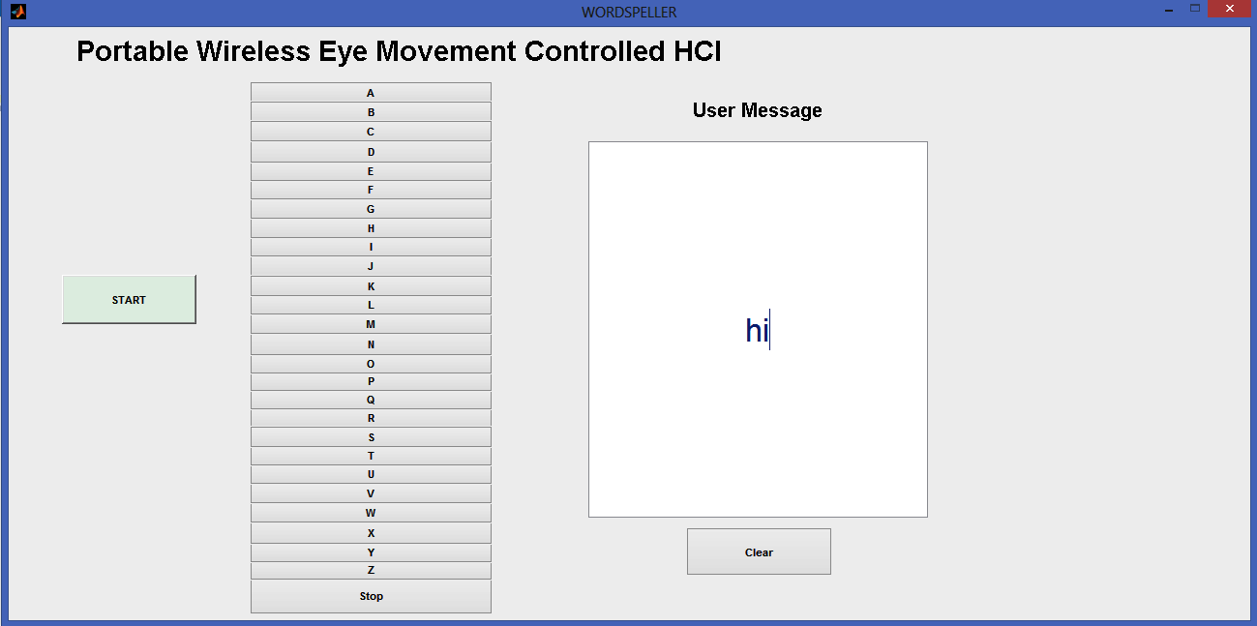
Communication Aid ImplementationView
A screenshot of implementation of communication aid

Slide 25
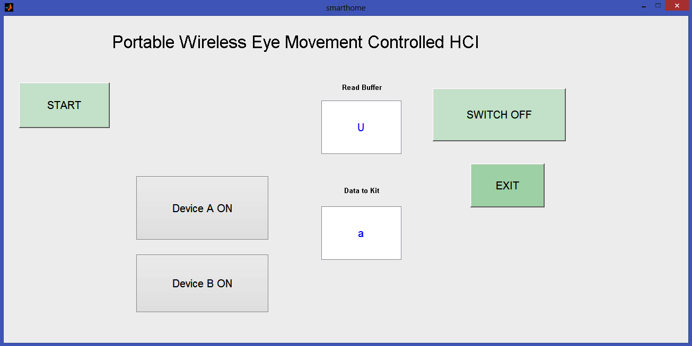
Smart Home Application View
A screenshot showing implementation of smart home application in PC

Slide 26
Advantages
This is one of the most user friendly HCI.
It’s easy to maintain and reliable.
Since it does not use any harmful rays as IR for detection it is a safe method
It consumes less power.
It doesn’t cause high strain to the patient.
It is compact and since wireless technology is used it is portable also.
It is highly accurate.
Real time monitoring system.

Slide 27

Epilogue
Thus a portable wireless eye movement based HCI using EOG signals is developed. It is :
Compact
Accurate
Cheaper
Portable
Safe
The applications implemented are on a small scale for practical purpose this technology can be expanded on a large scale which if done would be a real boon for the disabled people and even for elderly persons.
Applications in
Houses, Hospitals and Offices.

Slide 28
Future Enhancements
A method for measuring EOG maybe found out without using these kinds of sensors.
Zigbee range can be extended.
Patients can be monitored in hospital using this technology.
Wider scope applications.
Full virtual keyboard.
Can be implemented with the disciplines of Human Machine Interface and Artificial Intelligence.

Slide 29
Approximate product costing
S. NO. | ITEM | SPECIFICATION | NO. | PRICE | TOTAL
1 | Relay | 12v | 2 | 15 | 30
2 | Analog multiplexer /Demultiplexer | UTC4052 | 2 2 | 15 15 | 30 30
3 | Strap | - | 1 | 50 | 50
4 | Bulb | 60 W | 2 | 30 | 60
5 | Regulator | LM7812 | 2 | 30 | 60
6 | Transceivers | MC13192 | 2 | 30 | 60
7 | Integrated circuit | MAX232 | 2 | 50 | 100
8 | Transformer | (0-12)V | 2 | 50 | 100
9 | Breadboard | - | 2 | 50 | 100
10 | PCB | - | 2 | 50 | 100
11 | Amplifier | LT1167 | 3 | 50 | 150
12 | LCD | JHD162A | 2 | 190 | 380
13 | EOG sensors: Surface electrodes | Electrodes (EOG) | 3 | 200 | 600
14 | PIC board | - | 2 | 500 | 1000
15 | Interface Chords | USB 2.0 | 2 | 500 | 1000
16 | Basic Hardware | - | - | - | 1000
17 | Microcontroller | PIC16F877 | 2 | 2000 | 4000
18 | Wireless Zigbee | 30-100 feet | 2 | 5000 | 10000
Approximate total budget: |  |  | 18850

Slide 30
REFERENCES
“Focus on Human-Machine Interfaces,” www.nature.com/nature/focus/human .
O. Tonet, M. Marinelli, L. Citi and P. Dario, "Defining BCI applications by matching interface performance with device requirements," Journal of Neuroscience Methods, vol. 167, pp. 91-104, 2008.
M. A. Lebedev and M. A. Nicolelis, "Brain-machine interfaces: past,
present and future," Trends Neurosci, vol. 29, pp. 536-46, Sep 2006
R. Wolpaw, N. Birbaumer, D. J. McFarland, G. Pfurtscheller, and T.
M. Vaughan, "Brain-computer interfaces for communication and
control," Clinical Neurophysiology, vol. 113, pp. 767-791, 2002.

Slide 31


