Slide 1
Online Library Management System.
by
R.Vikram

Slide 2
Introduction:
Online Library Management System (LiMs).
Complete Database.
Computerized.

Slide 3
Existing System:
Completely manual.
Disadvantage:
Time consuming.
Complex.
Accuracy Less.

Slide 4
Proposed System:
A fully computerized system.
We can:
Maintain database
Update database
Edit database
Lists
Queries

Slide 5
System Requirements:
Hardware Requirements:
One PC which can support the desired software.
Software Requirements:
Windows 95/98/xp/vista/7.
Turbo C++ Software

Slide 6
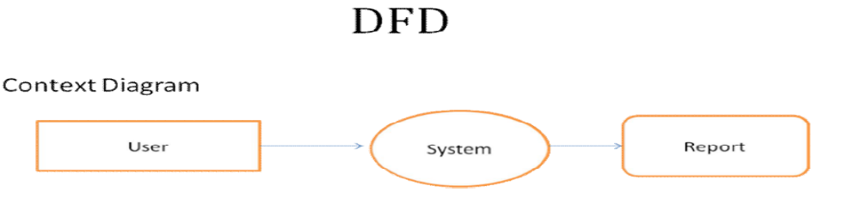
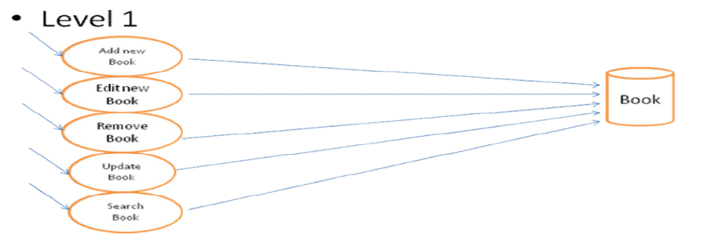
System Design:

Slide 7
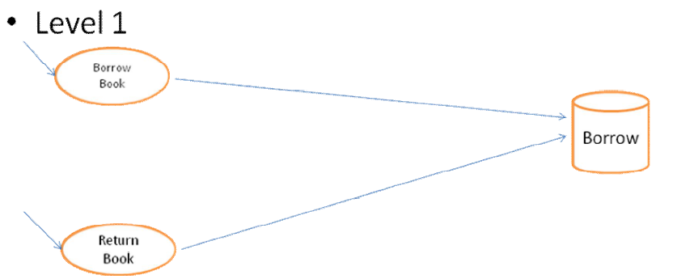
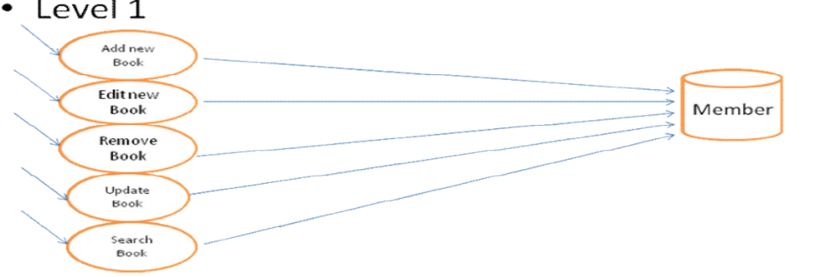

Slide 8
Modules Used:
Various blocks used are:
MENU BLOCK
BOOK PURCHASED.
BOOK LIST
MODIFY PURCHASE
BOOKS ISSUED
ISSUED LIST

Slide 9
BOOKS RETURNED
RETURNED LIST
LATE FINE DETAILS
QUERY BY BOOK
QUERY BY STUDENT
ABOUT
EXIT

Slide 10
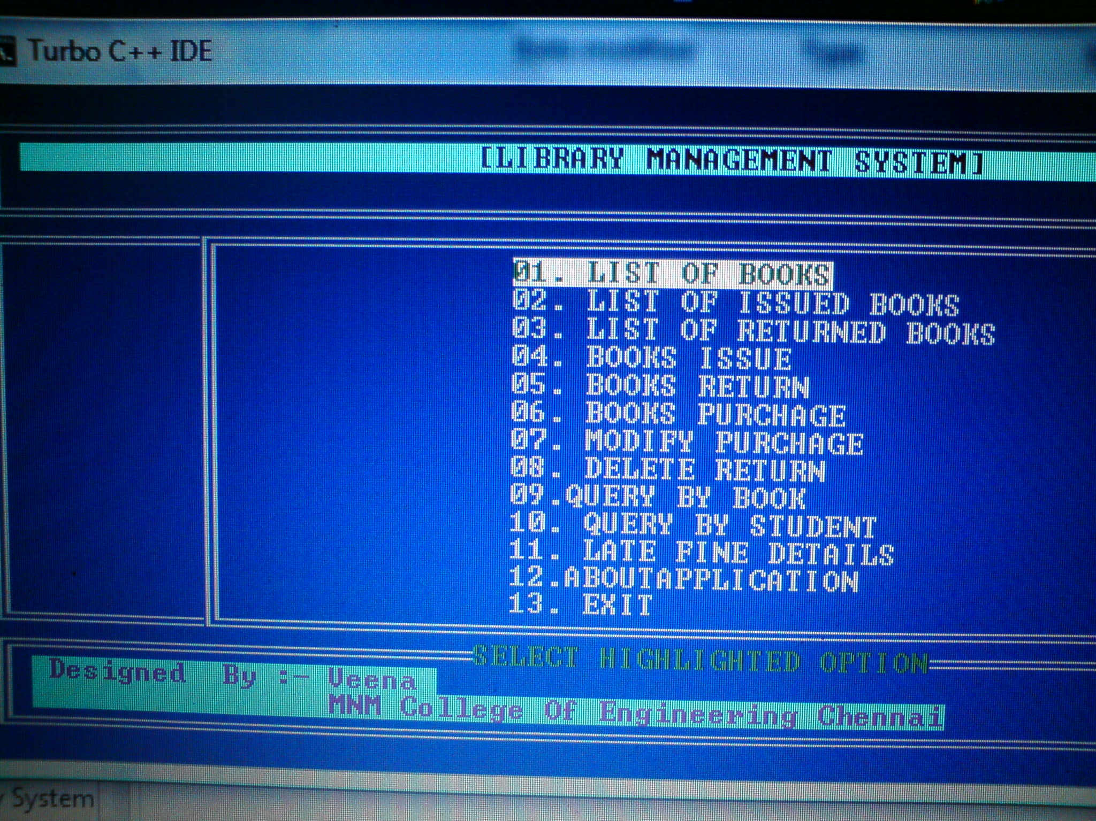
Output Slide View:

Slide 11
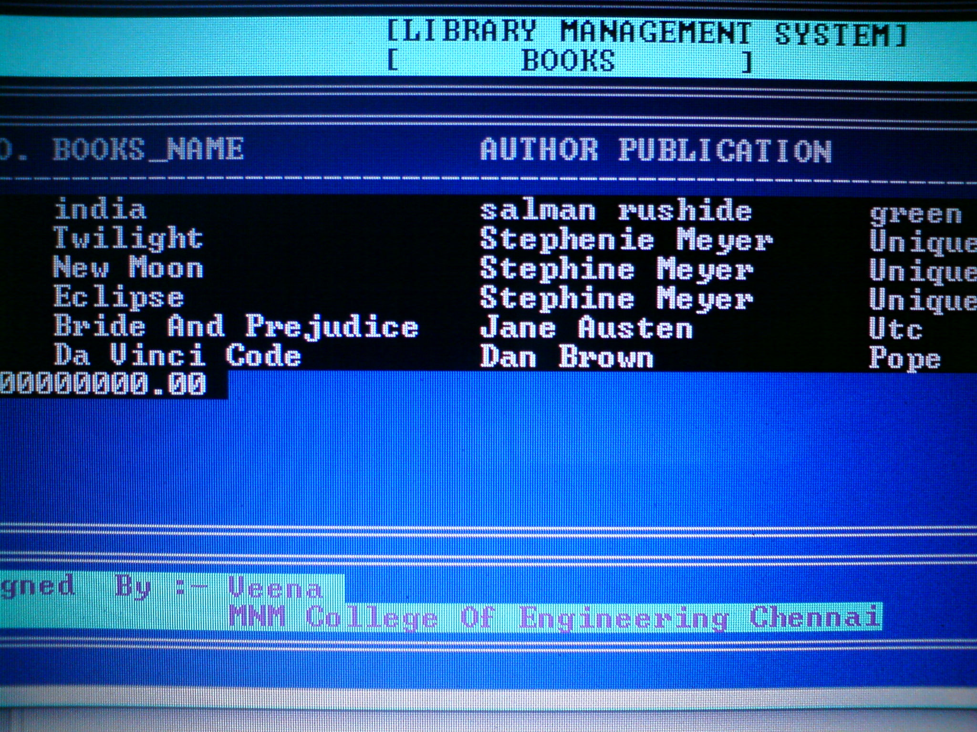

Slide 12
Conclusion:
We have developed an library management system.
It is:
User friendly and feasible.
Fast access.
Less error.
More Storage Capacity.
Future Enhancements:
More features
Other instituitions.

Slide 13
Thank You.

