Slide 1
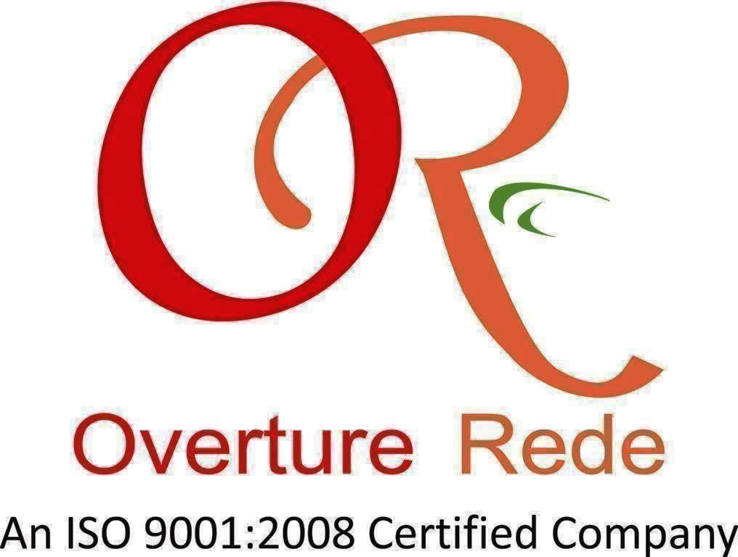

Slide 2
Heading
Getting Started with MVC and
Visual Studio 2015

Slide 3
What we will talk about
•
This is an introductory
VS 2015 is designed to
session on MVC and
get you going.
•
•
We’ll look at the Why of MVC vs Web Forms ☺
We’ll also look at some best practices and
things to think about
Lots of other great sessions and information available.
•

Slide 4

A history lesson..
ASP.NET Web Form
• A set of UI components (pages, buttons etc.) plus a stateful object oriented GUI programming model
The Strength of ASP.NET Web Forms
•
Making web development feel the same
as Windows Form development
No need to work with individual HTTP
requests and easier to think in terms of a
stateful UI
•
ASP.NET
• A way to host .NET application in IIS that let’s you interact with HTTP requests and responses
.NET
• A multi-language managed code platform

Slide 5

Some
Some problems with ASP.NET Web Forms
View state weight – Mechanism for maintaining state (view state) results in large blocks of data between client and server
Page life cycle – Connecting client side events with server side event handler code is complicated and delicate
False sense of separation – ASP.NET web Forms code behind model provides a means to take application code out of HTML markup. Unfortunately, this allows for mix presentation
models (manipulating a server side tree)
Limited control over HTML – Server side controls render themselves as HTML but not always the HTML you want
Low testability – Nobody could have anticipated that automated testing would become essential
Not all bad –
ASP.NET Web Forms provide a quick results and allows reasonably complex
web applications to be built quickly!

Slide 6

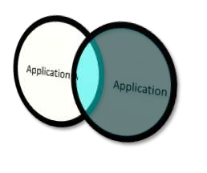

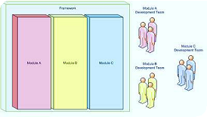
What matters…
Code reusability
Separation of concerns
•
•
•
•
Shortens development
Code libraries
Design patterns
Frameworks
•
Improves code clarity and
organization
Helps troubleshoot by
isolating issues
Allows for multiple teams to develop simultaneously
•
•

Slide 7
Hello MVC demo

Slide 8
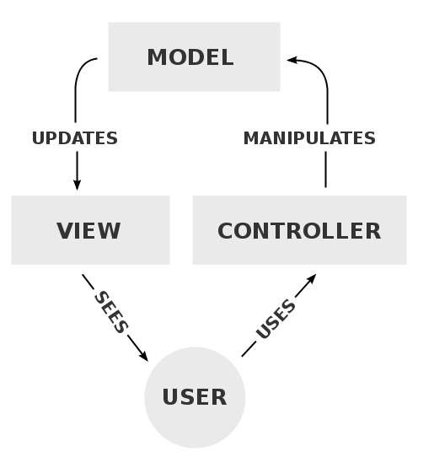
It’s
a
pattern
•
Model: Handles data
and business logic
View: Presents data to
the user using any
supported form and
layout
Controller: receives
user requests and calls
appropriate resources
to carry them out
•
•

Slide 9
What
is
MVC?
•
Model represents the data model
–
“Manages behavior and data of the
application domain”
•
View represents the screen
shown to the user
–
“Manages the graphical and/or
textual output to the portion of the
bitmapped display that is allocated
to the application”
•
Controller represents interaction
from the user that changes the
data and the view
–
“Interprets the mouse and
keyboard inputs from the user,
commanding the model and/or the
view to changes as appropriate”

Slide 10

MVC isn’t new!
•
Presented by Trygve
Reenskaug in 1979
First used in the
Smalltalk-80 framework
– Used in making Apple interfaces (Lisa and Macintosh)
•

Slide 11
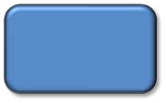





Step
by Step
The Controller asks
the Model for data
The request hits the
controller
2
Model
1
3
B
r
o
w
s
e
r
Controller
The Model gives the data
back to the Controller
The controller formats the
data and passes them to the
View
4
View
5
The view renders the HTML
that needs to be sent to the
client

Slide 12
Example control flow in MVC
•
•
User interacts with the View UI
Controller handles the user input (often a
callback function attached to a UI element)
Controller updates the Model
View uses the model to generate new UI
UI waits for user interaction
•
•
•

Slide 13
What’s the point?
•
Provides a logical structure for heavily
interactive system
Adheres to good engineering design principles and practices
– Information hiding, less coupling, simplicity, etc.
– Delegated control style
•

Slide 14
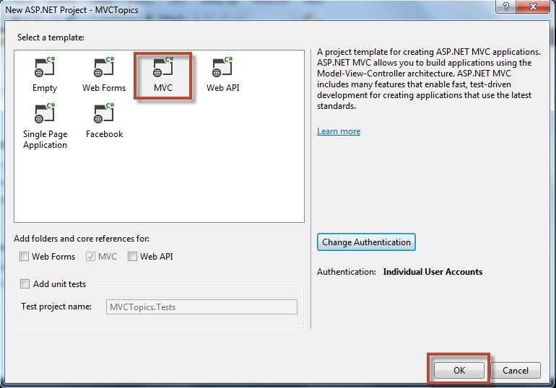
Getting started with MVC 5

Slide 15

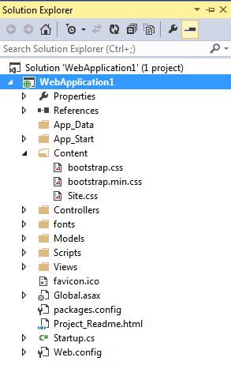





The
project
structure
•
•
•
App_Data is the physical store for data. This folder has the same role as it does in ASP.NET web sites that use Web Form pages
Content is the recommended location to add static content files like CSS and images
Controllers is the recommended location for controllers. All controllers must end with “Controller”
Models is provided for classes that represent the application model. This folder usually contains code that defines objects and logic for application with the data store
Scripts is the recommended location for script files that support the application. By default this folder contains ASP.NET Ajax Foundation files and Jquery
Views is the recommended location for views. These are ViewPage (.aspx), ViewUserControl (.ascx) and ViewMaster (.master) in additional to any other files needed for renderings. The view folder also contains
a folder for each controller.
•
•
•

Slide 16
App_Start Folder:
App_Start folder has been introduced in MVC4. It contains various configurations files like as BundleConfig.cs, FilterConfig.cs, RouteConfig.cs, WebApiConfig.cs for your application. All these settings are registered within Application_Start method of Global.asax.cs file.
BundleConfig.cs - This is used to create and register bundles for CSS and JS files. By default, various bundles are added in this files including jQuery, jQueryUI, jQuery validation, Modernizr, and Site CSS.
FIlterConfig.cs - This is used to register global MVC filters like error filters, actions filters etc. By default it contains HandleErrorAttribute filter.
RouteConfig.cs - This is used to register various route patterns for your ASP.NET MVC application. By default, one route is registered here named as Default Route.
WebApiConfig.cs - This is used to register various WEB API routes like as ASP.NET MVC, as well as set any additional WEB API configuration settings.

Slide 17
Everything
has
it’s
advantages
MVC
WebForms
•
Easier
to Manage
•
•
•
Preservers
State over HTTP
Complexity
Does not use view state
server based forms
Rich Routing Structure
Support for Test-Driven
Development
Page Controller Pattern
View state or server based
forms
Works well for small teams
Development is less
complex
•
or
•
•
•
•
•
Supports Large Teams Well

Slide 18
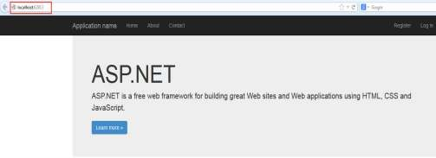
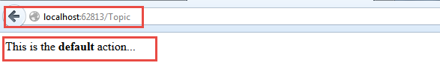
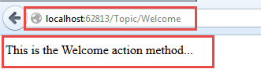
The
beauty
of
MVC
It’s Restful!

Slide 19
ASP.NET MVC pipeline
1.Routing - Routing is the first step in ASP.NET MVC pipeline. Typically, it is a pattern matching system that matches the incoming request to the registered URL patterns in the Route Table.
The UrlRoutingModule(System.Web.Routing.UrlRoutingModule) is a class which matches an incoming HTTP request to a registered route pattern in the RouteTable(System.Web.Routing.RouteTable).
2. Controller Initialization - The MvcHandler initiates the real processing inside ASP.NET MVC pipeline by using ProcessRequest method. This method uses the IControllerFactory instance (default is System.Web.Mvc.DefaultControllerFactory) to create corresponding controller.

Slide 21
3. Action Execution – Action execution occurs in the following steps:
When the controller is initialized, the controller calls its own InvokeAction() method by passing the details of the chosen action method. This is handled by the IActionInvoker.
After chosen of appropriate action method, model binders(default is System.Web.Mvc.DefaultModelBinder) retrieves the data from incoming HTTP request and do the data type conversion, data validation such as required or date format etc. and also take care of input values mapping to that action method parameters.
Authentication Filter was introduced with ASP.NET MVC5 that run prior to authorization filter. It is used to authenticate a user. Authentication filter process user credentials in the request and provide a corresponding principal. Prior to ASP.NET MVC5, you use authorization filter for authentication and authorization to a user.
By default, Authenticate attribute is used to perform Authentication. You can easily create your own custom authentication filter by implementing IAuthenticationFilter.
Authorization filter allow you to perform authorization process for an authenticated user. For example, Role based authorization for users to access resources.

Slide 22
By default, Authorize attribute is used to perform authorization. You can also make your own custom authorization filter by implementing IAuthorizationFilter.
Action filters are executed before (OnActionExecuting) and after (OnActionExecuted) an action is executed. IActionFilter interface provides you two methods OnActionExecuting and OnActionExecuted methods which will be executed before and after an action gets executed respectively. You can also make your own custom
ActionFilters filter by implementing IActionFilter. For more about filters refer this article Understanding ASP.NET MVC Filters and Attributes
When action is executed, it process the user inputs with the help of model (Business Model or Data Model) and prepare Action Result.

Slide 23
4. Result Execution - Result execution occurs in the following steps:
Result filters are executed before (OnResultExecuting) and after (OnResultExecuted) the ActionResult is executed. IResultFilter interface provides you two methods OnResultExecuting and OnResultExecuted methods which will be executed before and after an ActionResult gets executed respectively. You can also make your own custom ResultFilters filter by implementing IResultFilter.
Action Result is prepared by performing operations on user inputs with the help of BAL or DAL. The Action Result type can be ViewResult, PartialViewResult, RedirectToRouteResult, RedirectResult, ContentResult, JsonResult, FileResult and EmptyResult.
Various Result type provided by the ASP.NET MVC can be categorized into two category- ViewResult type and NonViewResult type. The Result type which renders and returns an HTML page to the browser, falls into ViewResult category and other result type which returns only data either in text format, binary format or a JSON format, falls into NonViewResult category.

Slide 24
4.1 View Initialization and Rendering - View Initialization and Rendering execution occurs in the following steps:
ViewResult type i.e. view and partial view are represented by IView (System.Web.Mvc.IView) interface and rendered by the appropriate View Engine.
This process is handled by IViewEngine (System.Web.Mvc.IViewEngine) interface of the view engine. By default ASP.NET MVC provides WebForm and Razor view engines. You can also create your custom engine by using IViewEngine interface and can registered your custom view engine in to your ASP.NET MVC application as shown below:
Html Helpers are used to write input fields, create links based on the routes, AJAX-enabled forms, links and much more. Html Helpers are extension methods of the HtmlHelper class and can be further extended very easily. In more complex scenario, it might render a form with client side validation with the help of JavaScript or jQuery.

Slide 25
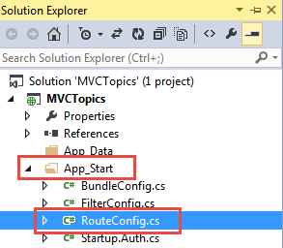

MVC Routes
•
A route is an object that
parses a requested URL and
determines the controller
and action to which the
request is forwarded
Routing operates on the
it
•
directories and the file name
of tin the relative URL
Uses the format
/[Controller]/[ActionName]/[Parameters]

Slide 26
What’s the route
•
Matching a URL request to a route depends on all
of
–
the following conditions:
The route patterns that you have defined or the default route patterns, if any, that are included in your project type.
The order in which you added them to the Routes
collection.
Any default values that you have provided for a route.
Any constraints that you have provided for a route.
Whether you have defined routing to handle requests
that match a physical file.
–
–
–
–

Slide 27
Request URL | Parameters
http://example.com/ | controller=Home, action=Index, id=none, Since default value of controller and action are Home and Index respectively.
http://example.com/Admin | controller=Admin, action=Index, id=none, Since default value of action is Index
http://example.com/Admin/Product | controller=Admin, action=Product, id=none
http://example.com/Admin/Product/1 | controller=Admin, action=Product, id=1
http://example.com/Admin/Product/SubAdmin/1 | No Match Found
http://example.com/Admin/Product/SubAdmin/Add/1 | No Match Found
Note: Always put more specific route on the top order while defining the routes, since routing system check the incoming URL pattern form the top and as it get the matched route it will consider that. It will not checked further routes after matching pattern.

Slide 28
Route constraints is way to put some validation around the defined route.
Creating Route Constraints
Suppose we have defined the following route in our application and you want to restrict the incoming request url with numeric id only.Now let's see how to do it with the help of regular expression.
public static void RegisterRoutes(RouteCollection routes)
{
routes.MapRoute(
"Default", // Route name
"{controller}/{action}/{id}", // Route Pattern
new
{
controller = "Home",
action = "Index",
id = UrlParameter.Optional
} // Default values for parameters
);
}

Slide 29
Restrict to numeric id only
public static void RegisterRoutes(RouteCollection routes)
{
routes.MapRoute(
"Default", // Route name
"{controller}/{action}/{id}", // Route Pattern
new
{
controller = "Home",
action = "Index",
id = UrlParameter.Optional
}, // Default values for parameters
new { id = @"\d+" } //Restriction for id
);
}
Now for this route, routing engine will consider only those URLs which have only numeric id like as http://example.com/Admin/Product/1 else it will considers that url is not matched with this route.

Slide 30
DEMO ON ROUTING, PLAY AROUND WITH ROUTING,ROUTE TABLE VALUES,QUERYSTRINGS AND ROUTING CONSTRAINTS

Slide 31
MODELS

Slide 32
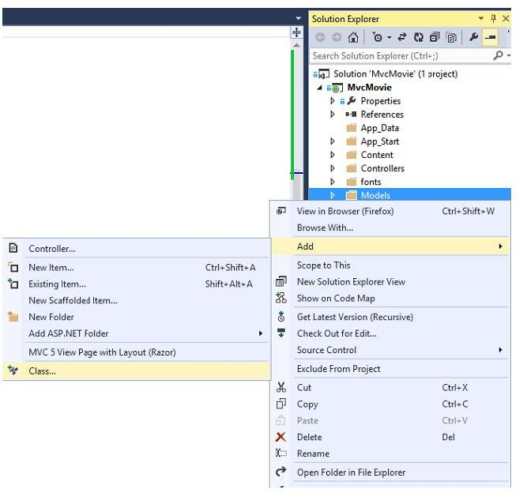
What is a model
•
The model should contain
all of the application
business logic, validation
logic, and database access
logic.
Supports a code first
model using the Entity
Framework (EF)
All .edmx files, .dbml files
etc. should be located in
the Models folder.
•
•

Slide 33
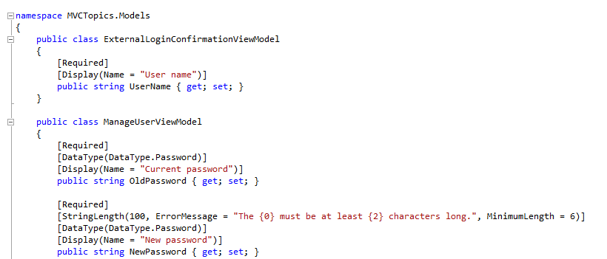
Custom view model
•
When
View
you
combine
properties
to
display
on
a
Similar problem with ASP.NET Webforms…

Slide 34
VIEWS

Slide 35
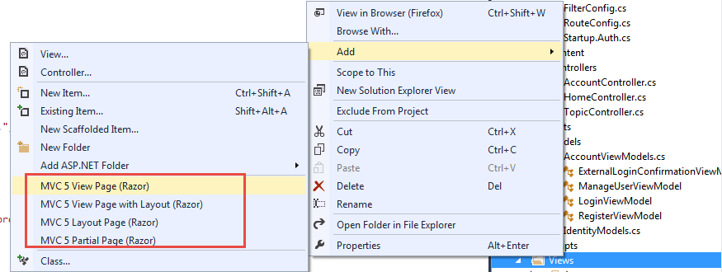
What is a View
→ Most of the Controller Actions return views
→ The path to the view is inferred from the name of the controller
and the name of the controller action.
✴ \Views\ControllerName\ControllerAction.aspx
→ A view is a standard (X)HTML document that can contain scripts.
→ script delimiters <% and %> in the views

Slide 36

Passing data to a view
→ With ViewData:
● ViewData["message"]
= "Hello World!";
● Strongly typed ViewData:
ViewData.Model = OurModel;
→ With ViewBag:
● ViewBag.Message = "Hello World!";

Slide 37
Post data to a controller
•
•
Verb Attributes
The action method in the controller accepts the values
posted from the view.
The view form fields must match the same names in the
controller.
•
[HttpPost]
public ActionResult Edit(Meeting meeting)
{
if (ModelState.IsValid)
{
db.Entry(movie).State = EntityState.Modified;
db.SaveChanges();
return RedirectToAction("Index");
}
return View(meeting);
}

Slide 38
DEMO ON VIEWS,MODEL,CONTROLLER AND PASSING DATA BETWEEN CONTROLLER AND VIEW

Slide 39
CONTROLLER

Slide 40
What is a controller
•
It’s a class derived from
System.Web.MVC.Controller class
Generate the response to the browser request
•
public class HomeController : Controller
{
public ActionResult Index()
{
ViewBag.Message = "Welcome to ASP.NET MVC!";
return View();
}
public ActionResult About()
{
return View();
}
}

Slide 41
Controller actions
→ Public method of the Controller class
→ Cannot be overloaded
→ Cannot be a static method
→ Returns action result
public class HomeController : Controller
{
public ActionResult Index()
{
ViewBag.Message = "Welcome to ASP.NET MVC!";
return View();
}
public ActionResult About()
{
return View();
}
}

Slide 42
View Engine
A View Engine is a MVC subsystem which has its own markup syntax. It is responsible for converting server-side template into HTML markup and rendering it to the browser. Initially, ASP.NET MVC ships with one view engine, web forms (ASPX) and from ASP.NET MVC3 a new view engine, Razor is introduced. With ASP.NET MVC, you can also use other view engines like Spark, NHaml etc.
Working of View Engine
Each view engine has following three main components:
1. ViewEngine class - This class implements the IViewEngine interface and responsible for locating view templates.
2. View class - This class implements the IView interface and responsible for combining the template with data from the current context and convert it to output HTML markup.
3. Template parsing engine - This parses the template and compiles the view into executable code.
RAZOR View Engine & ASPX View Engine

Slide 43
Razor View Engine | Webform View Engine
Razor Engine is an advanced view engine that was introduced with MVC3. This is not a new language but it is a new markup syntax. | Web Form Engine is the default view engine for the Asp.net MVC that is included with Asp.net MVC from the beginning.
Razor Engine is an advanced view engine that was introduced with MVC3. This is not a new language but it is a new markup syntax. | Web Form Engine is the default view engine for the Asp.net MVC that is included with Asp.net MVC from the beginning.
The namespace for Razor Engine is System.Web.Razor. | The namespace for Webform Engine is System.Web.Mvc.WebFormViewEngine.
The file extensions used with Razor Engine are different from Web Form Engine. It has .cshtml (Razor with C#) or .vbhtml (Razor with VB) extension for views, partial views, editor templates and for layout pages. | The file extensions used with Web Form Engine are also like Asp.net Web Forms. It has .aspx extension for views, .ascx extension for partial views & editor templates and .master extension for layout/master pages.
Razor has new and advance syntax that are compact, expressive and reduces typing. | Web Form Engine has the same syntax like Asp.net Web Forms uses for .aspx pages.
Razor syntax are easy to learn and much clean than Web Form syntax. Razor uses @ symbol to make the code like as: @Html.ActionLink("SignUp", "SignUp") | Web Form syntax are borrowed from Asp.net Web Forms syntax that are mixed with html and sometimes make a view messy. Webform uses <% and %> delimiters to make the code like as: <%: Html.ActionLink("SignUp", "SignUp") %>
By default, Razor Engine prevents XSS attacks (Cross-Site Scripting Attacks) means it encodes the script or html tags like <, > before rendering to view. | Web Form Engine does not prevent XSS attacks means any script saved in the database will be fired while rendering the page
Razor Engine is little bit slow as compared to Webform Engine. | Web Form Engine is faster than Razor Engine.
Razor Engine, doesn't support design mode in visual studio means you cannot see your page look and feel. | Web Form engine support design mode in visual studio means you can see your page look and feel without running the application.
Razor Engine support TDD (Test Driven Development) since it is not depend on System.Web.UI.Page class. | Web Form Engine doesn't support TDD (Test Driven Development) since it depend on System.Web.UI.Page class which makes the testing complex

Slide 44
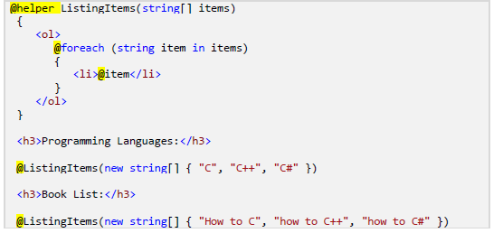
HTML Helpers in ASP.NET MVC
An HTML Helper is just a method that returns a HTML string. The string can represent any type of content that you want. For example, you can use HTML Helpers to render standard HTML tags like HTML <input>, <button> and <img> tags etc.
Different types of HTML Helpers
1. Inline Html Helpers - These are create in the same view by using the Razor @helper tag. These helpers can be reused only on the same view.

Slide 45
2. Built-In Html Helpers - Built-In Html Helpers are extension methods on the HtmlHelper class. The Built-In Html helpers can be divided into three categories-
2.1Standard Html Helpers - These helpers are used to render the most common types of TML elements like as HTML text boxes, checkboxes etc. A list of most common standard html helpers is given below:
HTML Element | Example
TextBox | @Html.TextBox("Textbox1", "val") Output: <input id="Textbox1" name="Textbox1" type="text" value="val" />
TextArea | @Html.TextArea("Textarea1", "val", 5, 15, null) Output: <textarea cols="15" id="Textarea1" name="Textarea1" rows="5">val</textarea>
Password | @Html.Password("Password1", "val") Output: <input id="Password1" name="Password1" type="password" value="val" />
Hidden Field | @Html.Hidden("Hidden1", "val") Output: <input id="Hidden1" name="Hidden1" type="hidden" value="val" />
CheckBox | @Html.CheckBox("Checkbox1", false) Output: <input id="Checkbox1" name="Checkbox1" type="checkbox" value="true" /> <input name="myCheckbox" type="hidden" value="false" />
RadioButton | @Html.RadioButton("Radiobutton1", "val", true) Output: <input checked="checked" id="Radiobutton1" name="Radiobutton1" type="radio" value="val" />
Drop-down list | @Html.DropDownList (“DropDownList1”, new SelectList(new [] {"Male", "Female"})) Output: <select id="DropDownList1" name="DropDownList1"> <option>M</option> <option>F</option> </select>
Multiple-select | Html.ListBox(“ListBox1”, new MultiSelectList(new [] {"Cricket", "Chess"})) Output: <select id="ListBox1" multiple="multiple" name="ListBox1"> <option>Cricket</option> <option>Chess</option> </select>

Slide 46
2.2 Strongly Typed HTML Helpers - These helpers are used to render the most common types of HTML elements in strongly typed view like as HTML text boxes, checkboxes etc. The HTML elements are created based on model properties.
The strongly typed HTML helpers work on lambda expression. The model object is passed as a value to lambda expression, and you can select the field or property from model object to be used to set the id, name and value attributes of the HTML helper. A list of most common strongly-typed html helpers is given below:
HTML Element | Example
TextBox | @Html.TextBoxFor(m=>m.Name) Output: <input id="Name" name="Name" type="text" value="Name-val" />
TextArea | @Html.TextArea(m=>m.Address , 5, 15, new{})) Output: <textarea cols="15" id="Address" name=" Address " rows="5">Addressvalue</textarea>
Password | @Html.PasswordFor(m=>m.Password) Output: <input id="Password" name="Password" type="password"/>

Slide 47
Hidden Field | @Html.HiddenFor(m=>m.UserId) Output: <input id=" UserId" name=" UserId" type="hidden" value="UserId-val" />
CheckBox | @Html.CheckBoxFor(m=>m.IsApproved) Output: <input id="Checkbox1" name="Checkbox1" type="checkbox" value="true" /> <input name="myCheckbox" type="hidden" value="false" />
RadioButton | @Html.RadioButtonFor(m=>m.IsApproved, "val") Output: <input checked="checked" id="Radiobutton1" name="Radiobutton1" type="radio" value="val" />
Drop-down list | @Html.DropDownListFor(m => m.Gender, new SelectList(new [] {"Male", "Female"})) Output: <select id="Gender" name="Gender"> <option>Male</option> <option>Female</option> </select>
Multiple-select | Html.ListBoxFor(m => m.Hobbies, new MultiSelectList(new [] {"Cricket", "Chess"})) Output: <select id="Hobbies" multiple="multiple" name="Hobbies"> <option>Cricket</option> <option>Chess</option> </select>

Slide 48
2.3 Templated HTML Helpers - These helpers figure out what HTML elements are required to render based on properties of your model class. This is a very flexible approach for displaying data to the user, although it requires some initial care and attention to set up. To setup proper HTML element with Templated HTML Helper, make use of DataType attribute of DataAnnitation class.
For example, when you use DataType as Password, A templated helper automatically render Password type HTML input element.
Templated Helper | Example
Display | Renders a read-only view of the specified model property and selects an appropriate HTML element based on property’s data type and metadata. Html.Display("Name")
DisplayFor | Strongly typed version of the previous helper Html.DisplayFor(m => m. Name)
Editor | Renders an editor for the specified model property and selects an appropriate HTML element based on property’s data type and metadata. Html.Editor("Name")
EditorFor | Strongly typed version of the previous helper Html.EditorFor(m => m. Name)

Slide 49
3 Custom Html Helpers - You can also create your own custom helper methods by creating an extension method on the HtmlHelper class or by creating static methods with in a utility class.
Image() html helper method
Unfortunately, MVC does not have built-in Image() html helper. So, let's build our own custom image html helper method. @Html.Image(Model.Photo, Model.AlternateText)
DEMO on all type of html helpers

Slide 50
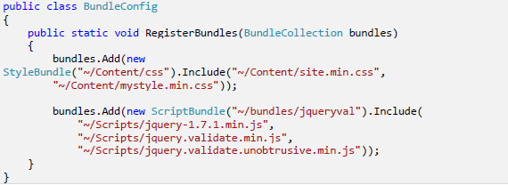
Bundling & Minification
ASP.NET MVC4 and .NET Framework 4.5 offer bundling and minification techniques that reduce the number of request to the server and size of requested CSS and JavaScript, which improve page loading time.
A bundle is a logical group of files that is loaded with a single HTTP request. You can create style and script bundle for CSS and Java Scripts respectively by calling BundleCollection class Add() method. All bundles are create with in BundleConfig.cs file

Slide 51
Bundling & Minification
Minification is technique for removing unnecessary characters (like white space, newline, tab) and comments from the JavaScript and CSS files to reduce the size which cause improved load times of a webpage. There are so many tools for minifying the js and css files. JSMin and YUI Compressor are two most popular tools for minifying js and css files.

Slide 52
Action Methods
Asp.net MVC has the following built-in ActionResults Type and Helper methods:
1. ViewResult - Returns a ViewResult which renders the specified or default view by using controller View() helper method.
2. PartialViewResult - Returns a PartialViewResult which renders the specified or default partial view (means a view without its layout) by using controller PartialView() helper method.
3. RedirectResult - Returns a RedirectResult which Issues an HTTP 301 or 302 redirection to a specific URL by using controller Redirect() helper method.
4. RedirectToRouteResult - Returns a RedirectToRouteResult which Issues an HTTP 301 or 302 redirection to an action method or specific route entry by using controller RedirectToAction(), RedirectToActionPermanent(), RedirectToRoute(), RedirectToRoutePermanent() helper methods.
5. ContentResult - Returns a ContentResult which renders raw text like as "Hello, DotNet Tricks!" by using controller Content() helper method.
6. JsonResult - Returns a JsonResult which serializes an object in JSON format ( like as "{ "Message": Hello, World! }") and renders it by using controller Json() helper method

Slide 53
7. JavaScriptResult - Returns a JavaScriptResult which renders a snippet of JavaScript code like as "function hello() { alert(Hello, World!); }" by using controller JavaScript() helper method. This is used only in AJAX scenarios.
8. FileResult - Returns a FileResult which renders the contents of a file like as PDF, DOC, Excel etc. by using controller File() helper method.
9. EmptyResult - Returns no result returned by an action. This has no controller helper method.
10. HttpNotFoundResult - Returns an HttpNotFoundResult which renders a 404 HTTP Status Code response by using controller HttpNotFound() helper method.
11. HttpUnauthorizedResult - Returns an HttpUnauthorizedResult which renders a 401 HTTP Status Code (means "not authorized") response. This has no controller helper method. This is used for authentication (forms authentication or Windows authentication) to ask the user to log in.
12. HttpStatusCodeResult - Returns an HttpStatusCodeResult which renders a specified HTTP code response. This has no controller helper method.

Slide 54
Action Methods
AJAX Helpers are used to create AJAX enabled elements like as Ajax enabled forms and links which performs request asynchronously. AJAX Helpers are extension methods of AJAXHelper class which exist in System.Web.Mvc.Ajax namespace.
ASP.NET MVC supports unobtrusive Ajax which is based on jQuery. The unobtrusive Ajax means that you use helper methods to define your Ajax features, rather than adding blocks of code throughout your views.

Slide 55
AJAX Option Class Properties
Property | Description
Url | Specify the URL that will be requested from the server.
Confirm | Specify a message that will be displayed in a confirm dialog to the end user. When user clicks on OK button in the confirmation dialog, the Ajax call performs.
OnBegin | Specify a JavaScript function name which is called at the beginning of the Ajax request.
OnComplete | Specify a JavaScript function name which is called at the end of the Ajax request.
OnSuccess | Specify a JavaScript function name which is called when the Ajax request is successful.
OnFailure | Specify a JavaScript function name which is called if the Ajax request fails.
LoadingElementId | Specify progress message container’s Id to display a progress message or animation to the end user while an Ajax request is being made.
LoadingElementDuration | Specify a time duration in milliseconds that controls the duration of the progress message or animation.
UpdateTargetId | Specify the target container’s Id that will be populated with the HTML returned by the action method.
InsertionMode | Specify the way of populating the target container. The possible values are InsertAfter, InsertBefore and Replace (which is the default).

Slide 56

Partial Views :
Partial views in MVC are similar to usercontrols in asp.net webforms.
Partial views helps us to reduce code duplication. Hence partial views are reusable views like as Header and Footer views.
We can use partial view to display blog comments, product category, social bookmarks buttons, a dynamic ticker, calendar etc.
It is best practice to create partial view in the shared folder and partial view name is preceded by "_", but it is not mandatory. The "_" before view name specify that it is a reusable component i.e. partial view.
return PartialView(options); where options could be a Model or a View name.
Child actions are useful for creating reusable widgets which could be embedded into your views. In ASP.NET MVC partial views are used to create reusable widgets and a partial can be render by an action method.
This action method can has child attribute and has its independent MVC lifecycle from parent view. Also, an action which has child attribute cannot be called independently. It always will be called within a parent view otherwise it would give error. A child action is invoked by using @Html.RenderAction or @Html.Action helper methods from inside of a view.

Slide 57
Html.Partial and Html.RenderPartial :
1. The return type of "RenderPartial" is void, where as "Partial" returns "MvcHtmlString" 2. Syntax for invoking Partial() and RenderPartial() methods in Razor views @Html.Partial("PartialViewName") { Html.RenderPartial("PartialViewName"); } 3. Syntax for invoking Partial() and RenderPartial() methods in webform views <%: Html.Partial("PartialViewName") %> <% Html.RenderPartial("PartialViewName"); %>
The main difference is that "RenderPartial()" returns void and the output will be written directly to the output stream, where as the "Partial()" method returns MvcHtmlString, which can be assigned to a variable and manipulate it if required. So, when there is a need to assign the output to a variable for manipulating it, then use Partial(), else use RenderPartial().
From a performance perspective, rendering directly to the output stream is better. RenderPartial() does exactly the same thing and is better for performance over Partial().

Slide 58
LayOut View :
Layout views provide the advantage of maintaining consistent look and feel across all the views in an mvc application. A typical layout view consists of 1. Header 2. Footer 3. Navigation menu 4. View specific content Rather than having all of these sections, in each and every view, we can define them in a layout view and then inherit that look and feel in all the views. With layout views, maintaining the consistent look and feel across all the views becomes much easier, as we have only one layout file to modify, should there be any change. The change will then be immediately reflected across all the views in entire application.

Slide 59
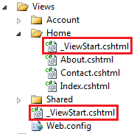
_ViewStart.cshtml :
ASP.NET MVC 3, has introduced _ViewStart.cshtml. Specify the Layout property in this file and place it in the Views folder. All the views will then use the layout file that is specified in _ViewStart.cshtml. This eliminates the need to specify Layout property on each and every view, and making them more cleaner and maintainable.
If you want a set of views in a specific folder, to use a different layout file, then you can include another _ViewStart.cshtml file in that specific folder.
Layout file can also be specified in a controller action method or in an action filter. In Controller Action Method: Specify which layout to use when returning a view inside a controller action public ActionResult Create() { return View("Create", "_Layout"); }

Slide 60
DataValidation:
ASP.NET MVC uses DataAnnotations attributes to implement validations.
DataAnnotations includes built-in validation attributes for different validation rules, which can be applied to the properties of model class. ASP.NET MVC framework will automatically enforce these validation rules and display validation messages in the view.The DataAnnotations attributes included in System.ComponentModel.DataAnnotations namespace.
The following table lists DataAnnotations validation attributes.
Attribute | Description
Required | Indicates that the property is a required field
StringLength | Defines a maximum length for string field
Range | Defines a maximum and minimum value for a numeric field
RegularExpression | Specifies that the field value must match with specified Regular Expression
CreditCard | Specifies that the specified field is a credit card number
CustomValidation | Specified custom validation method to validate the field
EmailAddress | Validates with email address format
FileExtension | Validates with file extension
MaxLength | Specifies maximum length for a string field
MinLength | Specifies minimum length for a string field
Phone | Specifies that the field is a phone number using regular expression for phone numbers

Slide 61
Filters:
Action filters are attributes that can be applied either on a controller action method or on a controller. When applied at the controller level, they are applicable for all actions within that controller. Action filters allow us to add, pre and post processing logic to an action method. This means, they allow us to modify the way in which an action is executed.
Action filters in mvc Authorize ChildActionOnly HandleError OutputCache RequireHttps ValidateInput ValidateAntiForgeryToken

Slide 62
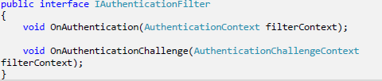
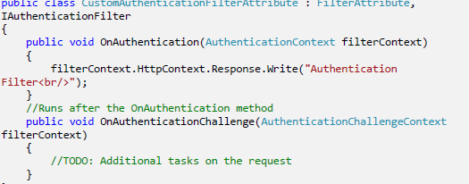


Authentication Filters - This filter is introduced with ASP.NET MVC5. The IAuthenticationFilter interface is used to create CustomAuthentication filter.
Authorization Filters
The ASP.NET MVC Authorize filter attribute implements the IAuthorizationFilter interface.

Slide 63


3. Action Filters - Action filters are executed before or after an action is executed. The IActionFilter interface is used to create an Action Filter which provides two methods OnActionExecuting and OnActionExecuted which will be executed before or after an action is executed respectively
4. Result Filters - Result filters are executed before or after generating the result for an action. The Action Result type can be ViewResult, PartialViewResult, RedirectToRouteResult, RedirectResult, ContentResult, JsonResult, FileResult and EmptyResult which derives from the ActionResult class. Result filters are called after the Action filters. The IResultFilter interface is used to create a Result Filter which provides two methods OnResultExecuting and OnResultExecuted which will be executed before or after generating the result for an action respectively.

Slide 64

Exception Filters - Exception filters are executed when exception occurs during the actions execution or filters execution. The IExceptionFilter interface is used to create an Exception Filter which provides OnException method which will be executed when exception occurs during the actions execution or filters execution.

Slide 65
DEMO ON
ActionFilters
ErrorHandling
Security
PartialViews
Caching
Validations
AJAX with MVC

Slide 66
DEMO ON
CRUD Scaffold
Custom Paging and Sorting webgrid Jquery

Slide 67

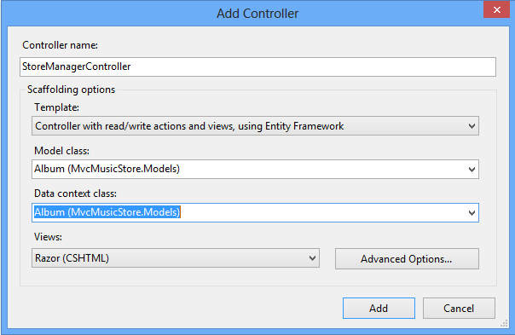
Other
Features
•
•
•
•
Scaffolding
Test Driven Development
Internationalization
Many More

Slide 68
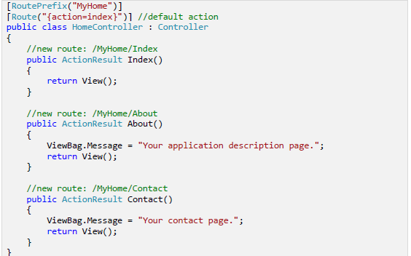
Attribute Routing
ASP.NET MVC5 and WEB API 2 supports a new type of routing, called attribute routing. In this routing, attributes are used to define routes. Attribute routing provides you more control over the URIs by defining routes directly on actions and controllers in your ASP.NET MVC application and WEB API.
Controller level routing – You can define routes at controller level which apply to all actions within the controller unless a specific route is added to an action.

Slide 69
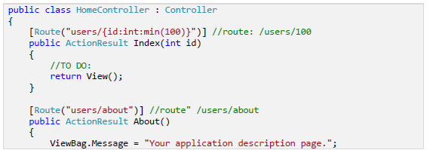
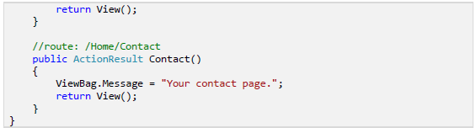
2. Action level routing – You can define routes at action level which apply to a specific action with in the controller.

Slide 70
Note:
Attribute routing should configure before the convention-based routing.
When you combine attribute routing with convention-based routing, actions which do not have Route attribute for defining attribute-based routing will work according to convention-based routing. In above example Contact action will work according to convention-based routing.
When you have only attribute routing, actions which do not have Route attribute for defining attribute-based routing will not be the part of attribute routing. In this way they can’t be access from outside as a URI.
Scenarios to use Attribute Routing?
The convention-based routing is complex to support certain URI patterns that are common in RESTful APIs. But by using attribute routing you can define these URI patterns very easily.
For example, resources often contain child resources like Clients have orders, movies have actors, books have authors and so on. It’s natural to create URIs that reflects these relations like as: /clients/1/orders
This type of URI is difficult to create using convention-based routing. Although it can be done, the results don’t scale well if you have many controllers or resource types

Slide 71
With attribute routing, it’s pretty much easy to define a route for this URI. You simply add an attribute to the controller action as:
[Route("clients/{clientId}/orders")]
public IEnumerable<Order> GetOrdersByClient(int clientId)
{
//TO DO
}
Demo on AttributeRouting

