Slide 1


Slide 2
Heading
Web API Design

Slide 3
Module 1: Introduction
Introduction
What are Web APIs?
Why is Design Important?
Types of APIs
Understanding REST
The Role of HTTP
Hypermedia

Slide 4
What is a "Web API"?
HTTP/RPC
REST-ful
HATEOAS
Verbs included in API
URI Endpoints
Resource URIs HTTP Verbs Stateless Server
Content Negotiation
Link Relations
E.g. Hypermedia

Slide 5
Resource Based Architectures
Resources are Representations of Real World Entities
E.g. People, Invoices, Payments, etc.
Relationships are typically nested
Hierarchies or Webs…not Relational Models

Slide 6
Resource Based Architectures
Resources are Represented in URIs
URIs are Paths to Resources
Query Strings for non-data elements
E.g. format, sorting, etc.

Slide 7
What is REST?
REpresentational State Transfer*
Concepts include:
Separation of Client and Server
Server Requests are Stateless
Cacheable Requests
Uniform Interface
* Introduced by Roy Fielding's doctoral dissertation

Slide 8
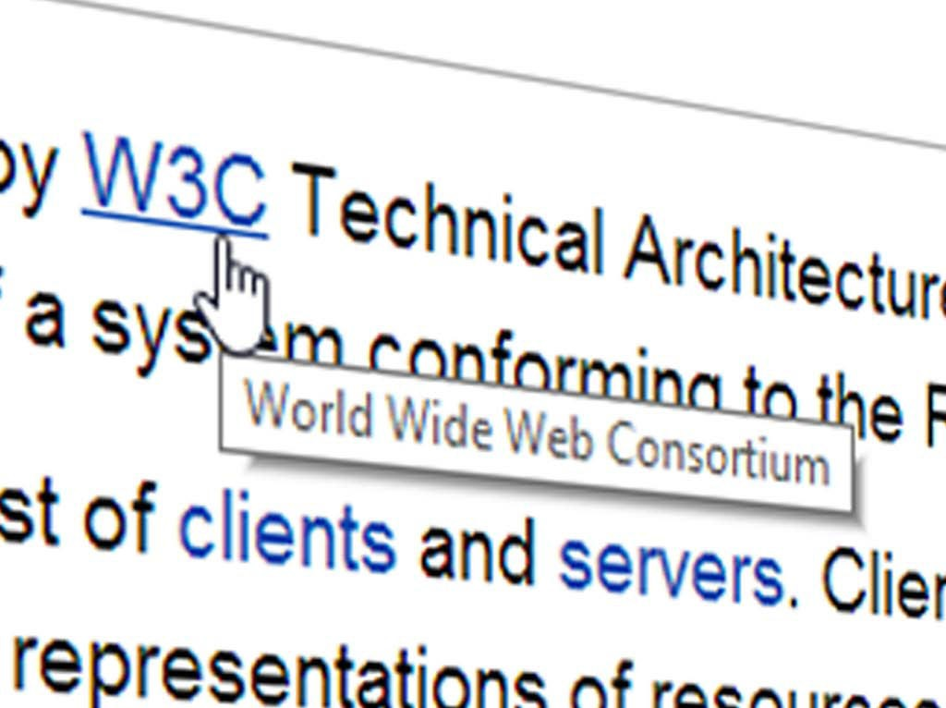
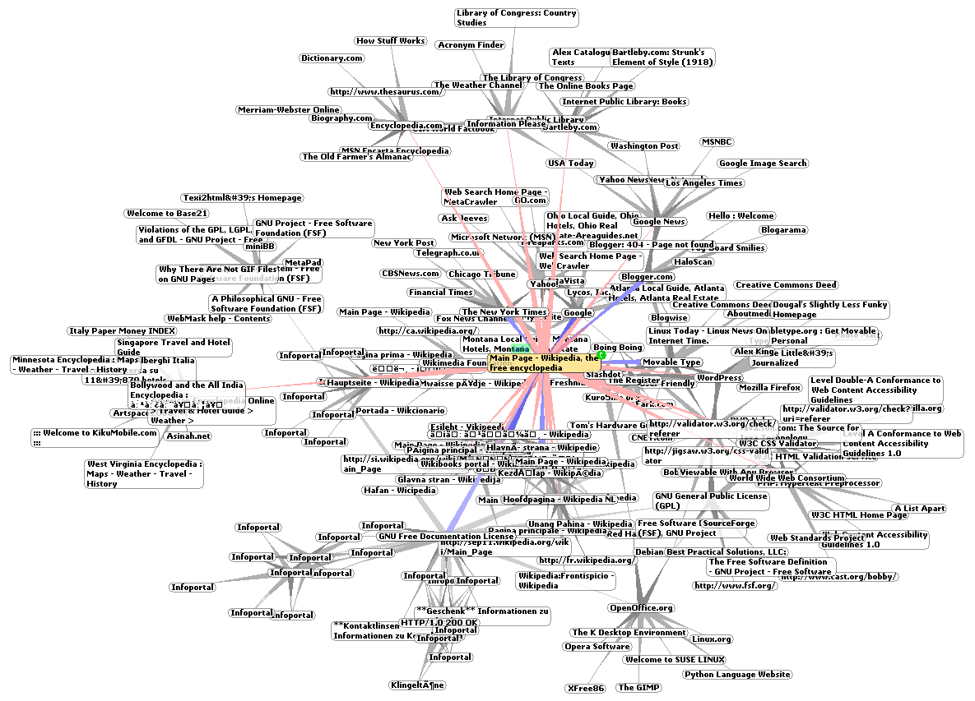

Slide 9
What is Hypermedia?
Method of Self-Describing Messages
Links in resources that describe how to process data
Hyperlinks for Resources

Slide 10
Is Hypermedia Important?
Hypermedia == HATEOAS
"Hypermedia As The Engine Of Application State"
Only as important as you need it to be…
Hypermedia can create dynamic, self-documenting APIs
But You *can* be a great API without HATEOAS
Don't get caught up in the dogma

Slide 11
Should You Use REST?
Archetypes of APIs Vary
REST or REST-ful APIs are easy to consume and maintain
If your API doesn't fit the Resource Model, RPC or custom APIs are fine
Fitting a square into a round hole doesn't make you a lesser developer
But in many or even most cases, REST is the right approach

Slide 12
Summary
API design is important
APIs are the UI layer to developers
Making it a pleasing, easy-to-use API benefits adoption
Picking the right type of design and level of API is crucial to success
There are few black and white 'rights and wrongs'
Finally, avoid dogma and be pragmatic…

Slide 13
Module 2: Designing the API
The API
URI Design
Understanding Verbs
Status Codes
Associations
Designing the Results
ETags
Paging and Partials
Non-Resource APIs

Slide 14
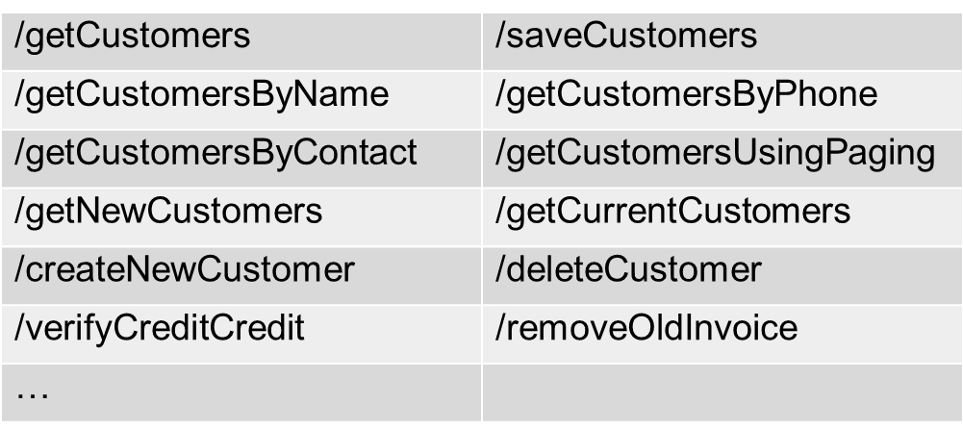
URI Design
Nouns are Good, Verbs are Bad
The problem:
/getCustomers
/saveCustomers

Slide 15
URI Design
URIs Should Point at Nouns (e.g. Resources)
Prefer Plurals
http://.../api/Customers http://.../api/Games http://.../api/Invoices
Use Identifiers to location individual items in URIs
Does not have to be internal key…
http://.../api/Customers/123 http://.../api/Games/halo-3 http://.../api/Invoices/2003-01-24

Slide 16
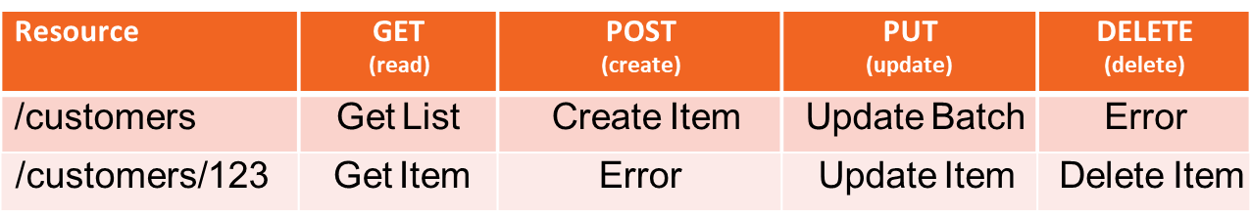
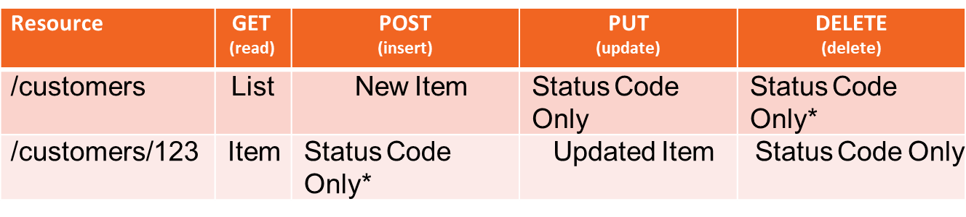
URI Design
How do I do Verbs then?
Resource
GET
(read)
POST
(create)
PUT
(update)
DELETE
(delete)
/customers
Get List
New Customer
Update Batch
Error
What should you return?
* Error Status Code

Slide 17
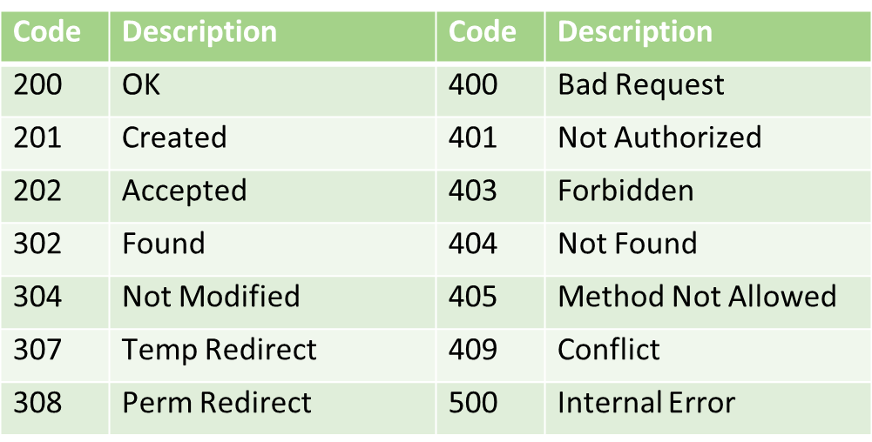
Status Codes
HTTP Defines Status Codes

Slide 18
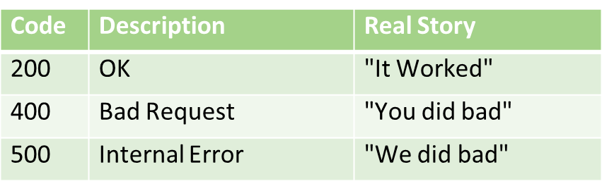
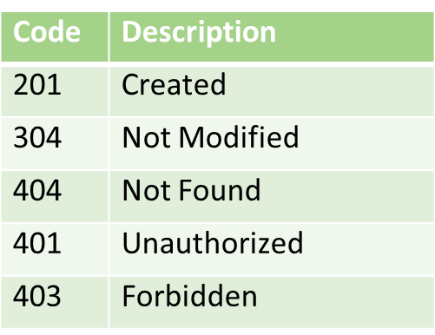
Status Codes
Use Http Status Codes
At a minimum:
Probably (but no more than about 10):

Slide 19
Associations
For sub-objects
Use URI Navigation
http://.../api/Customers/123/Invoices http://.../api/Games/halo-3/Ratings http://.../api/Invoices/2003-01-24/Payments
Should return List of Related Objects
-- Should return same shape list of Invoices http://.../api/Customers/123/Invoices http://.../api/Invoices

Slide 20
Associations
May include multiple associations on same object
http://.../api/Customers/123/Invoices http://.../api/Customers/123/Payments http://.../api/Customers/123/Shipments
Anything more complex should use query string
http://.../api/Customers?state=GA http://.../api/Customers?state=GA&salesperson=144 http://.../api/Customers?hasOpenOrders=true

Slide 21
Formatting Results
Content Negotiation is a Best Practice
Use Accept header to determine how to format
GET /api/games/2 HTTP/1.1 Accept: application/json, text/xml Host: localhost:8863
Not necessary to support all and have a sane default
Usually JSON for my tastes

Slide 22
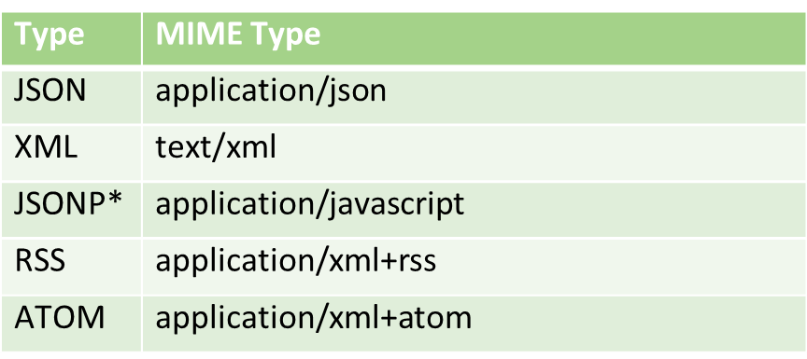
Formatting Results
Content Types
Type
Type
Type
Type
MIME Type
MIME Type
MIME Type
MIME Type
JSON
application/json
JSON
JSON
JSON
application/json
application/json
application/json
XML
text/xml
XML
XML
text/xml
text/xml
JSONP
JSONP
application/javascript
application/javascript
RSS
application/xml+rss
* Requires callback query parameter too: http://.../customers?callback=foo

Slide 23
Formatting Results
You can use URI components to format
Not a best practice, but sometimes best way to handle it
http://.../api/Customers?format=json http://.../api/Customers.json http://.../api/Customers?format=jsonp&callback=foo

Slide 24
Designing Results
Single Results should be simple objects
http://.../api/Customers/123
{
"id": "companyName": "address": {
"firstLine": "cityTown": "stateProvince": "postalCode": "country":
},
"phoneNumber":
123,
"Wilder Minds LLC",
"123 Main Street", "Atlanta", "Georgia", "30303",
"USA"
"404-555-1212"
}

Slide 25
Designing Results
Members Names
Naming Shouldn't Expose Server Details
E.g. Ruby, Java or .NET
I Prefer camelCasing
If objectionable, at least be consistent

Slide 26
Designing Results
Designing Collections
Usually object wrapping a simple collection
{
"numberResults": "results": [{
"id": "companyName": "address": {
"firstLine": "cityTown":
345,
123,
"Wilder Minds LLC",
"123 Main Street", "Atlanta", "Georgia", "30303",
"USA"
"stateProvince": "postalCode": "country":
},
"phoneNumber": "404-555-1212"
},
{ ... }]
}

Slide 27
Entity Tags (ETags)
Header to support smart server caching
Strong and Weak Caching Support
Returned in the Response
HTTP/1.1 200 OK
Content-Type: text/xml; charset=utf-8 Date: Thu, 23 May 2013 21:52:14 GMT
ETag: "4893023942098"
Content-Length: 639
HTTP/1.1 200 OK
Content-Type: text/xml; charset=utf-8 Date: Thu, 23 May 2013 21:52:14 GMT ETag: W/"4893023942098"
Content-Length: 639

Slide 28
Entity Tags (ETags)
Client Should Send ETag back to see if new version is available
Request with If-None-Match
GET /api/games/2 HTTP/1.1 Accept: application/json, text/xml Host: localhost:8863
If-None-Match: "4893023942098"
Use 304 to indicate that it hasn't changed
HTTP/1.1 304 Not Modified

Slide 29
Entity Tags (ETags)
Client Should Send ETag back to see if new version is available
For PUT, use If-Match
PUT /api/games/2 HTTP/1.1 Accept: application/json, text/xml Host: localhost:8863
If-Match: "4893023942098"
...
Use Status Code if it doesn't match
HTTP/1.1 412 Precondition Failed

Slide 30
Paging
Lists should always support paging
Query String parameters to request paging information
Object Wrapper to indicate next/prev links
{
"totalResults": 1598,
"nextPage": "http://.../api/games/?page=3", "prevPage": "http://.../api/games/?page=1", "results": [...]
}

Slide 31
Paging
Can use different page sizes too
But limit size of page to limit server load
http://.../api/games?page=5&pageSize=50

Slide 32
Partial Items
Allow for request of partial items
Query String is a common pattern for requesting parts
http://.../api/games/123?fields=id,name,price,imageUrl

Slide 33
Partial Items
Updating of Partial Items
Can use PATCH HTTP Verb
Update of partial is possible with ETag support
PATCH /api/games/2 HTTP/1.1 Accept: application/json
If-Match: "1234567890"
Host: localhost:8863 Content-Length: 192
{
"id":2,
"name":"Final Fantasy™ XIII 2nd Edition", "price":150.0,
"imageUrl":"…",
}

Slide 34
Summary
You can design a great API
The real guideline is to not surprise your users
Balancing what is good for the user and what is good for the server
(e.g. caching aggressively and etags)
Ultimately, users are what make a successful API…
…not approval of conference speakers

Slide 35
Module 3: Versioning
Versioning
Why is Versioning Important?
Some Examples
Using URI Path Versioning
Using URI Parameter Versioning
Using Content Type Versioning
Using Custom Header Versioning
Which One to Choose
Versioning Resources

Slide 36
Why Version
Once you publish an API, it's set in stone
Publishing an API is not a trivial move
Users/Customers rely on the API not changing
But requirements will change
Need a way to evolve the API without breaking existing clients
API Versioning isn't Product Versioning
Don't tie them together

Slide 37
The Right Way to Version Your API?
There isn't 'one'.
We can learn from existing APIs to see options
But there isn't a single option that I can recommend

Slide 38
Some Examples
Tumblr
Uri Path
http://api.tumblr.com/v2/user/
Netflix
Uri Parameter
http://api.netflix.com/catalog/titles/series/70023522?v=1.5
GitHub API
Content Negotiation
Content Type: application/vnd.github.1.param+json
Azure
Request Header
□ x-ms-version: 2011-08-18

Slide 39
Versioning in the URI Path
Using Part of Your Path to Version
Allows you to drastically change the API
Everything below the version is open to change
http://.../api/v1/Customers?type=Current&id=123 http://.../api/v2/CurrentCustomers/123

Slide 40
Versioning in the URI Path
Pro(s):
Simple to segregate old APIs for backwards compatibility
Con(s):
Requires lots of client changes as you version
E.g. version # has to change in every client
Increases the size of the URI surface area you have to support

Slide 41
Versioning in the URI Parameters
Version as Query String Parameter
Optional Parameter
http://.../api/Customers http://.../api/Customers?v=2.1

Slide 42
Versioning in the URI Parameters
Pro(s):
Without version, users always get latest version of API
Little client change as versions mature
Con(s):
Can surprise developers with unintended changes

Slide 43
Versioning with Content Negotiation
Versioning with Content Type in Accept Header
Instead of using standard MIME types, use custom
GET /api/customer/123 HOST: http://.../
Accept: application/myapp.v1.customer
Can include information in Accept Header for format too:
GET /api/customer/123 HOST: http://.../
Accept: application/myapp.v1.customer.json

Slide 44
Versioning with Content Negotiation
Alternatively can create own MIME type
Standard indicates you can use "vnd." as a starting point (meaning vendor)
GET /api/customer/123 HOST: http://.../
Accept: vnd.myapp.v1.customer

Slide 45
Versioning with Content Negotiation
Pro(s):
Packages API and Resource Versioning in one
Removes versioning from API so clients don't have to change
Con(s):
Adds complexity - adding headers isn't easy on all platforms
Can encourage increased versioning which causes more code churning

Slide 46
Versioning with Custom Header
Using a Custom Header to Version API calls
Should be a header value that is only of value to your API:
GET /api/customer/123 HOST: http://.../
x-MyApp-Version: 2.1
Common to use API Date instead of number:
GET /api/customer/123 HOST: http://.../
x-MyApp-Version: 2013-08-13

Slide 47
Versioning with Custom Header
Pro(s):
Separates Versioning from API call signatures
Not tied to resource versioning (e.g. Content Type)
Con(s):
Adds complexity - adding headers isn't easy on all platforms

Slide 48
Which to Choose?
There is no easy answer
Versioning with Content Negotiation and Custom Headers are popular now
Versioning with URI Components are more common
Easier to implement
Ultimately it's a pragmatic decision.
But you should version from the first release of your API

Slide 49
What About Resource Versioning?
The Resources You Return Should Be Versioned Too
Versioning API calls alone isn't enough
Structures and constraints change
Versioning with Custom Content Types is easier
But adds complexity
Including Version in resource body pollutes the data

Slide 50
You must version your API
There is no one canonical way to do API versioning
But pick one that best matches the maturity level of your team and users
Complex versioning isn't evil
But will increase friction with developers
Pragmatism again…
Version "just enough"

Slide 51
Module 4: Securing WebAPI’s
Securing Web APIs
Threats
How to Protect Your API
Cross Domain Security
Who You Should Authenticate
Working with API Keys
User Authentication
Understanding OAuth

Slide 52
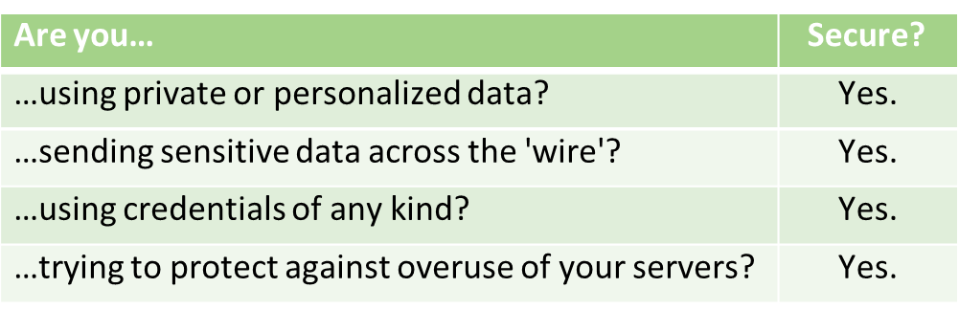
Security and Web APIs
Do you need to secure your API?

Slide 53








Threats to Your API
Eavesdroppers
(Packet Sniffers, etc.)
Hackers/Personnel
(Intrusion and Physical Security)
Users/Hackers
internet
user
browser
firewall
your server

Slide 54
Security
Protect Your API
Secure Your Server Infrastructure is outside scope of API security
Secure In-Transit
SSL is almost always appropriate
Cost of SSL is worth the expense…usually
Secure the API itself
Cross Origin Security
Authorization/Authentication

Slide 55
Cross Domain Security
Should you allow your API from separate domains?
Depends on whether it's a private or public API
Two Approaches:
Support JSONP as a format
Enable Cross-origin Resource Sharing (CORS)

Slide 56
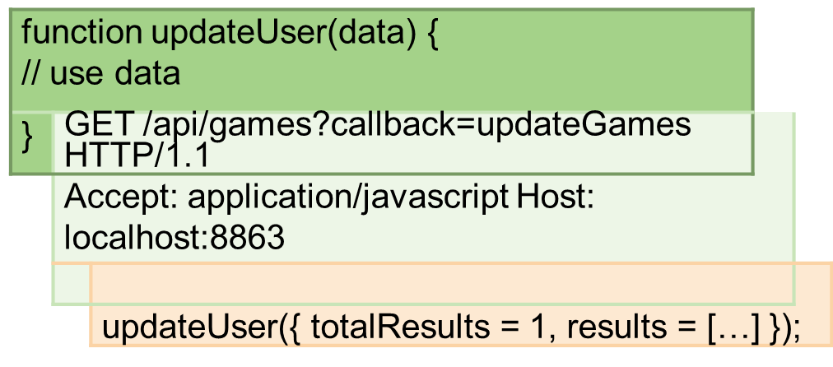
What is JSONP
"JSON with Padding"
JSONP is JavaScript
Packages results as a JavaScript script that is executed
JavaScript calls back into one of your functions with the data

Slide 57
Designing for JSONP
Designing for JSONP isn't any different
The data passed in will be same as JSON
Just packaged as JavaScript callback
Implementing CORS
Alternative to JSONP
Allows Cross Site support from Browser
But requires some handshaking
Implementing yourself can be difficult, but many platforms support it

Slide 58





How Does CORS Work?
Cross-Origin Request is Made
Server Asked if CORS Allowed
OPTIONS /api/games HTTP/1.1 Origin: http://mysite.com
Access-Control-Request-Method: POST Host: localhost:8863
Server Responds With Rules
Access-Control-Allow-Methods: GET, POST, OPTIONS Access-Control-Allow-Origin: http://mysite.com Content-Length: 0
Request is made With CORS Header
POST /api/games HTTP/1.1 Origin: http://mysite.com
Access-Control-Request-Method: POST Host: localhost:8863

Slide 59
Who Should You Authenticate
Who is calling the API?
Server-to-Server Authentication
API Keys and Shared Secrets
User Proxy Authentication
OAuth or Similar
Direct User Authentication
Cookies or token

Slide 60
Definitions
Credential:
A fact that describe an identity
Authentication:
Validate a set of credentials to identify an entity (whether virtual or actual)
Authorization:
Verification that an entity has rights to access a resource or action
API Keys
For non-user specific API usage
E.g. AWS
Used to verify that the real developer is making the API call

Slide 61





How API Key and Signing Works
Developer Signs Up for API
API Issues API Key and Shared Secret

Slide 62


















How API Key and Signing Works
Developer Creates Request
Action API Key
Timestamp
Developer Signs Request with Shared Secret
Developer Sends Request + Signature to Service
Service Verifies Same Signature and Within Timeout
Service Signs Request With Shared Secret
Service Looks up Shared Secret Via API Key
Executes Request
Returns Error
Yes
No
Is Valid?

Slide 63
Authenticating Users
If your system has users, how do you verify the API is calling as them?
If you are building a 1st party API
Piggybacking on website security is acceptable
But for App development can be painful
If you're expecting 3rd party API developers
Don't ask them to collect credentials…use OAuth

Slide 64
OAuth
For allowing developer to act as user in your system
Allows you to accept user credentials
Then trust a 3rd party with a token that represents the API developer
The developer never receives user credentials

Slide 65














How OAuth Works
Developer
API
User
Supplies API Key and Shared Secret
Requests API Key
Requests Request Token
Validates and Returns Token
Redirects to API's Auth URI
Displays Authorization UI
User Confirms Authorization
Redirects Back To Developer
Request Access Token Via OAuth & Request Token
Returns Access Token (with Timeout)
Uses API with Access Token until Timeout

Slide 66
Designing OAuth
Don't Implement It Directly
Use Libraries or Services to implement
It's complex and getting wrong means security holes
Using 3rd Party Identity (e.g. Facebook, Google or Microsoft ID)
Good for registration without storing your own identities
Users don't want their own IDs with your system
Unless you have a great payoff (e.g. Instagram or Twitter)

Slide 67
Summary
Securing Your API
Should be part of your original design
Don't try and layer security over your API
Secure By Default

Slide 68
Module 4: Hypermedia
Hypermedia
What is Hypermedia
REST and HATEOAS
What are Links?
Standard Formats for HATEOAS
What is HAL?
What is Collection+JSON?

Slide 69
What is Hypermedia?
<html>
<head>
<meta charset="utf-8" />
<meta name="viewport" content="width=device-width" />
<link rel="stylesheet" href="/Content/Site.css" />
<link rel="alternate" hreflang="ar" href="/index_ar" />
<link rel="alternate" media="print" href="/index_print" />
<link rel="next" href="/index/3" />
<link rel="prev" href="/index/1" />
</head>
<body>
<p>...</p>
<a href="http://wildermuth.com">Hello</a>
<a href="http://wildermuth.com" rel="search">Search</a>
</body>
</html>

Slide 70
What is Hypermedia?
Hypermedia are Links for APIs
Links are to help developers know how to use the API
API becomes self-describing
Links become the Application State
Hypermedia As The Engine of Application State (HATEOAS)
Worst Acronym Ever!

Slide 71
What is Hypermedia?
Hypermedia are Links for APIs
Links are to help developers know how to use the API
API becomes self-describing
Links become the Application State
Hypermedia As The Engine of Application State (HATEOAS)
Worst Acronym Ever!

Slide 72
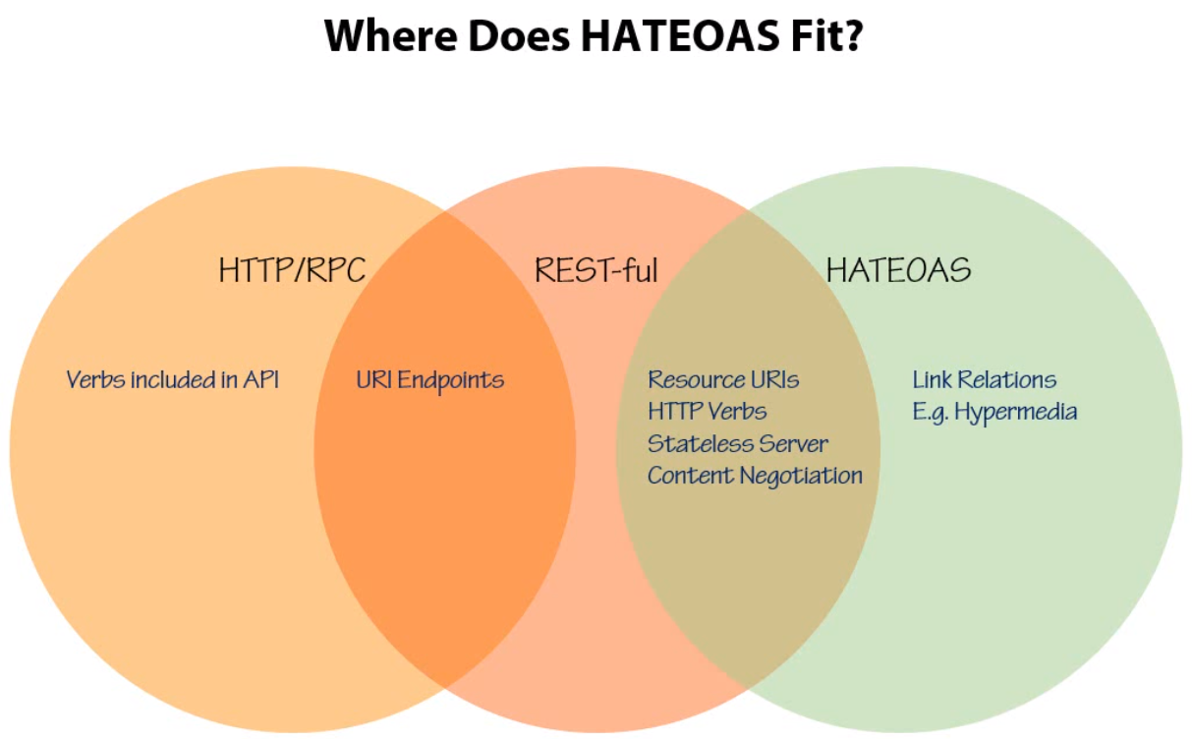

Slide 73
What Are Links?
Links should help developer use the API
Common scenarios:
Paging
Creating New Items
Retrieving Associations
Actions

Slide 74
{
"totalResults": 1598, "links": [
{
"href": "http://localhost:8863/api/v1/games?page=1", "rel": "prevPage"
},
{
"href": "http://localhost:8863/api/v1/games?page=3", "rel": "nextPage"
},
{
"href": "http://localhost:8863/api/v1/games", "rel": "insert"
}
],
"results": […]
}

Slide 75
{
"links": [
{
"href": "http://.../api/v1/Games/2", "rel": "self"
},
{
"href": "http://.../api/v1/Games/2/rating", "rel": "rating"
}
],
"id": 2,
"name": "Final Fantasy™ XIII 5th Edition", "description": "Final Fantasy™ XIII",
…
}

Slide 76
Profile Media Types
Profiles are descriptions of the data
Alternative to using custom MIME type in versioning
Should be included inside the Accept header
Though servers can return the profile too
GET /api/order/123 HOST: http://.../
Accept: application/json;profile=http://wilderminds.com/orders

Slide 77
Hypermedia Standards?
Standards are Emerging for Hypermedia
None are final or set in stone
HAL
Collection+JSON
Based on Custom Content Types with Profile media type
Content Type defines the data formatting
Profile Media Type defines the structure of the data
Keeps the format and structure/versioning separate

Slide 78
HAL
HAL: Hypertext Application Language
"A lean Hypermedia type"
Plain-old Formats (JSON or XML) to include resources and links
application/hal+json
application/hal+xml
application/hal+json;profile=http://wilderminds.com/orders

Slide 79
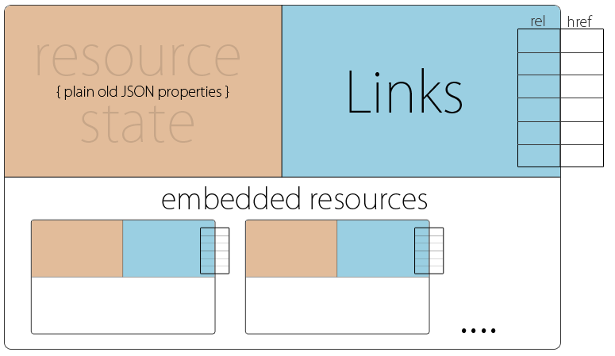
HAL
Source: http://stateless.co/hal_specification.html

Slide 80
HAL
{
"_links":{
"self":{ "href": "/games" },
"next":{ "href" : "/games?page=2" },
"find":{ "href": "/games{?query}", "templated": true },
},
"totalCount":100, "_embedded":{
"games":[
{
"_links":{
"self":{ "href": "/games/123" },
},
"price":30.00,
"currency":"USD",
"name":"Halo 3"
}
]
}
}

Slide 81
HAL
Template Links
Used when URI includes a template (e.g. RFC6570)
http://.../games{?query}
http://.../games?query=halo

Slide 82
Collection + JSON
Supports standard for reading and writing of collections
Defines standard way of communicating lists and individual items
Includes UI elements in messages
Uses MIME Type:
application/vnd.collection+json
Uses Profile Media Type too:
application/vnd.collection+json;profile=http://foo.com/bar

Slide 83
Collection+JSON
{ "collection" :
{
"version" : "1.0",
"href" : "http://example.org/friends/", "links" : [
{"rel" : "feed", "href" : "http://example.org/friends/rss"}
],
"items" : [
{
"href" : "http://example.org/friends/jdoe", "data" : [
{"name" : "full-name", "value" : "J. Doe", "prompt" : "Full Name"},
{"name" : "email", "value" : "jdoe@example.org", "prompt" : "Email"}
],
"links" : [
{"rel" : "blog", "href" : "http://examples.org/blogs/jdoe", "prompt" : "Blog"} ]

Slide 84
THANK YOU

