Slide 1


Slide 2
Heading
Generics
Why We Need Generics
Generics OverView
Generic Class
Generic interfaces
Generic Structs
Generic Methods

Slide 3
WHY WE NEED GENERICS
DEMO SHOWN FOR AreEqual() method with different datatypes

Slide 4
Generics Overview
Generics introduce to the .NET Framework the concept of type parameters, which make it possible to design classes and methods that defer the specification of one or more types until the class or method is declared and instantiated by client code.
The .NET Framework class library contains several new generic collection classes in the System.Collections.Generic namespace.
Generics allow you to define type-safe classes without compromising type safety, performance, or productivity.

Slide 5
Generics Overview
We use generic types to maximize Code Reuse, Type Safety, Performance, and Code Bloat.
Generics Features
Default Values
It is not possible to assign null to generic type
You can use default keyword to initialize default (Either 0 or null) value.
Constraints
If Generic Class needs to invoke some methods from the generic type,
you have to add constraints.
Inheritance
A generic type can implement a generic interface.
When deriving from a generic base class, you must provide a type argument instead of the base-class's generic type parameter.
Static Members
Static Members of generic class are only shared with one instantiation of the class.

Slide 6
Generic Class
Generic classes encapsulate operations that are not
specific to a particular data type.
The most common use for generic classes is with collections like linked lists, hash tables, stacks, queues, trees, and so on.
Operations such as adding and removing items from the collection are performed in basically the same way regardless of the type of data being stored.
Syntax:
public class ClassName<T>
{//Class Members………………}

Slide 7
When you define a generic class, you can apply restrictions to the kinds of types that client code can use for type arguments when it instantiates your class. If client code tries to instantiate your class by using a type that is not allowed by a constraint, the result is a compile-time error. These restrictions are called constraints. Constraints are specified by using the where contextual keyword. The following table lists the six types of constraints:
Constraint | Description
where T: struct | The type argument must be a value type. Any value type except Nullable can be specified. See Using Nullable Types for more information.
where T : class | The type argument must be a reference type; this applies also to any class, interface, delegate, or array type.
where T : new() | The type argument must have a public parameterless constructor. When used together with other constraints, the new() constraint must be specified last.
where T : <base class name> | The type argument must be or derive from the specified base class.
where T : <interface name> | The type argument must be or implement the specified interface. Multiple interface constraints can be specified. The constraining interface can also be generic.
where T : U | The type argument supplied for T must be or derive from the argument supplied for U.

Slide 8
Generic Interfaces
The System.Collections.Generic namespace contains interfaces and classes that define generic collections, which allow users to create strongly typed collections that provide better type safety and performance than non-generic strongly typed collections.

Slide 9


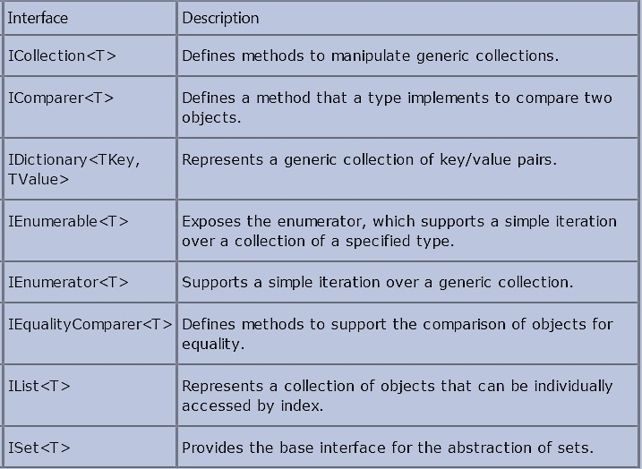

Slide 10
ICollection<T>
Add(), Clear(), Contains(), CopyTo(), Remove(),Count, IsReadOnly
The interface ICollection<T> is implemented by collection classes. Methods of this
interface can be used to add and remove elements from the collection. The generic
interface ICollection<T> inherits from the non-generic interface IEnumerable. With this
it is possible to pass objects implementing ICollection<T> to methods that require
IEnumerable objects as parameters.
IList<T>
Insert(), RemoveAt(), IndexOf(),Item
The interface IList<T> allows you to access a collection using an indexer. It is also
possible to insert or remove elements at any position of the collection. Similar to
ICollection<T>, the interface IList<T> inherits from IEnumerable.
IEnumerable<T>
GetEnumerator()
The interface IEnumerable<T> is required if a foreach statement is used with the
collection. This interface defines the method GetEnumerator() that returns an
enumerator implementing IEnumerator<T>.The generic interface IEnumerable<T>
inherits from the non- generic interface IEnumerable.

Slide 11
IEnumerator<T>
Current
The foreach statement uses an enumerator implementing IEnumerator<T> for accessing all elements in a collection. The interface IEnumerator<T> inherits from the non-generic interfaces IEnumerator and IDisposable. The interface IEnumerator defines the methods MoveNext() and Reset(), IEnumerator<T> defines the type-safe version of the property Current.
IDictionary<TKey, TValue>
Add(), ContainsKey(), Remove(), TryGetValue(),Item, Keys, Values
The interface IDictionary<K, V> is implemented by collections whose elements have a key and a value.
IComparer<T>
Compare()
The interface IComparer<T> is used to sort elements inside a collection with the Compare() method.
IEqualityComparer<T>
Equals(), GetHashCode()
IEqualityComparer<T> is the second interface to compare objects. With this interface the objects can be compared for equality. The method GetHashCode() should return a unique value for every object. The method Equals() returns true if the objects are equal, false otherwise.

Slide 12
The ICollection<T> interface is the base interface for classes in the
System.Collections.Generic namespace.
The ICollection<T> interface extends IEnumerable<T>.
IDictionary<TKey, TValue> and IList<T> are more specialized interfaces that extend ICollection<T>.
A IDictionary<TKey, TValue> implementation is a collection of key/value pairs, like the Dictionary<TKey, TValue> class.
A IList<T> implementation is a collection of values, and its members can be accessed by index, like the List<T> class.
IEnumerable is an interface that defines one method GetEnumerator which returns an IEnumerator interface, this in turn allows readonly access to a collection. A collection that implements IEnumerable can be used with a foreach statement.

Slide 13
Generic Structs
Generic Structs
Similar to Classes structs can be generic as well.
They are similar to generic classes with the exception of inheritance features.
Ex:
public struct Nullable<T>
{//…….}

Slide 14
Generic Methods
Generic Methods
A generic method is a method that is declared with type
parameters, as follows:
static void Swap<T>(ref T lhs, ref T rhs)
{
T temp;
temp = lhs; lhs = rhs; rhs = temp;
}
You can define method-specific generic type parameters even if the containing class does not use generics at all

Slide 15
Generic Delegates
A delegate defined in a class can take advantage of the generic type parameter of that class. For example:
Ex:
public delegate void Del<T>(T item); public static void Notify(int i) { } Del<int> m1 = new Del<int>(Notify);
Generic Methods Specialization
Generic methods can be overloaded to define specializations for specific types.
This is true for methods with generic parameters as well.
A generic delegate can point to methods with different parameter types. However, the number of parameters should be the same.

Slide 16
Generic Collections

Slide 17
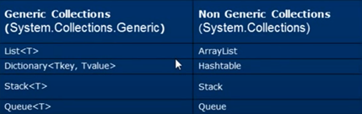
 | Advantages | Disadvantages
Arrrays | TypeSafe[Strongly typed) | Size cannot be changed dynamically 0 based index
.Net 1.0 collections(Arraylist,Hashtable) | Size changes dynamically Easily to add remove elements | Not strongly typed

Slide 18
Generic Collections | Description
List<T> | Generic List<T> contains elements of specified type. It grows automatically as you add elements in it.
Dictionary<TKey,TValue> | Dictionary<TKey,TValue> contains key-value pairs.
SortedList<TKey,TValue> | SortedList stores key and value pairs. It automatically adds the elements in ascending order of key by default.
Hashset<T> | Hashset<T> contains non-duplicate elements. It eliminates duplicate elements.
Queue<T> | Queue<T> stores the values in FIFO style (First In First Out). It keeps the order in which the values were added. It provides an Enqueue() method to add values and a Dequeue() method to retrieve values from the collection.
Stack<T> | Stack<T> stores the values as LIFO (Last In First Out). It provides a Push() method to add a value and Pop() & Peek() methods to retrieve values.

Slide 19
Dictionary in c#
A dictionary is a collection of (key, value) pairs.
Dictionary class is present in System.Collections.Generic namespace.
When creating a dictionary, we need to specify the type for key and value.
Dictionary provides fast lookups for values using keys.
Keys in the dictionary must be unique.

Slide 20
Methods of Dictionary Class
1. TryGetValue() 2. Count() 3. Remove() 4. Clear() 5. Using LINQ extension methods with Dictionary 6. Different ways to convert an array into a dictionary

Slide 21
List Collection class
List is one of the generic collection classes present in System.Collections.Genericnamespcae. There are several generic collection classes in System.Collections.Generic namespace as listed below. 1. Dictionary 2. List 3. Stack 4. Queue etc

Slide 22
1. Contains() function - Use this function to check if an item exists in the list. This method returns true if the items exists, else false.
2. Exists() function - Use this function, to check if an item exists in the list based on a condition. This method returns true if the items exists, else false.
3. Find() function - This method searches for an element that matches the conditions defined by the specified lambda expression and returns the first matching item from the list.
4. FindLast() function - This method searches for an element that matches the conditions defined by the specified lambda expression and returns the Last matching item from the list.
5. FindAll() function - This method returns all the items from the list that match the conditions specified by the lambda expression.

Slide 23
6. FindIndex() function - This method returns the index of the first item, that matches the condition specified by the lambda expression. There are 2 other overloads of this method which allows us to specify the range of elements to search, with in the list.
7. FindLastIndex() function - This method returns the index of the last item, that matches the condition specified by the lambda expression. There are 2 other overloads of this method which allows us to specify the range of elements to search, with in the list.
8. Convert an array to a List - Use ToList() method
9. Convert a list to an array - Use ToArray() method
10. Convert a List to a Dictionary - Use ToDictionary() method

Slide 24
GenericList Collection class
1. AddRange() - Add() method allows you to add one item at a time to the end of the list, where as AddRange() allows you to add another list of items, to the end of the list. 2. GetRange() - Using an item index, we can retrieve only one item at a time from the list, if you want to get a list of items from the list, then use GetRange() function. This function expects 2 parameters, i.e the start index in the list and the number of elements to return. 3. InsertRange() - Insert() method allows you to insert a single item into the list at a specificed index, where as InsertRange() allows you, to insert another list of items to your list at the specified index.

Slide 25
4. RemoveRange() - Remove() function removes only the first matching item from the list. RemoveAt() function, removes the item at the specified index in the list. RemoveAll() function removes all the items that matches the specified condition. RemoveRange() method removes a range of elements from the list. This function expects 2 parameters, i.e the start index in the list and the number of elements to remove. If you want to remove all the elements from the list without specifying any condition, then use Clear() function.

Slide 26
Dictionary over list
Find() method of the List class loops thru each object in the list until a match is found. So, if you want to lookup a value using a key, dictionary is better for performance over list. So, use dictionary when you know the collection will be primarily used for lookups.

Slide 27
Generic Stack collection class
Stack is a generic LIFO (Last In First Out) collection class that is present in
System.Collections.Generic namespace.
The Stack collection class is analogous to a stack of plates.
If you want to add a new plate to the stack of plates, you place it on top of all the already
existing plates.If you want to remove a plate from the stack, you will first remove the one that
you have last added. The stack collection class also operates in a similar fashion.
The last item to be added (pushed) to the stack, will be the first item to be removed (popped)
from the stack.
To insert an item at the top of the stack, use Push() method.
To remove and return the item that is present at the top of the stack, use Pop() method.

Slide 28
A foreach loop iterates thru the items in the stack, but will not remove them from the stack.
The items from the stack are retrieved in LIFO (Last In First Out), order.
The last element added to the Stack is the first one to be removed.
To check if an item exists in the stack, use Contains() method.
Pop() vs Peek() methods
Pop() method removes and returns the item at the top of the stack,
where as Peek() returns the item at the top of the stack, without removing it.

Slide 29
Generic Queue collection class
Queue is a generic FIFO (First In First Out) collection class that is present in System.Collections.Generic namespace. The Queue collection class is analogous to a queue at the ATM machine to withdraw money. The order in which people queue up, will be the order in which they will be able to get out of the queue and withdraw money from the ATM. The Queue collection class operates in a similar fashion. The first item to be added (enqueued) to the queue, will be the first item to be removed (dequeued) from the Queue.
Enqueue() To add items to the end of the queue
Dequeue() To remove an item that is present at the beginning of the queue,
Contains() To check if an item, exists in the queue Dequeue() vs Peek() methods
Dequeue() method removes and returns the item at the beginning of the queue, where as Peek() returns the item at the beginning of the queue, without removing it.

Slide 30
Exercises –Generics
Create a token generation system
When we walk in to bank we will collect a token and we will wait in a queue. Once our token number is called or displayed on screen we will go to the specific counter and we will do our transactions there.
UI Screen will look like below
There are 2 customers before you in the queue
Counter 1
Counter 2
Counter 3
2
1
3
Next
Next
Next
Token Number : 3 Please go to counter : 3
4
5
6
Print Token

Slide 31
Exercises –Generics
Design an application to mimic browser back button functionality
Back
Webpage 1
Webpage 2
Webpage 3
Webpage 3 is displayed

Slide 32
LINQ in C#

Slide 33
What is LINQ?
Language Integrated Query
Make query a part of the language
Component of .NET Framework 3.5
Now shipping with Visual Studio 2008

Slide 34
Advantages
Unified data access Single syntax to learn and remember
Strongly typed Catch errors during compilation
IntelliSense Prompt for syntax and attributes
Bindable result sets

Slide 35

Architecture
C#
VB.NET
Others
.NET Language Integrated Query (LINQ)
LINQ data source providers
ADO.NET support for LINQ
LINQ to Objects
LINQ to Datasets
LINQ to SQL
LINQ to Entities
LINQ to XML

Slide 36
Linq is about data queries
The most important part of Linq is about getting sequences from data sources.
By default, the data sources that can be requested by Linq are :
Object (Linq to Objects)
XML fragments or docs (Linq to XML)
ADO.NET DataSet ( Linq to DataSet)
Sql Server (Linq to SQL)
Entity Framework (Linq to Entities)
In theory, every kind of data source can be handled by Linq, with custom Linq providers ( as Linq to Google or Linq to Lucene)
Ressources to create your own linq provider:
http://msdn.microsoft.com/en-us/library/vstudio/bb546158.aspx
http://msdn.microsoft.com/en-us/library/system.linq.expressions.expressionvisitor.aspx
36

Slide 37
Query Syntax
Query syntax is similar to SQL (Structured Query Language) for the database.
It is defined within the C#
Query Syntax starts with from clause and can be end with Select or
GroupBy clause.

Slide 38
Query Syntax
Implicitly typed variable - var can be used to hold the result of the LINQ query.
We use various operators like filtering,
operators to construct the desired result.
joining,
grouping,
sorting

Slide 39
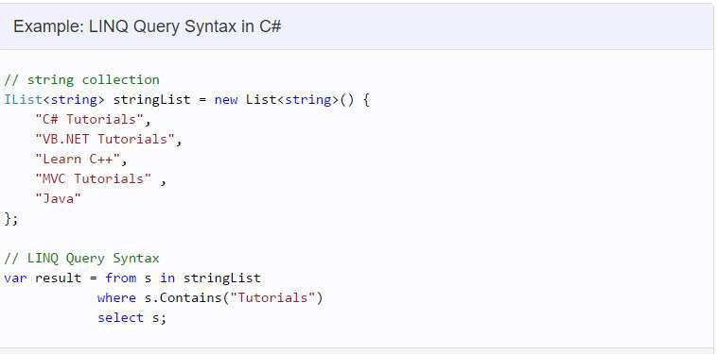

Slide 40
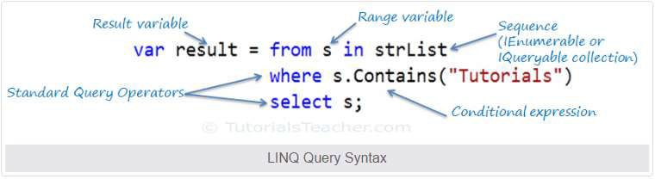

Slide 41
(lamda) Method Syntax
Method Syntax is like calling extension method already included.
Implicitly typed variable - var can be used to hold the result of the
LINQ query.

Slide 42
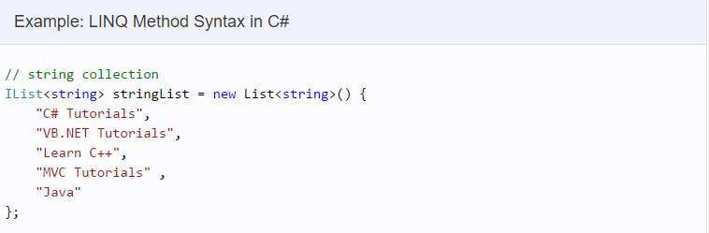

Slide 43
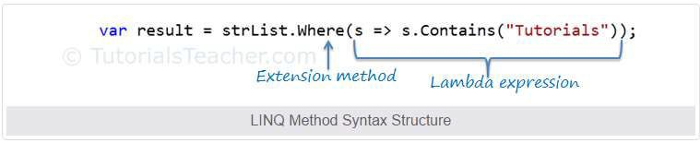

Slide 46
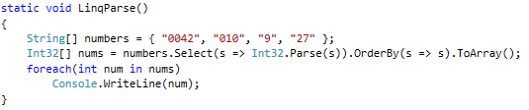
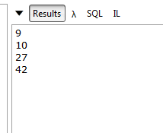
Linq can do more than queries
You can use LINQ to transform set of data :
- Convert your data :
46

Slide 47
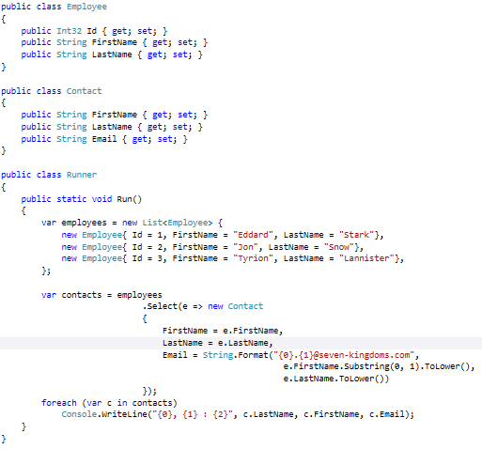
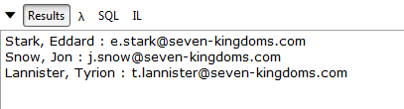
- Transform your data :
47

Slide 48
Linq to Objects
Linq to Objects is the base functionnality of Linq.
It targets sequences of objects (collections, lists, arrays) and yields most often IEnumerable<T> (undefered operators) or IQueryable<T> (defered operators)
Linq to Objects functiunalities are under the System.Linq
namespace
48

Slide 49
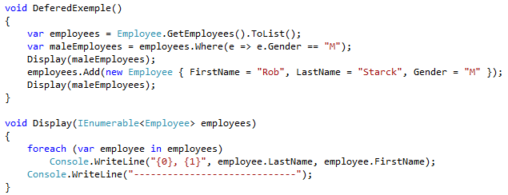
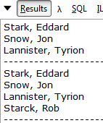
Defered vs Undefered operators
Defered operators doŶ͛t execute queries until explicitly asked. Futhermore,
they return a query, not the result of query :
Gives the following result :
As you can see, each time that maleEmployees is
enumerated, the query is executed.
49

Slide 50
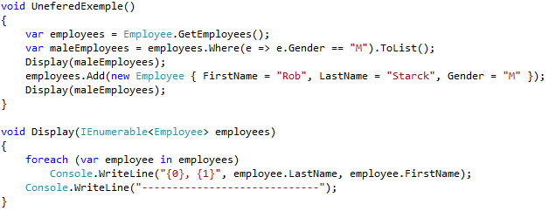
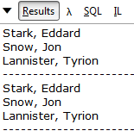
Defered vs Undefered operators
Unefered operators exucute queries directly. Here .ToList() operator is an
undefered one
Gives the following result : maleEmployees will not change when adding a new entry to employees
50

Slide 51
Base defered operators
Restriction
- Where
Projection
Sorting
Set
Distinct
Union
Intersect
Except
OrderBy
OrderByDescending
ThenBy
ThenByDescending
Reverse
Join
-
-
Select
SelectMany
Partitioning
Conversion
Take
TakeWhile
Skip
SkipWhile
Cast
OfType
AsEnumrable
Join
GroupJoin
Element
Concatenation
- Concat
- DefaultIfEmpty
Grouping
Generation
- GroupBy
Range
Repeat
Empty
29

Slide 52
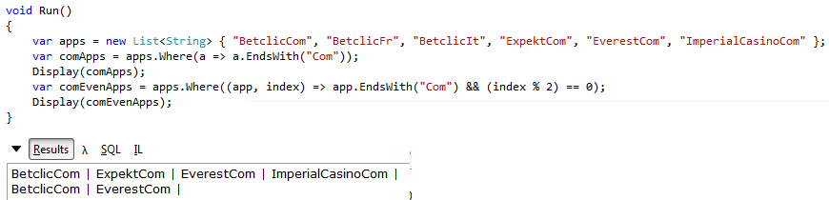
Base defered operators
Where() operator
Is used to refine data following the passed predicate Has two prototypes :
Only the predicate differs. The second one pass the item index to the predicate :
In a general way, several Linq operators offer an additionnal « predicate with index » prototype, check out the System.Linq namespace of System.Core assembly in the Object Explorer!
30

Slide 53
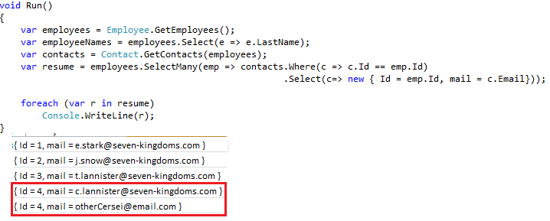
Base defered operators
Projection operators
- Select :
This operator aim is to specify and cutomize the output of a query.
will return an IEnumerable<String>.
When used without selector simply return the full object
- SelectMany :
Is used to create one-to-many sequences, It always takes a selector parameter.
53

Slide 54
Base defered operators
Partitioning Operators :
Take()
TakeWhile()
Skip()
SkipWhile()
Thoses operators allow to split sequences easily, for paging purpose, for example.
54

Slide 55
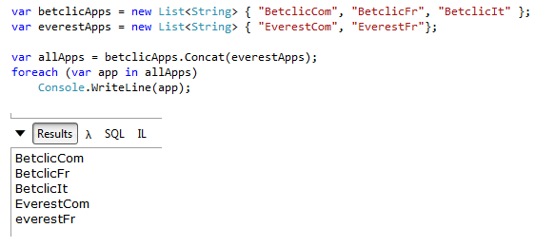
Base defered operators
Concatenation:
- Concat() :
It allows to simply concat sequences of the same type:
55

Slide 56
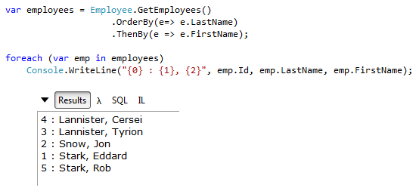
Base defered operators
Ordering:
Those operators allow to simply order sequences.
OrderBy() and OrderByDescending() :
Return IOrderedEnumerable<T> and cannot take IOrderedEnumerable<T> parameter
ThenBy() end ThenByDescending() :
Return IOrderedEnumerable<T> and must take IOrderedEnumerable<T> parameter
Each one has an additionnal prototype taking an IComparer, if a custom ordering is
needed
- Reverse() :
Simply output a reversed sequence.
34

Slide 57
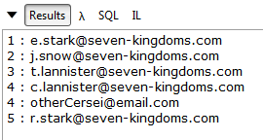
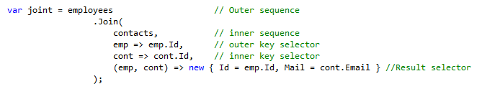
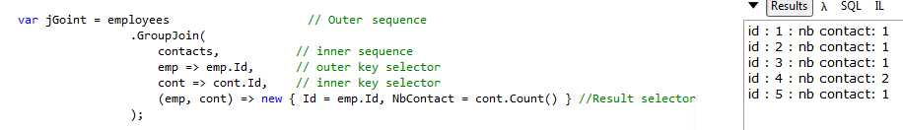
Base defered operators
Joining:
- Join()
It performs an equi-join between sequences :
- GroupJoin()
Perform a join between sequences, and enumerates the inner sequence
57

Slide 58
Base defered operators
Set operators
Thoses operators are used to perform mathematical set-type operations on sequences
Distinct() : Removes duplicates elements in sequence
Union() : Yields element of input sequences, and then yields element of second sequence that are not in the first one
Intersect() : Yields elements that are in both sequences
Except() : Yields the elements of the input sequence that are not in the 2nd one
58

Slide 59
Base defered operators
Conversion operators
Cast()
OfType() :
Cast() and OfType target non-generic Ienumerable interface, in order to open Linq functionnalities to legacy collections.
Cast() will throw an exception if it cannot cast an element of the input sequence, while OfType will simply ignore the uncastable elements
AsEnumrable() :
Cast a sequence into a normal IEnumerable<T> in order to use standard Linq operators. For example, Select() in Linq To SQL returns IQueryable<T> that doŶ͛t implement the Reverse() operator,
59

Slide 60
Base defered operators
Element operator
- DefaultIfEmpty()
This operator will generate a default element if the output sequence is empty.
Basically, it avoids the System.InvalidOperationException: Sequence contains no elements
60

Slide 61
Base defered operators
Generation operators
Range()
Static method (not a extension) that generates a sequence of integers,
Repeat()
Its generates a sequence of the same specified element.
Empty()
Static method (not a extension) that generates an empty sequence of the requested type
61

Slide 62
Base undefered operators
Conversion
ToArray
ToList
ToDictionary
ToLookup
Element
First
FirstOrDefault
Last
LastOrDefault
Single
SingleOrDefault
ElementAt
ElementAtOrDefault
Quantifiers
Any
All
Contains
Equality
- SequenceEqual
Aggregate
Count
LongCount
Sum
Min
Max
Average
Aggregate
40

Slide 63

Base undefered operators
Conversion operators
ToArray() :
Take an IEnumrable<T> and return an array T[].
ToList() :
Take an IEnumrable<T> and return a List<T>.
ToDictionary()
ToLookup() :
Have the same prototypes, and rely on Func<> to select Keys and Elements :
63

Slide 64
Base undefered operators
Element Operators
First
FirstOrDefault
Last
LastOrDefault
Single
SingleOrDefault
ElementAt
ElementAtOrDefault
Self speaking methods. Just keep in mind that the « OrDefault » version will generate a default element if no element is found whereas classic version will throw an exception.
64

Slide 65
Base undefered operators
Quantifiers Operators
Any()
Returns true if at least one element of the sequnce match the predicate
All()
Returns true if all elements of the sequnce match the predicate
Contains()
Returns true if the sequence contains the parameter item.
Equality operator
SequenceEqual()
It determines whether two input sequences are equal.
65

Slide 66
Base undefered operators
Aggregate operators
Count()
LongCount()
Sum()
Min()
Max()
Average()
Thoses operators usage is obvious, just keep in mind that they can take a predicate parameter, saving a call to Where()
66

Slide 67

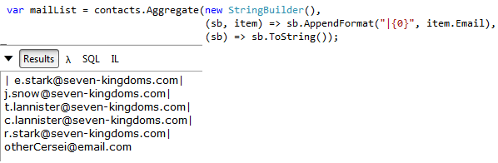
Base undefered operators
Aggregate operators
Aggregate()
It͛s a tricky but powerful one! The Aggregate operator performs a user-specified function on each element of an input sequence, passing iŶ the fuŶĐtioŶ͛s returŶ value froŵ the previous element and returning the return value of the last element.
No seed prototype :
Fast, isŶ͛t it?
- With seed :
67

Slide 68
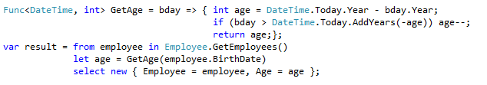
Tips and tricks!
When you cannot know the returned type of a query, do not hesitate to
use the var keyword!
You can use Cast or OfType operators when you have to query a legacy collection!
In query expression, you can use the « Let » clause, that allows to query
subsets in the current query :
68

Slide 69
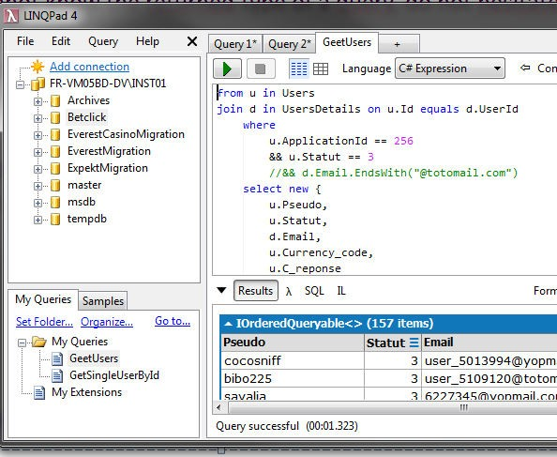
Tips and tricks!
- Get Linqpad!
It͛s a simple ( and free! ) tool that allows you to test your queries, your code snippets. You can even query the BDD :
http://www.linqpad.net/
69

Slide 70
Advanced concepts
A) Linq To DatatSet
B) Linq To XML
C) Linq To SQL
70

Slide 71
Advanced concepts
A) Linq To DatatSet
Linq to Dataset relies on the System.Data namespace part embedded in System.Data.DataSetExtensions Assembly.
Linq to DataSet is a very useful feature when dealing with legacy code that relies on
standard ADO.NET DataSet, DataTablr, DataRow and DataColumn.
The first thing to do is to call the .AsEnumerable() extension on your DataSet or
DataTable, and this one become Linq-ready!
Linq To DataSet could be view as an extension of Linq To Object, because its matter is to adapt specific objects to make its queryable through Linq.
71

Slide 72
Advanced concepts
A) Linq To DatatSet
DataRow Operators :
Set operators
Distinct()
Except()
Intersect()
Union()
SequenceEqual()
Fields Operators
Field<T>() : obtain the value of a column from a DataRow object and handles the casting of DBNull
SetField<T> () : allow to change a value of a property (column) in a DataRow
50

Slide 73
Advanced concepts
A) Linq To DatatSet
DataTable Operators :
AsEnumerable() :
Yield an IEnumerable<DataRow>
CopyToDataTable<DataRow>() :
Copy a set of DataRow in the targeted DataTable.
73

Slide 74
Advanced concepts
B) Linq To XML
Linq To Xml relies on the System.Xml.Linq
Obviously, Linq To XML first intention is to query XML with Linq. But Microsoft takes
the opportunity to add a new (and waaay easier) XML API.
Indeed, when it͛s about creating XML, previous API ( called W3C DOM XML API ) was so cumbersome that most developers prefer to build XML-like strings.
Linq To XML allows to divide the amount of code needed by 3 when creating XML.
74

Slide 75
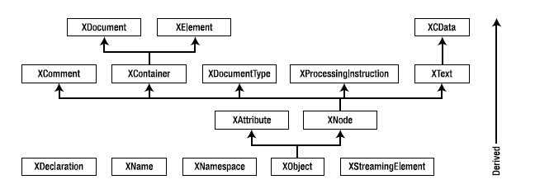
Advanced concepts
B) Linq To XML
Here is the X-Linq Object Model :
75

Slide 76
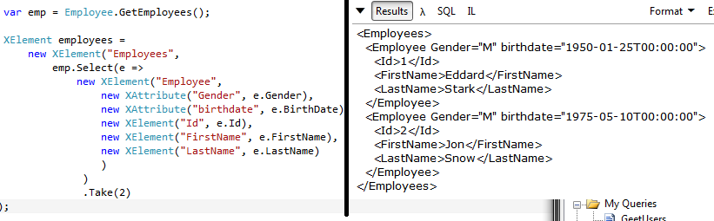
Advanced concepts
B) Linq To XML
XML Creation :
With X-Linq, creating Xml is very easy, thank to the fluent API.
When a full (and valid) document is needed, simply put an Xdocument as root element :
76

Slide 77
Advanced concepts
B) Linq To XML
XML Output:
X-Linq offers simple Save mechanism: XDocument.Save and XElement.Save
The second one will automatically add the xml header.
XML Input :
X-Linq allow you to work with external xml document and fragement
Load() : Allow to convert raw XML fragements into XDoc or XElt
Parse() : Allow to convert non formarted xml strings into XDoc or Xelt
77

Slide 78
• B) Linq To XML
XML Traversal Methods:
- forward :
- XNode.NodesAfterSelf()
- XNode.ElementsAfterSelf()
- backward :
- XNode.NodesBeforeSelf()
- XNode.ElementsBeforeSelf()
- down :
- XContainer.Nodes()
- XContainer.Elements()
- XContainer.Element()
- XContainer.Descendants() recursive
- XElement.DescendantsAndSelf() recursive
- up :
- XNode.Ancestors() recursive
- XElement.AncestorsAndSelf() recursive

Slide 79
• B) Linq To XML
XML Traversal Properties:
- forward : XNode.NextNode
- backward : XNode.PreviousNode
- up : XObject.Document
XObject.Parent

Slide 80
• B) Linq To XML
X-LINQ operators:
- Ancestors()
- AncestorAndSelf()
- Attributes()
- DescendantNodes()
- DescendantNodesAndSelf()
- Descendants()
- Elements()
- InDocumentOrder()
- Remove()
58

Slide 81
• C) Linq To SQL
Linq to SQL is an API to work with MS SqlServer DBs. Its aim it to make the bridge between our classes and the way their data are stored, and to make this bridge easier to craft and maintain. It’s an entry-level ORM.
To enable Linq to SQL, there are some prerequisites :
- Generating the Entity classes, with SQLMetal utility, for example.
=> create classes that reflect the DB model
- Generating the XML mapping file
=> create a file that will allow to map objects into sql entries and sql queries results into objects, automatically
59
Generating the Entity classes :
in vs command prompt
sqlmetal /namespace:nwind /code:Northwind.cs /pluralize /functions /sprocs /views <path to Northwind MDF file>
Generating the xml mapping file :
in vs command prompt
sqlmetal /map:northwindmap.xml "C:\Northwind.mdf" /pluralize /functions /sprocs /views /namespace:nwind /code:Northwind.cs

Slide 82
• C) Linq To SQL
DataContext
One key concept of LINQ to SQL is the DataContext class, that establishes database connection, holds common methods to interact with databases, holds the references to the entities.
When using Linq To SQL, the first thing to do is to instantiate your DataContext

Slide 83
• C) Linq To SQL
Standard Database operations
Once your DataContext is instantiated, you can start to query it with standard Linq queries. There is two point to keep in mind :
-Linq to SQL operators return IQueryable<T>
-Queries are translated into SQL, meaning that some advanced restriction clause may throw exceptions at runtime, like custom user type comparison.
In the following, an example will be given in the Northwind DataContext.
http://businessimpactinc.com/blog/install-northwind-database/

Slide 84

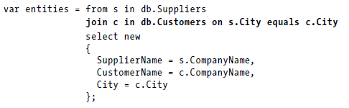
• C) Linq To SQL
Standard Database operations
-Select :
-Join :

Slide 85
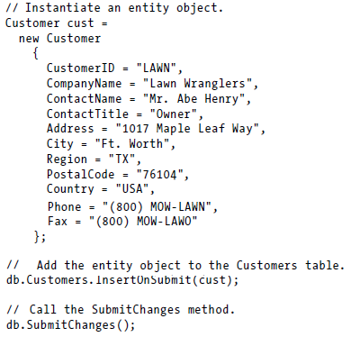
• C) Linq To SQL
Standard Database operations
-Insert :

Slide 86
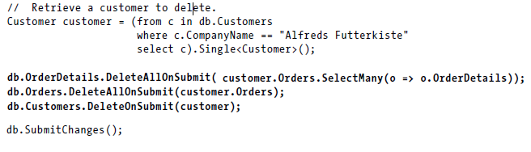
• C) Linq To SQL
Standard Database operations
-Delete :

Slide 87
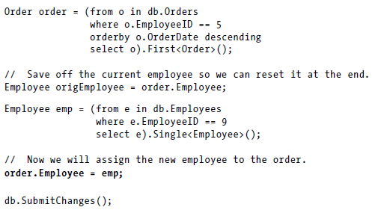
• C) Linq To SQL
Standard Database operations
-Update:

Slide 88
VI) Examples
• A) Build a querystring formated based on a dictionary
• B) Convert a enum to a list of its values
• C) Extract data from legacy dataset

Slide 89
Going Deeper !
• A) MoreLinq library
• B) DinamycLinq Library
• C) Linq To whatever : build you own IQueryable
- Steps (msdn)
- Linq to Google
- Linq to Lucene 70

Slide 90
•MoreLinq Library - Available by Nuget : Add usefull operator
Operator | Summary
AssertCount | Asserts that a source sequence contains a given count of elements.
Batch | Batches the source sequence into sized buckets.
Concat | Returns a sequence consisting of the head element and the given tail elements. This operator uses deferred execution and streams its results.
Consume | Completely consumes the given sequence. This method uses immediate execution, and doesn't store any data during execution.
DistinctBy | Returns all distinct elements of the given source, where "distinctness" is determined via a projection and the default eqaulity comparer for the projected type.
EquiZip | Returns a projection of tuples, where each tuple contains the N-th element from each of the argument sequences.
ForEach | Immediately executes the given action on each element in the source sequence.
Generate | Returns a sequence of values consecutively generated by a generator function.
GenerateByIndex | Returns a sequence of values based on indexes.
MaxBy | Returns the maximal element of the given sequence, based on the given projection.
MinBy | Returns the minimal element of the given sequence, based on the given projection.
Pad | Pads a sequence with default values if it is narrower (shorter in length) than a given width.
Pipe | Executes the given action on each element in the source sequence and yields it.
Prepend | Prepends a single value to a sequence.
PreScan | Performs a pre-scan (exclusive prefix sum) on a sequence of elements.
Scan | Peforms a scan (inclusive prefix sum) on a sequence of elements.
SingleOrFallback | Returns the single element in the given sequence, or the result of executing a fallback delegate if the sequence is empty.
TakeEvery | Returns every N-th element of a source sequence.
ToDelimitedString | Creates a delimited string from a sequence of values. The delimiter used depends on the current culture of the executing thread.
Trace | Traces the elements of a source sequence for diagnostics.
Zip | Returns a projection of tuples, where each tuple contains the N-th element from each of the argument sequences.
ZipLongest | Returns a projection of tuples, where each tuple contains the N-th element from each of the argument sequences.

Slide 91
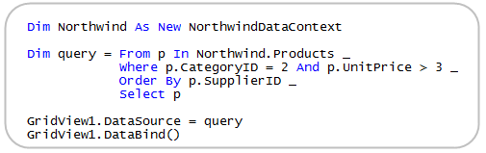
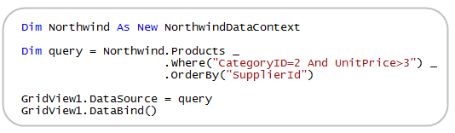
Dynamic Linq Library
Library provided by Microsoft.
Allow to build dynamic linq queries, by making restriction and ordering operator accepting string instead of lambda
Classic query
Dynamic Linq Query

Slide 92
Linq To whatever : build you own IQueryable!
Linq is not limited to the Microsoft’s tools. You can build a Linq API to nearly every datasource, since you create Iqueryable LINQ provider.
Numerous projects take advantage of this opportunity.
The most well known are
- LINQ to Google (GLinq) : you can query Google’s datasources easily
- Linq to Lucene : Lucene is a strong, fast, lightweight and open source text search engine. Linq to Lucene allow you to simplify access to data indexed by Lucene

