Slide 1
ABAN SAVER

Slide 2
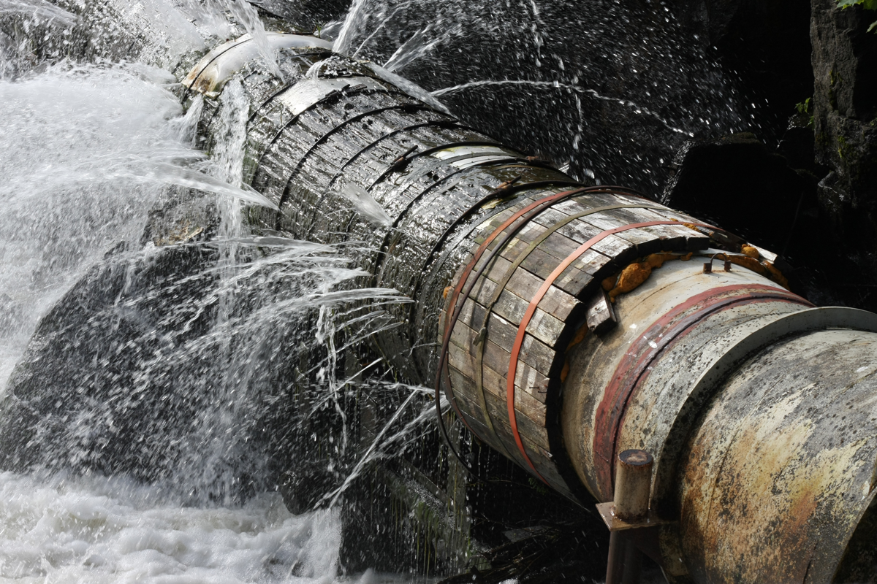
PROBLEM
Water wastage main source:- water leakage.
32billion cubic meter of water is being wasting/year.
50Lakh lit. of water has leaked few days ago in Bisalpur.

Slide 3
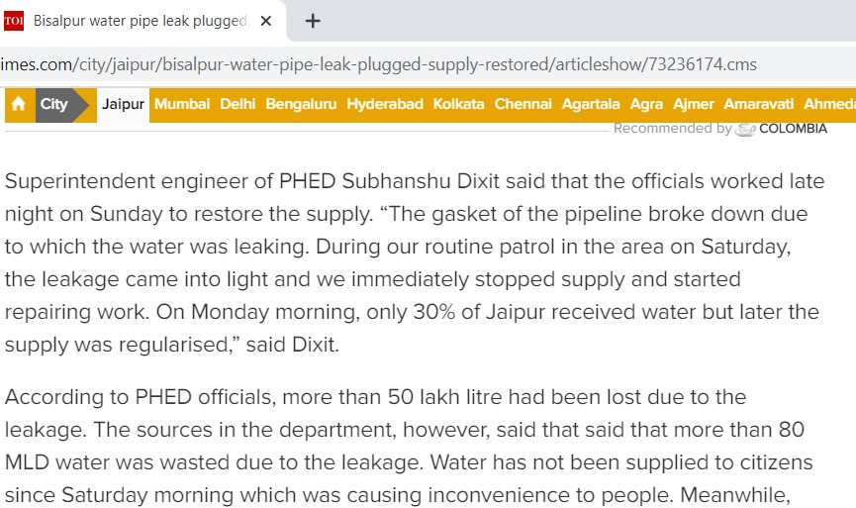
Only 30% of jaipur received water after this incident.

Slide 4
WATER PRODUCTION AND SUPPLY
From Bisalpur system | 275 MLD
From tube wells (1900 nos. Operated on rotation) | 97MLD
From single point tube wells (117 nos.) | 2 MLD
Total supply | 374MLD
Loss of water | 90 MLD
Length of pipeline network | 23500km

Slide 5
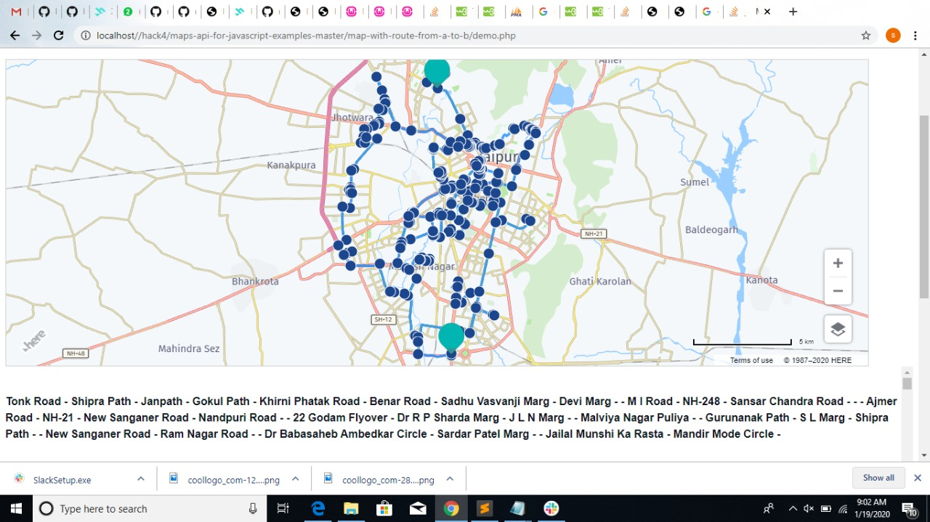
SOLUTION
We are saving this leaking water by:
detecting the leakage instantly by Paddlewheel flow meters.
Get the location of leakage by HERE MAPS.
Informing the municipal authority.
Helping the repairers to get to the location by HERE MAPS.

Slide 6
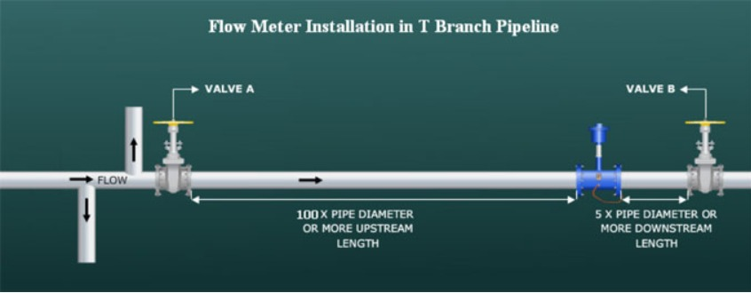
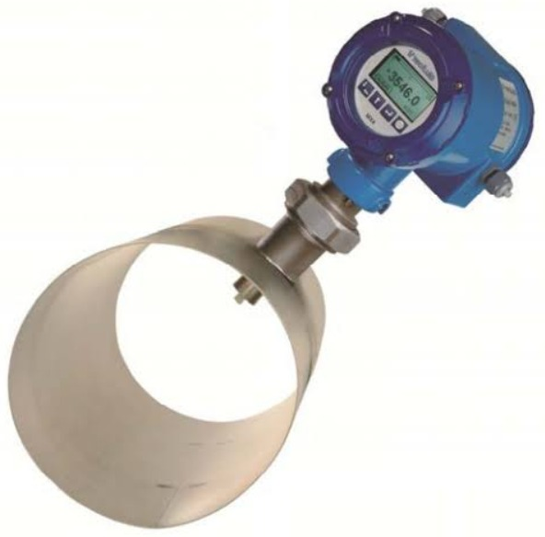
IMPLEMENTATION
Installing flow meters into the pipes with unique id’s.
Difference between two consecutive meters will be considered as leakage.
Then authorities will be informed with location.

Slide 7

APIS Used
Routing API
Geocoding API
Website Homepage

Slide 8
Cost Estimation
Total pipeline area in jaipur is 23,500km.
Installing flow meter at every 2km.
Cost of 1 flow meter is 6000.
Total estimation : 7.5cr(approx)

Slide 9
THANK YOU!
Presented by HACK 4
Saumya Sharma
Tuli Biswas
Vikram Singh
Ridhi Dadhich

