Slide 1

MACHINE LEARNING
INDUSTRIAL TRAINING SEMINAR
ON
Presented To :
Vijay Bijlwan Sir
Dept. Of CSE
Presented by :
Vikram Singh
B.Tech (CSE) 7th sem
18134501032

Slide 2
Contents
Introduction of ML
Why ML?
Applications
Advantages & Disadvantages
Project using ML
Conclusion

Slide 3
Introduction of ML
Machine learning (ML) is a type of artificial intelligence (AI) that allows software applications to become more accurate at predicting outcomes without being programmed to do so. Machine learning algorithms use historical data as input to predict new output values.

Slide 4
WHY ML?
Machine learning is important because it gives enterprises a view of trends in customer behavior and business operational patterns, as well as supports the development of new products.
Many of today's leading companies, such as Facebook, Google and Uber, make machine learning a central part of their operations. Machine learning has become a significant competitive differentiator for many companies.

Slide 5
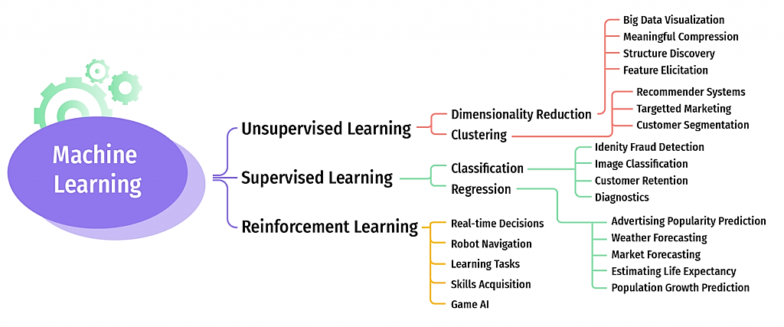
Types of ML

Slide 6
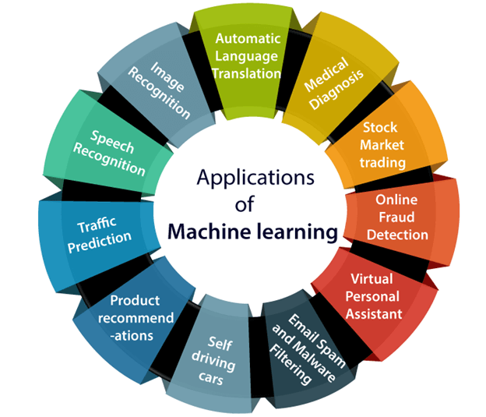
Applications of Machine learning

Slide 7
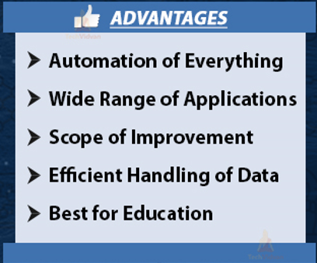
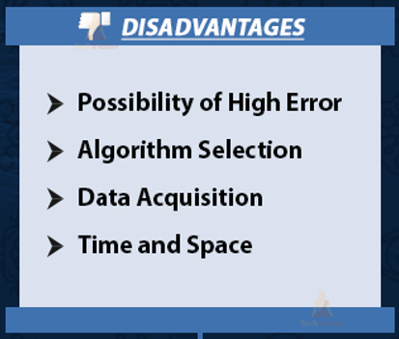
Advantages & Disadvantages

Slide 8

Ptoject Using ML
Smart ML Chatbot

Slide 9
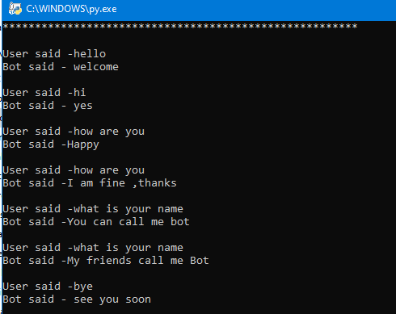
ML CHAT BOT
A chatbot is an automated program that simulates human conversation through text messages, voice chats, or both. It learns to do that based on a lot of inputs.

Slide 10
Conclusion
You know that Machine Learning is a technique of training machines to perform the activities a human brain can do, it is faster and better than an average human-being. Today we have seen that the machines can beat human champions in games such as Chess, AlphaGo, which are considered very complex. You have seen that machines can be trained to perform human activities in several areas and can aid humans in living better lives.

Slide 11


