Slide 1
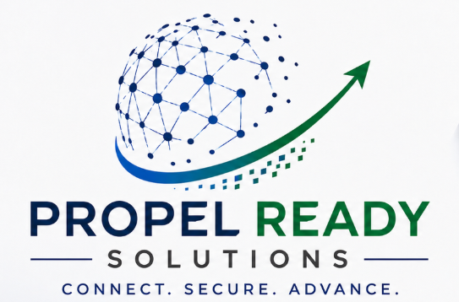
GOVERNANCE - RISK - COMPLIANCE
ONE PLATFORM - FIVE OUTCOMES
ComplAI
Frameworks
Controls
One Stop GRC for CISOs & CIOs
SOC 2 - ISO 27001
154+ per tenant
The leadership portal that unifies frameworks, controls, and risk - so security executives answer the board in minutes, not weeks.
ComplAI
GRC Portal
SOC 2 - ISO 27001 - 21+ frameworks
RAG leadership view
Risk-to-control traceability
Risk Register
Leadership
Linked to controls
RAG dashboard
Audit Ready
Slide 1 of 4 - Introduction
Confidential
Evidence - Export - Proof

Slide 2
The challenge - GRC is broken across too many tools
CISOs and CIOs lose visibility, time, and audit confidence when data lives in silos.
TODAY'S REALITY - FRAGMENTED GRC STACK
5+
disconnected tools typical per org (spreadsheets, risk tools, drives, ticketing)
Risk Tool
Jira / ITSM
Excel
SharePoint
Email
Separate DB
Issues
Controls
Evidence
Status
40h+
lost per audit cycle reconciling controls, risks, and evidence manually
CISO / CIO
"Which number do I trust?"
?
Board asks "Are we green?" - often no real-time, domain-level answer
AUDIT PREP TIME - 85% manual
!
Risks float without control linkage - audit gaps stay hidden.
LEADERSHIP CONFIDENCE - Low (stale data)
!
Open issues can mask "audit ready" status - leadership sees green, auditors see red.
Slide 2 of 4 - The problem
Confidential

Slide 3
What ComplAI provides - one portal, full GRC lifecycle
From framework activation to audit-ready proof - designed for how CISOs and CIOs actually work.
1
Leadership dashboard - RAG by domain and framework, click-to-filter charts, path-to-green.
Leadership Dashboard - RAG Posture
Green 55%
Needs attention
- Access mgmt - Red
- Change control - Amber
- 3 open risks block audit
-> Path to green
2
Control register - per-control compliance method, remediation, evidence, audit-ready rules.
Amber 28%
Red 17%
By domain
3
Risk register - inherent and present scoring; every risk/issue linked to a control.
4
Export and integrate - CSV for auditors; architecture for IdAM, SIEM, access tools.
Risk <-> Control linkage
21+
frameworks prebuilt - SOC 2 (61) - ISO 27001 (93) enabled by default
CC6.1
<->
Privileged access risk
Logical Access
Inherent High -> Present Medium
Audit Ready blocked until linked risks & issues are resolved
Slide 3 of 4 - Product capabilities
Confidential

Slide 4
Why purchase ComplAI - the executive business case
Reduce risk, cut audit friction, and give the board a number they can trust.
BEFORE vs AFTER
WHY CISOs & CIOs BUY - DECISION DRIVERS
BEFORE
Quarterly fire drill
Weeks of manual prep
High stress - High cost
Repeat every cycle
AFTER
Continuous GRC
Real-time RAG dashboard
Audit-ready on demand
One export - One truth
Board
confidence
Audit
pass rate
->
ComplAI
Risk
visibility
Team
efficiency
Board confidence - Audit pass - Risk visibility - Team efficiency
Audit prep effort
Before
Single pane of glass
Faster red to green
Defensible audit trail
Your stack, your way
After
One login for posture, risks, and compliance - no reconciling 5 tools before board meetings.
Domain RAG + path-to-green actions focus budget and people where impact is highest.
Risks tied to controls, evidence per context, CSV export - auditors get proof, not stories.
Customer-defined compliance per control - flexible for your environment, structured for SOC 2 and ISO.
Purchase ComplAI when you need to lead GRC - not chase it.
Track risk. Prove control. Walk into every audit with confidence.
Slide 4 of 4 - Business case
Confidential

