Slide 1
Agenda
Data Visualization (What? Why? How?)
Univariate vs Bivariate vs Multivariate
Graphs/charts
Histogram
Box plot
Bar plot
Pie chart
Stacked bar plot
Scatter plot
Heat map
Line chart
Visualization on sample dataset

Slide 2
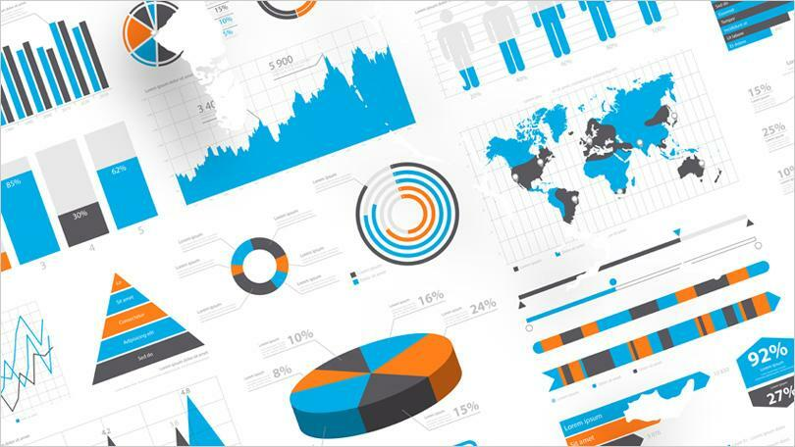

Slide 3
DATA VISUALIZATION
VISUALIZATION
DATA
Finding solution to problem
Decision making
For understanding data clearly
To find relationship among data
Comparative analysis
Data Visualization is a process of converting data into information in the form of chart/diagram/picture etc.

Slide 4
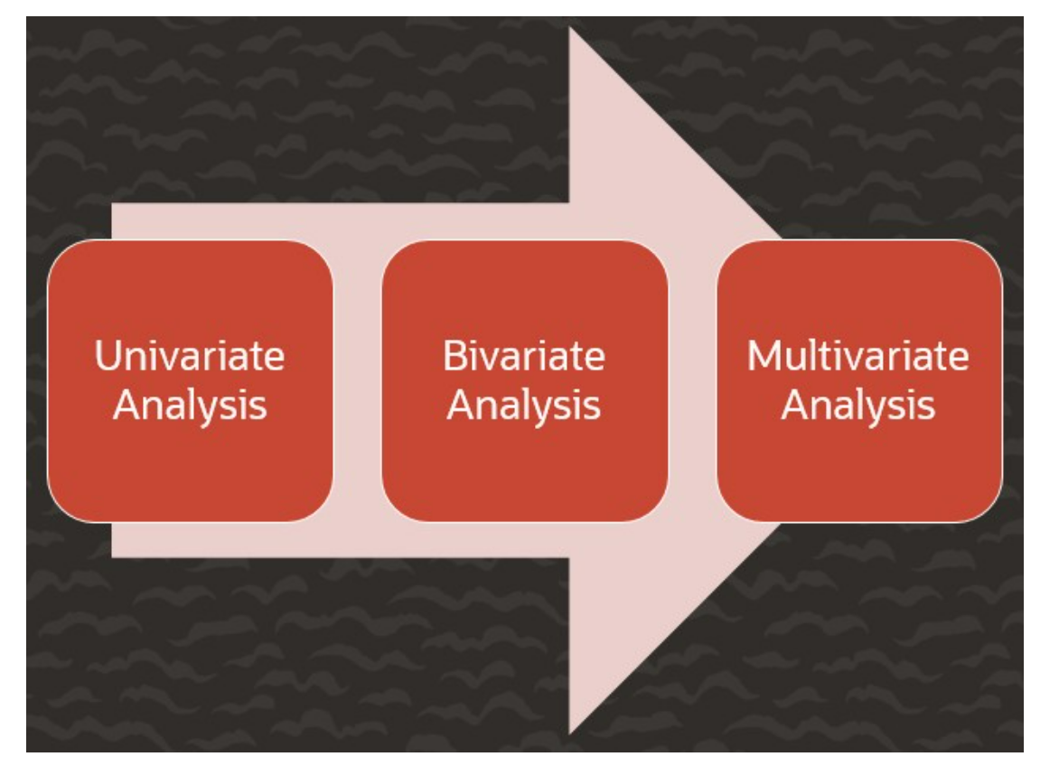
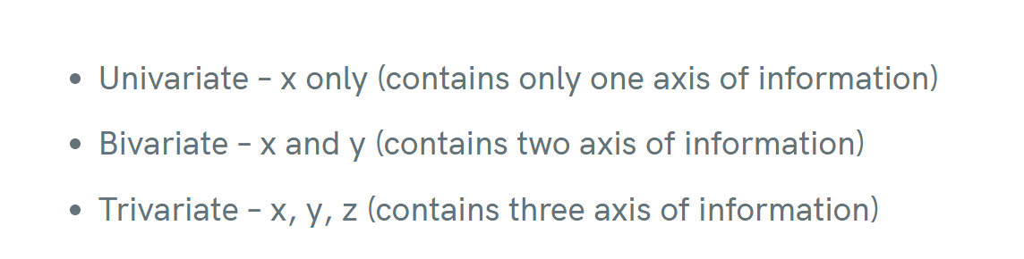

Slide 5
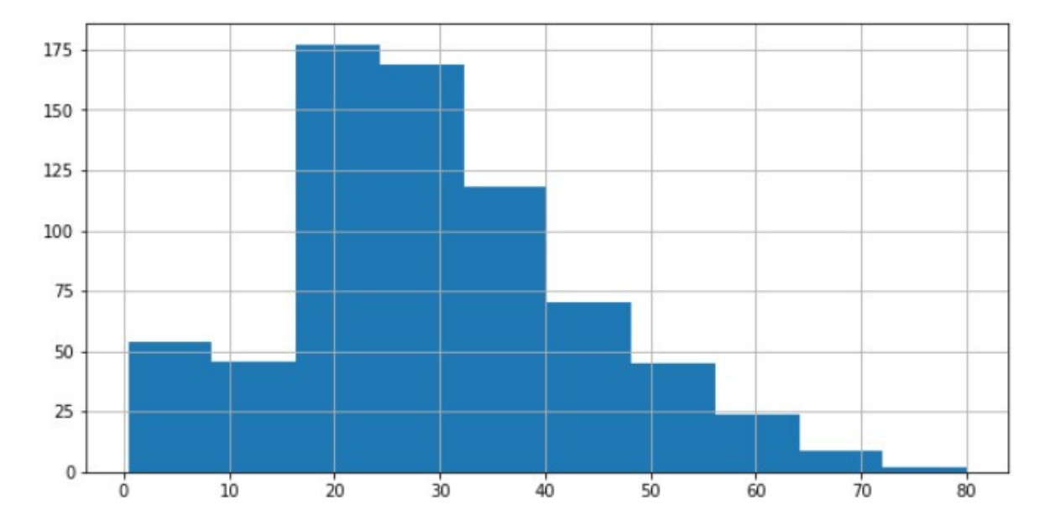
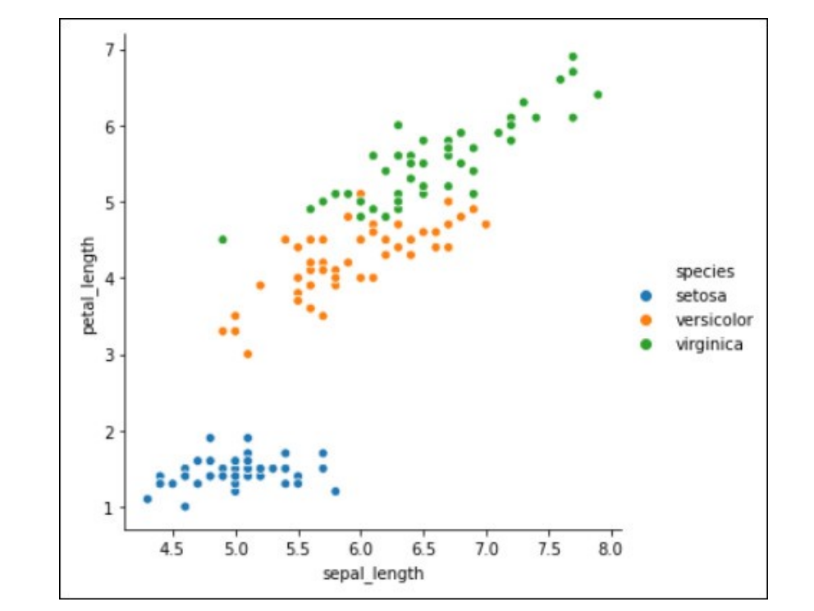
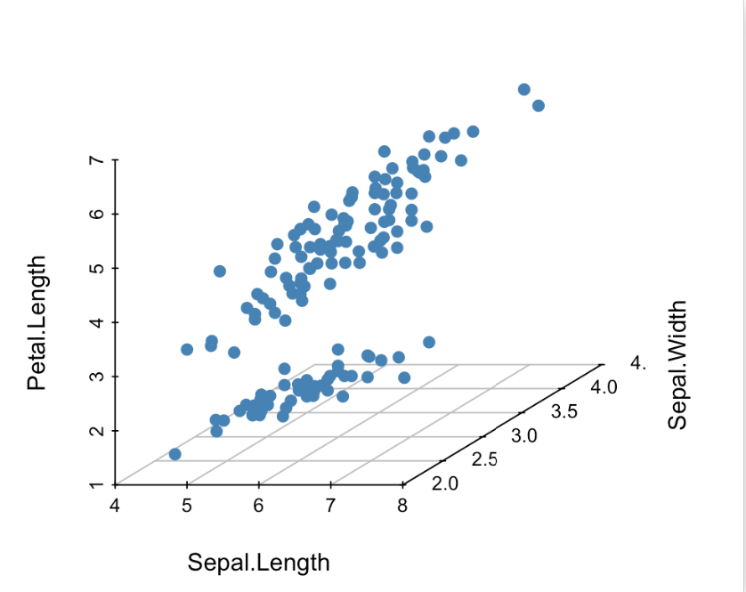
1
2
3

Slide 6
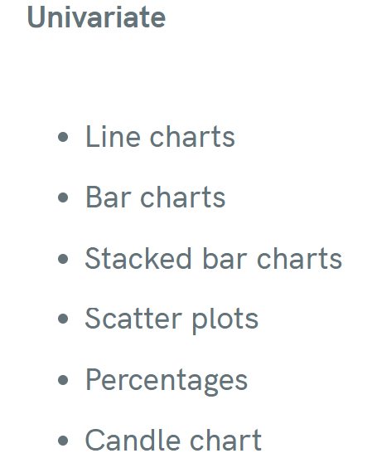
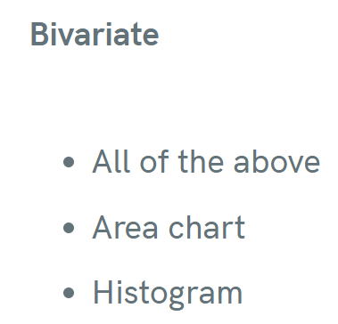
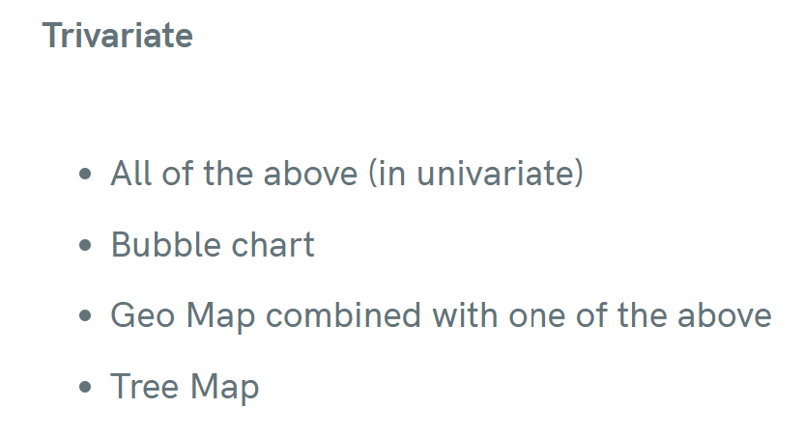

Slide 7
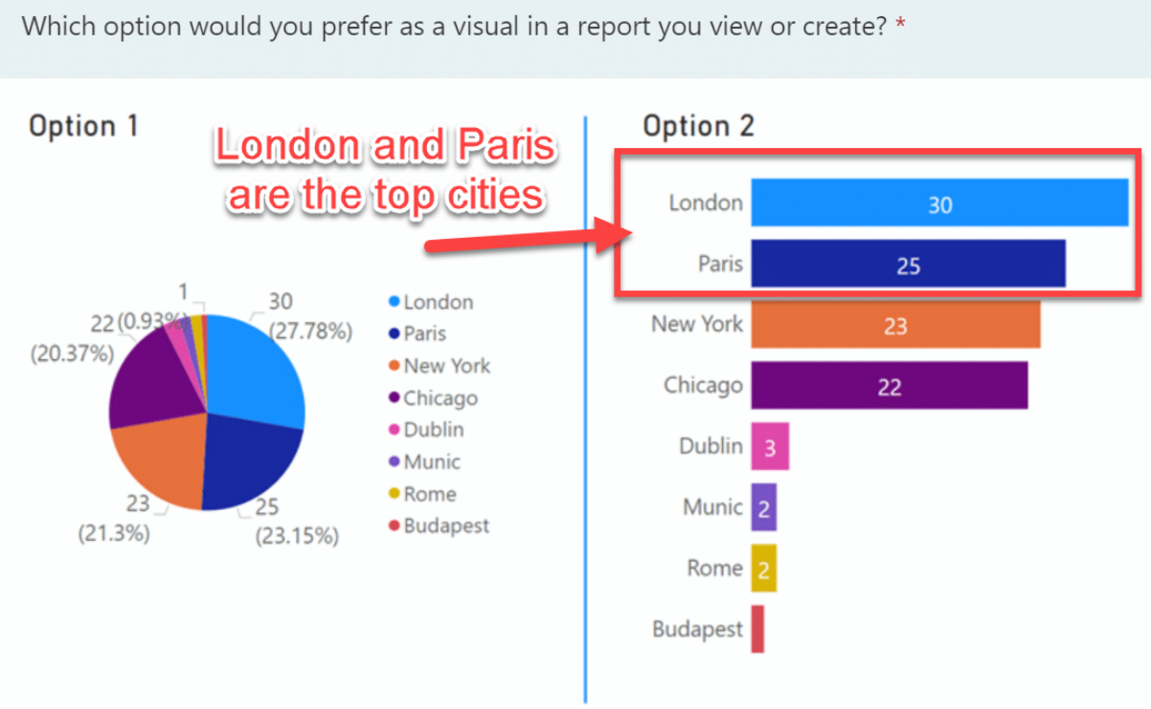
How to choose a chart ?
What's the story your data is trying to deliver?
Who will you present your results to?
How big your data is?
What is your data type?
How do the different elements of your data relate each other

Slide 8
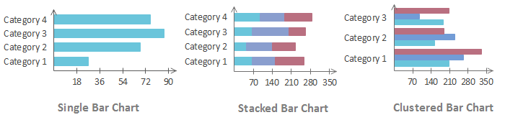
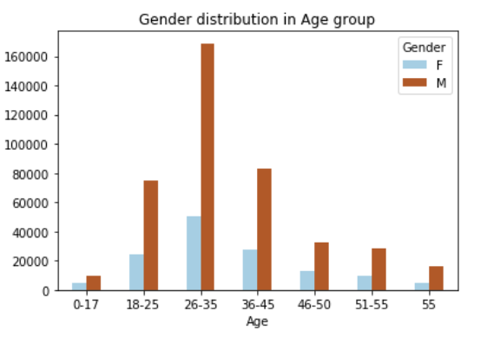
Bar Graph
Values of each category need to be viewed intuitively.
A comparison of data is needed on the chart
comparing values across several categories at once.
Bar graph should be avoided when there is no categorical data

Slide 9
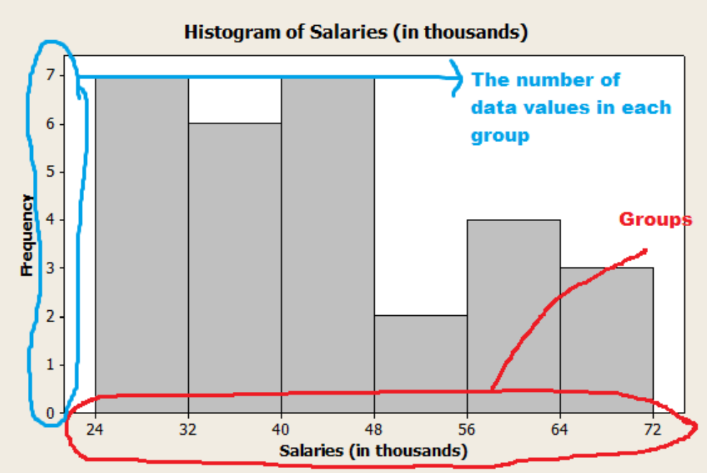
Histogram
Histogram is a display of statistical information that uses rectangles to show the frequency of data items in successive numerical intervals of equal size

Slide 10
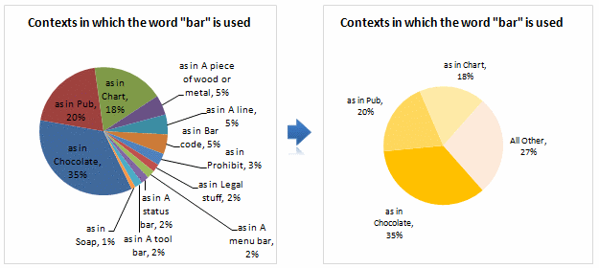
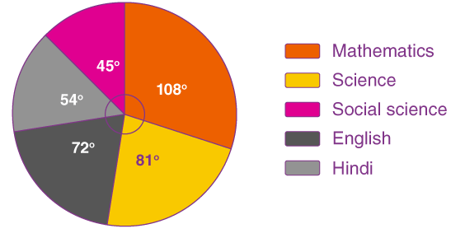
Pie Chart
To convey that one segment of the total is relatively small or large.
Quantity is represented by slices; humans aren't particularly good at estimating quantity from angles, which is the skill needed.
Matching the labels and the slices can be hard work.
Small percentages (which might be important) are tricky to show.

Slide 11
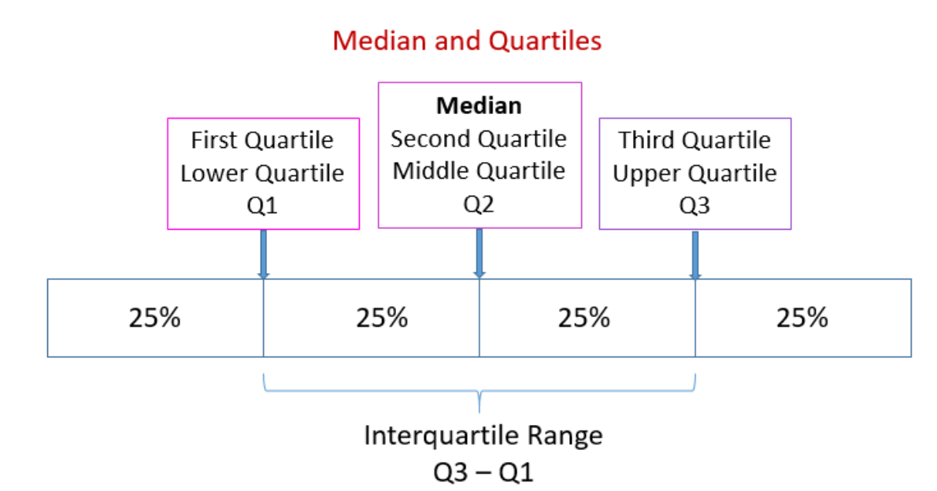
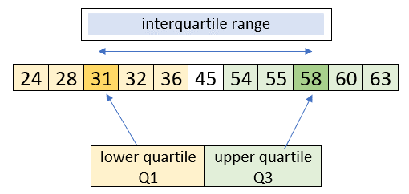
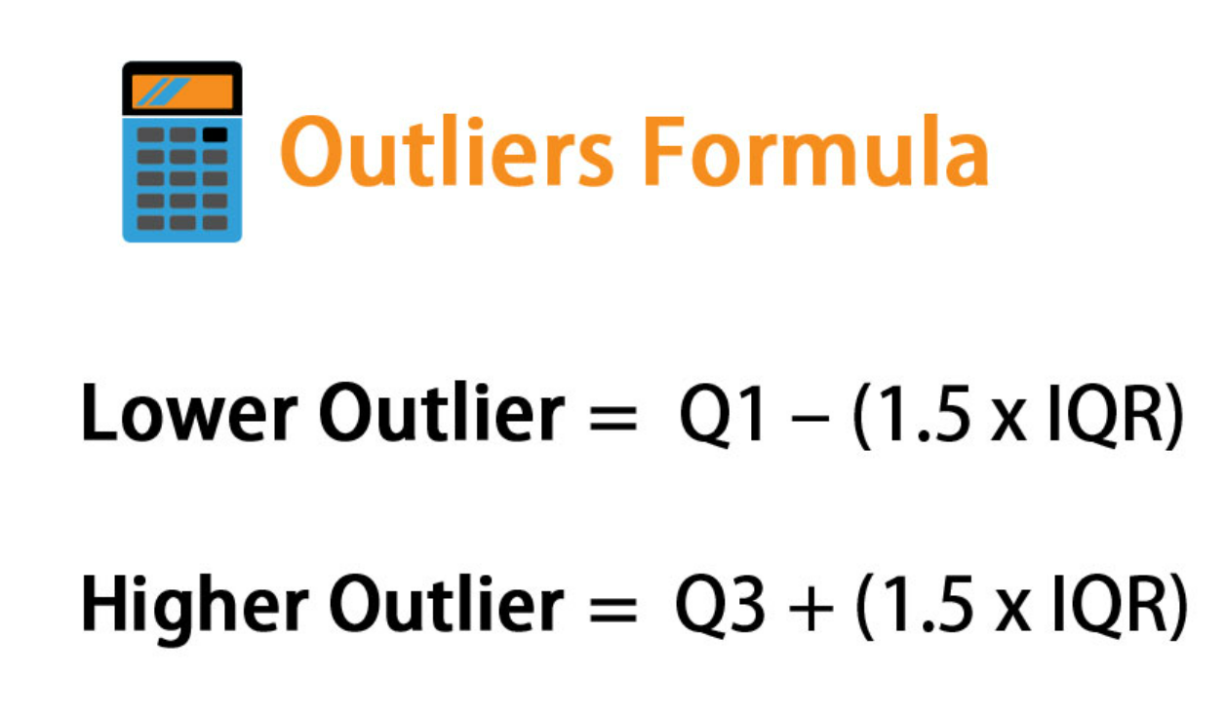
Outlier

Slide 12
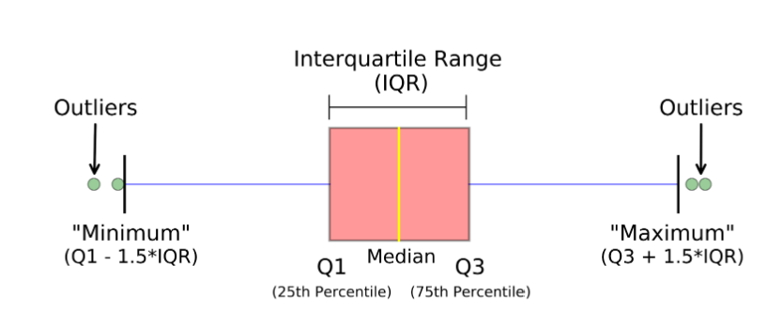
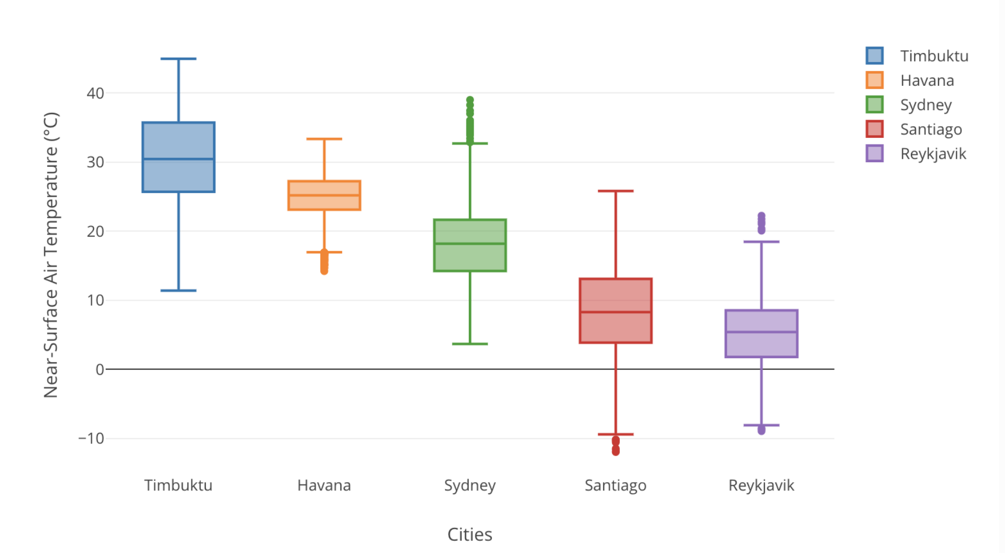
Box Plot
boxplot is a method for graphically demonstrating the locality, spread and skewness groups of numerical data

Slide 13
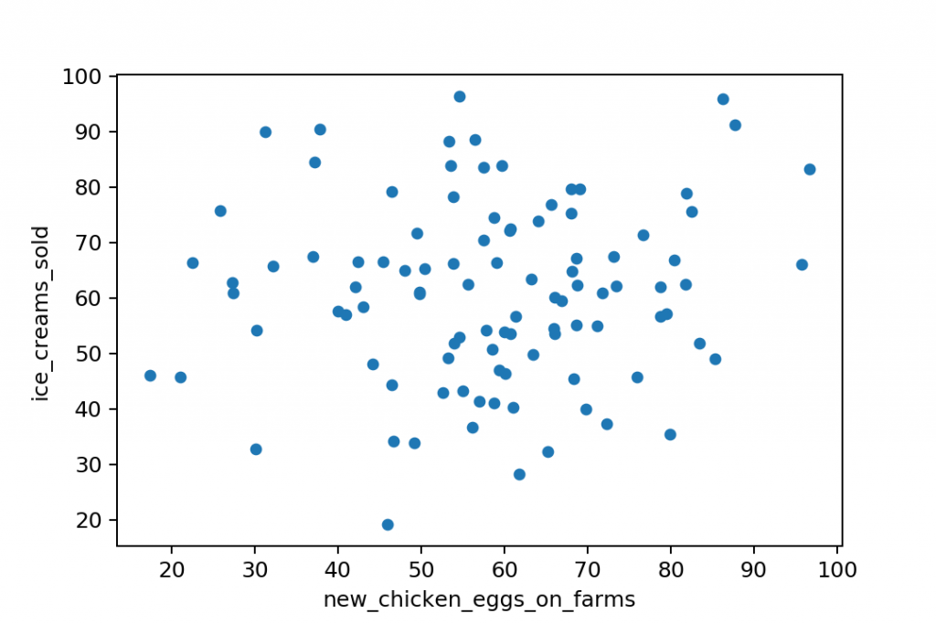
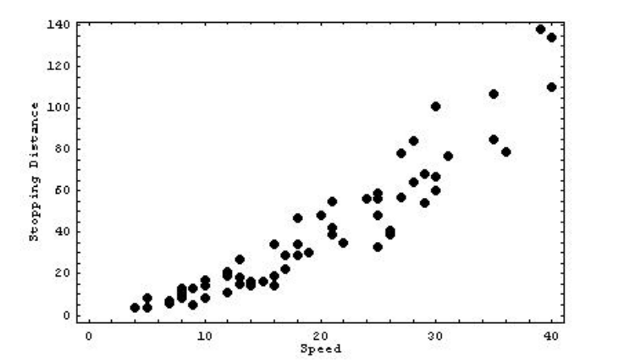
Scatter plot
A scatterplot shows the relationship between two quantitative variables measured for the same individuals.

