Slide 1
Agenda
Types of Variables
Data Wrangling (What? Why? How?)
Need for Wrangling
Steps in Wrangling
Data Wrangling in Python
Wrangling on sample dataset

Slide 2
Types of Variables in Data Science
Numerical
Categorical
Date Time
Mixed

Slide 3
Numerical Variables
This is the category of variables that deals with the numbers only. This category can be further divided into 2 sub-categories.
Discrete
Continuous
Discrete Numerical Variable
This is the category of the variables that only contain a discrete quantity, that is integers. No fractions are allowed in this category.
Few examples of this category are:
Whole numbers or Natural Numbers
The number of shirts you have.
The number of houses you own.
The number of vehicles you own.
The number of children in the family.
The number of pets in the family.
The number of laptops you own, (here you will definitely have an integer as an answer, no one can say that it has
1.1 laptops, it will be obviously 1, 2, 3, etc.)

Slide 4
Continuous Numerical Variables
This is the category of the numerical variables that deal with the continuous quantities or fractional quantities.
Few examples of this category are:
The amount of your post-paid mobile bill. (Generally, it is not an integer, it is like 500.50, etc)
Total time spent on watching a web series (120.5 seconds, etc)
Total amount spent on ordering food online (1500.57 INR, etc)

Slide 5
Categorical Variables
This is the category of the Variables that deals with the categories. It is also divided into 2 subcategories.
Ordinal
Nominal
Ordinal Categorical Variable
Those variables that have an order associated with them are known as Ordinal Categorical variables or categorized into Ordinal Categorical Variables. The order is just been observed in the values that a particular variable is holding.
Days of the week (here there is a specific order => Monday always comes before Tuesday and so on…)
Educational Degrees (Ph.D. always comes after master's degree & so on…)
Nominal Categorical variables
Those variables that do not have any order associated with them are known as Nominal Categorical variables or categorized into Nominal Categorical Variables.
Country Names
City Names

Slide 6
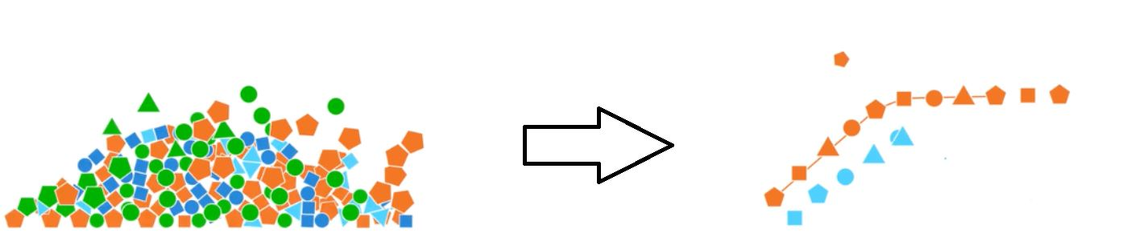

Slide 7

Data Wrangling
Data Wrangling, is the cleaning and transforming of one type of data to another type to make it more appropriate into a processed format
Data wrangling involves processing the data in various formats and analysis and get them to be used with another set of data and bringing them together into valuable insights
It further includes data aggregation, data visualization, and training statistical models for prediction.

Slide 8
NEED FOR WRANGLING
The main purpose of data wrangling is to make raw data usable.
On average, data scientists spend 75% of their time wrangling the data, which is not a surprise at all
The important needs of data wrangling include
The quality of the data is ensured.
Supports timely decision-making and fastens data insights.
Noisy, flawed, and missing data are cleaned.
Raw data are pieced together to the required format.
To create a transparent and efficient system for data management
Wrangling the data helps make decisions promptly and helps the wrangler clean,
enrich, and transform the data into a perfect picture

Slide 9
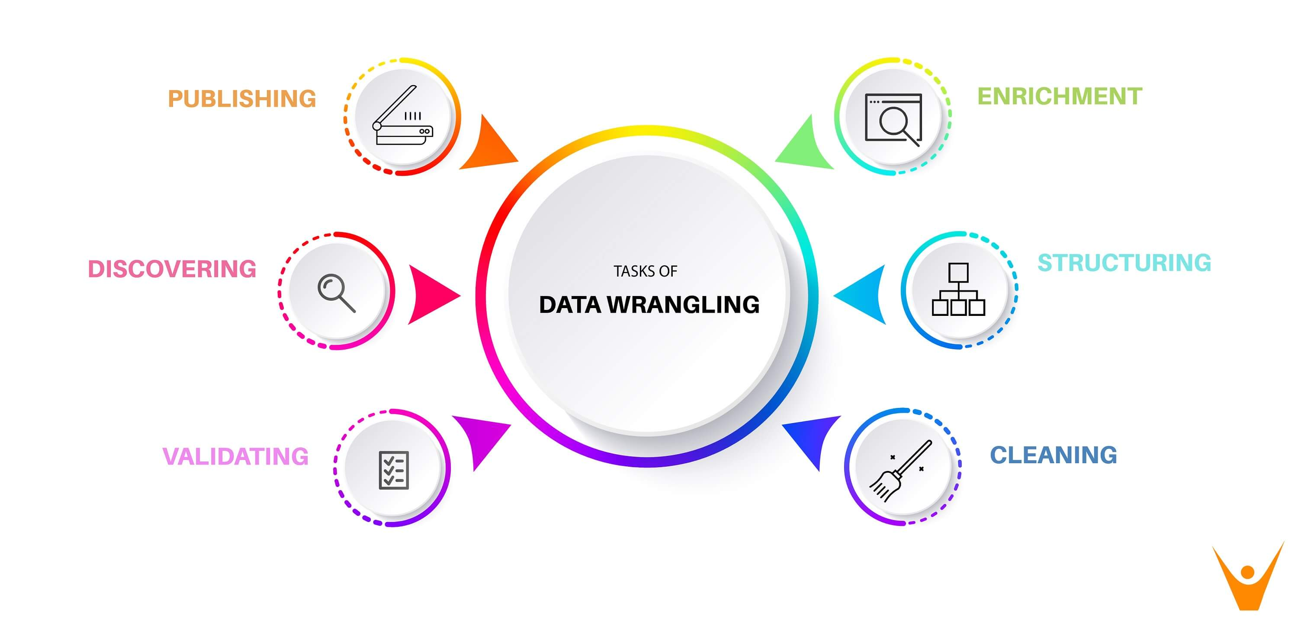
Powell Menezes

Slide 10
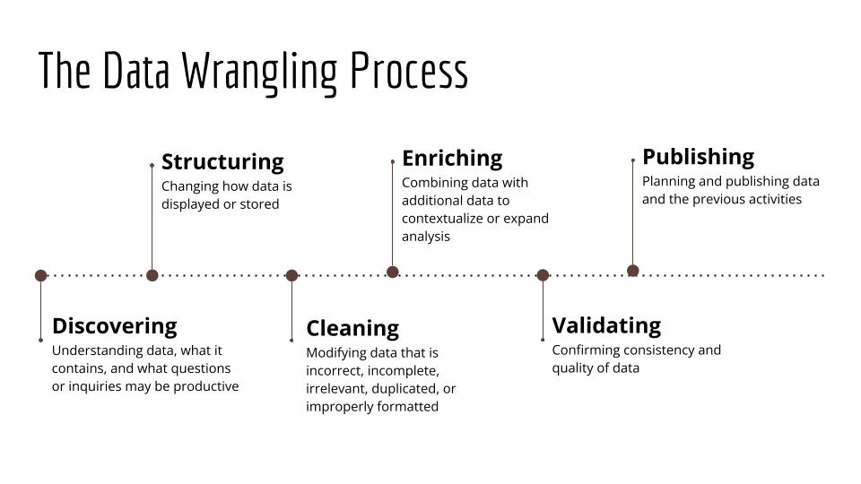

Slide 11
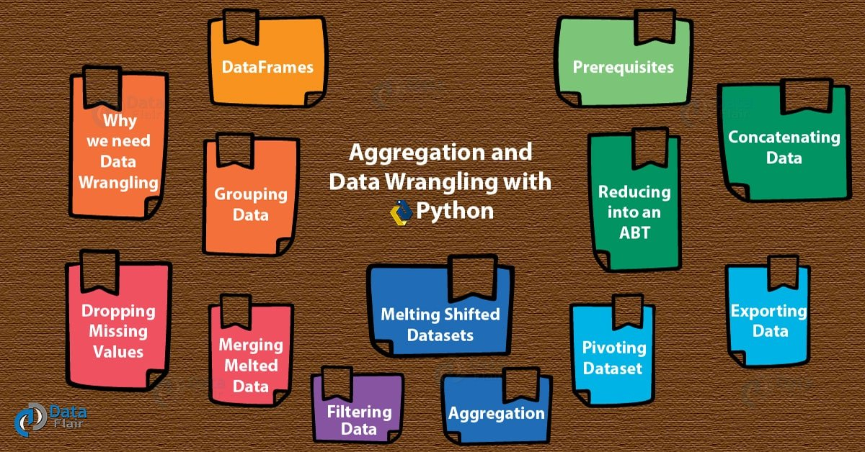
Data Wrangling in Python
Data exploration: Visualization of data is made to analyse and understand the data.
Dealing with missing values: Having Missing values in the data set has been a common issue when dealing with large data set and care must be taken to replace them. It can be replaced either by mean, mode or just labelling them as NaN value.
Reshaping data: Here the data is either modified from the addressing of pre-existing data or the data is modified and manipulated according to the requirements.
Filtering data: The unwanted rows and columns are filtered and removed which makes the data into a compressed format.
Others: After making the raw data into an efficient dataset, it is bought into useful for data visualization, data analysing, training the model, etc.

Slide 12
Data Wrangling in Python (Hands – On)
Identify and handle missing values
Identify missing values
Deal with missing values
Correct data format
Data standardization
Data Normalization (scaling)
Binning
Indicator variable

