Slide 1

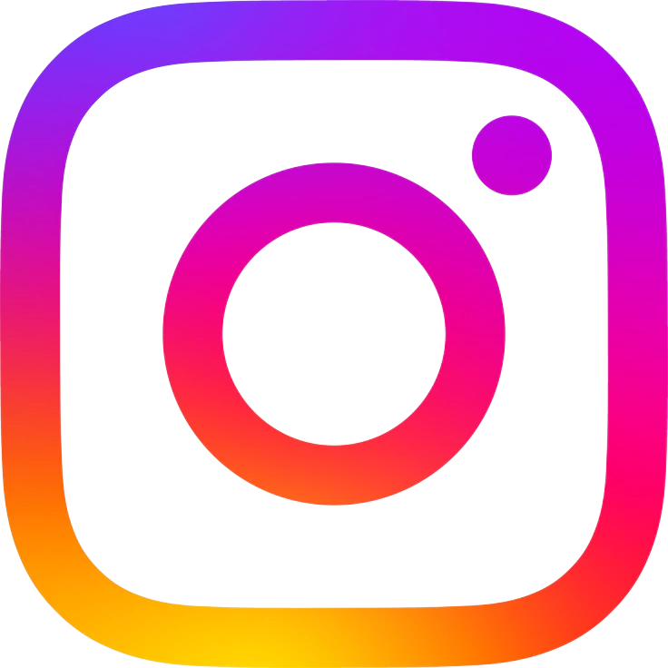
SOCIAL MEDIA PROJECT
By Vikrant Rajput

Slide 2



TABLE OF CONTENTS
About Meta
Problem Statement
Data Description
Data Overview
Content Performance
Advertisement Strategy
Campaigns and Projections
Engagement Analysis
Users Classification
Conclusion

Slide 3
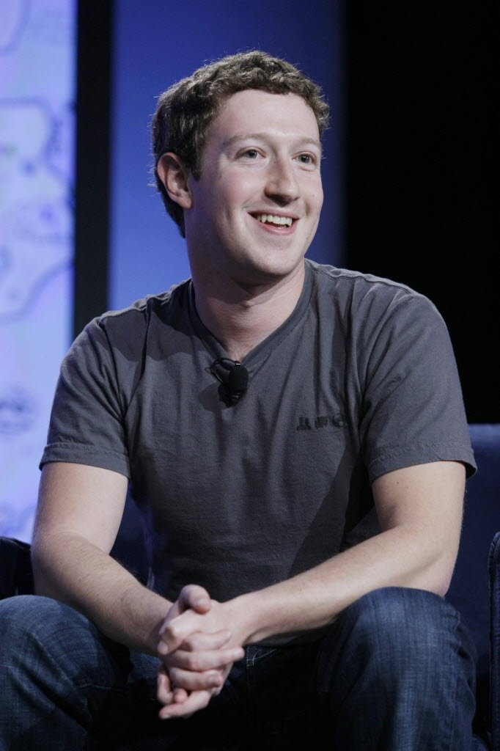
ABOUT META
Meta Platforms Inc. (formerly Facebook) is a leading technology company founded by Mark Zuckerberg in 2004. In October 2021, the company rebranded to Meta to reflect its vision of building the Metaverse - a digital environment where people can connect, work, and interact through immersive virtual experiences.
Meta owns and operates some of the world's most popular social media platforms, including Facebook, Instagram, WhatsApp, and Messenger. Through its products and technologies, Meta aims to bring people together, foster online communities, and shape the future of digital communication.

Slide 4

PROBLEM STATEMENT
You are hired as a data analyst at Meta and asked to collaborate with the Marketing team. Marketing teams want to leverage Instagram's user data to develop targeted marketing strategies that will increase user engagement, retention, and acquisition. Provide insights and recommendations to address the following objectives

Slide 5
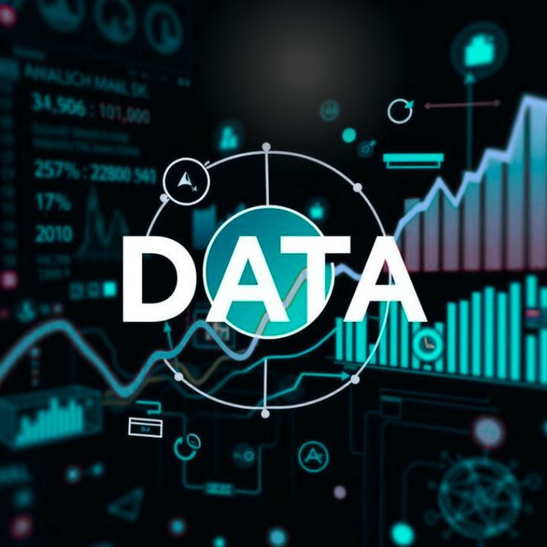
DATA DESCRIPTION
• A total of 7 Tables are present in the given dataset.
• The total number of users is 100.
• Total number of posts made so far is 257.
• Total number of likes posted by the users on posts is 8782.
• Total number of comments on all posts is 7488.
• Total Engagement is calculated as the sum of likes and comments received by a user.
• Engagement rate is calculated by dividing total engagements by the number of posts.

Slide 6
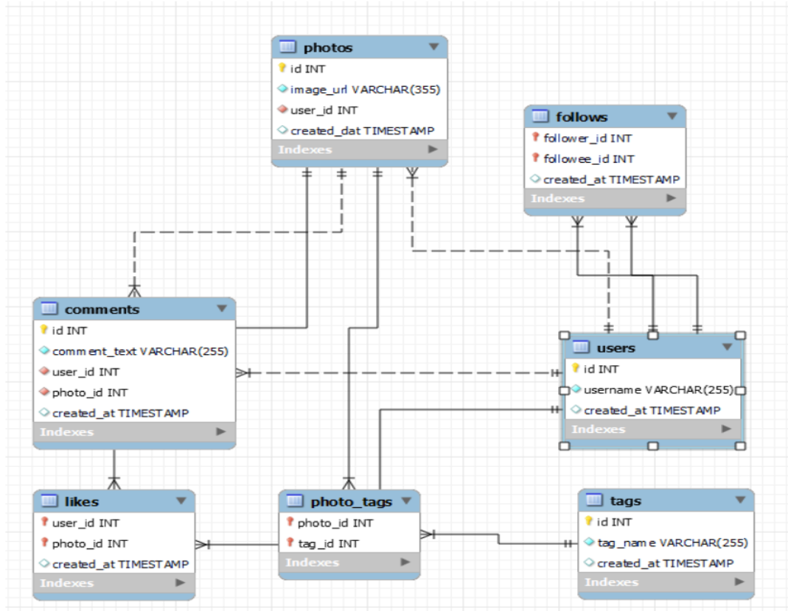
DATABASE SCHEMA

Slide 7
CONTENT PERFORMANCE
#dreamy is the highest-performing hashtag.
#foodie ranks lowest among the top hashtags.
#beauty, #stunning, and #delicious generate similar engagement.
All top hashtags consistently attract user attention and engagement.

Slide 8
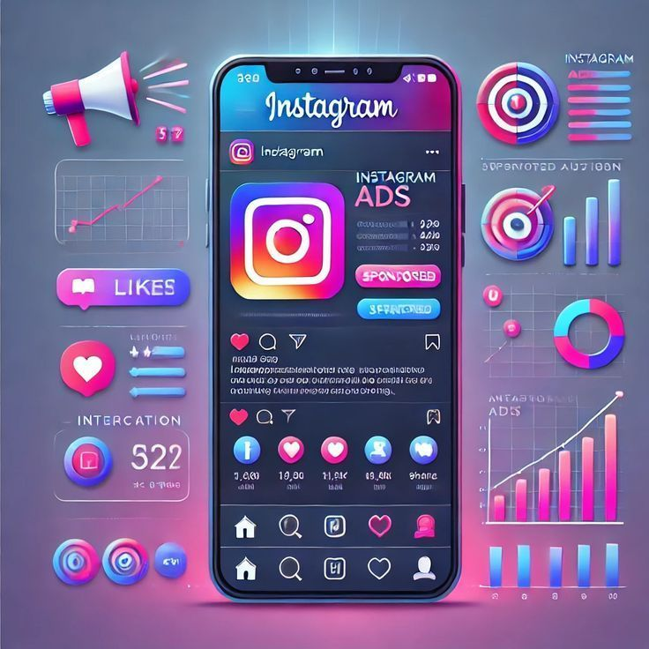
ADVERTISEMENT STRATEGY
• Target highly engaged users, as they are more likely to interact with ads and influence others.
Use trending hashtags such as #dreamy, #beauty, #stunning, and #delicious to increase reach and visibility.
Deliver personalized ads based on user interests, activity, and content preferences.
Focus on relevant content recommendations to improve engagement and conversion rates.

Slide 9
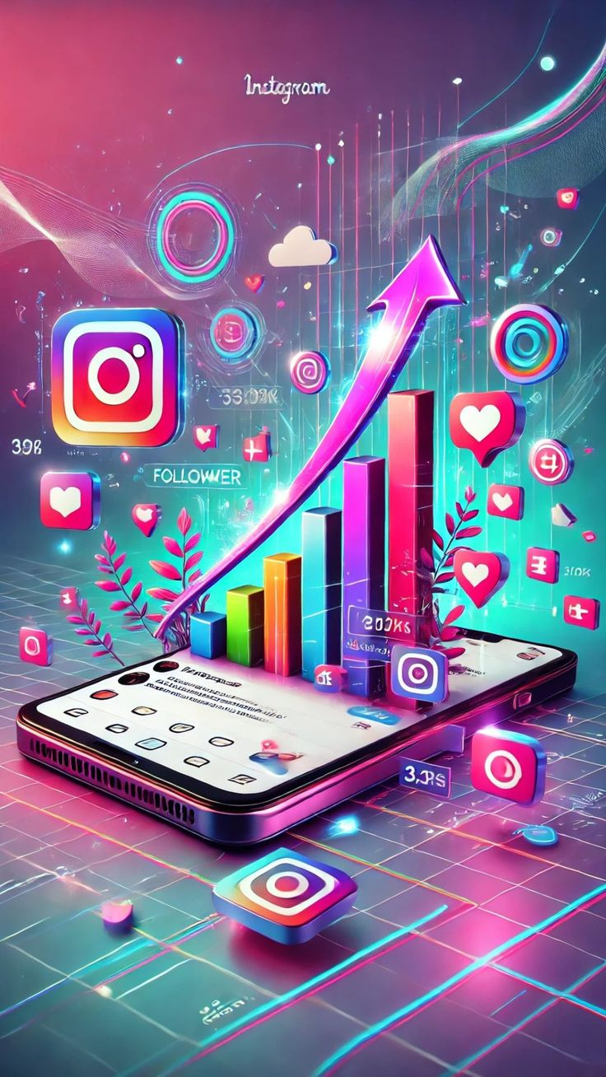
CAMPAIGN OPTIMIZATION STRATEGY
• Target users based on their interests and activity patterns.
Use personalized notifications and emails to boost engagement.
Partner with influencers and highly engaged users for promotions.
Leverage trending hashtags and popular content categories.
Reward users with high reach and engagement for sponsored campaigns.

Slide 10
TOP 10 USERS BY TOTAL ENGAGEMENT
Keenan.Schamberger60 recorded the highest engagement (173) among all users.
Rick29 and Karley_Bosco showed strong engagement, each with 166 interactions.
The top 10 users have engagement scores ranging from 159 to 173, indicating consistently high activity.
These users contribute significantly to overall platform engagement through likes, comments, and interactions.

Slide 11
USER ENGAGEMENT METRICS
Comments dominate: For nearly all users, total comments are consistently higher than likes and photo tags.
Likes vs tags: Likes generally outnumber photo tags, showing stronger interaction through reactions than tagging.
Top performers: Users like Justina.Gaylord27, Kenton_Kirlin, and Travon.Waters show the highest overall engagement.
Inactive accounts: Aniya_Hackett and Kasandra_Homenick have zero engagement across all metrics.

Slide 12
USER ACTIVITY ANALYSIS
Low Activity Users
Limited platform interaction
Potential users for engagement campaigns
2. Moderately Active Users
Regular participation through posts and interactions
Opportunity to increase engagement further
3. Highly Active Users
Frequent posts, likes, and comments
Most valuable and loyal users

Slide 13

RECOMMENDATIONS
• Re-engage inactive users through personalized notifications and special incentives.
Promote trending hashtags and post content during peak engagement hours.
Segment users by activity level and run targeted marketing campaigns.
Reward loyal users with badges, exclusive offers, and early access benefits.
Continuously track engagement trends and optimize campaigns accordingly.

Slide 14
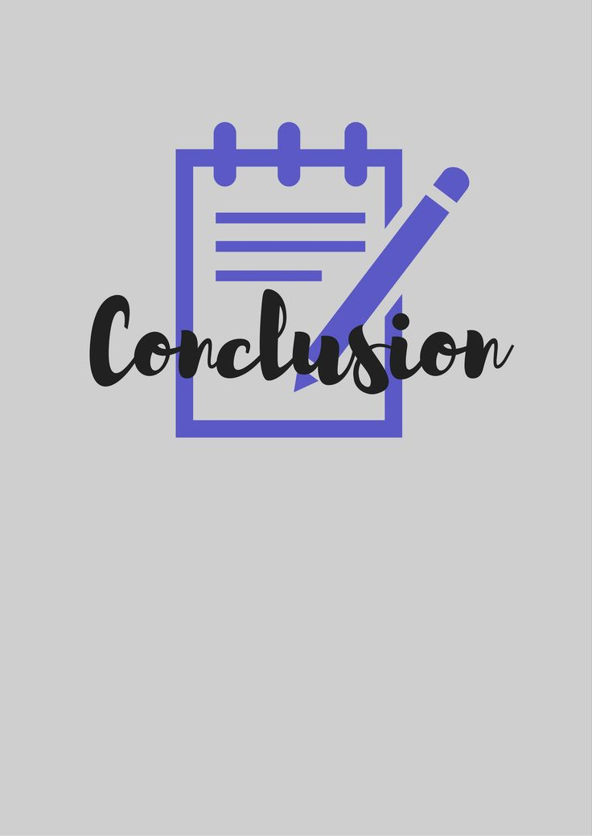
CONCLUSION
CONCLUSION
• User engagement analysis helped identify active, inactive, and high-value users.
Trending hashtags and popular content categories were key drivers of engagement.
User segmentation supports personalized marketing and retention strategies.
Highly engaged users and influencers can help expand brand reach and awareness.
Combining user behavior analysis with targeted campaigns can drive sustainable platform growth.

Slide 15


