Slide 1
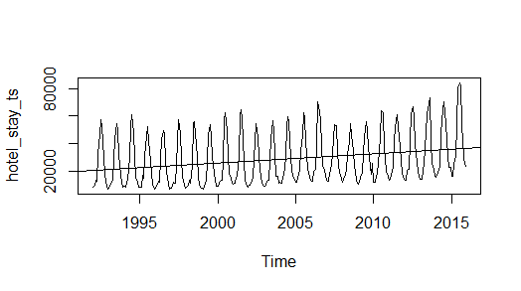
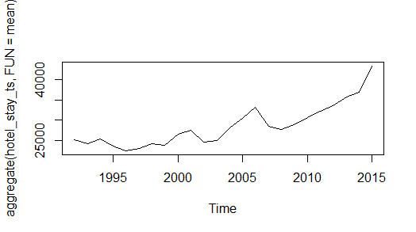
Forecasting Overnight Stay in Hotel
Dataset: Monthly overnight stay in hotel from 1992 to 2015
Problem Statement: To analyze the time series and forecast for the year 2016-17
Fig. a
Fig: b
The time-series plot and the regression line in Fig. a clearly shows an upward trend.
In Fig. b the cycles were aggregated to display year-on-year trend.
The following can be inferred from Fig. b:
  The average overnight stay is constantly increasing for last 6 years i.e from 2010 to 2015
  From 1992 to 2009 there were ups and downs in the average number of stays per year.

Slide 2
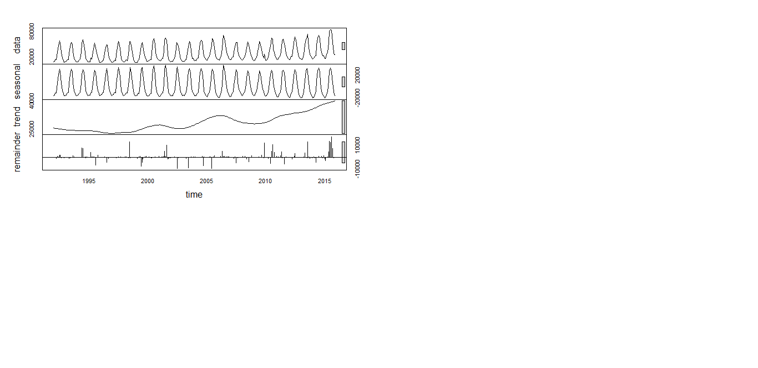
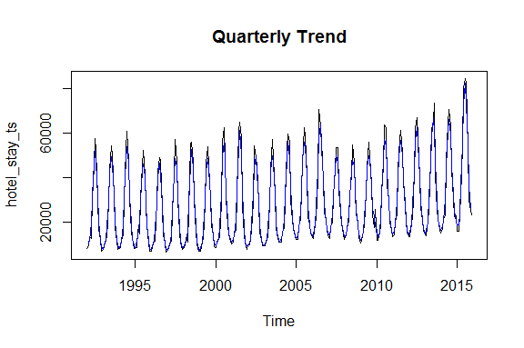
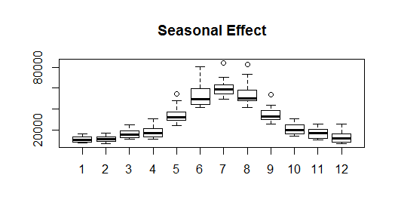
Fig. c
Fig: d
Corresponding Year and Month of Outliers:
1996: August
1998: June
2001: August
2002: July
2004: June
2004: September
2006: June
2009: December
2010: July
2010: August
2013: August
2015: June
2015: August
Fig. e
Table: a
The following can be inferred from Fig. e (Box Plot across months):
  Though July has the highest mean but June and August have highest variance.
  Even though the mean value of each month is quite different their variance is small. Hence, we have strong seasonal effect with a cycle of 12 months or less. (Seasonal Component in Fig.c )
  Some outliers can be seen in the months of May, July, August and September. (Details in Table: a)

Slide 3
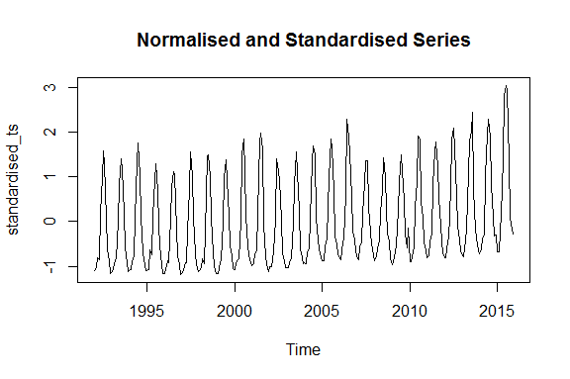
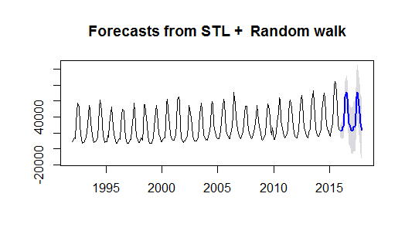
The Dickey Fuller Test of Stationarity performed using R function adf.test says that the series is stationary.
Log conversion is done to remove the unequal variance.
The original time-series data is normalized and standardized to make it fit for different types of modelling. (Fig. f)
Fig. f
The original time-series data is decomposed into Seasonal and seasonally adjusted component(trend + remainder).
Seasonally adjusted component is forecasted using random walk and for seasonal component seasonal naive method is used.
The forecast for 2016 and 2017 can be seen on Fig. g
Fig. g

Slide 4
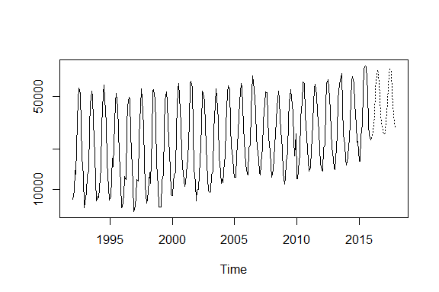
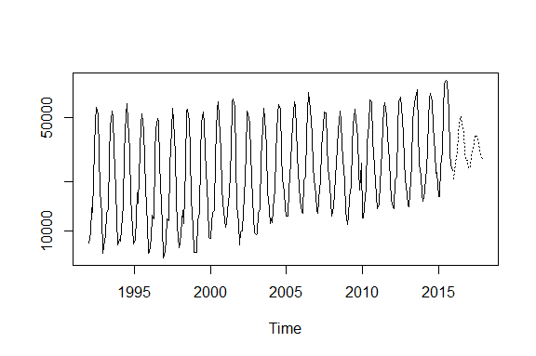

Holt-Winters Forecast
ARIMA Forecast
Holt-Winters model is applied directly on the time-series as it takes care of both the seasonal and trend component.
ARIMA forecast is performed on log transformed data as it can’t handle trend and seasonality.
ARIMA is also applied on Standardized and Normalized Data which gave results nearly equal to that of Holt-Winters model.
ARIMA Forecast on Standardized and Normalized Data

