Slide 1
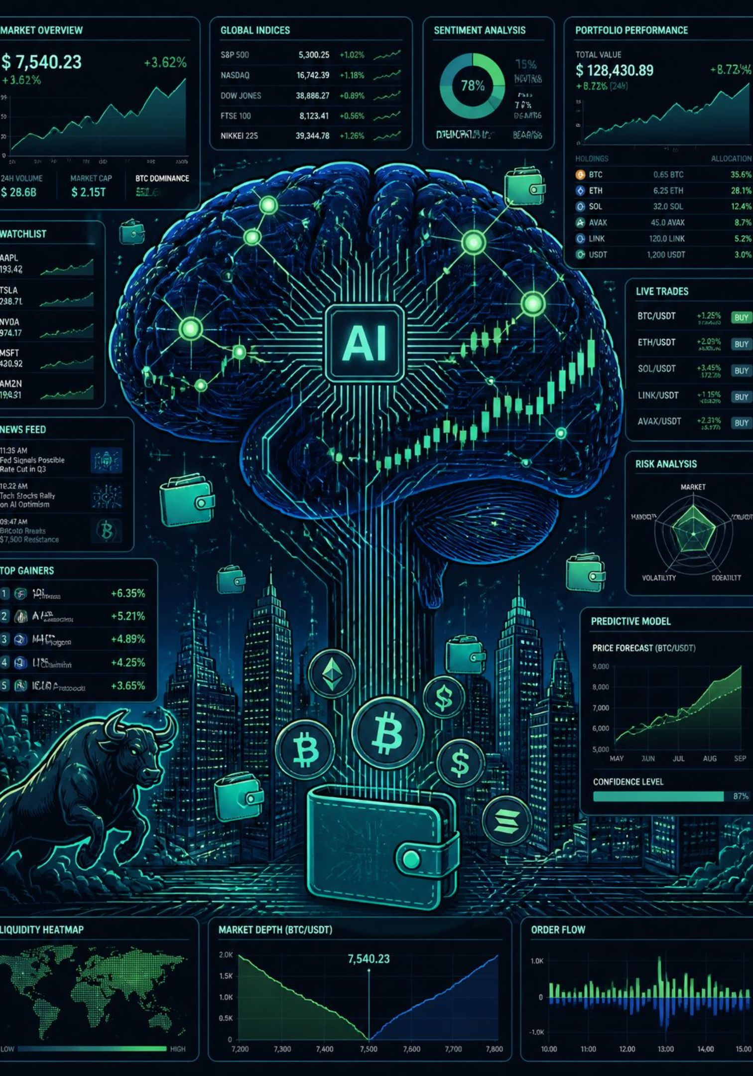
Aethia trade
AI-Powered Personalized Investment Assistant
An intelligent investment platform that creates personalised strategies, monitors portfolios, and provides AI-driven financial recommendations.
Team Area51

Slide 2

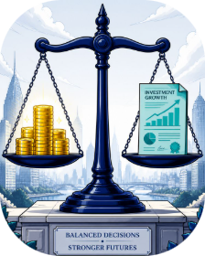
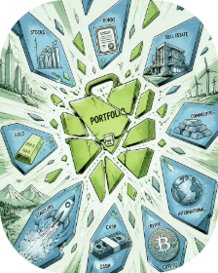
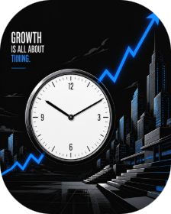


The Problem: Investing Without Guidance
Where to invest?
How much to invest?
How to diversify?
When to buy or sell?
Beginners lack signals and strategy — choices are overwhelming.
No personalised sizing based on income, expenses, goals.
Spreading risk requires expertise most users don't have.
Timing signals are opaque and noisy for retail users.
How to manage risk?
Continuous monitoring and rebalancing are lacking in generic apps.
Professional advisors cost too much; existing apps lack deep personalisation.

Slide 3
Our Solution: AI-Powered Investment Intelligence
InvestAI combines autonomous AI agents, market signals, and secure blockchain wallets to deliver:
Personalised Investment Plans
Portfolio Allocation
Risk Analysis
Automated diversification across asset classes and sectors.
Real-time risk scoring and stress testing.
Tailored strategies based on income, goals and risk profile.
Real-time Recommendations
Blockchain Wallet Integration
Buy / Sell / Hold alerts with explainability and confidence scores.
Secure custody, transparent transaction history and on-chain settlement options.

Slide 4

How InvestAI Works
Landing Page
Login / Signup
Financial Profile
AI Analysis
A seamless end-to-end journey: onboarding to recommendations and live portfolio monitoring with continuous AI feedback.

Slide 5

Autonomous AI Investment Agents
Portfolio Generator Agent
AI Advisor Chat Agent
Inputs: income, risk tolerance, investment amount. Output: diversified portfolio tailored to goals.
Conversational interface: answers queries like “Can I invest ₹10,000?” and explains recommendations.
Market Analysis Agent
Alert Agent
Continuously ingests news, social sentiment, and technical indicators for signal generation.
Monitors volatility, threshold breaches and rebalancing triggers; pushes actionable alerts.

Slide 6


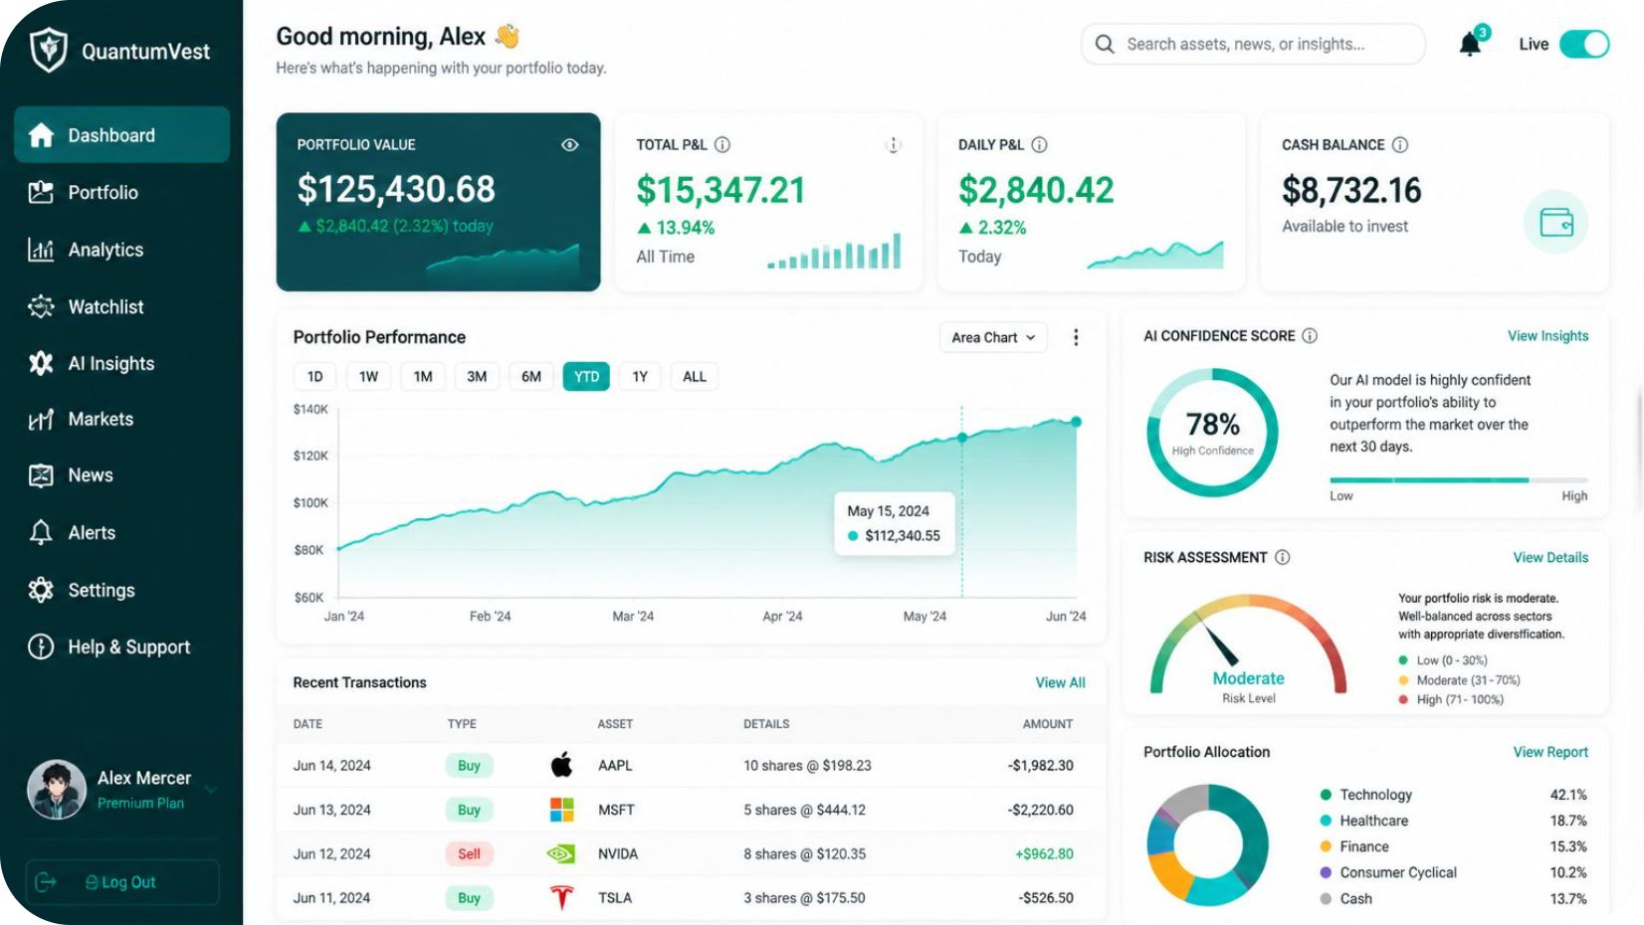


Smart Investment Dashboard
Portfolio Value
Portfolio Growth
Real-time valuation with daily and YTD change.
Interactive chart showing performance vs benchmark.
Allocation & Sectors
AI Confidence & Risk
Clear breakdown by asset class and industry sector.
Score-based guidance and suggested rebalances.

Slide 7
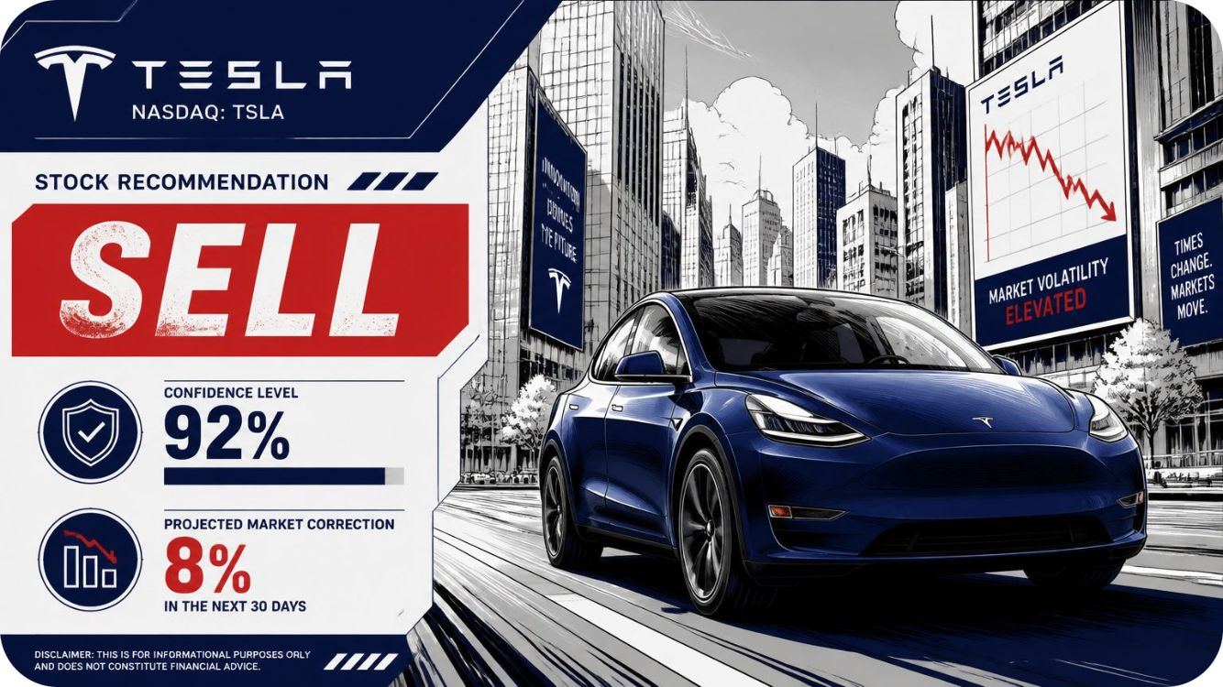
AI-Based Buy / Sell / Hold Decisions
Example Recommendation
Decision Controls
Buttons: Accept Recommendation • Dismiss • Schedule Auto-Trade
Stock: Tesla — Recommendation: SELL
Reason: Valuation stretched relative to fundamentals and sentiment spike.
Expected Correction: 8% • Confidence: 92%
What AI Uses
Market trends & technical signals
Portfolio risk contribution
News & sentiment analysis

Slide 8
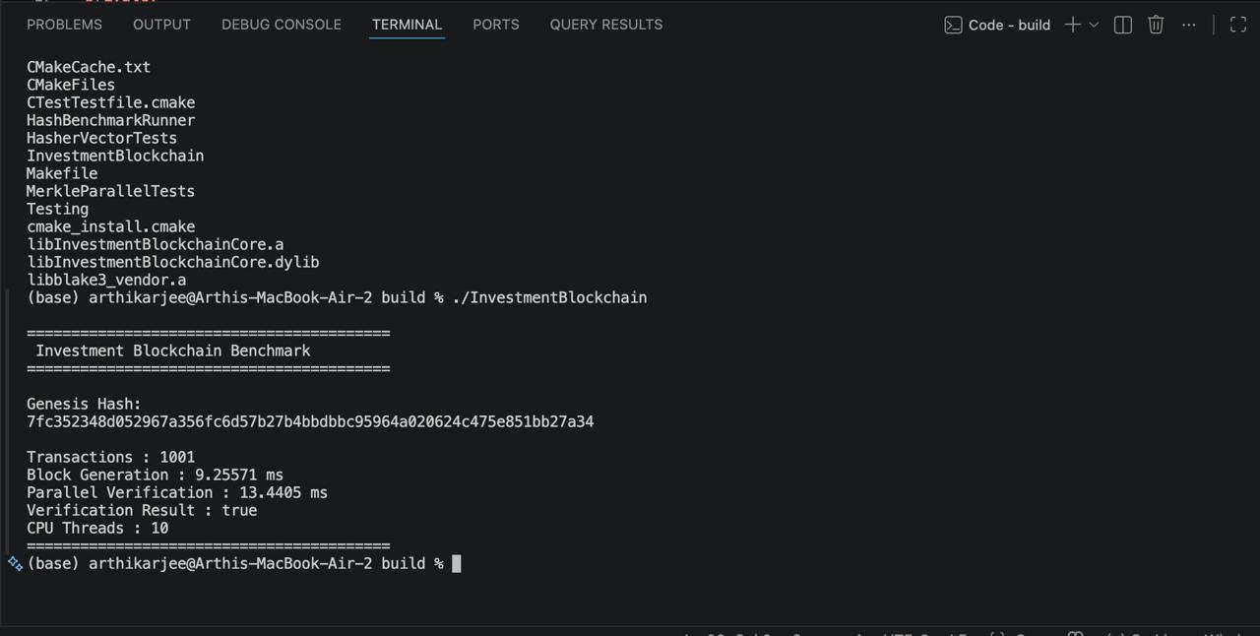

Secure Digital Investment Wallet
Features
Wallet connection: MetaMask, WalletConnect
Deposit / Withdraw / Transfer with on-chain receipts
Immutable transaction history and audit logs
Optional on-chain settlement and tokenised assets
Technology
Smart contracts: Solidity
Wallet SDKs: MetaMask, WalletConnect, Ethers.js
Secure key management & encryption
Privacy-first design: users control keys; InvestAI supports custodial & non-custodial flows.

Slide 9
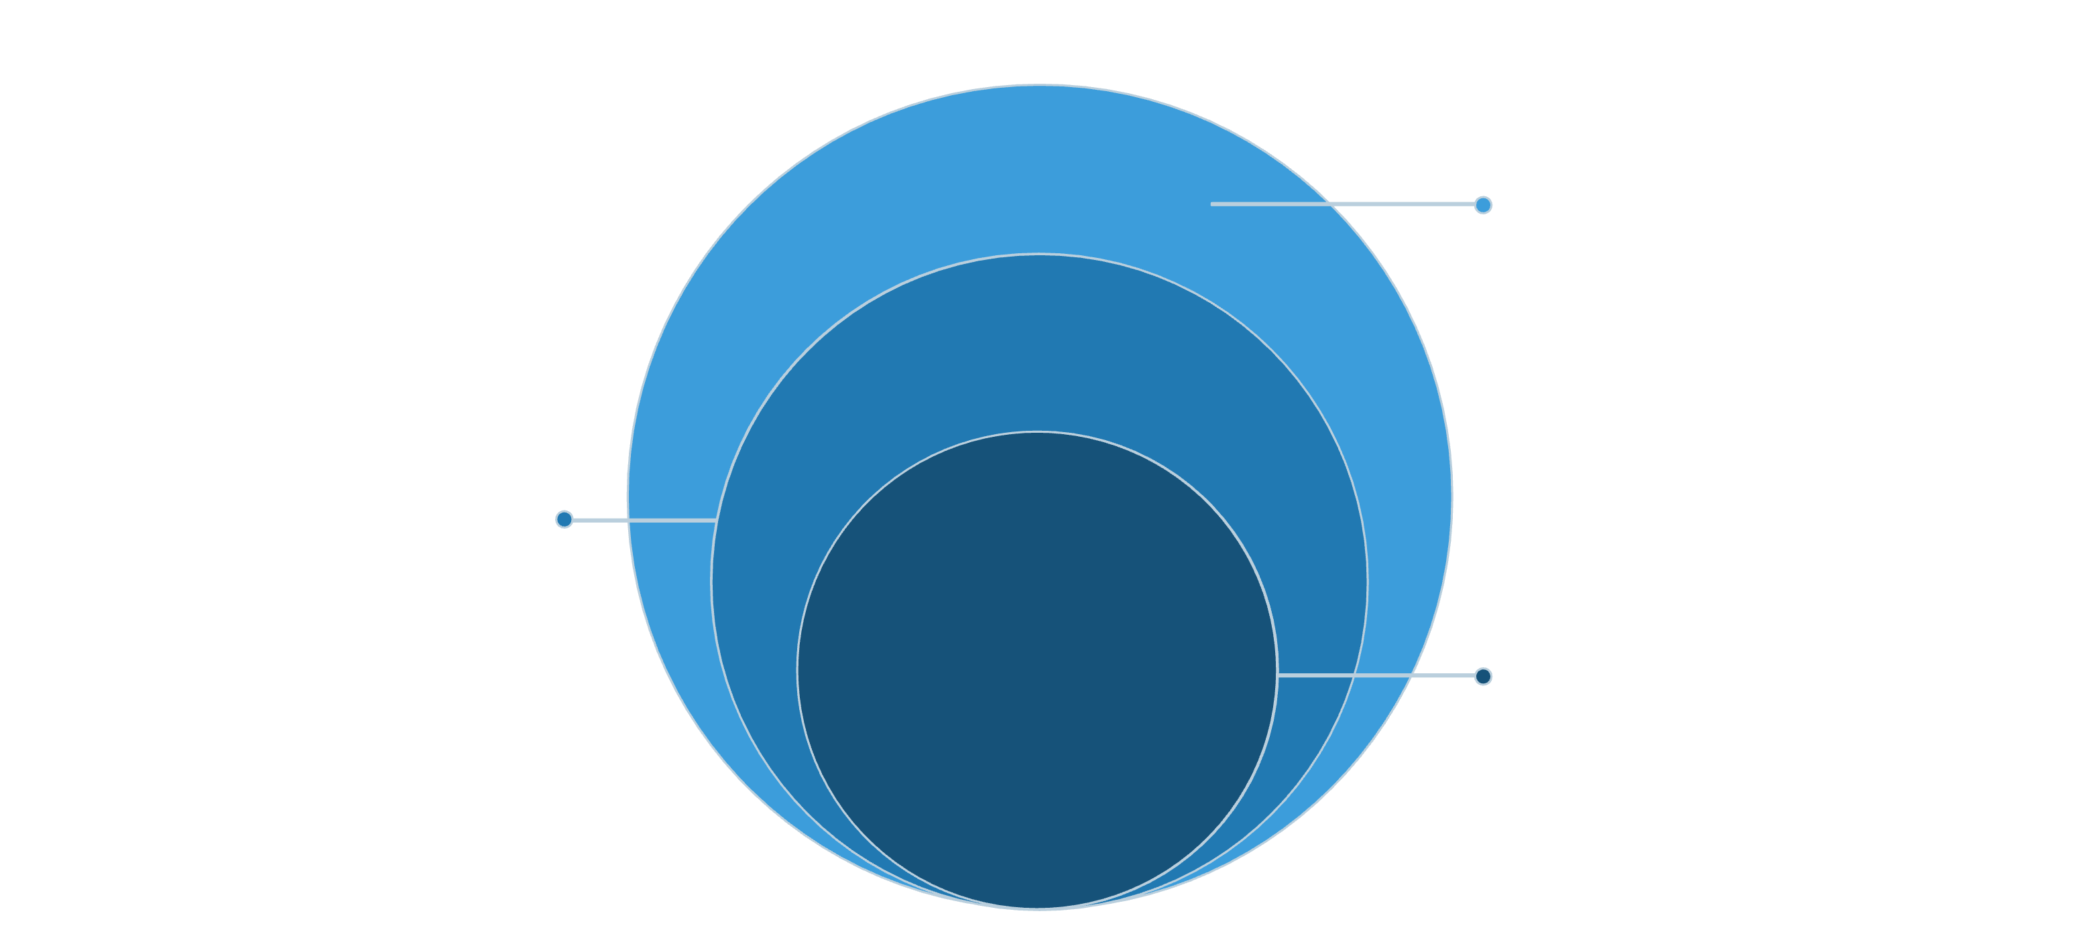
Technical Architecture
Client & Web3
Next.js, React, Solidity, Vercel
API & Data
Node/Express, FastAPI, PostgreSQL
Core AI
OpenAI, Claude, Gemini for inference
Modular, scalable design for realtime inference, secure transactions and horizontally scalable services.

Slide 10
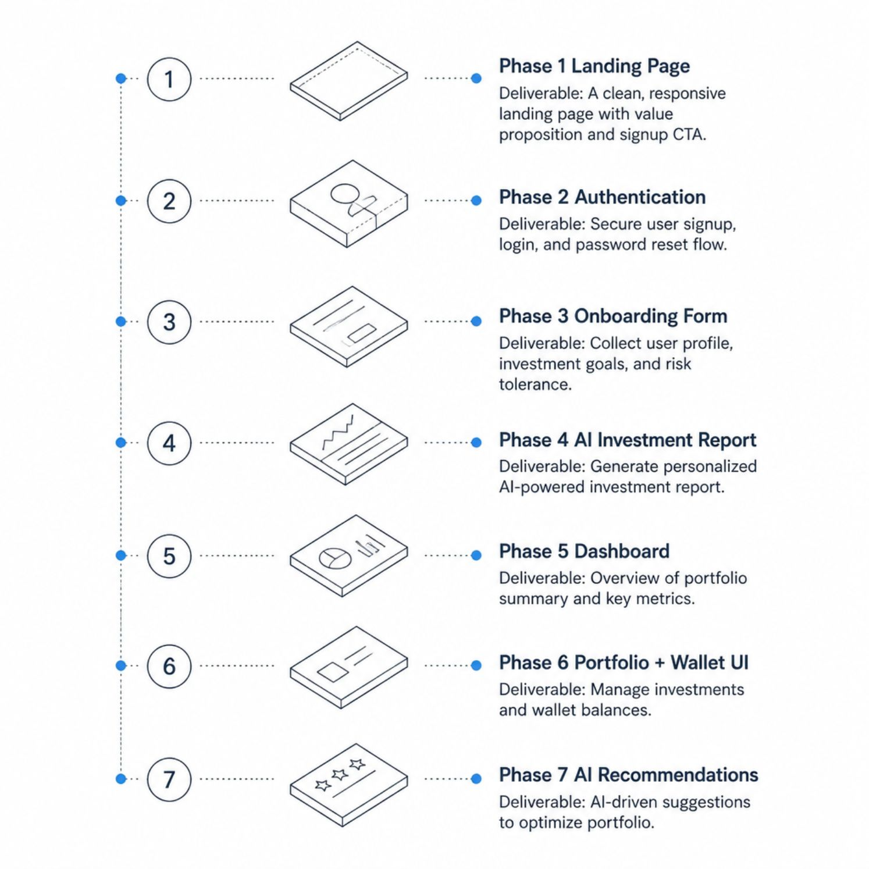
MVP Roadmap & Impact
Impact
Smarter investing via personalised advice
Accessible AI financial guidance for retail users
Risk-aware decisions with transparent explainability
Scalable platform ready for rapid feature expansion
Focus
Innovation • Problem relevance • Technical feasibility • Scalability • Social impact
Closing
Making intelligent investing accessible for everyone.

